Slide 1
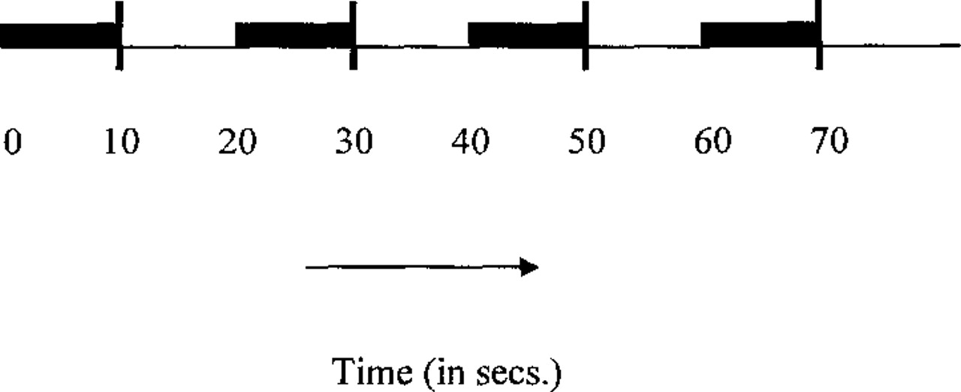
Figure 1. Schematic representation of the experiment. The shaded horizontal rectangle represents 10 s long ...
Notes:
Figure 1. Schematic representation of the experiment. The shaded horizontal rectangle represents 10 s long blocks of stimuli, and the vertical line a single multislice volume. Each block began 10 s after the end of the preceding one, and the end of each block was followed by the acquisition of a multislice volume. The experimented consisted of 40 such blocks, with ten blocks of each of the four stimulus types randsomised so that no two consecutive blocks were of the same stimulus type.
Unless provided in the caption above, the following copyright applies to the content of this slide:

Slide 2
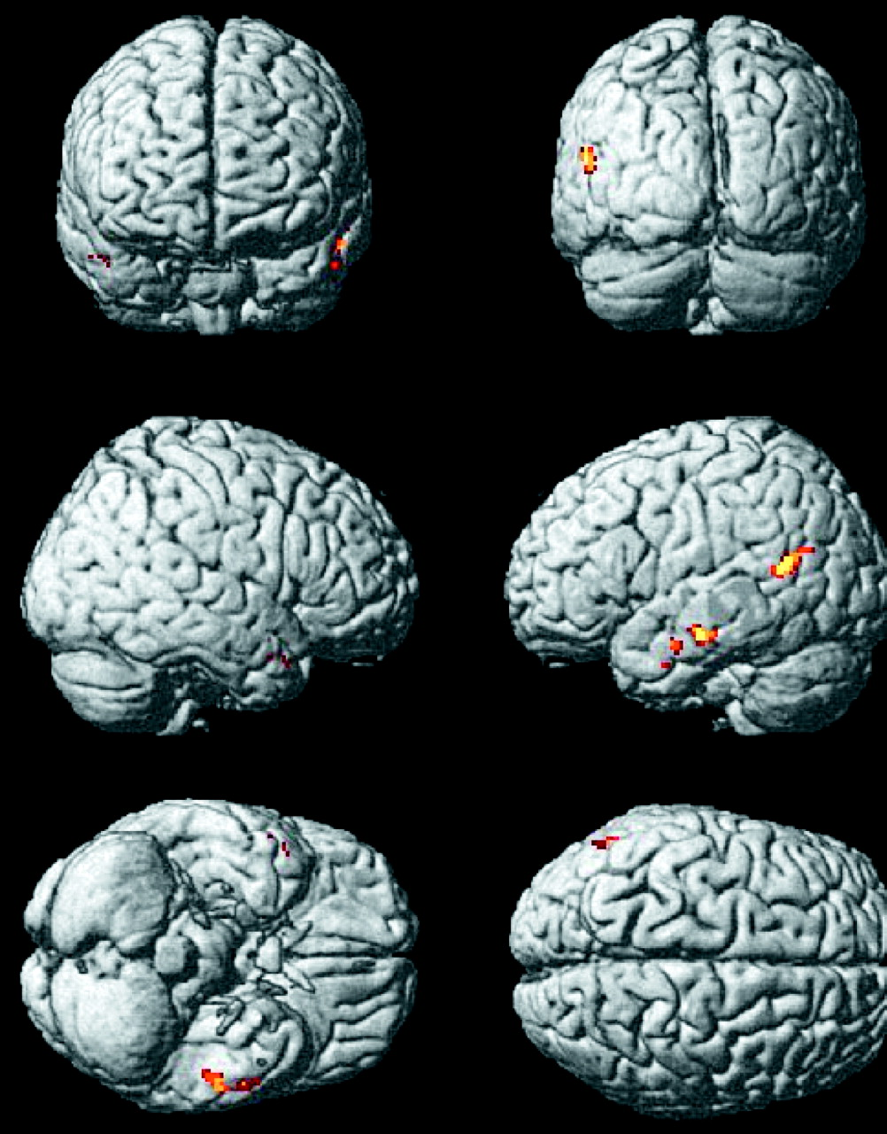
Figure 2. Maximum intensity projections of conjunction analysis between (Sp – RSp) and (Vco – RVCo). The ...
Notes:
Figure 2. Maximum intensity projections of conjunction analysis between (Sp – RSp) and (Vco – RVCo). The areas in common are processing intelligibility. The figure shows the results of a fixed effects group analysis t test plotted onto an MNI template. P = 0.05 (corrected).
Unless provided in the caption above, the following copyright applies to the content of this slide:

