Slide 1
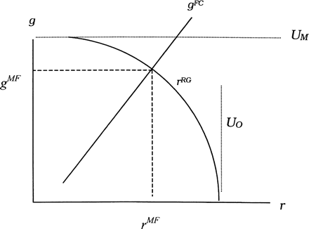
Fig. 1. Preferences and constraints in a managerial firm (MF).
Notes:
Fig. 1. Preferences and constraints in a managerial firm (MF).
Unless provided in the caption above, the following copyright applies to the content of this slide: Cambridge Journal of Economics, Vol. 28, No. 5, © Cambridge Political Economy Society 2004; all rights reserved

Slide 2
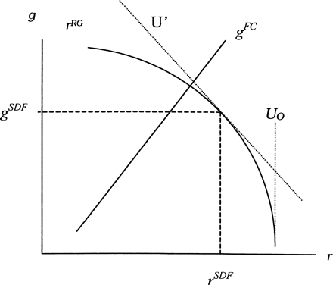
Fig. 2. Preferences and constraints in the shareholder dominated firm (SDF).
Notes:
Fig. 2. Preferences and constraints in the shareholder dominated firm (SDF).
Unless provided in the caption above, the following copyright applies to the content of this slide: Cambridge Journal of Economics, Vol. 28, No. 5, © Cambridge Political Economy Society 2004; all rights reserved

Slide 3
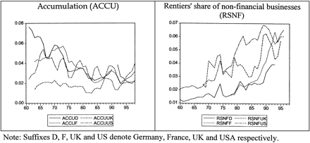
Fig. 3. Left-hand side, accumulation (ACCU); right-hand side, rentier share of non-financial businesses (RSNF). Note: ...
Notes:
Fig. 3. Left-hand side, accumulation (ACCU); right-hand side, rentier share of non-financial businesses (RSNF). Note: Suffixes D, F, UK and US denote Germany, France, the UK and the USA, respectively.
Unless provided in the caption above, the following copyright applies to the content of this slide: Cambridge Journal of Economics, Vol. 28, No. 5, © Cambridge Political Economy Society 2004; all rights reserved

