Slide 1
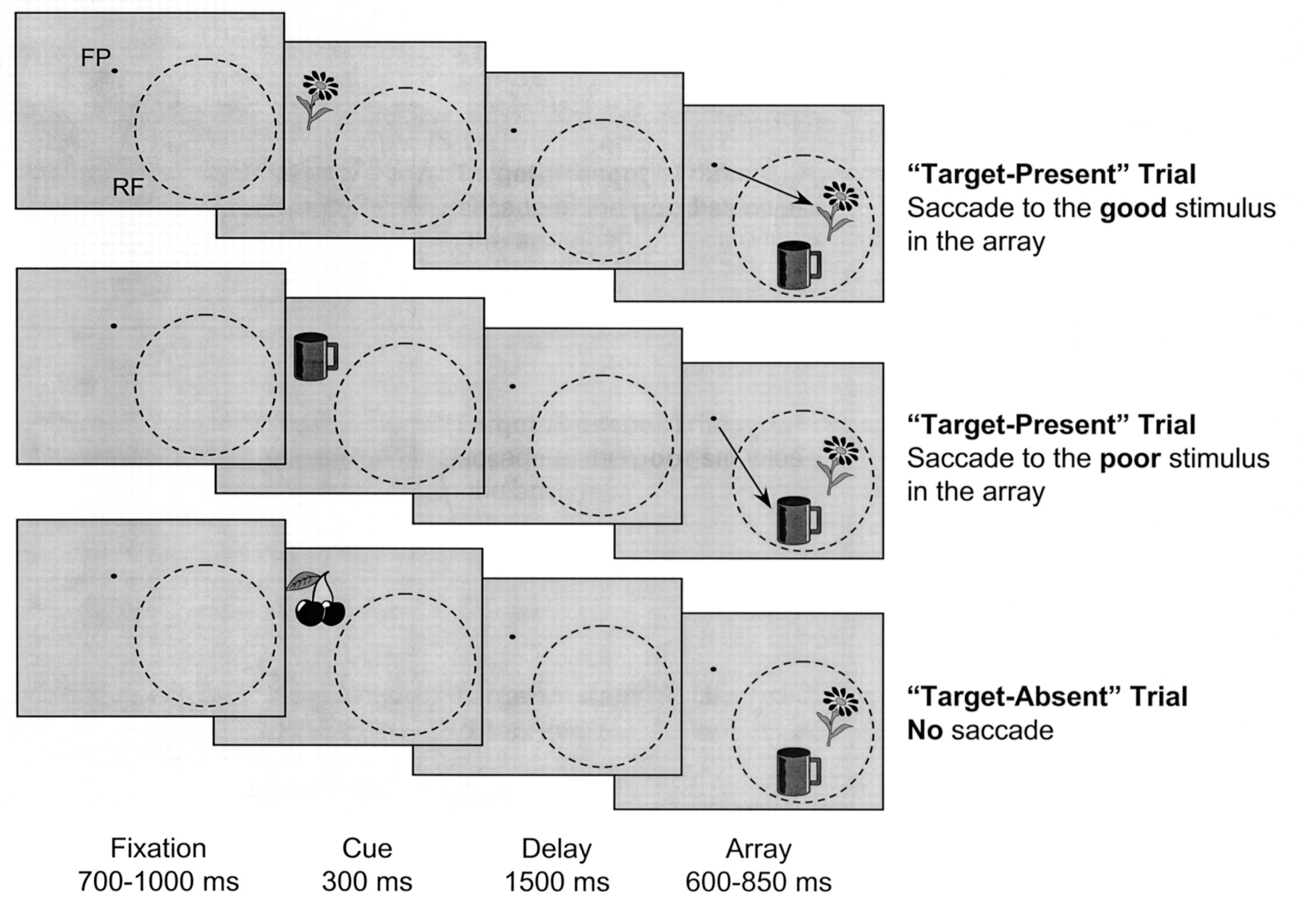
Figure 1. Stimulus sequences for representative trials in the task with two-stimulus arrays, with the array confined ...
Notes:
Figure 1. Stimulus sequences for representative trials in the task with two-stimulus arrays, with the array confined to the RF of the recorded neuron. FP is the fixation point at the center of the computer monitor. RF is the RF of the neuron under study. The arrow at the end of target-present trials denotes the required saccade.
Unless provided in the caption above, the following copyright applies to the content of this slide: © Oxford University Press

Slide 2
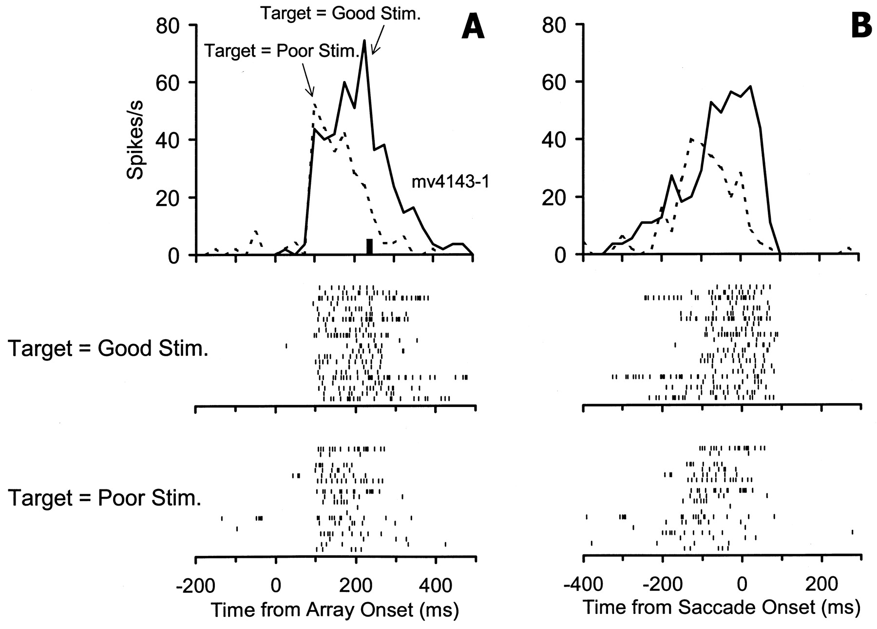
Figure 2. Response of an individual neuron to the two-stimulus array presented within the boundary of the RF. (A) ...
Notes:
Figure 2. Response of an individual neuron to the two-stimulus array presented within the boundary of the RF. (A) Responses time-locked to the onset of the array. Vertical bar indicates average saccadic latency to the target. (B) Responses time-locked to the onset of the saccade. Bin width is 25ms. Below the histograms in (A) and (B) are rasters from the good-target and poor-target trials. Each tick in the rasters represents an action potential from the neuron, and each row corresponds to a different trial.
Unless provided in the caption above, the following copyright applies to the content of this slide: © Oxford University Press

Slide 3
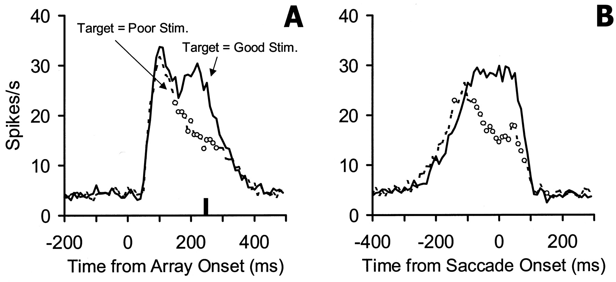
Figure 3. Population histograms showing the average response of 76 neurons to the two-stimulus search array confined ...
Notes:
Figure 3. Population histograms showing the average response of 76 neurons to the two-stimulus search array confined to the RF. (A) Responses time-locked to array onset. Vertical bar indicates average latency of the saccade to the target. (B) Responses time-locked to eye movement onset. Bin width is 10ms. Empty circles on the ‘Target = Poor Stim.’ curve indicate bins in which the response differed significantly (at P<0.05 level) from that in the ‘Target = Good Stim.’ condition.
Unless provided in the caption above, the following copyright applies to the content of this slide: © Oxford University Press

Slide 4
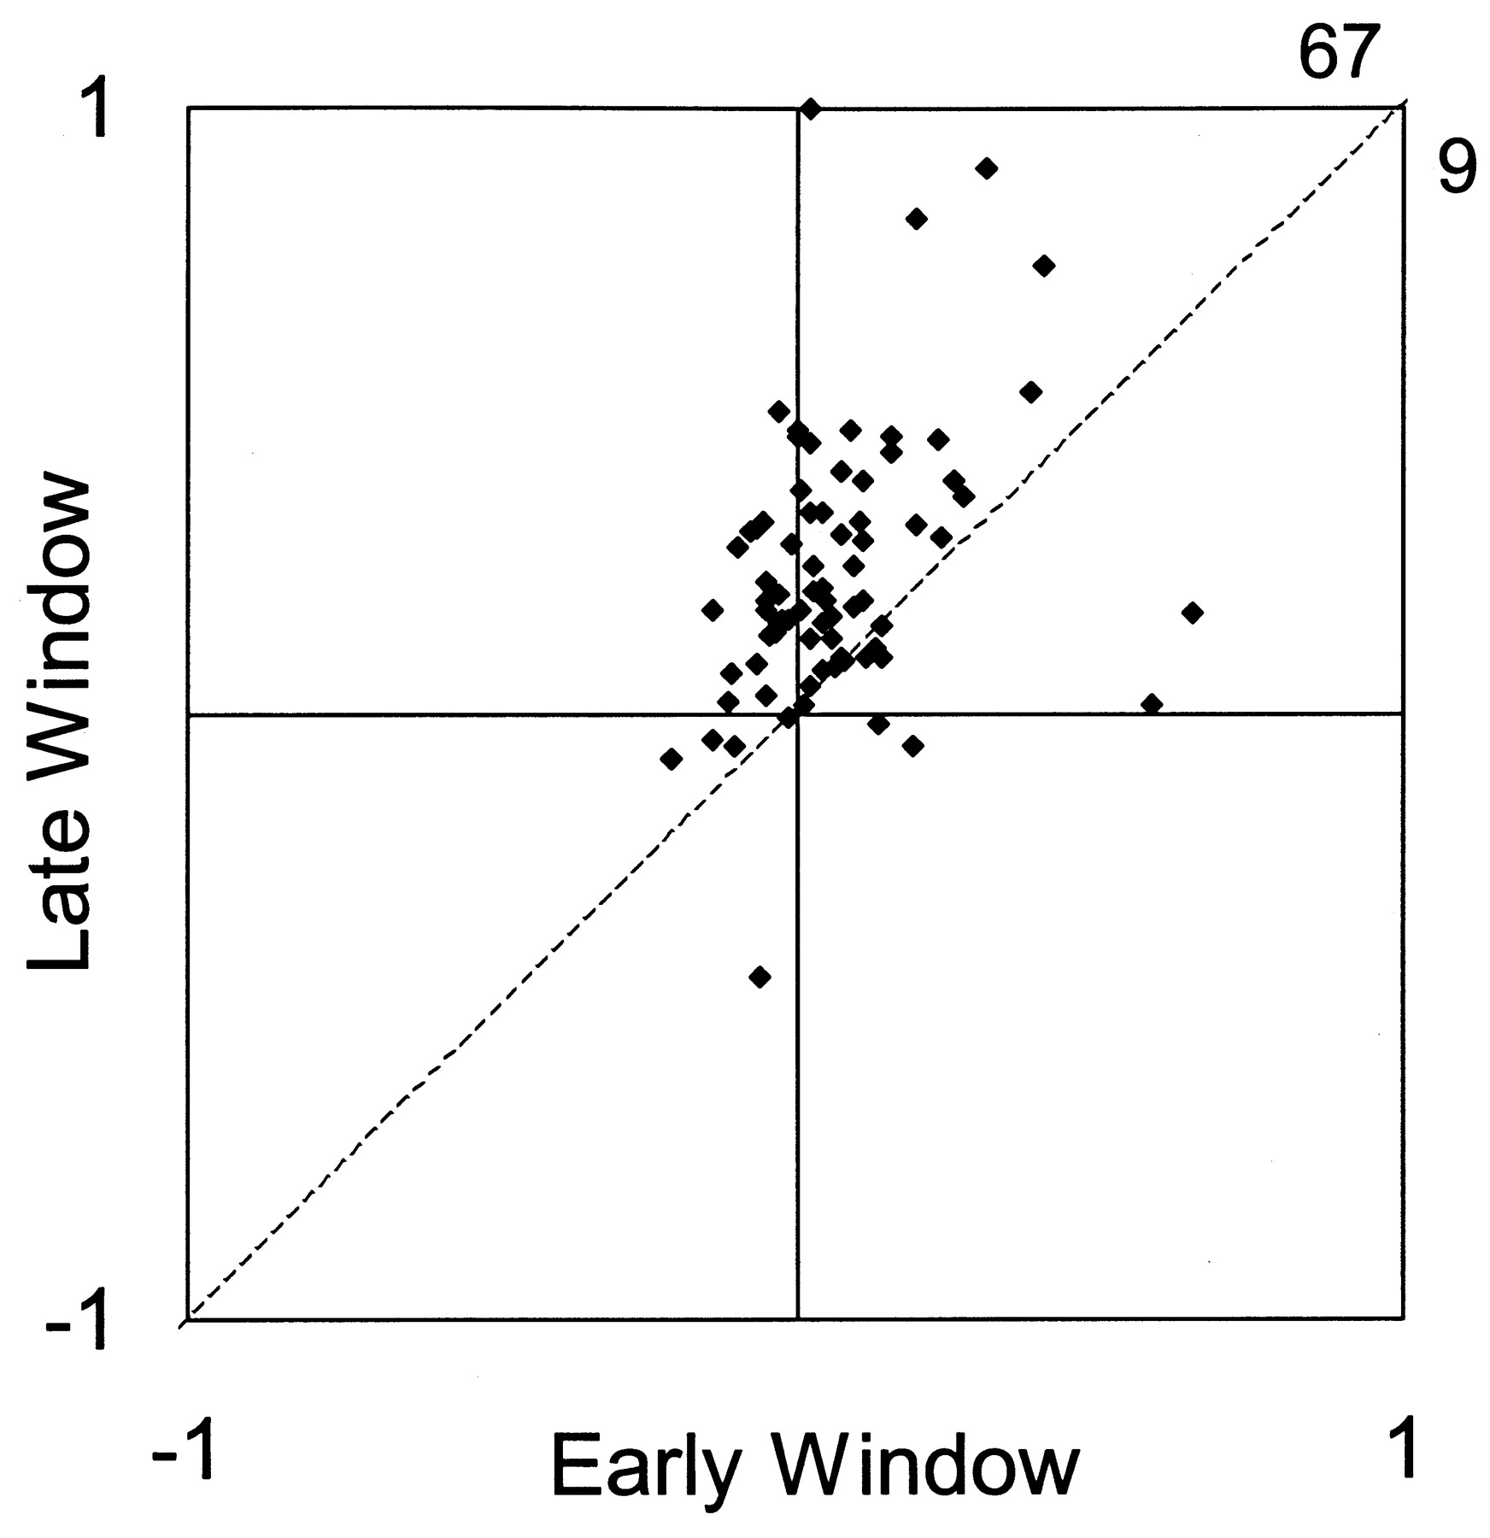
Figure 4. Relationship between the TEI computed in the early time window (50–150ms post-array onset) and the TEI ...
Notes:
Figure 4. Relationship between the TEI computed in the early time window (50–150ms post-array onset) and the TEI computed in the late time window (last 100ms before saccade onset). Numbers at the two sides of the upper right corner of the box indicate the relative number of cells falling to the right and left of the diagonal (dashed line).
Unless provided in the caption above, the following copyright applies to the content of this slide: © Oxford University Press

Slide 5
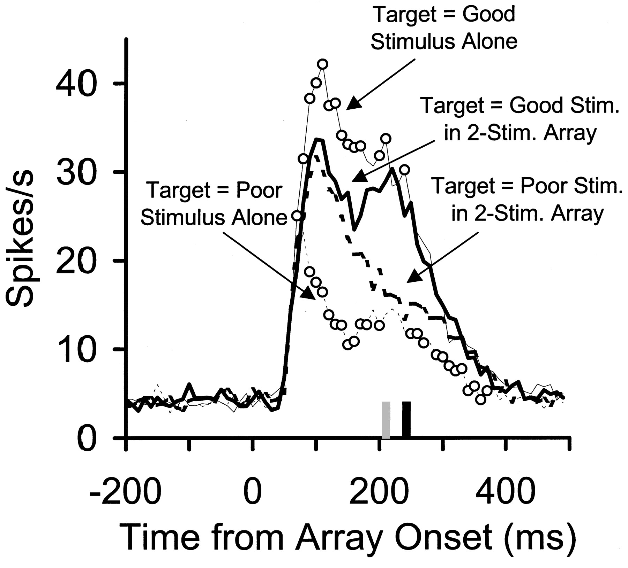
Figure 5. Population histograms from 76 cells comparing the response to the two-stimulus array with the responses to ...
Notes:
Figure 5. Population histograms from 76 cells comparing the response to the two-stimulus array with the responses to the component stimuli presented alone. Responses are time-locked to array onset. Stippled and solid vertical bars indicate average saccadic latency for one-stimulus and two-stimulus arrays, respectively. Empty circles on the ‘Target = Good Stimulus Alone’ curve indicate bins in which the response differed significantly from that in the ‘Target = Good Stim. in 2-Stim. Array’ condition. Empty circles on the ‘Target = Poor Stimulus Alone’ curve indicate bins in which the response differed significantly from that in the ‘Target = Poor Stim. in 2-Stim. Array’ condition. Bin width is 10ms.
Unless provided in the caption above, the following copyright applies to the content of this slide: © Oxford University Press

Slide 6
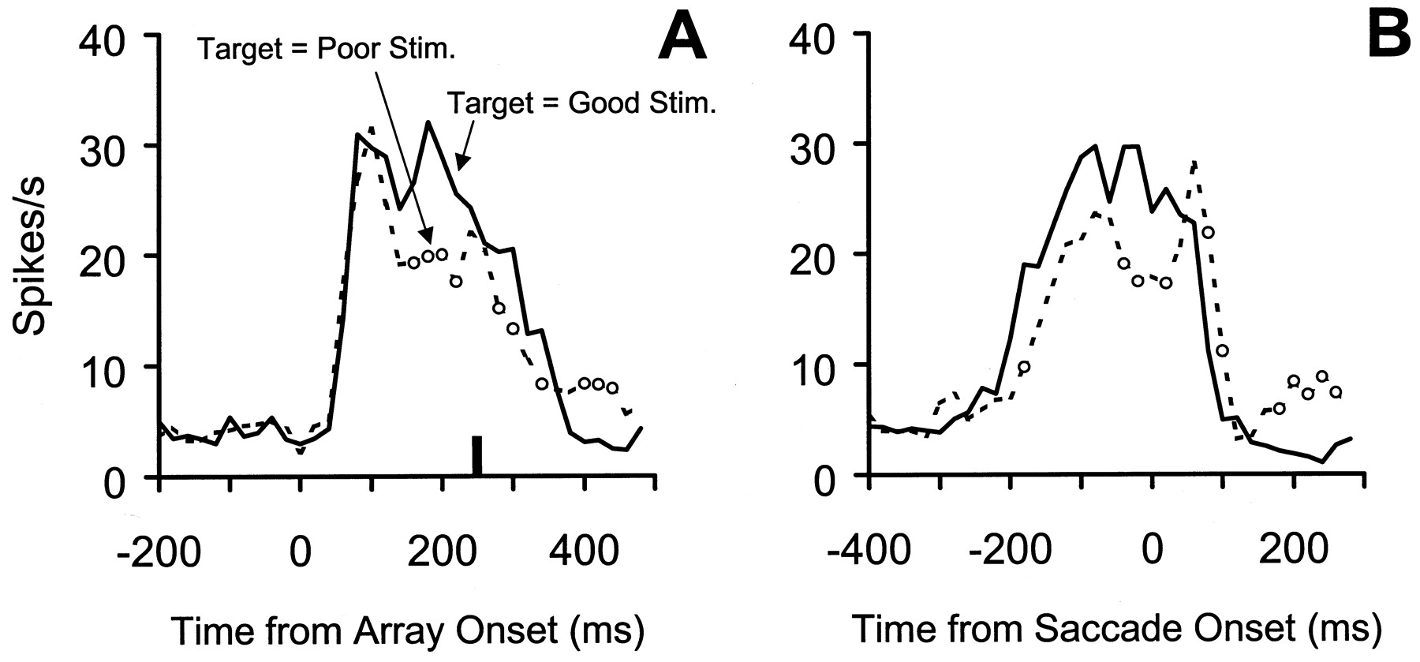
Figure 6. Population histograms showing the average response of 24 neurons to the two-stimulus search array presented ...
Notes:
Figure 6. Population histograms showing the average response of 24 neurons to the two-stimulus search array presented in the inside/near-outside configuration, with the good stimulus inside and the poor stimulus outside the RF boundary. (A) Responses time-locked to array onset. Vertical bar indicates average latency of the saccade to the target. (B) Responses time-locked to eye movement onset. Bin width is 20ms. Empty circles on the ‘Target = Poor Stim.’ curve indicate bins in which the response differed significantly (at P<0.05 level) from that in the ‘Target = Good Stim.’ condition.
Unless provided in the caption above, the following copyright applies to the content of this slide: © Oxford University Press

Slide 7
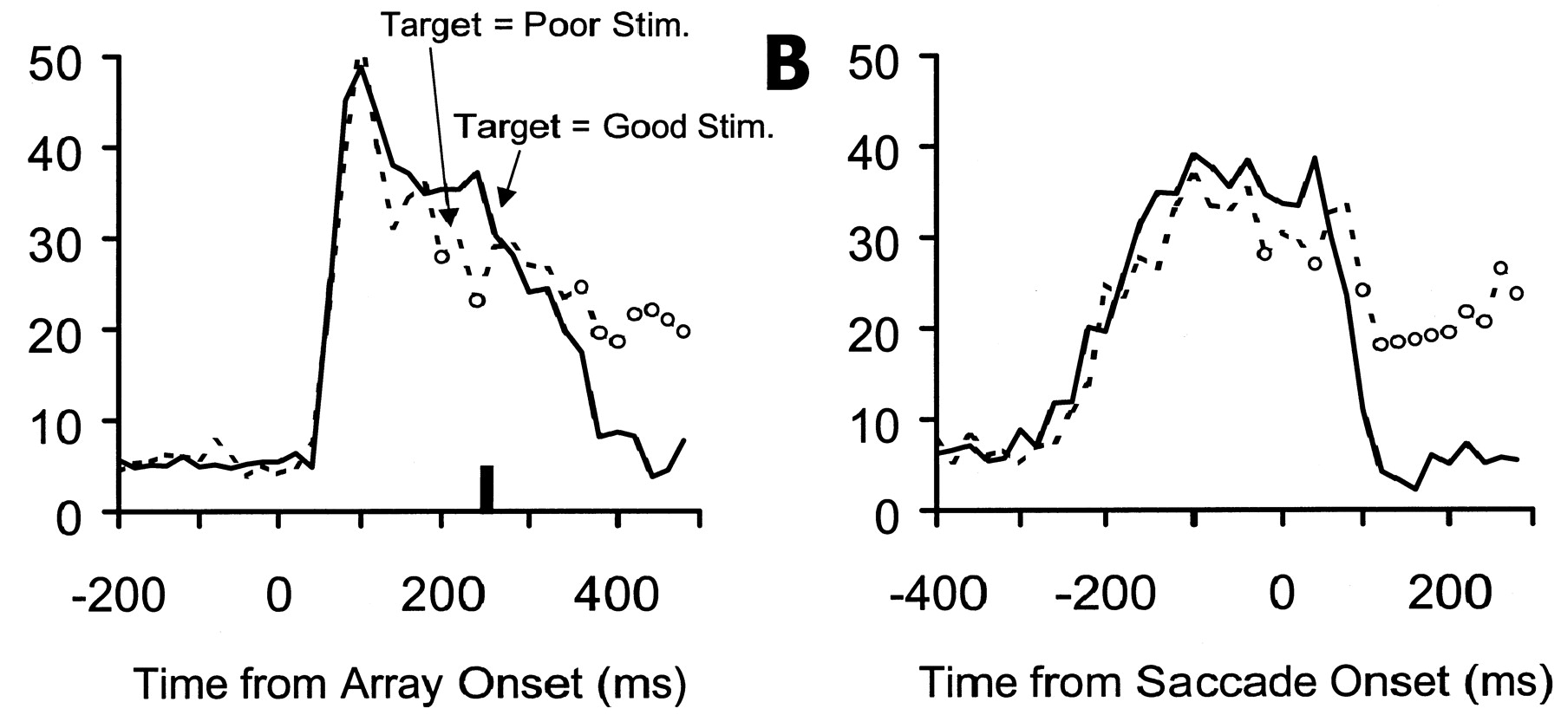
Figure 7. Population histograms showing the average response of 25 neurons to the two-stimulus search array presented ...
Notes:
Figure 7. Population histograms showing the average response of 25 neurons to the two-stimulus search array presented in the inside/far-outside configuration, with the good stimulus inside and the poor stimulus outside the RF boundary. (A) Responses time-locked to array onset. Vertical bar indicates average latency of the saccade to the target. (B) Responses time-locked to eye movement onset. Bin width is 20ms. Empty circles on the ‘Target = Poor Stim.’ curve indicate bins in which the response differed significantly (at P<0.05 level) from that in the ‘Target = Good Stim.’ condition.
Unless provided in the caption above, the following copyright applies to the content of this slide: © Oxford University Press

Slide 8
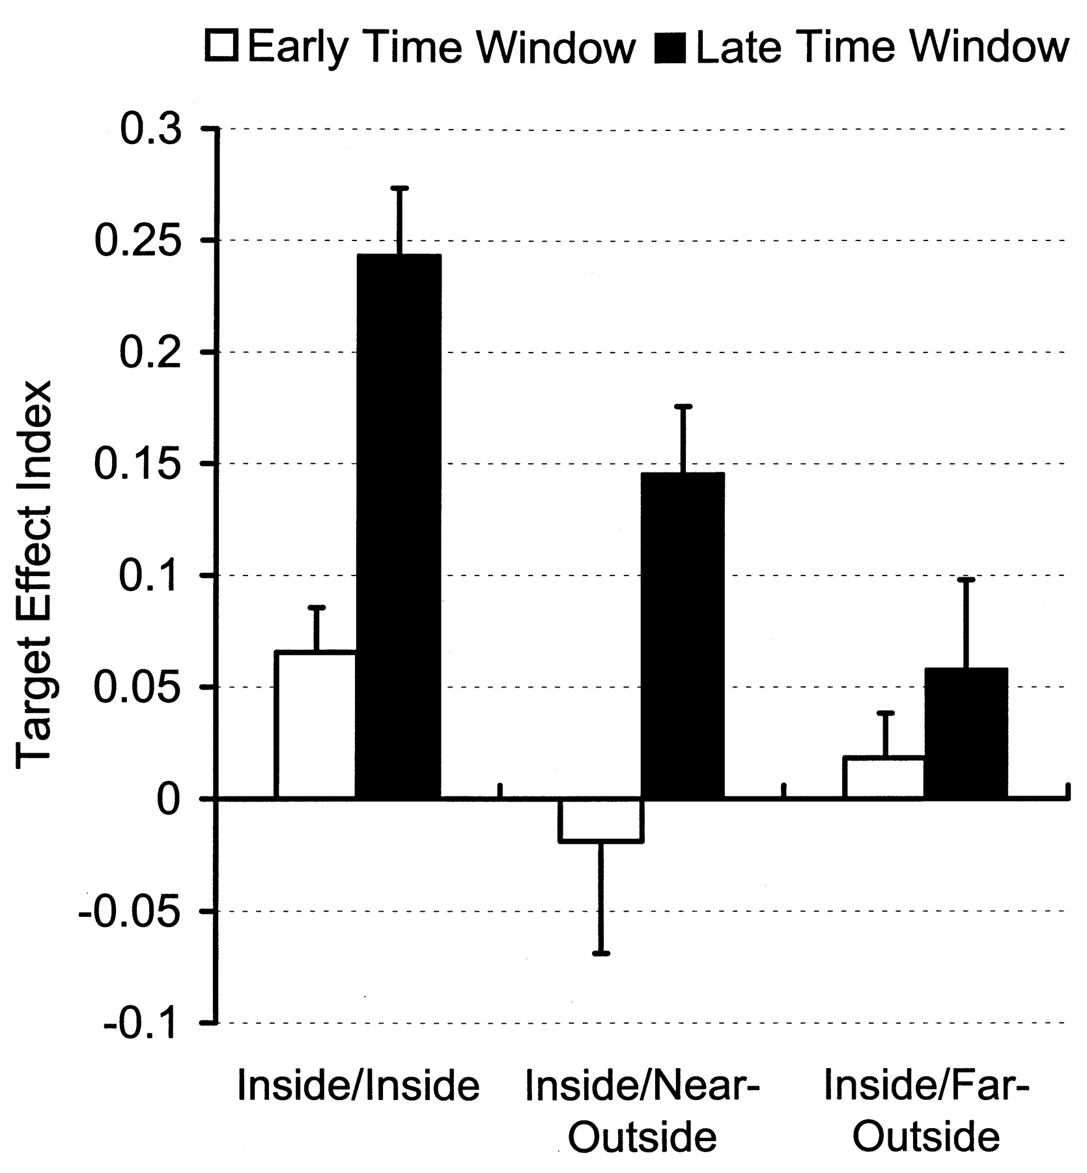
Figure 8. Average TEI (+SEM) across the population of studied cells for the inside/inside, inside/near-outside and ...
Notes:
Figure 8. Average TEI (+SEM) across the population of studied cells for the inside/inside, inside/near-outside and inside/far-outside conditions. For each spatial configuration, the TEI was computed separately for an early time window between 50 and 150ms post-array onset, and for a late time window, spanning the last 100ms prior to the onset of the eye movement to the target.
Unless provided in the caption above, the following copyright applies to the content of this slide: © Oxford University Press

Slide 9
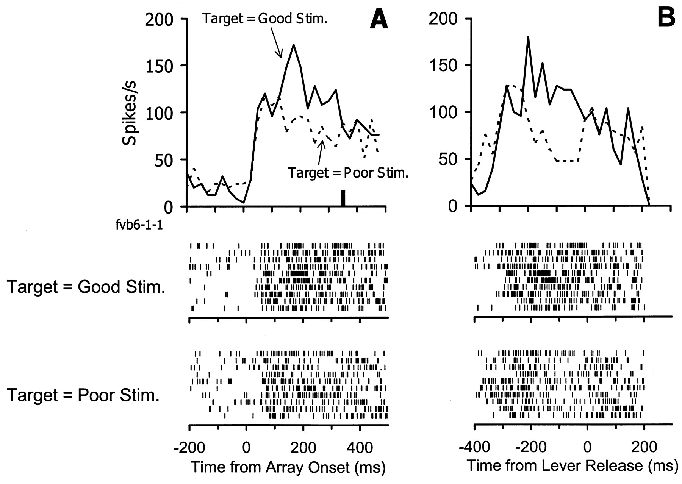
Figure 9. Response of an example neuron to the two-stimulus array presented within the boundary of the RF in the ...
Notes:
Figure 9. Response of an example neuron to the two-stimulus array presented within the boundary of the RF in the lever-release version of the search task. (A) Responses time-locked to the onset of the array. Vertical bar indicates average latency of the lever release. (B) Responses time-locked to the lever release. Bin width is 25ms. Below the histograms in (A) and (B) are rasters from the good-target and poor-target trials. Each tick in the rasters represents an action potential from the neuron, and each row corresponds to a different trial.
Unless provided in the caption above, the following copyright applies to the content of this slide: © Oxford University Press

