Slide 1
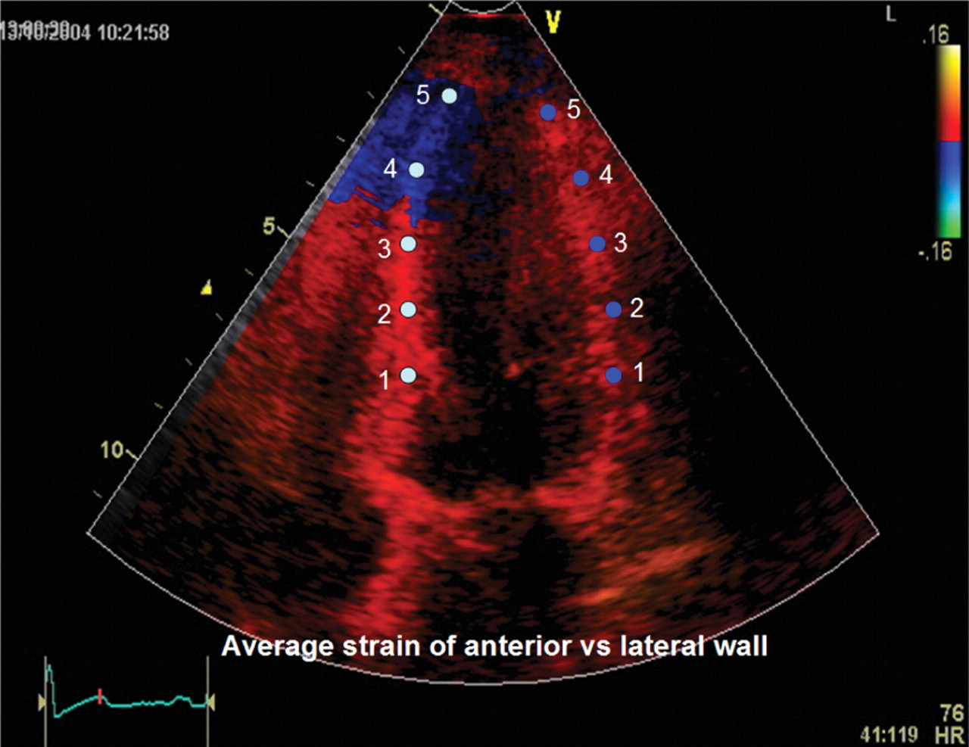
Figure 1 Four-chamber view. Comparison of strain and strain rate between infracted anteroapical and normal lateral ...
Notes:
Figure 1 Four-chamber view. Comparison of strain and strain rate between infracted anteroapical and normal lateral wall.
Unless provided in the caption above, the following copyright applies to the content of this slide: Published on behalf of the European Society of Cardiology. All rights reserved. © The Author 2010. For permissions please email: journals.permissions@oxfordjournals.org

