Slide 1
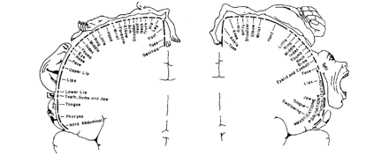
Figure 1 Penfield sensory (left) and motor (right) homunculi (Penfield and Boldrey, 1937).
Notes:
Figure 1 Penfield sensory (left) and motor (right) homunculi (Penfield and Boldrey, 1937).
Unless provided in the caption above, the following copyright applies to the content of this slide: © The Author (2009). Published by Oxford University Press on behalf of the Guarantors of Brain. All rights reserved. For Permissions, please email: journals.permissions@oxfordjournals.org

Slide 2
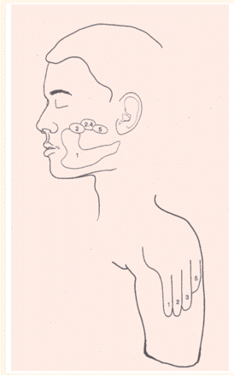
Figure 2 Topographic map of the hand onto the face (and stump) (from Ramachandran and Hirstein, 1998).
Notes:
Figure 2 Topographic map of the hand onto the face (and stump) (from Ramachandran and Hirstein, 1998).
Unless provided in the caption above, the following copyright applies to the content of this slide: © The Author (2009). Published by Oxford University Press on behalf of the Guarantors of Brain. All rights reserved. For Permissions, please email: journals.permissions@oxfordjournals.org

Slide 3
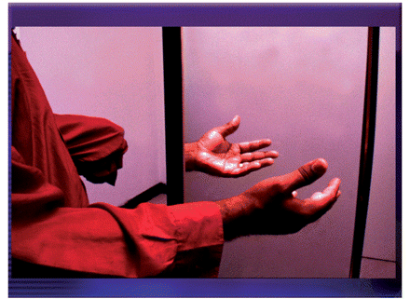
Figure 3 The mirror box.
Notes:
Figure 3 The mirror box.
Unless provided in the caption above, the following copyright applies to the content of this slide: © The Author (2009). Published by Oxford University Press on behalf of the Guarantors of Brain. All rights reserved. For Permissions, please email: journals.permissions@oxfordjournals.org

Slide 4
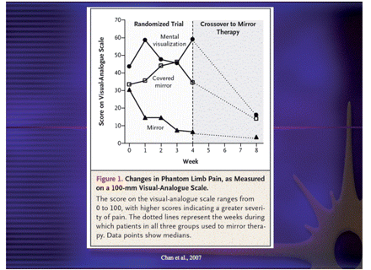
Figure 4 Beneficial effect of mirror therapy in phantom pain (from Chan et al., 2007).
Notes:
Figure 4 Beneficial effect of mirror therapy in phantom pain (from Chan et al., 2007).
Unless provided in the caption above, the following copyright applies to the content of this slide: © The Author (2009). Published by Oxford University Press on behalf of the Guarantors of Brain. All rights reserved. For Permissions, please email: journals.permissions@oxfordjournals.org

Slide 5
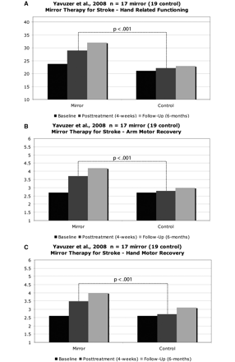
Figure 5 (A) Functional independence measure (FIM) self-care score (adapted from Yavuzer et al., 2008). (B) Brunnstrom ...
Notes:
Figure 5 (A) Functional independence measure (FIM) self-care score (adapted from Yavuzer et al., 2008). (B) Brunnstrom stage (upper extremity). (C) Brunnstrom stage (hand).
Unless provided in the caption above, the following copyright applies to the content of this slide: © The Author (2009). Published by Oxford University Press on behalf of the Guarantors of Brain. All rights reserved. For Permissions, please email: journals.permissions@oxfordjournals.org

