Slide 1
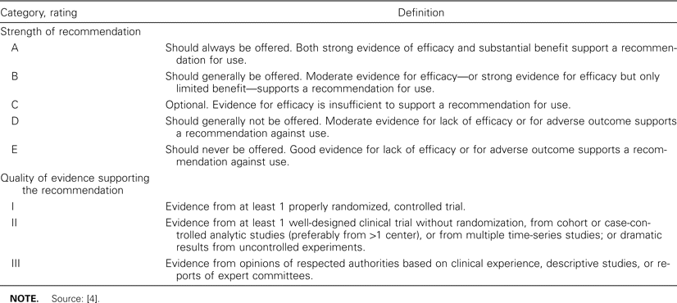
Table 1 Rating systems for strength of recommendations and quality of evidence supporting the recommendations.
Notes:
Table 1 Rating systems for strength of recommendations and quality of evidence supporting the recommendations.
Unless provided in the caption above, the following copyright applies to the content of this slide: © 2004 by the Infectious Diseases Society of America

Slide 2
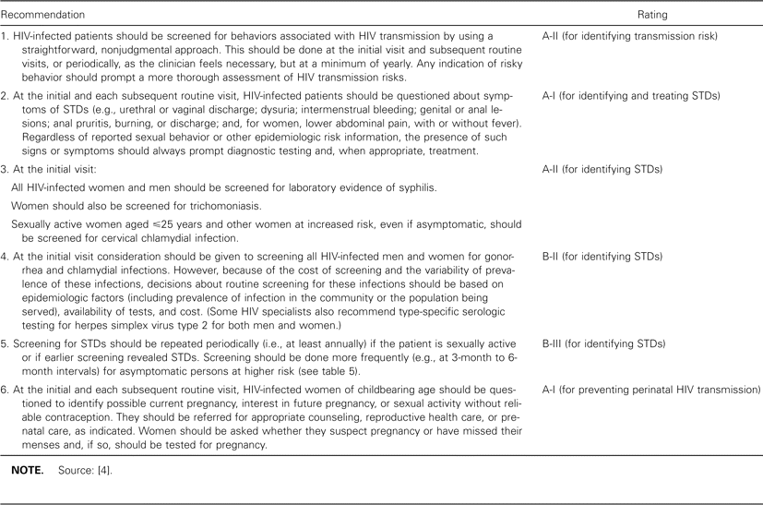
Table 2 Recommendations for screening human immunodeficiency virus (HIV)-infected persons for HIV transmission risk.
Notes:
Table 2 Recommendations for screening human immunodeficiency virus (HIV)-infected persons for HIV transmission risk.
Unless provided in the caption above, the following copyright applies to the content of this slide: © 2004 by the Infectious Diseases Society of America

Slide 3
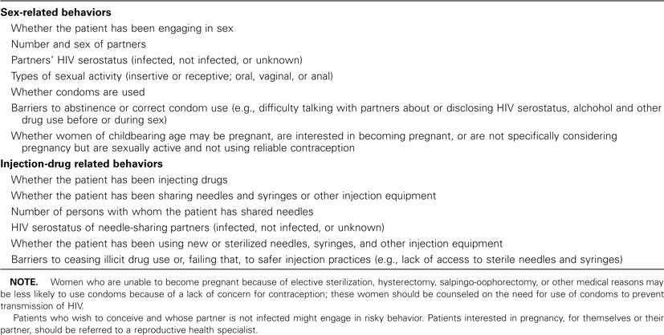
Table 3 Sex-related and injection-drug—related behaviors to address in behavioral risk screening.
Notes:
Table 3 Sex-related and injection-drug—related behaviors to address in behavioral risk screening.
Unless provided in the caption above, the following copyright applies to the content of this slide: © 2004 by the Infectious Diseases Society of America

Slide 4
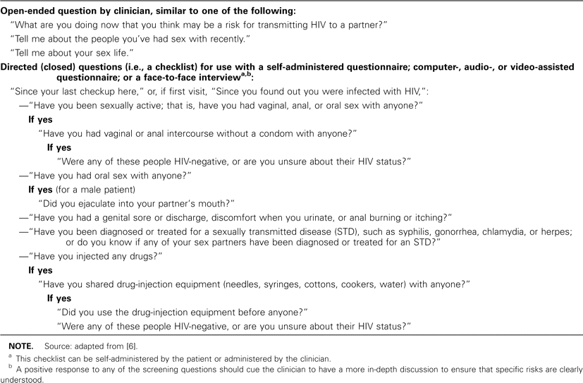
Table 4 Examples of screening strategies to elicit patient-reported risk for human immunodeficiency virus (HIV) ...
Notes:
Table 4 Examples of screening strategies to elicit patient-reported risk for human immunodeficiency virus (HIV) transmission.
Unless provided in the caption above, the following copyright applies to the content of this slide: © 2004 by the Infectious Diseases Society of America

Slide 5
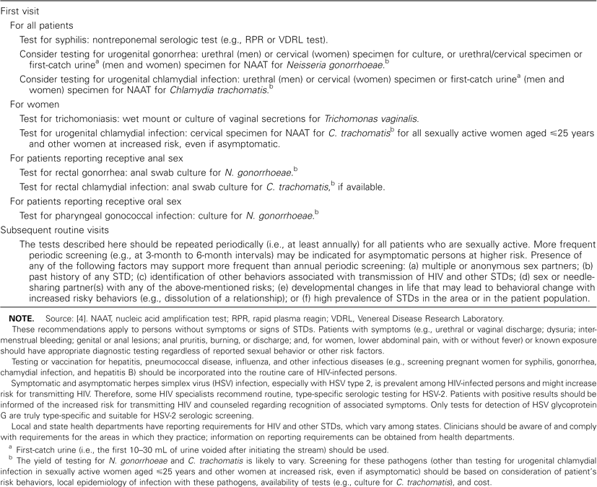
Table 5 Examples of laboratory screening strategies to detect asymptomatic sexually transmitted diseases.
Notes:
Table 5 Examples of laboratory screening strategies to detect asymptomatic sexually transmitted diseases.
Unless provided in the caption above, the following copyright applies to the content of this slide: © 2004 by the Infectious Diseases Society of America

Slide 6
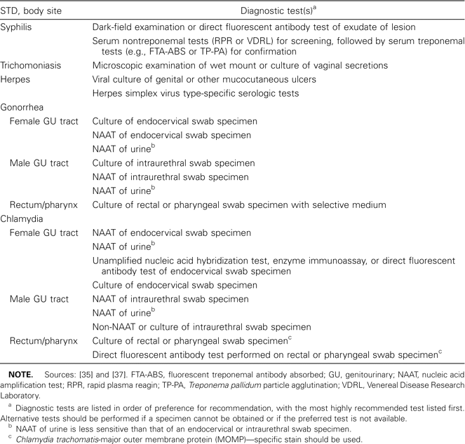
Table 6 Available diagnostic testing for detection of sexually transmitted diseases (STDs).
Notes:
Table 6 Available diagnostic testing for detection of sexually transmitted diseases (STDs).
Unless provided in the caption above, the following copyright applies to the content of this slide: © 2004 by the Infectious Diseases Society of America

Slide 7
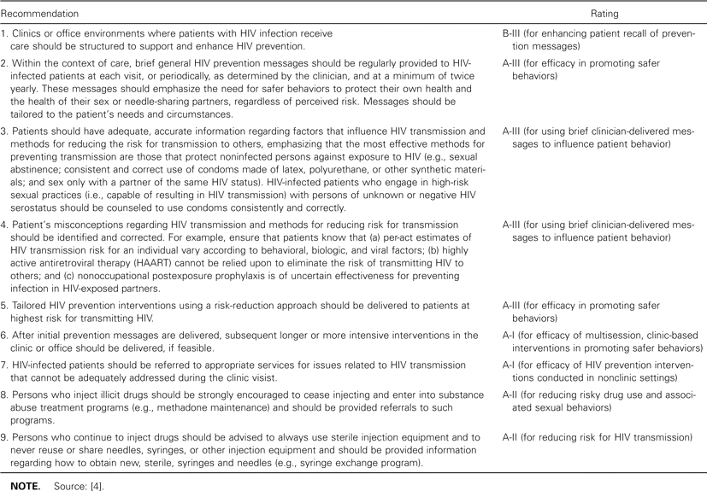
Table 7 Recommendations for behavioral interventions to reduce human immunodeficiency virus (HIV) transmission risk.
Notes:
Table 7 Recommendations for behavioral interventions to reduce human immunodeficiency virus (HIV) transmission risk.
Unless provided in the caption above, the following copyright applies to the content of this slide: © 2004 by the Infectious Diseases Society of America

Slide 8
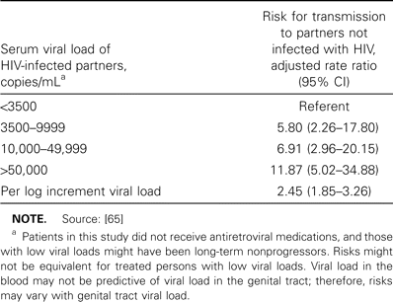
Table 8 Estimated per-act relative risk (RR) for a person without human immunodeficiency virus (HIV) infection ...
Notes:
Table 8 Estimated per-act relative risk (RR) for a person without human immunodeficiency virus (HIV) infection acquiring HIV infection, based on sex act and condom use.
Unless provided in the caption above, the following copyright applies to the content of this slide: © 2004 by the Infectious Diseases Society of America

Slide 9
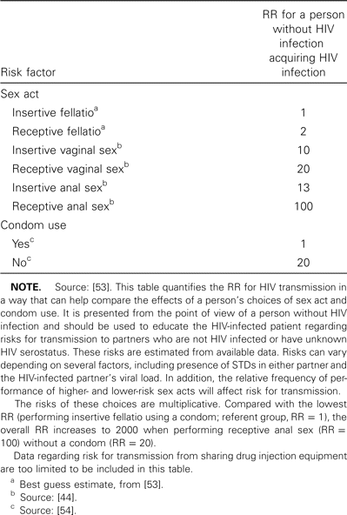
Table 9 Adjusted rate ratios of the risk for transmission and acquisition of human immunodeficiency virus type 1 ...
Notes:
Table 9 Adjusted rate ratios of the risk for transmission and acquisition of human immunodeficiency virus type 1 (HIV-1) among discordant partners.
Unless provided in the caption above, the following copyright applies to the content of this slide: © 2004 by the Infectious Diseases Society of America

Slide 10
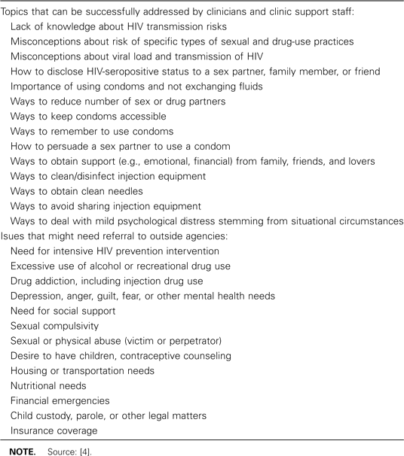
Table 10 Examples of which concerns to address and which to refer.
Notes:
Table 10 Examples of which concerns to address and which to refer.
Unless provided in the caption above, the following copyright applies to the content of this slide: © 2004 by the Infectious Diseases Society of America

Slide 11
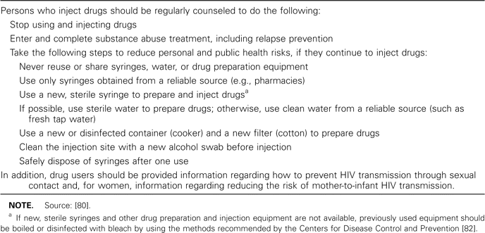
Table 11 Examples of messages that should be communicated to drug users who continue to inject.
Notes:
Table 11 Examples of messages that should be communicated to drug users who continue to inject.
Unless provided in the caption above, the following copyright applies to the content of this slide: © 2004 by the Infectious Diseases Society of America

Slide 12
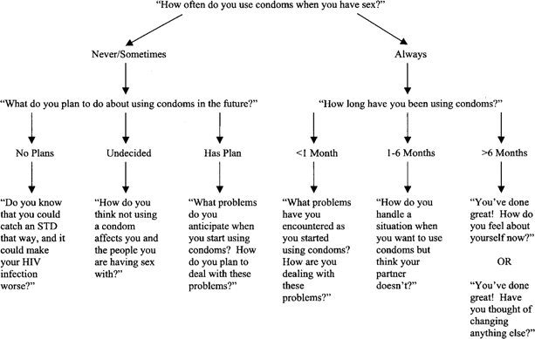
Figure 1 Examples of tailoring messages regarding condom use for sexually active, HIV-infected persons. This is not a ...
Notes:
Figure 1 Examples of tailoring messages regarding condom use for sexually active, HIV-infected persons. This is not a comprehensive list of all questions that could be asked.
Unless provided in the caption above, the following copyright applies to the content of this slide: © 2004 by the Infectious Diseases Society of America

Slide 13
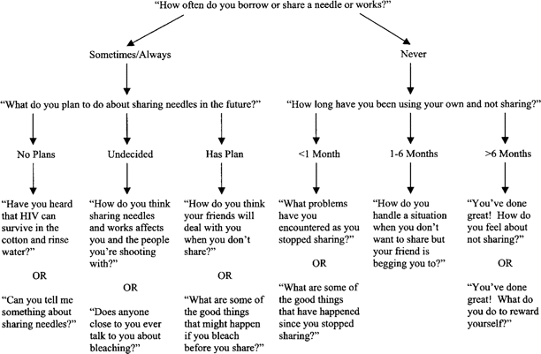
Figure 2 Examples of tailoring messages regarding needle sharing for HIV-infected persons who continue to inject ...
Notes:
Figure 2 Examples of tailoring messages regarding needle sharing for HIV-infected persons who continue to inject drugs. This is not a comprehensive list of all questions that could be asked.
Unless provided in the caption above, the following copyright applies to the content of this slide: © 2004 by the Infectious Diseases Society of America

Slide 14
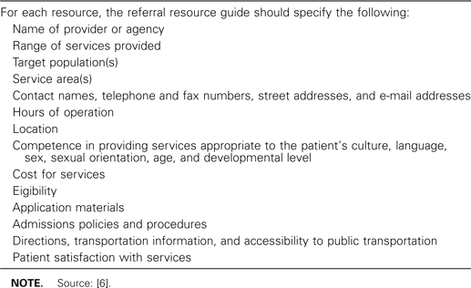
Table 12 Suggested contents for referral resource guide.
Notes:
Table 12 Suggested contents for referral resource guide.
Unless provided in the caption above, the following copyright applies to the content of this slide: © 2004 by the Infectious Diseases Society of America

Slide 15
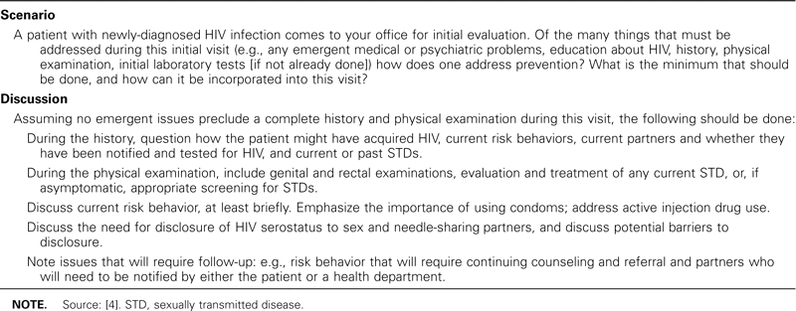
Table 13 Case scenario 1.
Notes:
Table 13 Case scenario 1.
Unless provided in the caption above, the following copyright applies to the content of this slide: © 2004 by the Infectious Diseases Society of America

Slide 16
Table 16 Case scenario 4.
Notes:
Table 16 Case scenario 4.
Unless provided in the caption above, the following copyright applies to the content of this slide: © 2004 by the Infectious Diseases Society of America

Slide 17
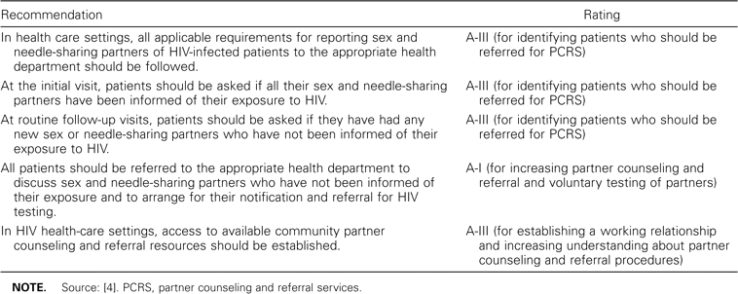
Table 17 Recommendations for partner counseling and referral services, including partner notification.
Notes:
Table 17 Recommendations for partner counseling and referral services, including partner notification.
Unless provided in the caption above, the following copyright applies to the content of this slide: © 2004 by the Infectious Diseases Society of America

Slide 18
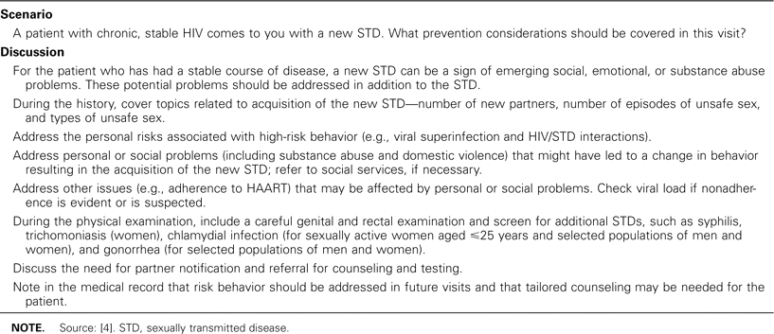
Table 14 Case scenario 2.
Notes:
Table 14 Case scenario 2.
Unless provided in the caption above, the following copyright applies to the content of this slide: © 2004 by the Infectious Diseases Society of America

Slide 19
Table 15 Case scenario 3.
Notes:
Table 15 Case scenario 3.
Unless provided in the caption above, the following copyright applies to the content of this slide: © 2004 by the Infectious Diseases Society of America

