Slide 1
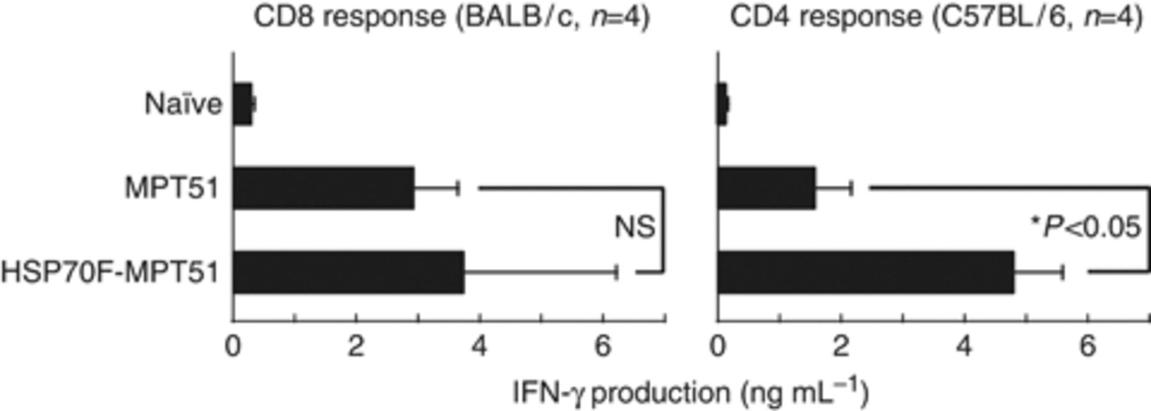
Figure 1 Enhancing effect of HSP70 conjugation on MPT51-specific immune response. BALB/c (for CD8+ T-cell response) ...
Notes:
Figure 1 Enhancing effect of HSP70 conjugation on MPT51-specific immune response. BALB/c (for CD8+ T-cell response) and C57BL/6 (for CD4+ T-cell response) mice were immunized with plasmids that encoded HSP70F-MPT51 or MPT51 alone, and their spleen cells were stimulated with the corresponding antigenic peptides. The IFN-γ concentration of the culture supernatants was determined by ELISA. The results of four mice per group are presented as mean ± SD. NS, not significant; *P<0.05. IFN-γ productions from unstimulated spleen cells were nearly undetectable in all groups.
Unless provided in the caption above, the following copyright applies to the content of this slide: © 2010 Federation of European Microbiological Societies.

Slide 2
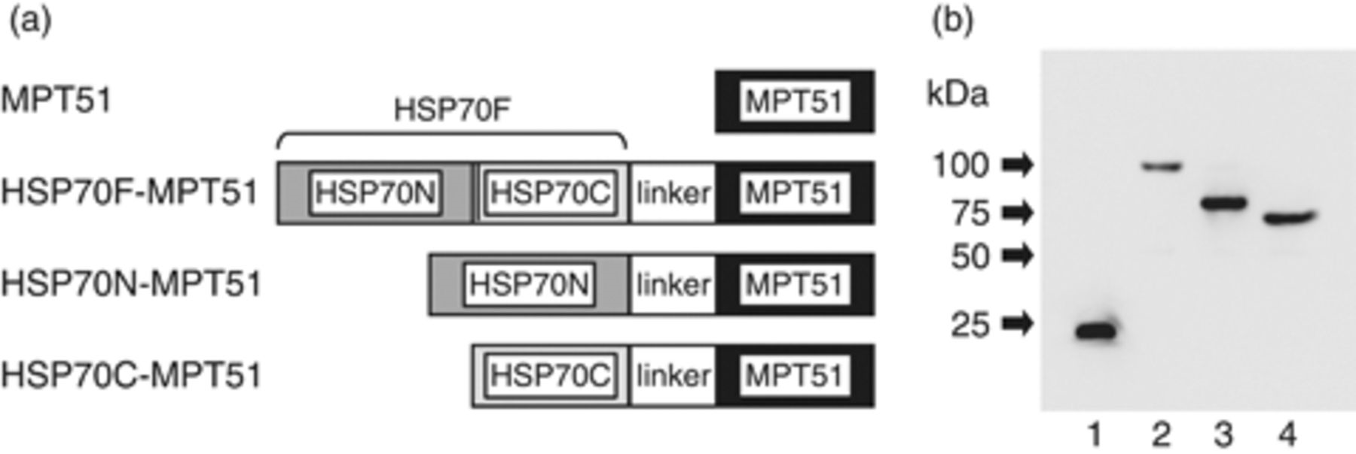
Figure 2 Chimeric HSP70-MPT51 molecules. (a) Schematic diagram of chimeric molecules. HSP70F, HSP70N, and HSP70C mean ...
Notes:
Figure 2 Chimeric HSP70-MPT51 molecules. (a) Schematic diagram of chimeric molecules. HSP70F, HSP70N, and HSP70C mean full-length, the N-terminal domain, and the C-terminal domain of HSP70, respectively. (b) Expression of chimeric proteins in HEK293T cells. Cells were transfected with plasmids that encoded DNA for various MPT51 molecules, and the protein expression was detected by Western blotting using anti-MPT51 mAb (derived from a clone 2B11F5). 1, MPT51 (expected molecular weight: 27 979.17); 2, HSP70F-MPT51 (95 570.65); 3, HSP70N-MPT51 (67 382.45); and 4, HSP70C-MPT51 (57 774.05). Expected molecular sizes were calculated by an algorithm termed ‘compute pi/mw tool’ in expasy (http://expasy.org/tools/pi_tool.html).
Unless provided in the caption above, the following copyright applies to the content of this slide: © 2010 Federation of European Microbiological Societies.

Slide 3
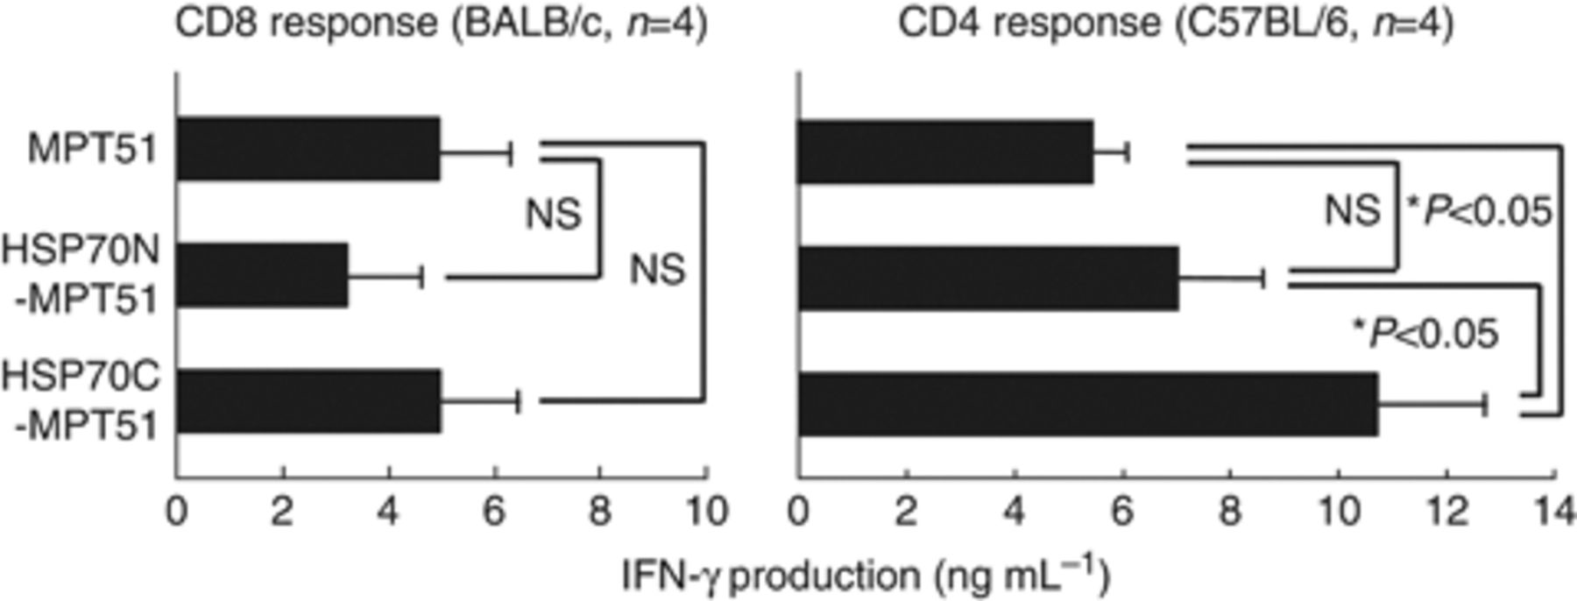
Figure 3 Comparison of the enhancing effects of the N- and C-domains of HSP70 in DNA vaccination. BALB/c and C57BL/6 ...
Notes:
Figure 3 Comparison of the enhancing effects of the N- and C-domains of HSP70 in DNA vaccination. BALB/c and C57BL/6 mice were immunized with plasmids that encoded HSP70N-MPT51, HSP70C-MPT51, or MPT51 alone, and the effects were determined by an IFN-γ production assay using MPT51 peptides for stimulation. The results of four mice per group are presented as mean ± SD. NS, not significant; *P<0.05. IFN-γ productions from unstimulated spleen cells were nearly undetectable in all the groups.
Unless provided in the caption above, the following copyright applies to the content of this slide: © 2010 Federation of European Microbiological Societies.

Slide 4
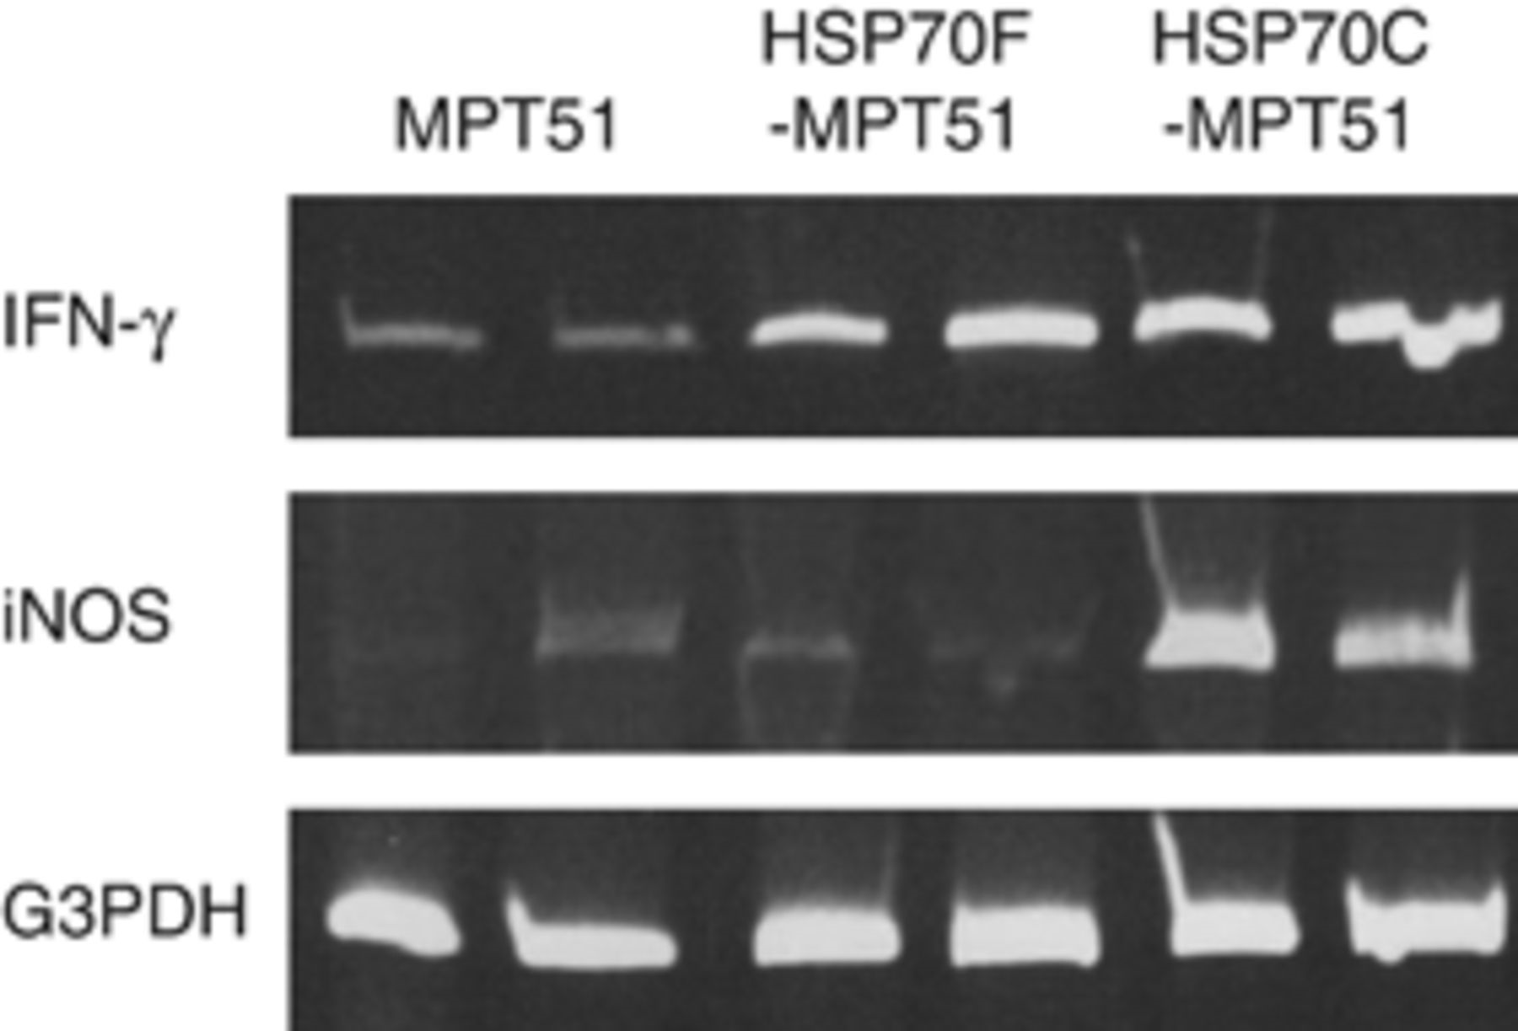
Figure 4 Semi-quantitative RT-PCR for iNOS and IFN-γ. Spleen cells from immunized C57BL/6 mice were stimulated with ...
Notes:
Figure 4 Semi-quantitative RT-PCR for iNOS and IFN-γ. Spleen cells from immunized C57BL/6 mice were stimulated with MPT51 peptide (P171-190), and the expression of iNOS and IFN-γ was tested by semi-quantitative RT-PCR. G3PDH was used as a control.
Unless provided in the caption above, the following copyright applies to the content of this slide: © 2010 Federation of European Microbiological Societies.

Slide 5
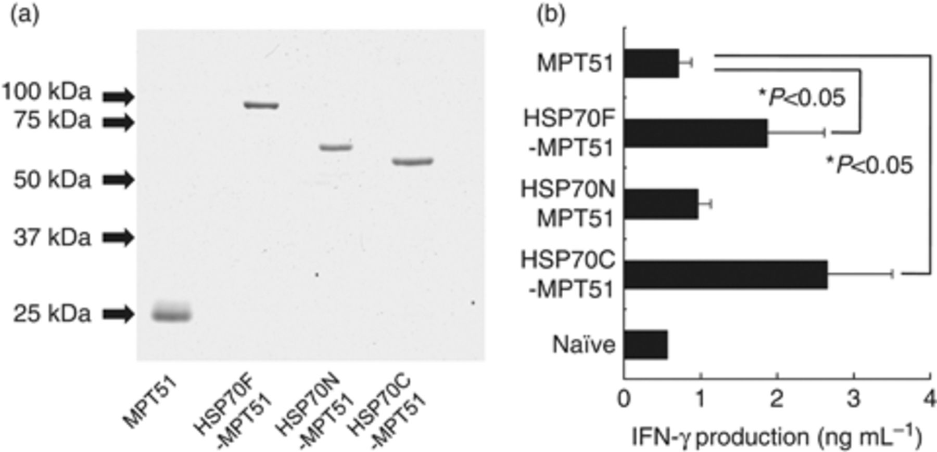
Figure 5 Comparison of the enhancing effects of the N- and C-domains of HSP70 in protein vaccination. (a) SDS-PAGE ...
Notes:
Figure 5 Comparison of the enhancing effects of the N- and C-domains of HSP70 in protein vaccination. (a) SDS-PAGE analysis of recombinant proteins. Proteins were purified with Ni-NTA agarose, subjected to SDS-PAGE, and stained with Coomassie Brilliant Blue R-250. For the expected molecular sizes, see the legend for Fig. 2b. (b) MPT51-specific IFN-γ production. C57BL/6 mice were immunized with recombinant proteins, and their spleen cells were used for an IFN-γ production assay in response to the MPT51 peptide (P171–190). The results of four mice per group are presented as mean ± SD. *P<0.05. IFN-γ productions from unstimulated spleen cells were nearly undetectable in all the groups.
Unless provided in the caption above, the following copyright applies to the content of this slide: © 2010 Federation of European Microbiological Societies.

