Slide 1
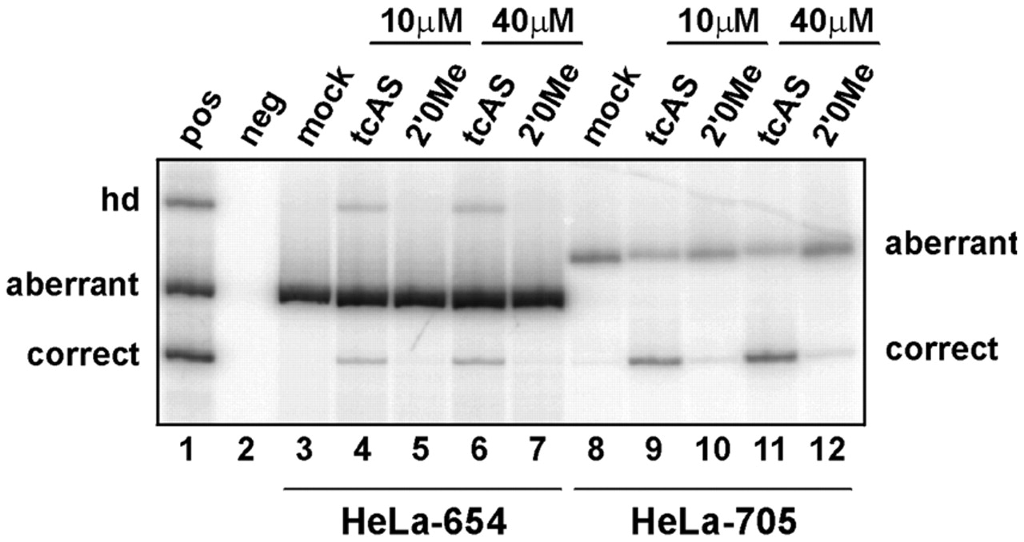
Figure 6. Correction of β-globin mRNA splicing after co-incubation (without liposomes) of tc-DNA ...
Notes:
Figure 6. Correction of β-globin mRNA splicing after co-incubation (without liposomes) of tc-DNA oligonucleotide. Total RNA from HeLa-654 and HeLa-705 cells was subjected to RT-PCR with primers in exons 2 and 3. Concentrations (µM) of the transfected oligonucleotides are indicated above the lanes. pos, neg, mock and hd, as in Figure 5.
Unless provided in the caption above, the following copyright applies to the content of this slide:

Slide 2
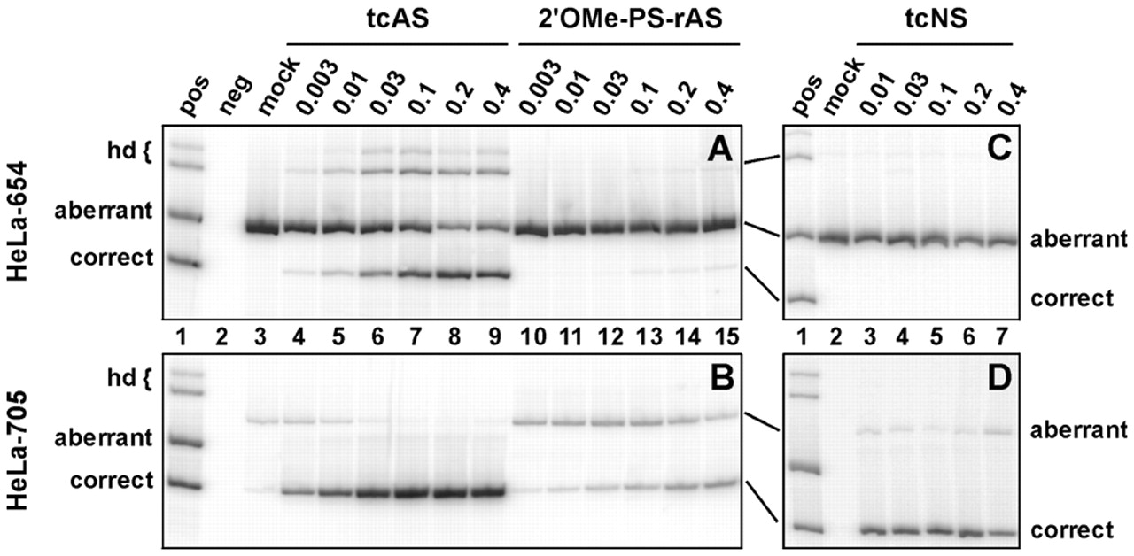
Figure 5. Correction of β-globin mRNA splicing after lipofection of tc-DNA oligonucleotide. Total RNA from ...
Notes:
Figure 5. Correction of β-globin mRNA splicing after lipofection of tc-DNA oligonucleotide. Total RNA from HeLa cells expressing the human β-globin gene with either the IVS2-654 or IVS2-705 mutation, which result in the inclusion of an aberrant exon between the normal exons 2 and 3, was subjected to RT–PCR with primers in exons 2 and 3. Concentrations (µM) of the transfected oligonucleotides are indicated above the lanes. pos, RT–PCR products from cells expressing both the aberrant IVS2-654 and correct β-globin mRNA; neg (lanes 2 in A , B and D ), RT–PCR with RNA from a mouse cell line not expressing β-globin; mock (lane 2 in C , lane 3 in A and B), RT–PCR with RNA from cells transfected with empty liposomes; hd, heteroduplexes between aberrant and correct RT–PCR products. Note that the aberrantly spliced product is longer in HeLa-705 than in HeLa-654 cells.
Unless provided in the caption above, the following copyright applies to the content of this slide:

Slide 3
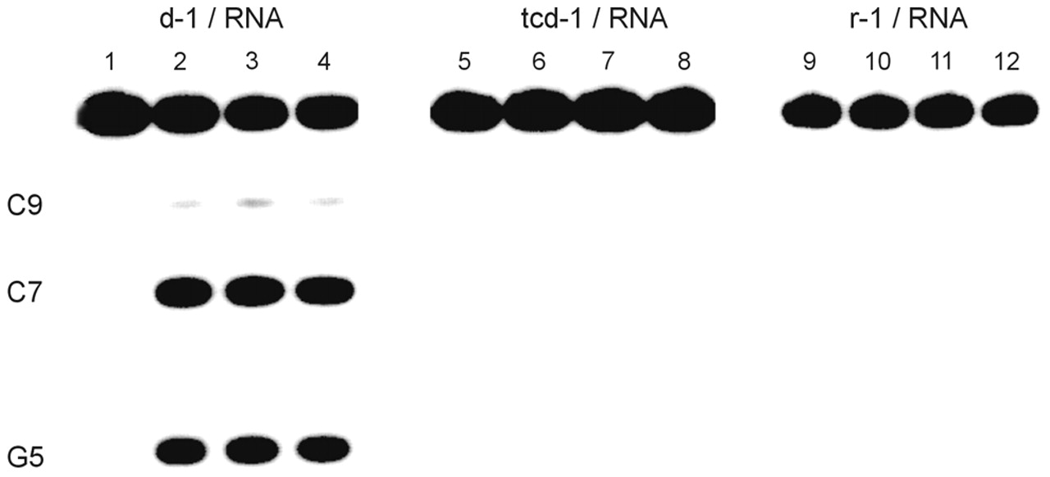
Figure 4. Autoradiogram of a 20% denaturing polyacrylamide gel showing the RNase H mediated cleavage of ...
Notes:
Figure 4. Autoradiogram of a 20% denaturing polyacrylamide gel showing the RNase H mediated cleavage of r(AACUGUCACG) by d-1 (lanes 1–4), tcd-1 (lanes 5–8) and r-1 (lanes 9–12) at 1, 30, 120 and 300 min each.
Unless provided in the caption above, the following copyright applies to the content of this slide:

Slide 4
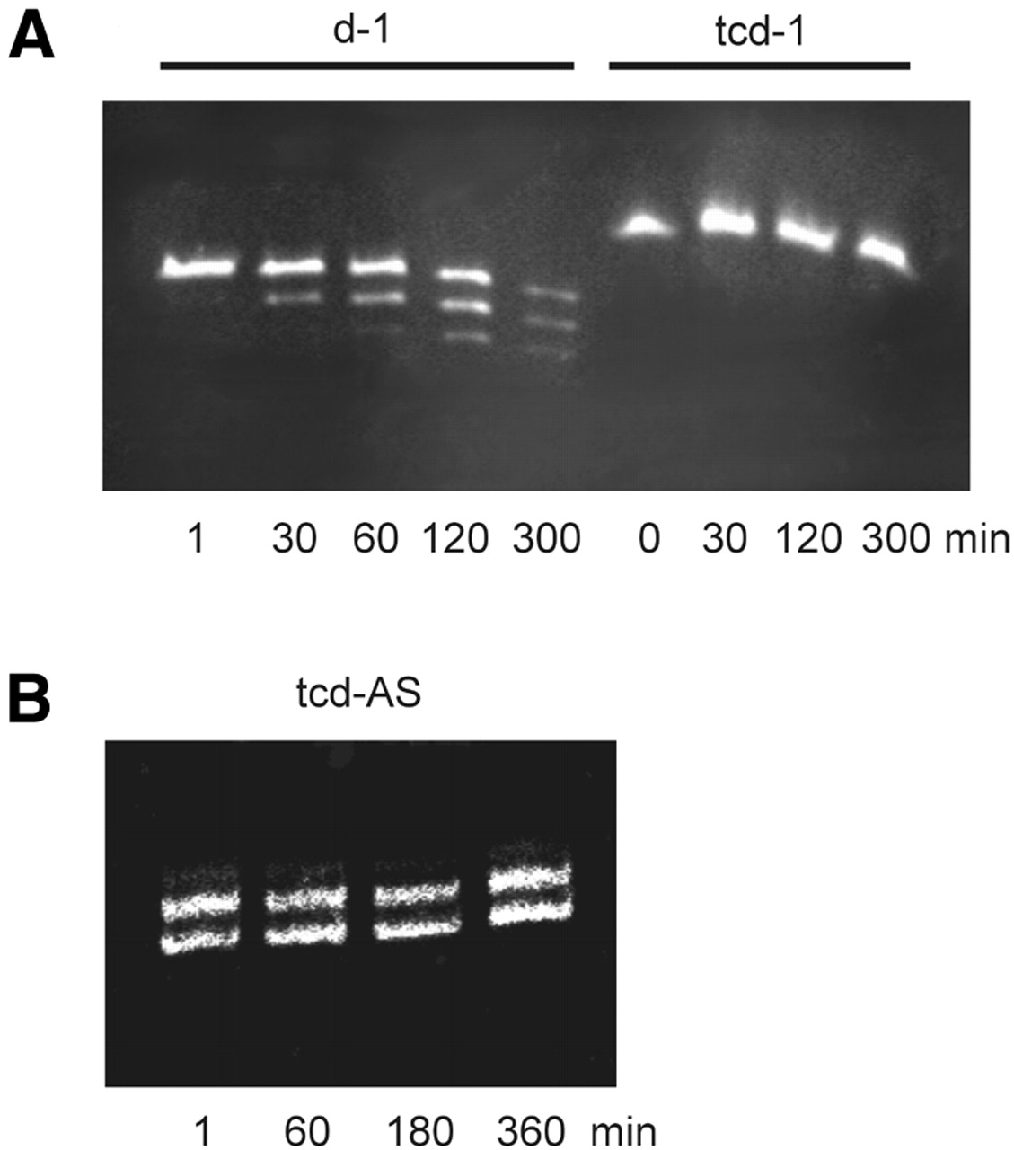
Figure 3. Polyacrylamide gel (20%) showing the time course of the FCS mediated degradation of ...
Notes:
Figure 3. Polyacrylamide gel (20%) showing the time course of the FCS mediated degradation of oligonucleotides d-1 and tcd-1 ( A ) and tcd-AS ( B ) at the indicated time intervals. Bands were visualized by staining with ‘stains all’.
Unless provided in the caption above, the following copyright applies to the content of this slide:

Slide 5
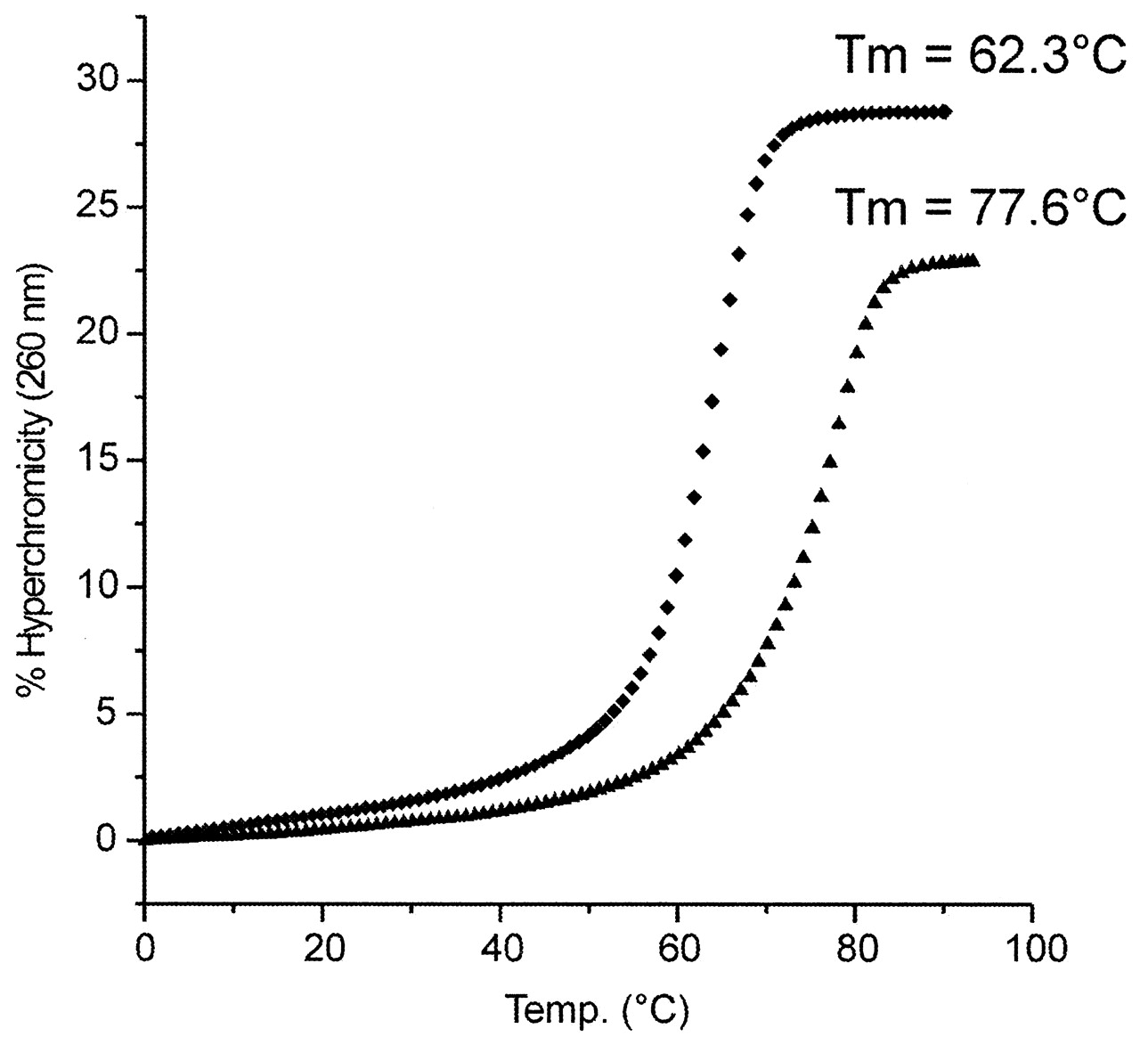
Figure 2. UV-melting curves (260 nm) of the duplexes of 2′- O -Me-PS-AS (diamonds) and tcd-AS (triangles) ...
Notes:
Figure 2. UV-melting curves (260 nm) of the duplexes of 2′- O -Me-PS-AS (diamonds) and tcd-AS (triangles) with the corresponding RNA complement r(pUCUUUCAGGGCAAUAAUG) in 10 mM NaH 2 PO 4 , 150 mM NaCl, pH 7.0 (2 µM duplex concentration).
Unless provided in the caption above, the following copyright applies to the content of this slide:

Slide 6
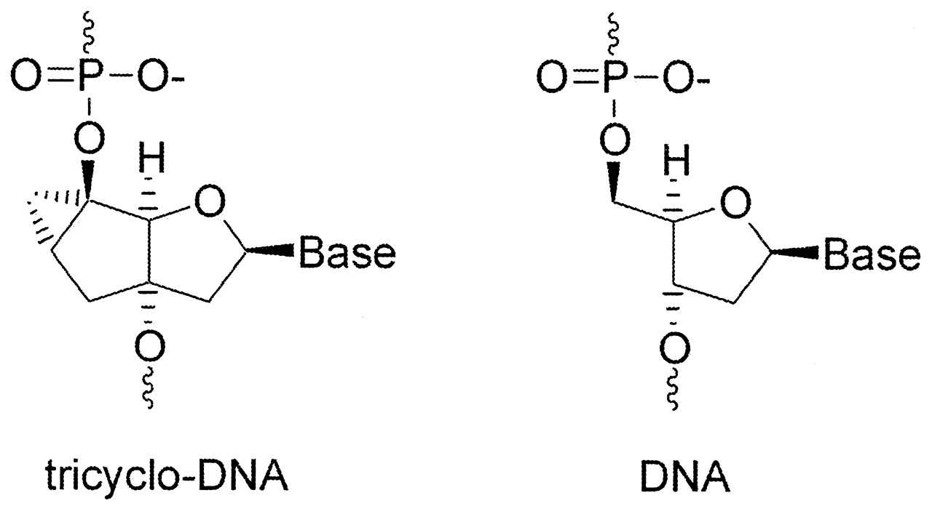
Figure 1. Representation of the chemical structure of tc-DNA as compared with DNA.
Notes:
Figure 1. Representation of the chemical structure of tc-DNA as compared with DNA.
Unless provided in the caption above, the following copyright applies to the content of this slide:

