Slide 1
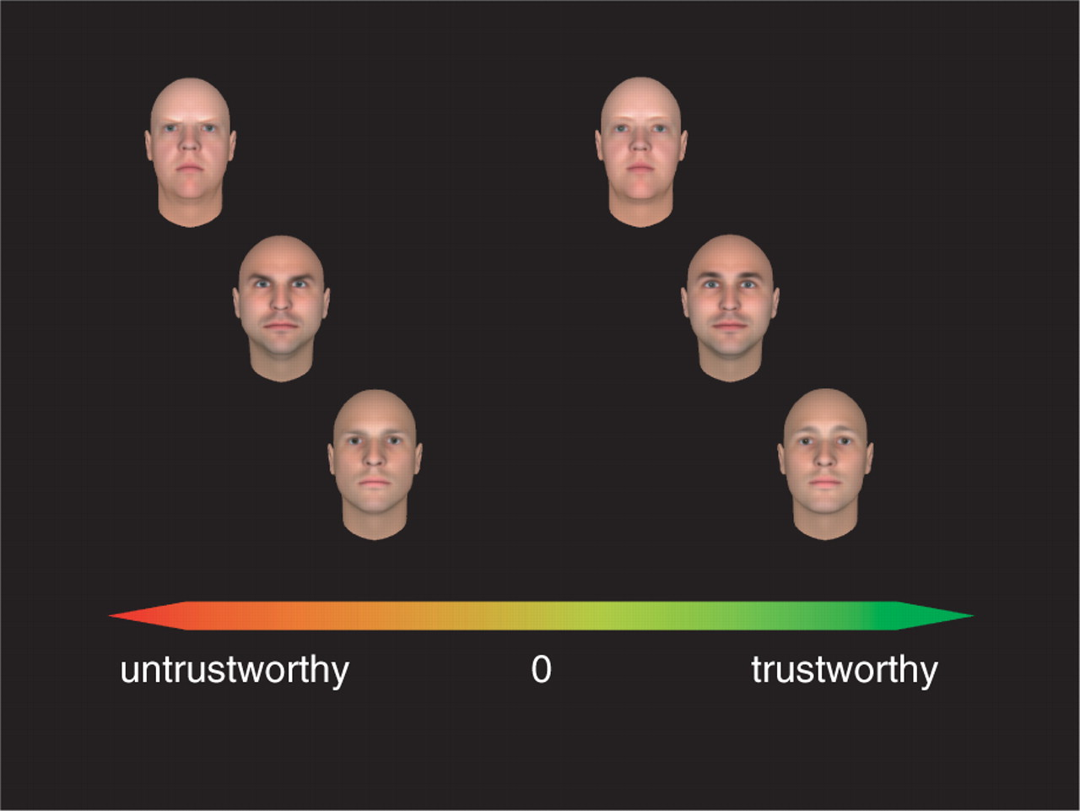
Fig. 1 Examples of faces used in the fMRI experiment. Each of the three rows shows the untrustworthy (on the left) ...
Notes:
Fig. 1 Examples of faces used in the fMRI experiment. Each of the three rows shows the untrustworthy (on the left) and trustworthy (on the right) versions of a face. Their position on the trustworthiness axis indicates the trustworthiness predicted by the regression model (see text for details).
Unless provided in the caption above, the following copyright applies to the content of this slide: © The Author(s) (2008). Published by Oxford University Press.This is an Open Access article distributed under the terms of the Creative Commons Attribution Non-Commercial License (http://creativecommons.org/licenses/by-nc/4.0/), which permits non-commercial re-use, distribution, and reproduction in any medium, provided the original work is properly cited. For commercial re-use, please contact journals.permissions@oup.com

Slide 2
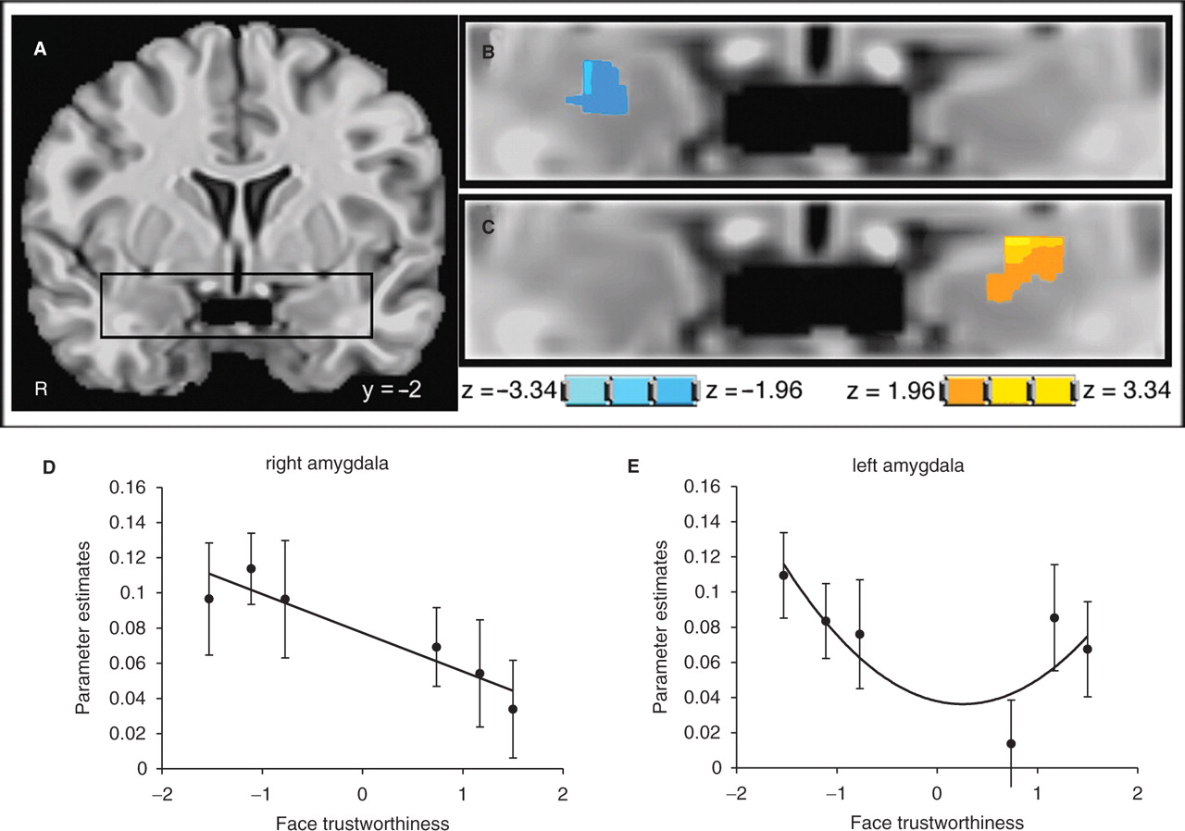
Fig. 2 Amygdala response as a function of face trustworthiness. (A) Amygdala region of a standardized brain. (B) ...
Notes:
Fig. 2 Amygdala response as a function of face trustworthiness. (A) Amygdala region of a standardized brain. (B) Area in the right amygdala showing a significant negative linear change, this area showed the same linear response in Engell et al. (2007). (C) Area in the left amygdala showing a significant quadratic change. The statistical maps show the results of a t-test performed on the coefficients of the linear and quadratic trend regressors on the individual data. (D) Parameter estimates (percent signal change) in the functionally defined right amygdala as a function of face trustworthiness. (E) Parameter estimates (percent signal change) in the functionally defined left amygdala as a function of face trustworthiness. For the plots in panels D and E, the faces were binned into six categories according to their trustworthiness. The lines represent the best fitting curves.
Unless provided in the caption above, the following copyright applies to the content of this slide: © The Author(s) (2008). Published by Oxford University Press.This is an Open Access article distributed under the terms of the Creative Commons Attribution Non-Commercial License (http://creativecommons.org/licenses/by-nc/4.0/), which permits non-commercial re-use, distribution, and reproduction in any medium, provided the original work is properly cited. For commercial re-use, please contact journals.permissions@oup.com

Slide 3
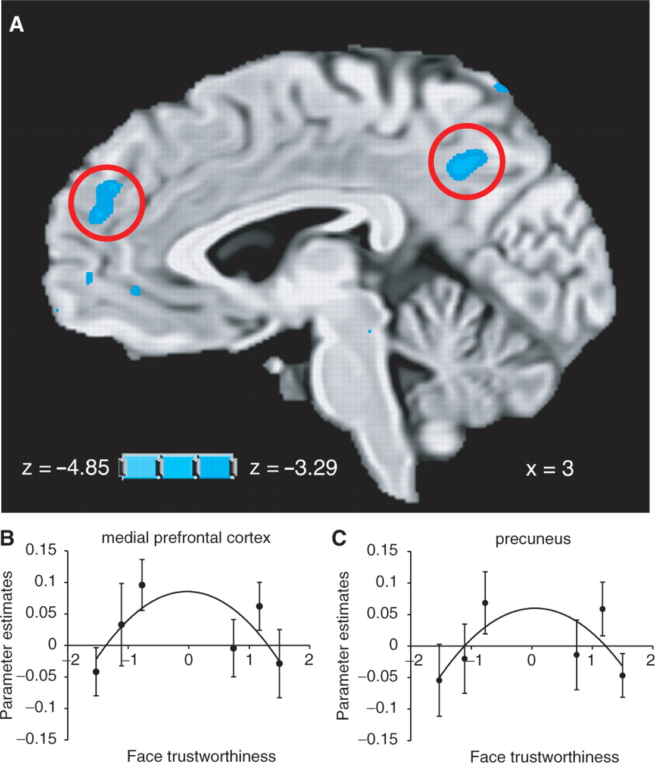
Fig. 3 (A) Regions in the medial prefrontal cortex and precuneus showing significant quadratic effects as a function ...
Notes:
Fig. 3 (A) Regions in the medial prefrontal cortex and precuneus showing significant quadratic effects as a function of face trustworthiness. The results of a t-test performed on the coefficients of the quadratic trend regressors on the individual data. (B) Parameter estimates (percent signal change) in the functionally defined MPFC as a function of face trustworthiness. (C) Parameter estimates (percent signal change) in the functionally defined precuneus as a function of face trustworthiness. For the plots in panels B and C, the faces were binned into six categories according to their trustworthiness. The lines represent the best fitting curves.
Unless provided in the caption above, the following copyright applies to the content of this slide: © The Author(s) (2008). Published by Oxford University Press.This is an Open Access article distributed under the terms of the Creative Commons Attribution Non-Commercial License (http://creativecommons.org/licenses/by-nc/4.0/), which permits non-commercial re-use, distribution, and reproduction in any medium, provided the original work is properly cited. For commercial re-use, please contact journals.permissions@oup.com

