Slide 1
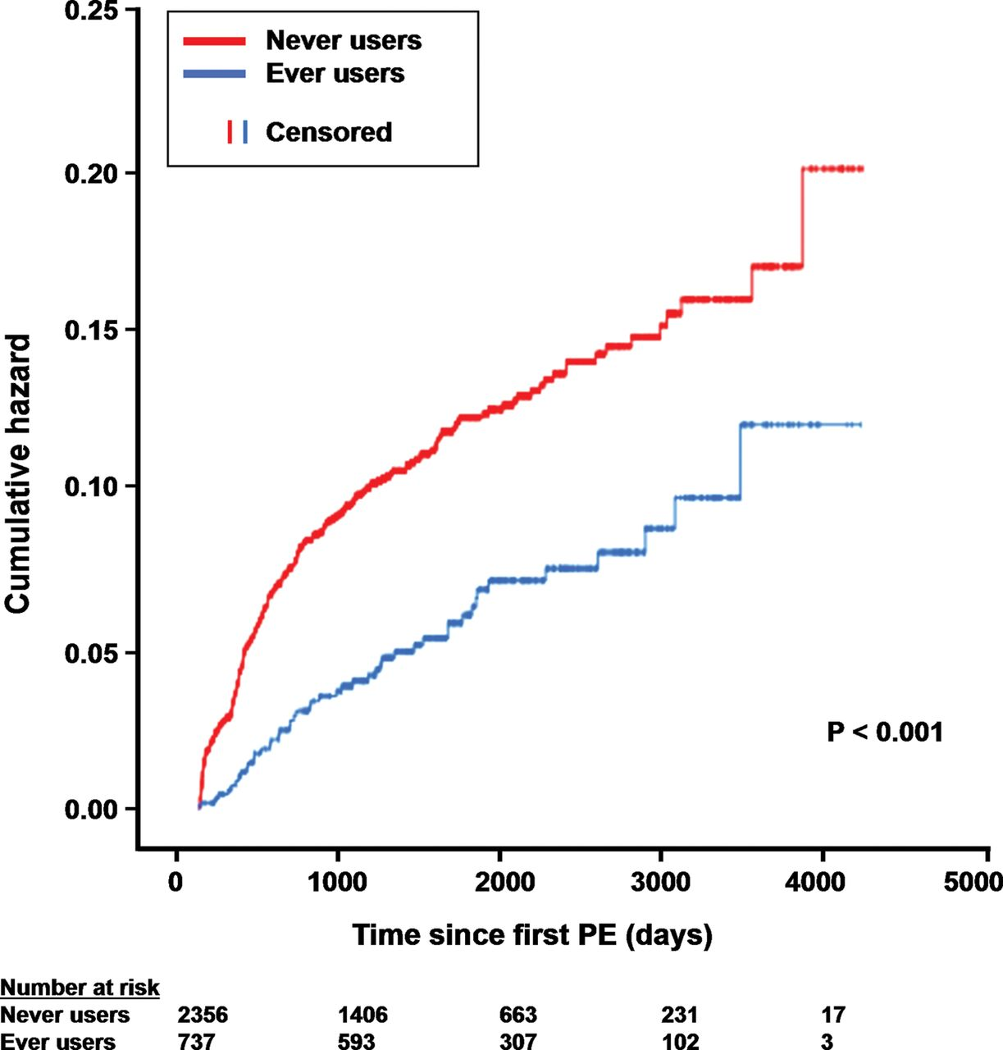
Figure 1 Time to recurrent pulmonary embolism for never and ever users of statins.
Notes:
Figure 1 Time to recurrent pulmonary embolism for never and ever users of statins.
Unless provided in the caption above, the following copyright applies to the content of this slide: Published on behalf of the European Society of Cardiology. All rights reserved. © The Author 2013. For permissions please email: journals.permissions@oup.com

Slide 2
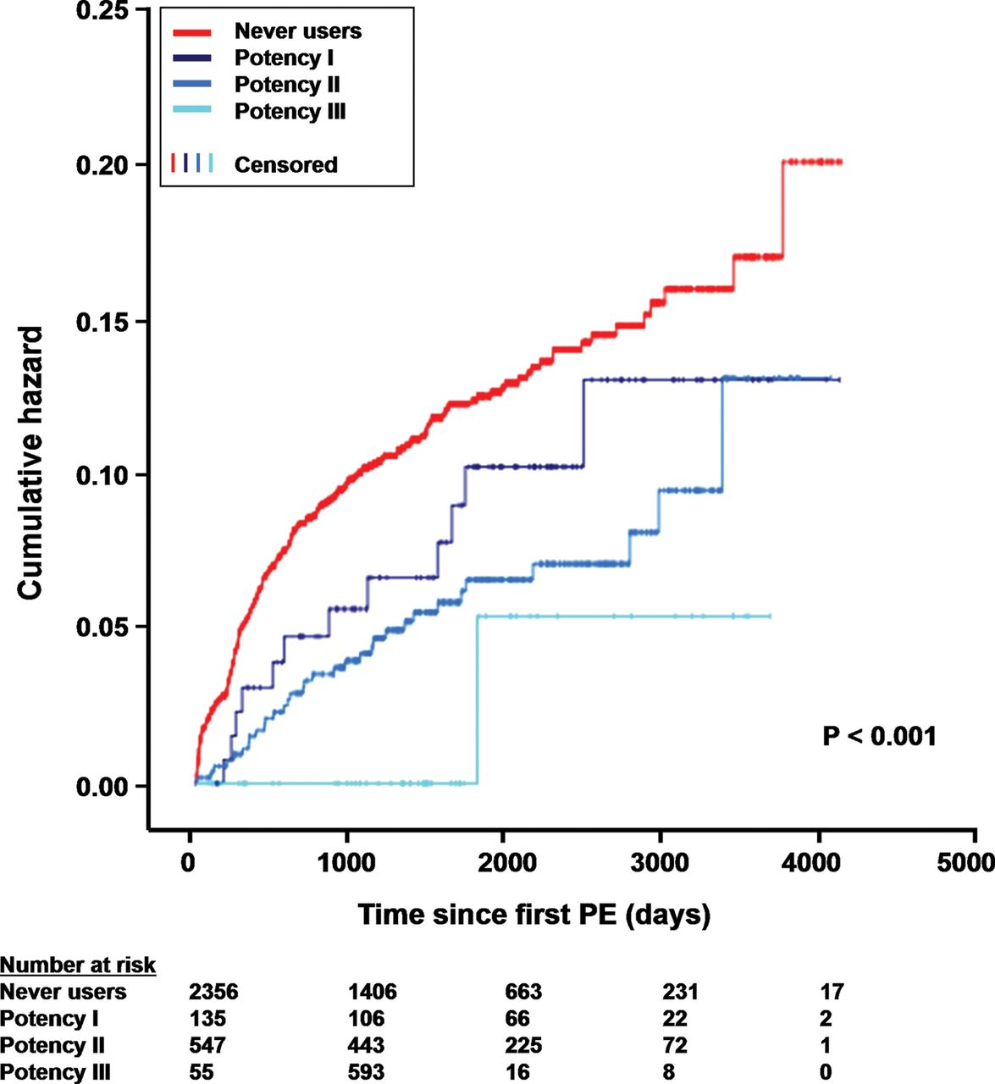
Figure 2 Time to recurrent pulmonary embolism and statin potency. Potency I: <20% LDL cholesterol reduction. Potency ...
Notes:
Figure 2 Time to recurrent pulmonary embolism and statin potency. Potency I: 40% LDL cholesterol reduction.
Unless provided in the caption above, the following copyright applies to the content of this slide: Published on behalf of the European Society of Cardiology. All rights reserved. © The Author 2013. For permissions please email: journals.permissions@oup.com

