Slide 1
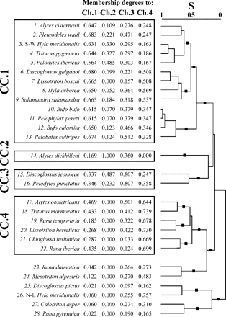
FIGURE 1. Classification tree of the amphibian distributions in the Iberian Peninsula according to S, the Baroni-Urbani ...
Notes:
FIGURE 1. Classification tree of the amphibian distributions in the Iberian Peninsula according to S, the Baroni-Urbani and Buser (1976) similarity index. The species that constituted the four chorotypical clusters (CC.1, CC.2, CC.3, and CC.4) are enclosed in squares. The degree to which each distribution belongs to each significant chorotype (Ch) is shown. Black symbols (circles and squares) indicate all branches susceptible to be interpreted as fuzzy biogeographic patterns with different levels of fuzziness of which a maximum of 11 nonnested patterns are identified with black squares.
Unless provided in the caption above, the following copyright applies to the content of this slide: © The Author(s) 2011. Published by Oxford University Press, on behalf of the Society of Systematic Biologists. All rights reserved. For Permissions, please email: journals.permissions@oup.com

Slide 2
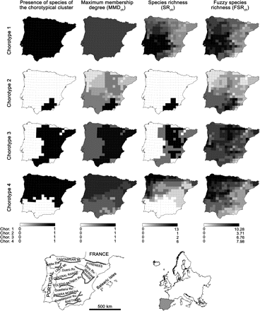
FIGURE 2. Geographical representations of the four significant chorotypes described for the amphibians in the Iberian ...
Notes:
FIGURE 2. Geographical representations of the four significant chorotypes described for the amphibians in the Iberian Peninsula. The presence of at least one species of the chorotypical clusters, the species richness of the chorotypical clusters (SRch), the maximum membership degree (MMDch), and the fuzzy species richness (FSRch) are mapped. Main mountain ranges and rivers are represented below to aid comprehension of Results and Discussion section.
Unless provided in the caption above, the following copyright applies to the content of this slide: © The Author(s) 2011. Published by Oxford University Press, on behalf of the Society of Systematic Biologists. All rights reserved. For Permissions, please email: journals.permissions@oup.com

Slide 3
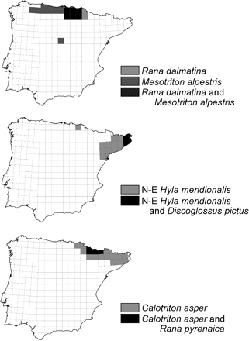
FIGURE 3. Amphibian distributions in the Iberian Peninsula that were not included in significant chorotypes. For Hyla ...
Notes:
FIGURE 3. Amphibian distributions in the Iberian Peninsula that were not included in significant chorotypes. For Hyla meridionalis, only the north eastern (N-E) ranges, resulting from a human introduction, are drawn.
Unless provided in the caption above, the following copyright applies to the content of this slide: © The Author(s) 2011. Published by Oxford University Press, on behalf of the Society of Systematic Biologists. All rights reserved. For Permissions, please email: journals.permissions@oup.com

Slide 4
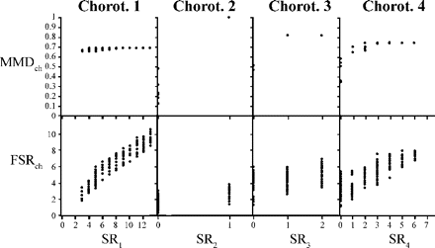
FIGURE 4. Scatter plots of the relationships, in each chorotype, between the maximum membership degree ...
Notes:
FIGURE 4. Scatter plots of the relationships, in each chorotype, between the maximum membership degree (MMDch) and species richness of the chorotypical cluster (SRch), and between fuzzy species richness (FSRch) and SRch. Subscript “ch” was replaced with the corresponding number when referred to a single chorotype.
Unless provided in the caption above, the following copyright applies to the content of this slide: © The Author(s) 2011. Published by Oxford University Press, on behalf of the Society of Systematic Biologists. All rights reserved. For Permissions, please email: journals.permissions@oup.com

Slide 5
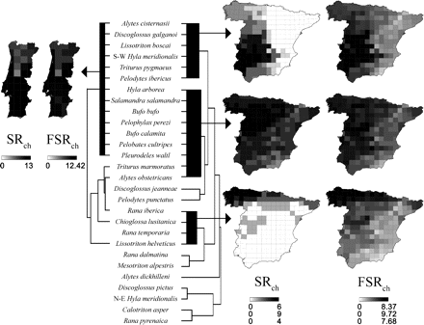
FIGURE 5. Classification trees and geographical representations of the significant chorotypes described separately for ...
Notes:
FIGURE 5. Classification trees and geographical representations of the significant chorotypes described separately for the amphibians in mainland Spain and Portugal. The species richness of the chorotypical clusters (SRch) and the fuzzy species richness (FSRch) are mapped. Thick lines in the trees indicate chorotypical clusters.
Unless provided in the caption above, the following copyright applies to the content of this slide: © The Author(s) 2011. Published by Oxford University Press, on behalf of the Society of Systematic Biologists. All rights reserved. For Permissions, please email: journals.permissions@oup.com

Slide 6
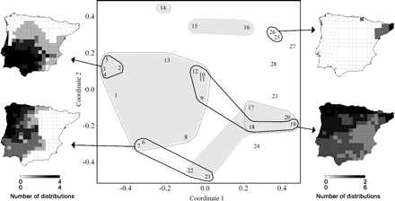
FIGURE 6. Two first axes of the multidimensional scaling plot of the amphibian distributions in the Iberian Peninsula. ...
Notes:
FIGURE 6. Two first axes of the multidimensional scaling plot of the amphibian distributions in the Iberian Peninsula. Distributions in the same biotic element are rounded together by a line: a black line for the model-based Gaussian clustering and a gray line for the model-based hierarchical clustering; distributions in the same chorotypical cluster are grouped together with gray shadows. The number of distributions in each biotic element according to the Gaussian clustering is geographically represented.
Unless provided in the caption above, the following copyright applies to the content of this slide: © The Author(s) 2011. Published by Oxford University Press, on behalf of the Society of Systematic Biologists. All rights reserved. For Permissions, please email: journals.permissions@oup.com

