Slide 1
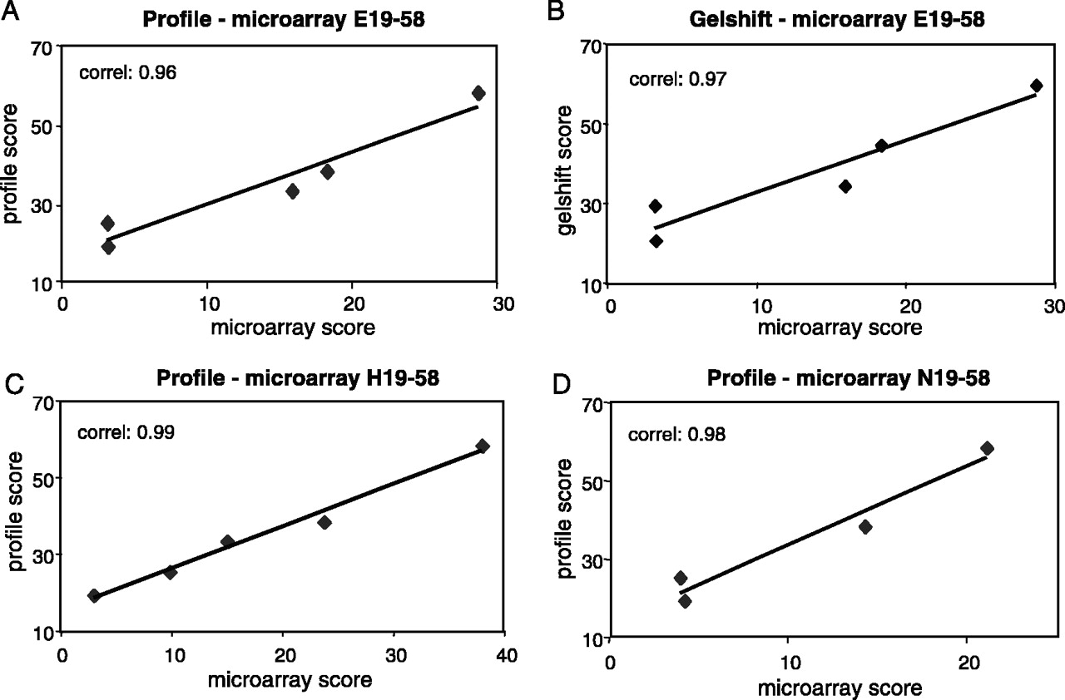
Figure 3 Comparisons of relative AP-2 binding activities using in silico , in vitro and on-chip assays. Comparison ...
Notes:
Figure 3 Comparisons of relative AP-2 binding activities using in silico , in vitro and on-chip assays. Comparison between profile prediction scores and microarray binding values using E19–E58 ( A ), H19–H58 ( C ) and N19–N58 ( D ) probes, determined as detailed in the legends to Figures 1 and 2 . ( B ) displays a comparison of gel shift and microarray binding values for the E19–E58 probes. Correlation coefficients are given in the top left corner of (A–D).
Unless provided in the caption above, the following copyright applies to the content of this slide: © The Author 2005. Published by Oxford University Press. All rights reserved The online version of this article has been published under an open access model. Users are entitled to use, reproduce, disseminate, or display the open access version of this article for non-commercial purposes provided that: the original authorship is properly and fully attributed; the Journal and Oxford University Press are attributed as the original place of publication with the correct citation details given; if an article is subsequently reproduced or disseminated not in its entirety but only in part or as a derivative work this must be clearly indicated. For commercial re-use, please contact journals.permissions@oupjournals.org

Slide 2
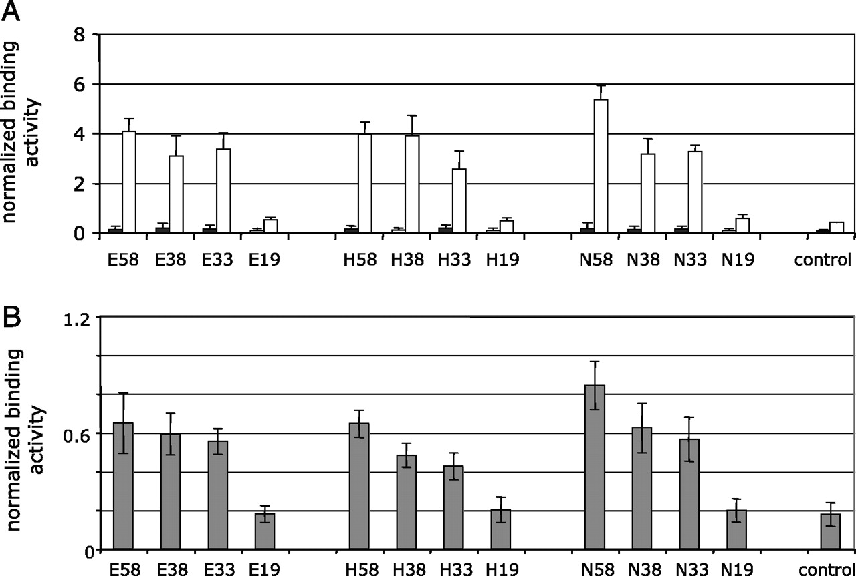
Figure 4 Microarray-based detection of sequence-specific AP-2 DNA-binding activity from human cell nuclear extracts. ...
Notes:
Figure 4 Microarray-based detection of sequence-specific AP-2 DNA-binding activity from human cell nuclear extracts. Normalized binding activities were determined for the indicated microarray probes incubated with AP-2-containing nuclear extracts. Nuclear extracts consisted of 2 μg total proteins of HepG2 hepatocellular carcinoma cells, either non-transfected (closed bars) or transiently transfected with an AP-2 expression vector (open bars) [four data points, ( A )], or of 10 μg total proteins from untransfected MCF-7 mammary gland carcinoma cells [ n = 20, ( B )].
Unless provided in the caption above, the following copyright applies to the content of this slide: © The Author 2005. Published by Oxford University Press. All rights reserved The online version of this article has been published under an open access model. Users are entitled to use, reproduce, disseminate, or display the open access version of this article for non-commercial purposes provided that: the original authorship is properly and fully attributed; the Journal and Oxford University Press are attributed as the original place of publication with the correct citation details given; if an article is subsequently reproduced or disseminated not in its entirety but only in part or as a derivative work this must be clearly indicated. For commercial re-use, please contact journals.permissions@oupjournals.org

Slide 3
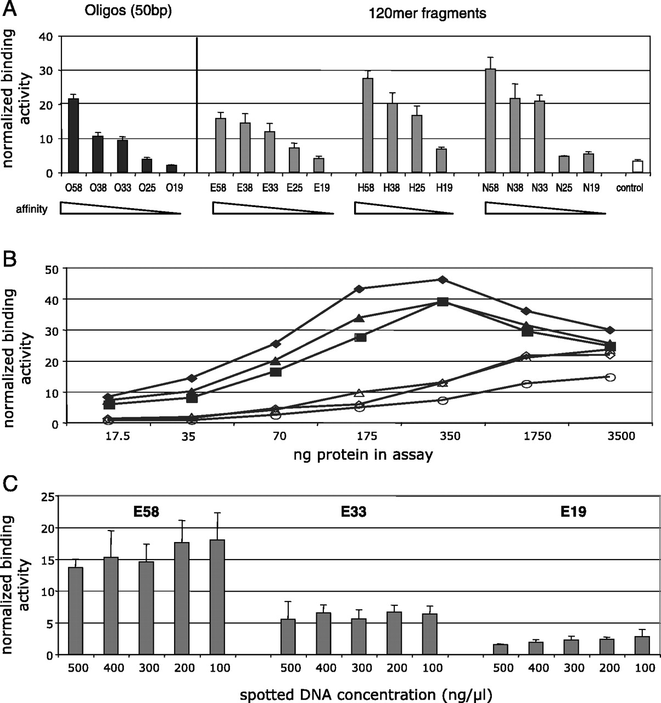
Figure 2 AP-2 binding to double-stranded DNA microarray probes. ( A ) AP-2 DNA-binding specificity. Microarrays were ...
Notes:
Figure 2 AP-2 binding to double-stranded DNA microarray probes. ( A ) AP-2 DNA-binding specificity. Microarrays were spotted with probes in the form of 50 bp oligonucleotides (O58–O19, black columns) or of 120 bp PCR products (grey columns) generated as described in the legend to Figure 1 . Binding sites are located either in central (EcoRV site, E58–E19) or in terminal (HincII, H58–H19 and NotI, N58–N19) position on the 120 bp probes. Probe numbers indicate the profile score of the binding sites computed as in Figure 1 . Microarrays were incubated with purified GST-AP-2 fusion and bound proteins were detected with Cy3-labeled polyclonal antisera as described in Materials and methods. Binding activities determined from the Cy3 fluorescence were normalized to the Cy5 signal corresponding to the spotted DNA. The white column indicates background binding to a control PCR fragment into which no AP-2 site has been inserted. Values depict the average and SD of three data points. ( B ) Protein dose–response curves. Normalized binding activities were determined as above using the indicated amounts in nanograms of GST-AP-2 protein. High-affinity sequences (matrix values >33) are given as closed symbols (diamonds N58, triangles N38, squares N33), and low-affinity sequences (matrix values <25) are shown as open symbols (triangles N25, diamonds N19, circles control). ( C ) Binding activity as a function of DNA-spotting concentration. DNA probes containing high- (E58), intermediate- (E33) or low-affinity (E19) sites were spotted in various concentrations as in Figure 1D and incubated with 70 ng of purified GST-AP-2. The average and SD of three data points of normalized binding activities are displayed as for (A).
Unless provided in the caption above, the following copyright applies to the content of this slide: © The Author 2005. Published by Oxford University Press. All rights reserved The online version of this article has been published under an open access model. Users are entitled to use, reproduce, disseminate, or display the open access version of this article for non-commercial purposes provided that: the original authorship is properly and fully attributed; the Journal and Oxford University Press are attributed as the original place of publication with the correct citation details given; if an article is subsequently reproduced or disseminated not in its entirety but only in part or as a derivative work this must be clearly indicated. For commercial re-use, please contact journals.permissions@oupjournals.org

Slide 4
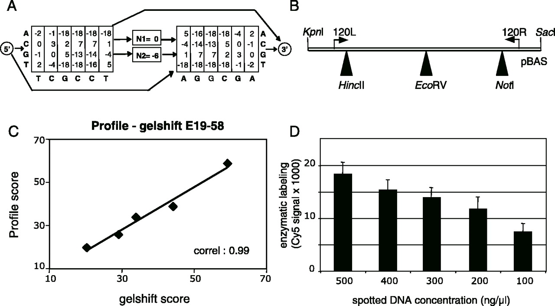
Figure 1 Bioinformatics prediction profile and microarray standardization tools for AP-2 binding studies. ( A ) ...
Notes:
Figure 1 Bioinformatics prediction profile and microarray standardization tools for AP-2 binding studies. ( A ) Architecture of the AP-2 profile. The model was constructed from in vitro DNA binding sequences ( 13 ), as described in Materials and methods. It is composed of two palindromic half-sites, each containing 6 nt positions, with allowed spacing between the half-sites of 1 or 2 bp. The position-specific weights associated with the four possible nucleotides and with the two possible spacings are indicated within boxes. The resulting consensus sequence is given below. Arrows indicate alternative paths corresponding to different binding modes. The score of a potential binding site is computed as the sum of the corresponding weights. ( B ) Construction of microarray DNA probes. Double-stranded oligonucleotides coding for potential AP-2 binding sequences of various predicted affinities, with profile score of 19, 25, 33, 38 or 58, were cloned into the constant backbone of pBAS using restriction sites HincII, EcoRV or NotI (black triangles). PCR amplification with primers 120L and 120R (arrows) produced 120 bp products that were used to spot microarrays. ( C ) Correlation of computer-predicted binding scores with experimental binding values. Affinity scores computed from the AP-2 profile shown in part (A) were plotted against experimental gel shift binding values expressed as gel shift scores (see Materials and methods). The correlation coefficient of the profile score and gel shift binding values is 0.99. ( D ) Enzymatic quantification of microarray-spotted DNA. DNA solutions of indicated concentrations were spotted onto a microarray surface, immobilized DNA probes were subjected to enzymatic Cy5 labeling and fluorescence was scanned. Background fluorescence was subtracted from all values, which represent the average fluorescence and SD from four experiments.
Unless provided in the caption above, the following copyright applies to the content of this slide: © The Author 2005. Published by Oxford University Press. All rights reserved The online version of this article has been published under an open access model. Users are entitled to use, reproduce, disseminate, or display the open access version of this article for non-commercial purposes provided that: the original authorship is properly and fully attributed; the Journal and Oxford University Press are attributed as the original place of publication with the correct citation details given; if an article is subsequently reproduced or disseminated not in its entirety but only in part or as a derivative work this must be clearly indicated. For commercial re-use, please contact journals.permissions@oupjournals.org

