Slide 1
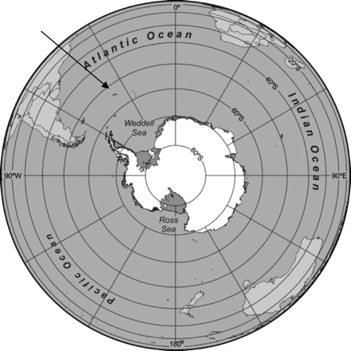
Figure 1. Polar projection of the Southern Ocean showing the location of South Georgia (arrow).
Notes:
Figure 1. Polar projection of the Southern Ocean showing the location of South Georgia (arrow).
Unless provided in the caption above, the following copyright applies to the content of this slide: © 2010 International Council for the Exploration of the Sea. Published by Oxford Journals. All rights reserved. For Permissions, please email: journals.permissions@oxfordjournals.org

Slide 2
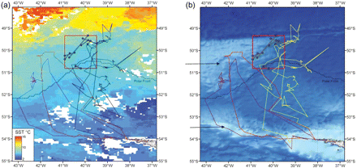
Figure 2. (a) False colour sea surface temperature image of the Antarctic Polar Frontal Zone at the time of the ...
Notes:
Figure 2. (a) False colour sea surface temperature image of the Antarctic Polar Frontal Zone at the time of the sampling programme [Physical Oceanography DAAC; AVHRR Oceans Pathfinder Global Equal-angle Best SST (NOAA/NASA); NASA JPL Physical Oceanography DAAC, Pasadena, CA, February 1996). (b) False colour bathymetric image of the same area (IOC, IHO, and BODC, 2003; Centenary Edition of the GEBCO Digital Atlas, published on CD-ROM on behalf of the Intergovernmental Oceanographic Commission and the International Hydrographic Organization as part of the General Bathymetric Chart of the Oceans; British Oceanographic Data Centre, Liverpool). South Georgia is located in the southeast corner of the images, and Bird Island lies off the western tip. Overlaid are the tracks of three satellite-tagged grey-headed albatrosses, a box showing tracks of pelagic midwater trawl hauls, and the mean position of the Antarctic Polar Front (from Moore et al., 1997; Trathan et al., 1997). In (b), the arrows show the Maurice Ewing Bank to the north and the North Scotia Arc to the south.
Unless provided in the caption above, the following copyright applies to the content of this slide: © 2010 International Council for the Exploration of the Sea. Published by Oxford Journals. All rights reserved. For Permissions, please email: journals.permissions@oxfordjournals.org

