Slide 1
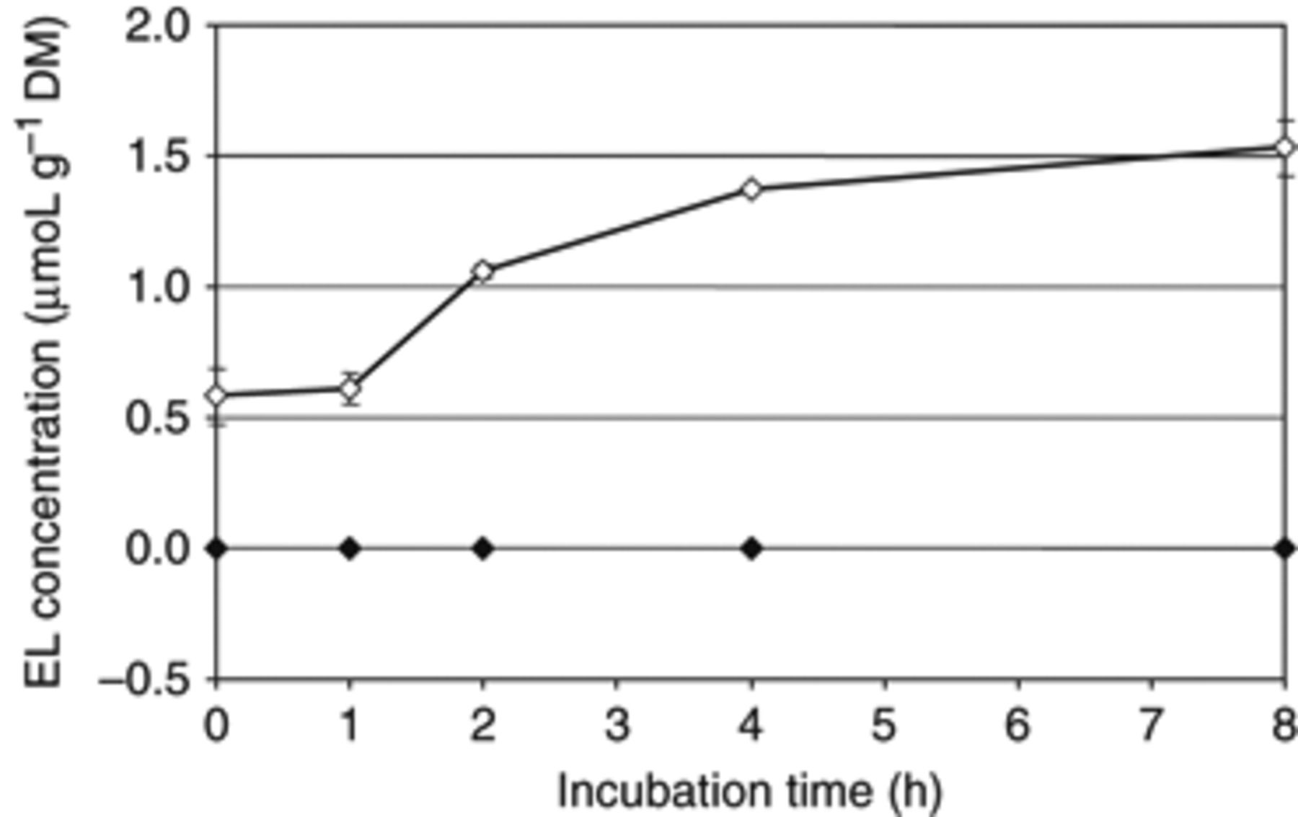
1 Formation of unconjugated EL by pooled caecal contents of rats associated with lignan-activating bacteria (◊) ...
Notes:
1 Formation of unconjugated EL by pooled caecal contents of rats associated with lignan-activating bacteria (◊) and of germ-free rats (◆) under anaerobic conditions (N2/CO2/H2, 80/10/10, v/v/v) at 37°C. Values are means ± SD, n=2. DM, dry matter.
Unless provided in the caption above, the following copyright applies to the content of this slide: © 2010 Federation of European Microbiological Societies

