Slide 1
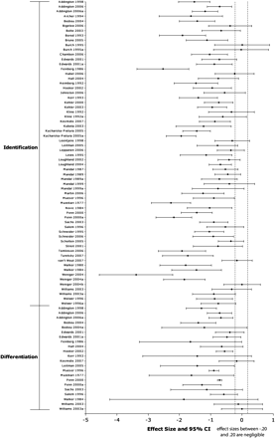
Fig. 1. Individual Effect Sizes (Cohen d and 95% CIs) for Emotion Perception Studies.
Notes:
Fig. 1. Individual Effect Sizes (Cohen d and 95% CIs) for Emotion Perception Studies.
Unless provided in the caption above, the following copyright applies to the content of this slide: © The Author 2009. Published by Oxford University Press on behalf of the Maryland Psychiatric Research Center. All rights reserved. For permissions, please email: journals.permissions@oxfordjournals.org.

Slide 2
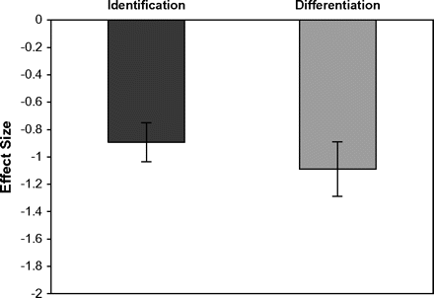
Fig. 2. Effect Sizes (Cohen d and 95% CI) for Facial Emotion Identification and Differentiation Deficits.
Notes:
Fig. 2. Effect Sizes (Cohen d and 95% CI) for Facial Emotion Identification and Differentiation Deficits.
Unless provided in the caption above, the following copyright applies to the content of this slide: © The Author 2009. Published by Oxford University Press on behalf of the Maryland Psychiatric Research Center. All rights reserved. For permissions, please email: journals.permissions@oxfordjournals.org.

Slide 3
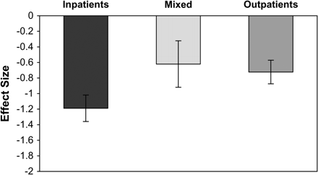
Fig. 3. Effect Sizes (Cohen d and 95% CI) for Facial Emotion Perception Deficits in Schizophrenia Patients by Study ...
Notes:
Fig. 3. Effect Sizes (Cohen d and 95% CI) for Facial Emotion Perception Deficits in Schizophrenia Patients by Study Setting (ie, Inpatients, Outpatients, and Mixed).
Unless provided in the caption above, the following copyright applies to the content of this slide: © The Author 2009. Published by Oxford University Press on behalf of the Maryland Psychiatric Research Center. All rights reserved. For permissions, please email: journals.permissions@oxfordjournals.org.

Slide 4
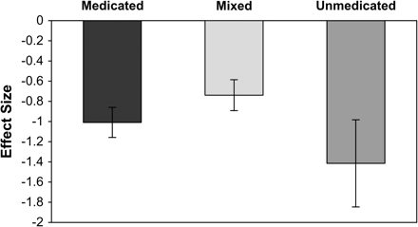
Fig. 4. Effect Sizes (Cohen d and 95% CI) for Facial Emotion Perception Deficits in Schizophrenia Patients by ...
Notes:
Fig. 4. Effect Sizes (Cohen d and 95% CI) for Facial Emotion Perception Deficits in Schizophrenia Patients by Medication Status (ie, Medicated, Unmedicated, and Mixed).
Unless provided in the caption above, the following copyright applies to the content of this slide: © The Author 2009. Published by Oxford University Press on behalf of the Maryland Psychiatric Research Center. All rights reserved. For permissions, please email: journals.permissions@oxfordjournals.org.

Slide 5
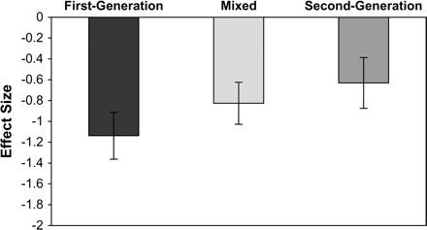
Fig. 5. Effect Sizes (Cohen d and 95% CI) for Facial Emotion Perception Deficits in Schizophrenia Patients by Type of ...
Notes:
Fig. 5. Effect Sizes (Cohen d and 95% CI) for Facial Emotion Perception Deficits in Schizophrenia Patients by Type of Antipsychotic Medication (ie, First Generation, Second Generation, and Mixed).
Unless provided in the caption above, the following copyright applies to the content of this slide: © The Author 2009. Published by Oxford University Press on behalf of the Maryland Psychiatric Research Center. All rights reserved. For permissions, please email: journals.permissions@oxfordjournals.org.

