Slide 1
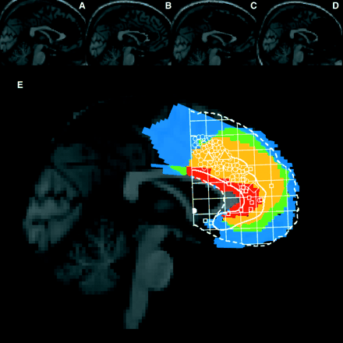
Fig. 1 Sagittal views of the standard Montreal Neurological Institute (MNI) brain showing the location of the lesion ...
Notes:
Fig. 1 Sagittal views of the standard Montreal Neurological Institute (MNI) brain showing the location of the lesion in each dACC subject. Two subjects (A and B) had focal damage primarily confined to the left dACC. One (C) had more extensive injury to the left cingulate and supplementary motor area, with involvement of the corpus callosum. The fourth subject (D) had suffered bilateral anterior cerebral artery infarction, with extensive damage to medial frontal structures, including medial orbitofrontal cortex, ventral dACC and fronto-polar areas bilaterally. This subject was included because she appears to have extensive damage to the dACC bilaterally. We reasoned that while any impairment this subject manifested could not necessarily be attributed to dACC damage, intact performance would be strong evidence that the dACC was not necessary for the cognitive processes being examined. An overlap view of the lesions of all four subjects is shown beneath (E): blue indicates areas damaged in a single subject, green in two, orange three and red all four subjects. A sketch of the areas activated in a variety of functional neuroimaging experiments using a variety of attention-demanding tasks, as summarized in the meta-analysis of Bush et al. (2000), is overlaid for comparison. Circles indicate activations in cognitive tasks, squares activations in tasks with emotional content.
Unless provided in the caption above, the following copyright applies to the content of this slide: © The Author (2005). Published by Oxford University Press on behalf of the Guarantors of Brain. All rights reserved. For Permissions, please email: journals.permissions@oupjournals.org

Slide 2
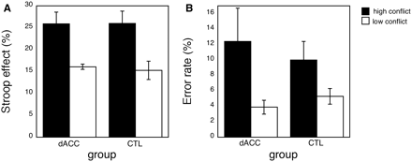
Fig. 2 Modulation of the Stroop effect (expressed as mean percentage change from congruent trial RT; A) and go–no go ...
Notes:
Fig. 2 Modulation of the Stroop effect (expressed as mean percentage change from congruent trial RT; A) and go–no go error rate (expressed as mean percentage of no go trials; B) as a function of conflict level. Subjects with dACC lesions modulated performance to the same degree as controls in response to changes in the frequency of incongruent trials in both tasks. Error bars show the SEM.
Unless provided in the caption above, the following copyright applies to the content of this slide: © The Author (2005). Published by Oxford University Press on behalf of the Guarantors of Brain. All rights reserved. For Permissions, please email: journals.permissions@oupjournals.org

Slide 3
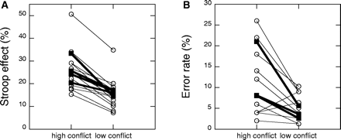
Fig. 3 Modulation of performance by level of conflict in individual subjects. (A) The effect of changing conflict ...
Notes:
Fig. 3 Modulation of performance by level of conflict in individual subjects. (A) The effect of changing conflict level on the Stroop effect (expressed as percentage change from congruent trial RT). (B) The effect on error rates (expressed as a percentage of no go trials) in the go–no go task. Control values are represented by the open circles and thin lines. The dACC subjects are shown by filled squares and thick lines.
Unless provided in the caption above, the following copyright applies to the content of this slide: © The Author (2005). Published by Oxford University Press on behalf of the Guarantors of Brain. All rights reserved. For Permissions, please email: journals.permissions@oupjournals.org

