Slide 1
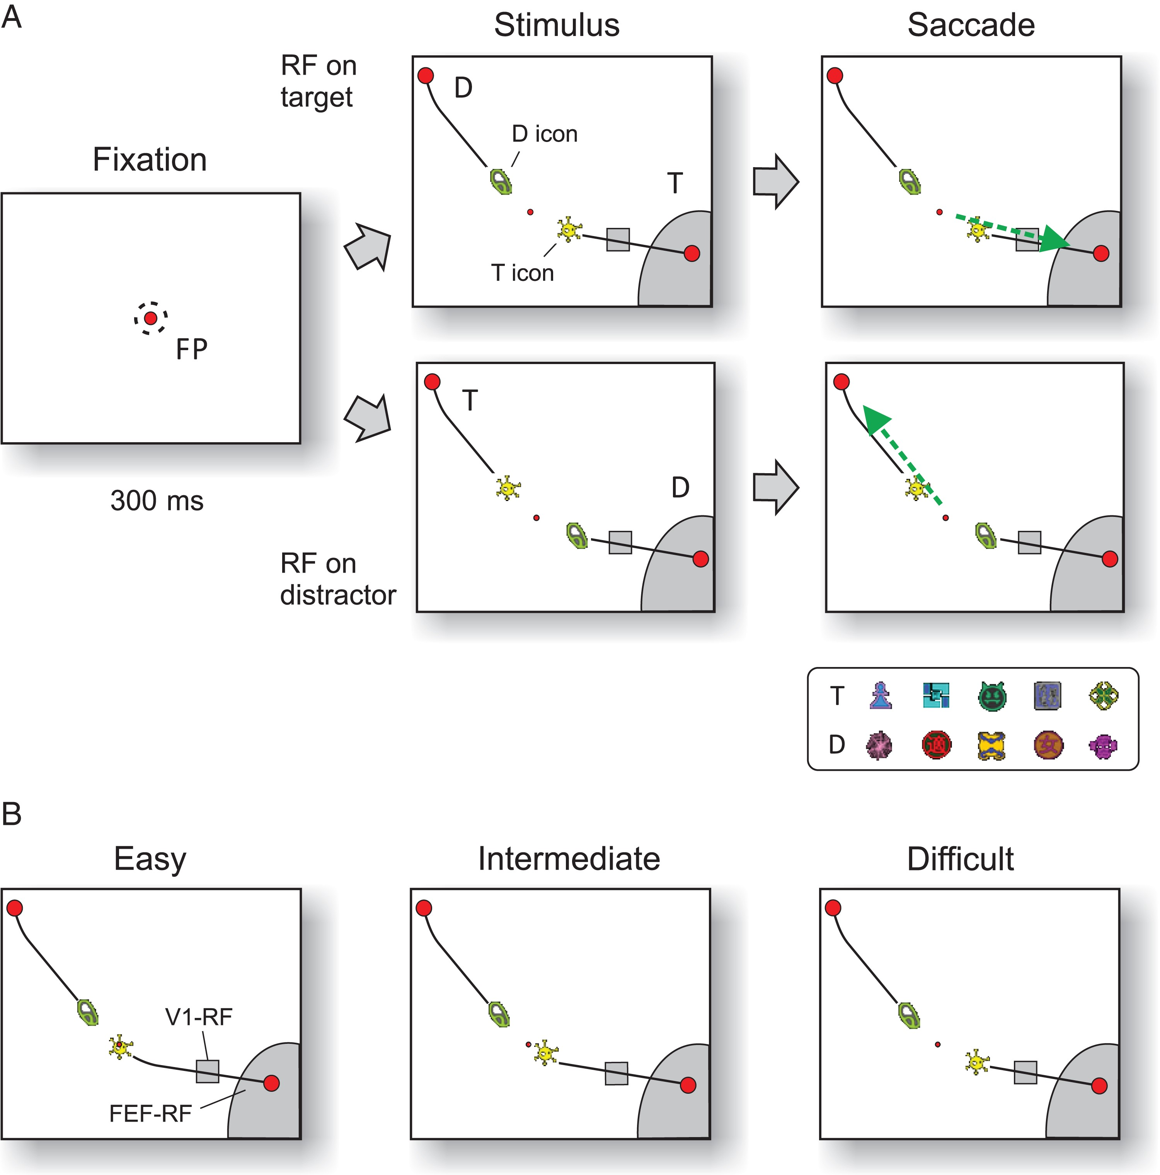
Figure 1. Icon-selection task. (A) After the monkey fixated a central fixation point for 300 ms, 2 icons appeared that ...
Notes:
Figure 1. Icon-selection task. (A) After the monkey fixated a central fixation point for 300 ms, 2 icons appeared that were connected by curves (black lines) to 2 red disks. The monkey had to make a saccade (green arrow) to the target disk (T) that was connected to the target icon (yellow icon). The other icon, curve, and disk were distractors (D). The lower panel shows examples of target and distractor icons used in different sessions. (B) For easy and intermediate stimuli, the target icon was on top of or closer to the fixation point than the distractor icon. In the difficult condition, the distance between the icons and the fixation point was identical so that the monkeys could only rely on icon identity to make a correct choice. RF, receptive field; FP, fixation point.
Unless provided in the caption above, the following copyright applies to the content of this slide: © The Author 2016. Published by Oxford University Press.This is an Open Access article distributed under the terms of the Creative Commons Attribution Non-Commercial License (http://creativecommons.org/licenses/by-nc/4.0/), which permits non-commercial re-use, distribution, and reproduction in any medium, provided the original work is properly cited. For commercial re-use, please contact journals.permissions@oup.com

Slide 2
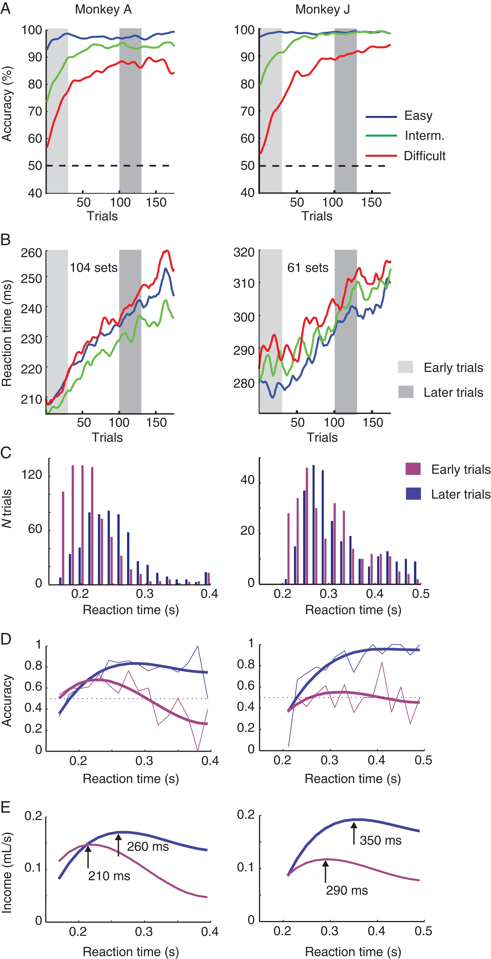
Figure 2. Behavioral performance and reward income in the reaction time task. (A) Accuracy during learning, averaged ...
Notes:
Figure 2. Behavioral performance and reward income in the reaction time task. (A) Accuracy during learning, averaged across sessions. Performance improved in the intermediate (green) and the difficult condition (red), and was always near 100% in the easy condition (blue). (B) Average reaction time, which increased during the sessions. (C) Reaction time distributions in early and late trials for the difficult condition. (D) Accuracy as function of reaction time for early (purple) and late (blue) trials, with a spline fit of the data (smooth thick line). After learning, accuracy increases with reaction time. (E) Reward income (mL juice per second) as a function of reaction time, computed with the following equation: Reward income (RT) = Accuracy (RT) × 0.2 mL/(waiting time + RT). Arrows indicate reaction times that maximize reward income in early and late trials.
Unless provided in the caption above, the following copyright applies to the content of this slide: © The Author 2016. Published by Oxford University Press.This is an Open Access article distributed under the terms of the Creative Commons Attribution Non-Commercial License (http://creativecommons.org/licenses/by-nc/4.0/), which permits non-commercial re-use, distribution, and reproduction in any medium, provided the original work is properly cited. For commercial re-use, please contact journals.permissions@oup.com

Slide 3
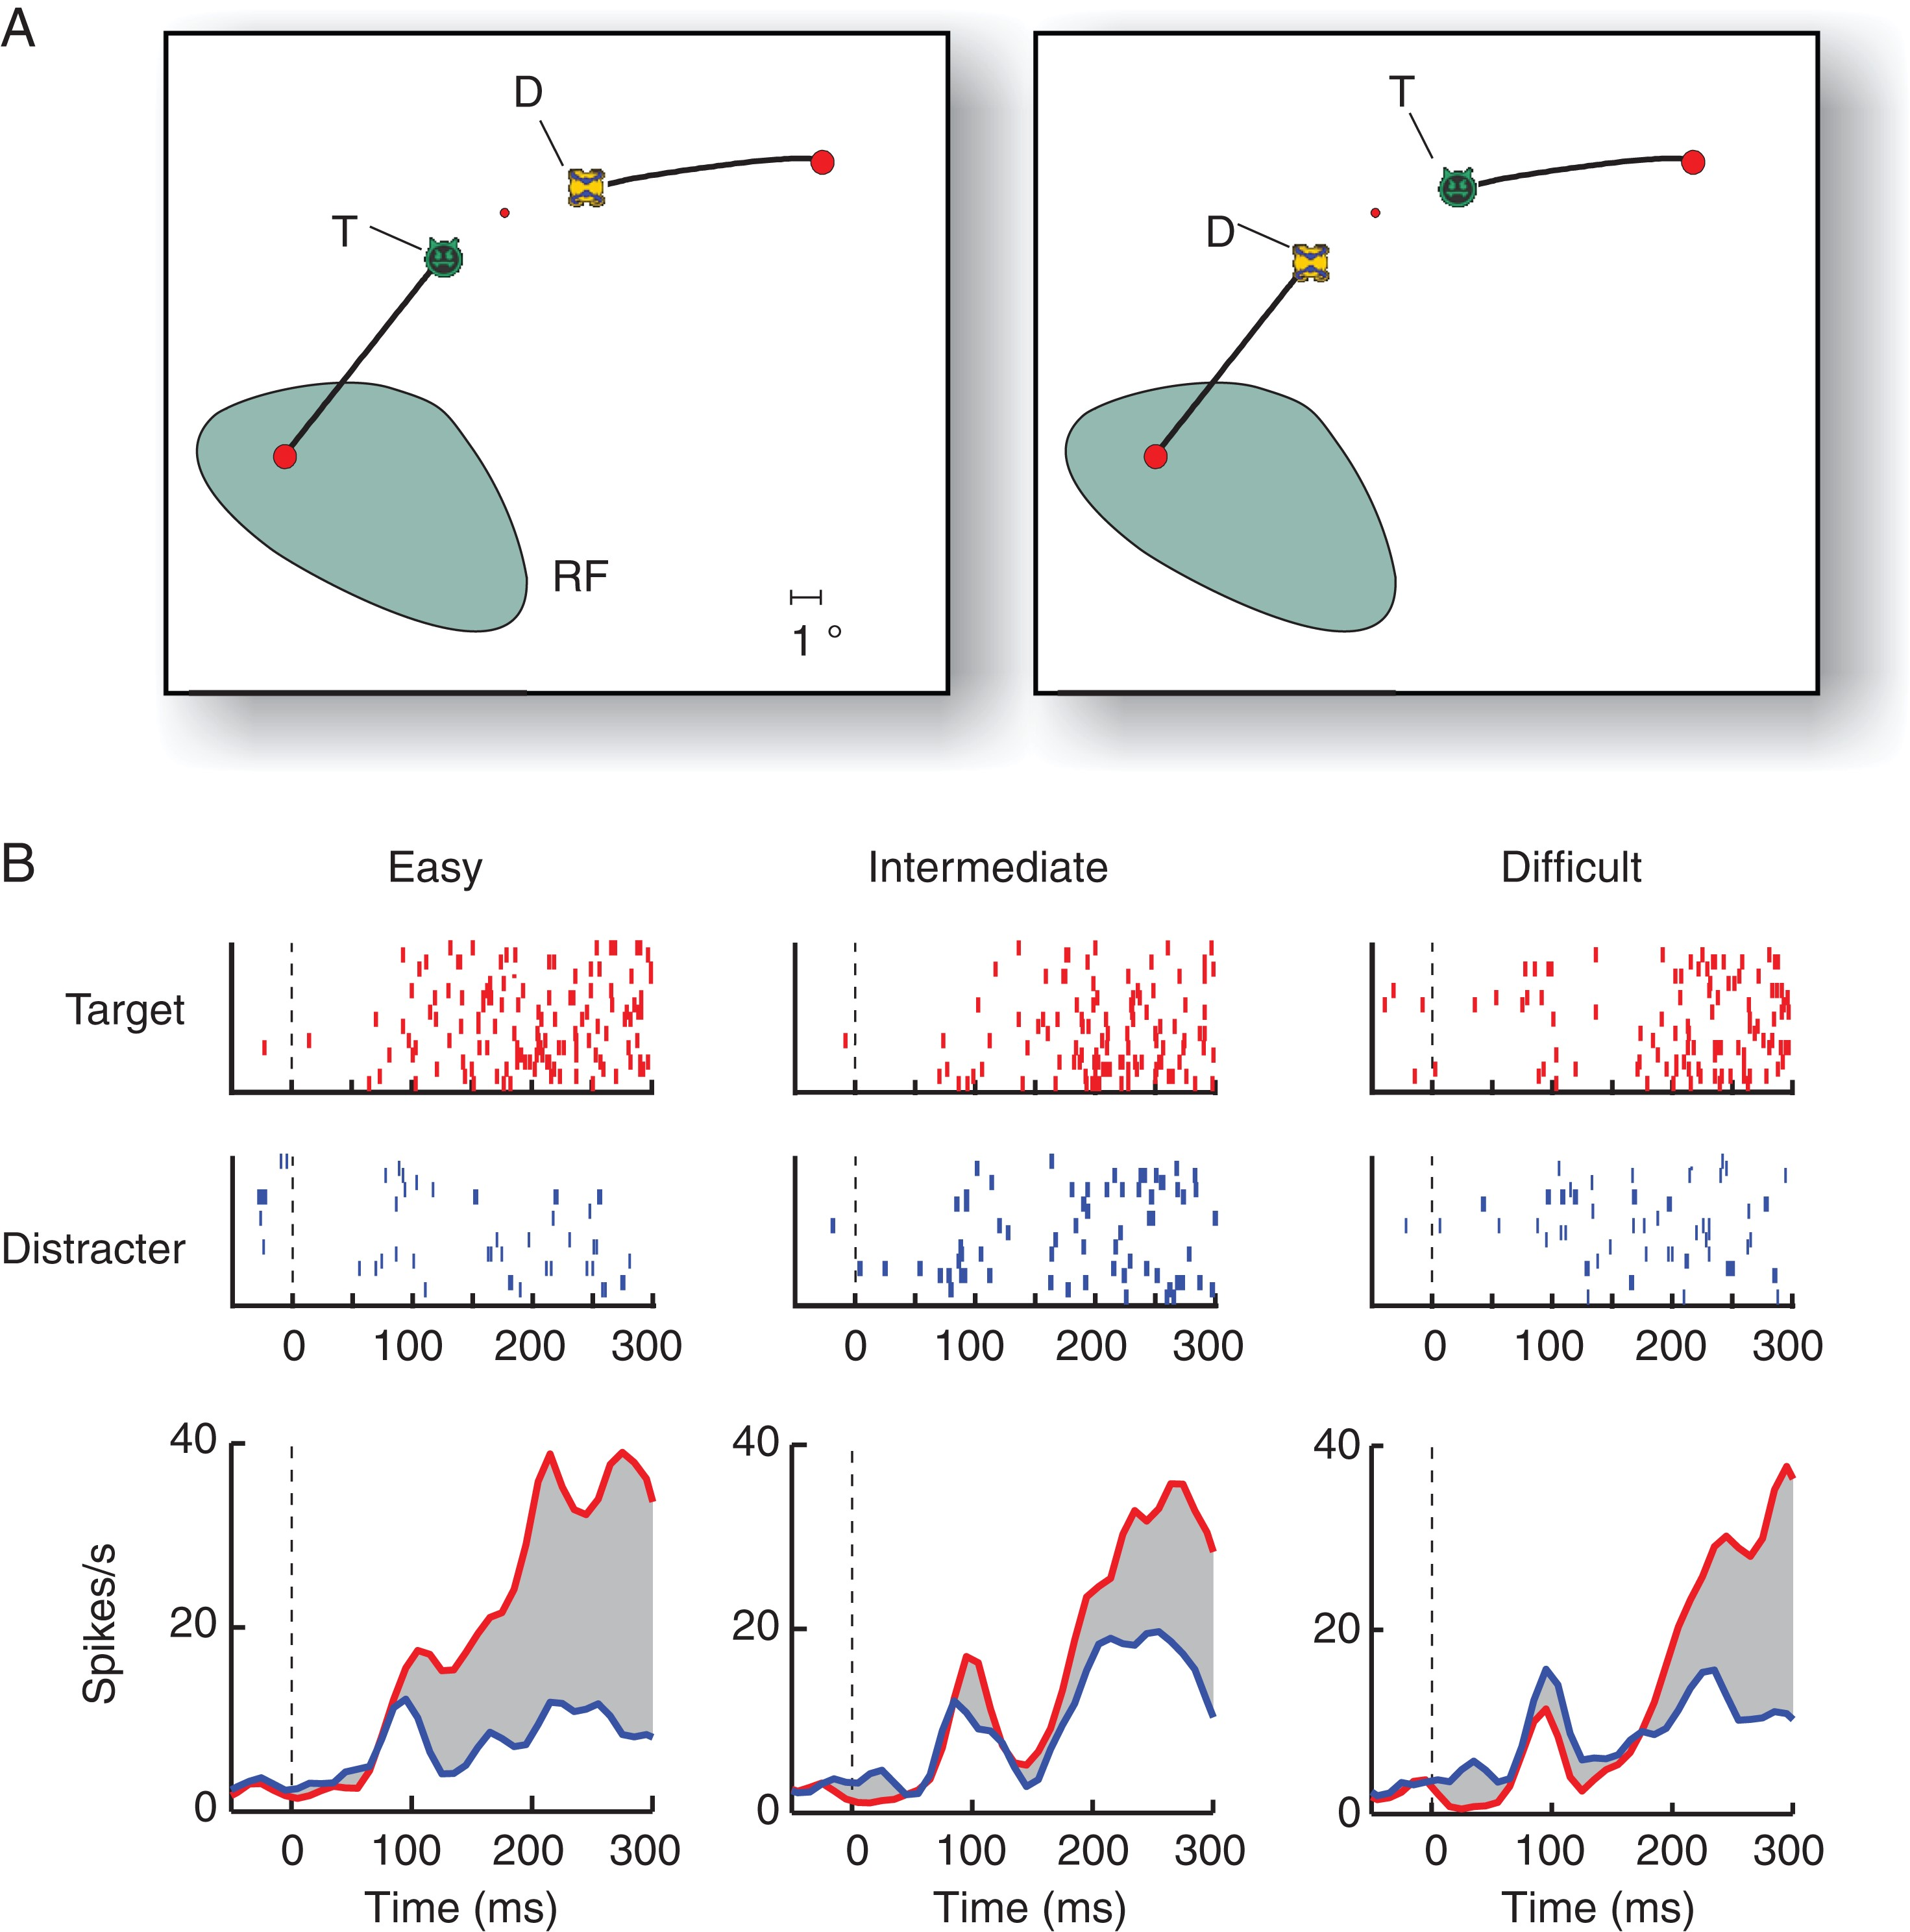
Figure 3. Example FEF neuron in the icon-learning task. (A) Stimuli of the difficult condition. The RF is shown in ...
Notes:
Figure 3. Example FEF neuron in the icon-learning task. (A) Stimuli of the difficult condition. The RF is shown in green. (B) The upper panels show raster plots (ticks are spikes in successive trials in the same condition) in the easy, intermediate, and difficult condition with the target (red) or distractor disk (blue) in the RF. The lower panels show the average responses of this neuron. The gray region illustrates the selection signal, defined as the difference in activity elicited by the target and distractor.
Unless provided in the caption above, the following copyright applies to the content of this slide: © The Author 2016. Published by Oxford University Press.This is an Open Access article distributed under the terms of the Creative Commons Attribution Non-Commercial License (http://creativecommons.org/licenses/by-nc/4.0/), which permits non-commercial re-use, distribution, and reproduction in any medium, provided the original work is properly cited. For commercial re-use, please contact journals.permissions@oup.com

Slide 4
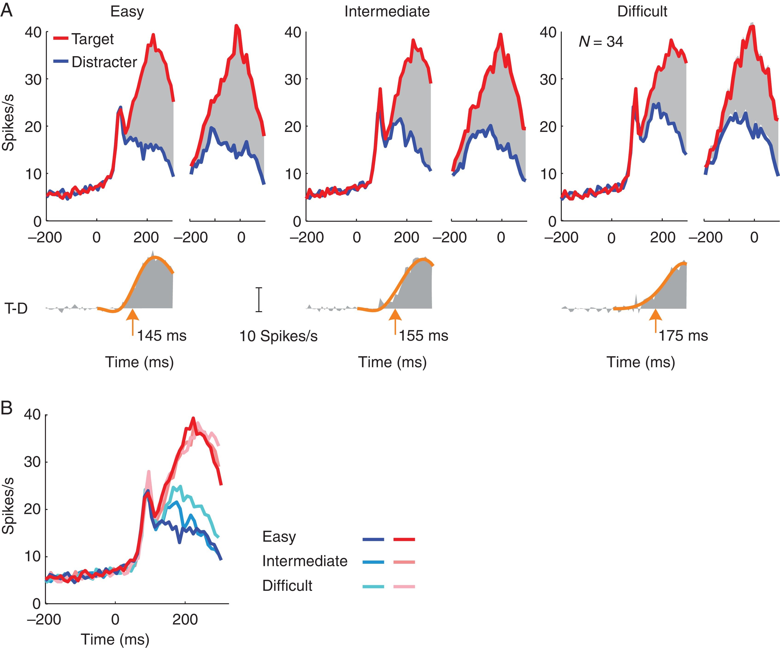
Figure 4. Population activity in FEF in correct trials of the easy, intermediate, and difficult conditions. (A) Average ...
Notes:
Figure 4. Population activity in FEF in correct trials of the easy, intermediate, and difficult conditions. (A) Average activity across all sessions and both monkeys, elicited by the target (T, red) and distractor (D, blue) and aligned on stimulus onset (left) or saccade (right). Lower insets depict the selection signal (T-D) aligned on stimulus onset. The latency of target discrimination was measured as the time point where a piecewise cubic spline fit (orange curve) reached 33% of its maximum. (B) Direct comparison of activity elicited by the target and distractor at different difficulty levels.
Unless provided in the caption above, the following copyright applies to the content of this slide: © The Author 2016. Published by Oxford University Press.This is an Open Access article distributed under the terms of the Creative Commons Attribution Non-Commercial License (http://creativecommons.org/licenses/by-nc/4.0/), which permits non-commercial re-use, distribution, and reproduction in any medium, provided the original work is properly cited. For commercial re-use, please contact journals.permissions@oup.com

Slide 5
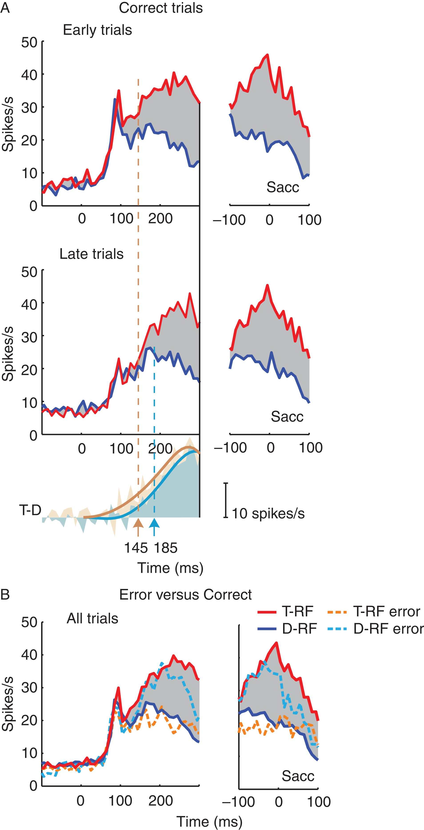
Figure 5. Influence of learning and errors on neuronal activity in FEF. (A) Left panels show stimulus-aligned activity, ...
Notes:
Figure 5. Influence of learning and errors on neuronal activity in FEF. (A) Left panels show stimulus-aligned activity, right panels saccade-aligned activity in early and late trials. The panel below shows the time course of the selection signal (T-D) in the early (orange) and later trials (light blue) aligned on stimulus onset and a curve that was fitted to determine the latency. (B) Comparison of activity in correct (continuous curves) and error trials (dashed) elicited by the target (red) and distractor (blue). The number of error trials decreased with learning so that we could not compare activity between early and late error trials.
Unless provided in the caption above, the following copyright applies to the content of this slide: © The Author 2016. Published by Oxford University Press.This is an Open Access article distributed under the terms of the Creative Commons Attribution Non-Commercial License (http://creativecommons.org/licenses/by-nc/4.0/), which permits non-commercial re-use, distribution, and reproduction in any medium, provided the original work is properly cited. For commercial re-use, please contact journals.permissions@oup.com

Slide 6
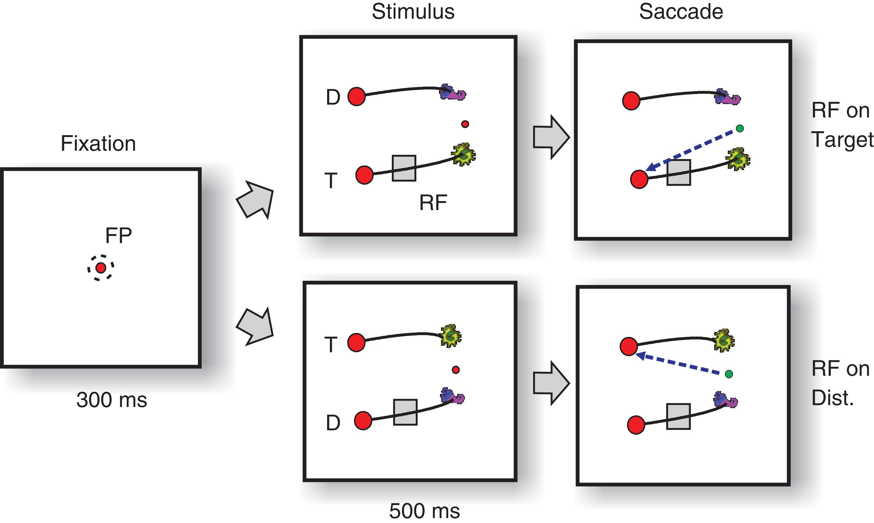
Figure 6. Delayed version of the icon-selection task. The monkeys directed their gaze to a central fixation point (FP) ...
Notes:
Figure 6. Delayed version of the icon-selection task. The monkeys directed their gaze to a central fixation point (FP) for 300 ms and then the stimulus appeared. Either the target (T) or the distractor curve (D) fell in the RF of a group of neurons in area V1. After an additional delay of 500 ms, the color of the fixation changed, cueing the monkeys to indicate their choice by making a saccade to the disk connected to the target icon (green arrow).
Unless provided in the caption above, the following copyright applies to the content of this slide: © The Author 2016. Published by Oxford University Press.This is an Open Access article distributed under the terms of the Creative Commons Attribution Non-Commercial License (http://creativecommons.org/licenses/by-nc/4.0/), which permits non-commercial re-use, distribution, and reproduction in any medium, provided the original work is properly cited. For commercial re-use, please contact journals.permissions@oup.com

Slide 7
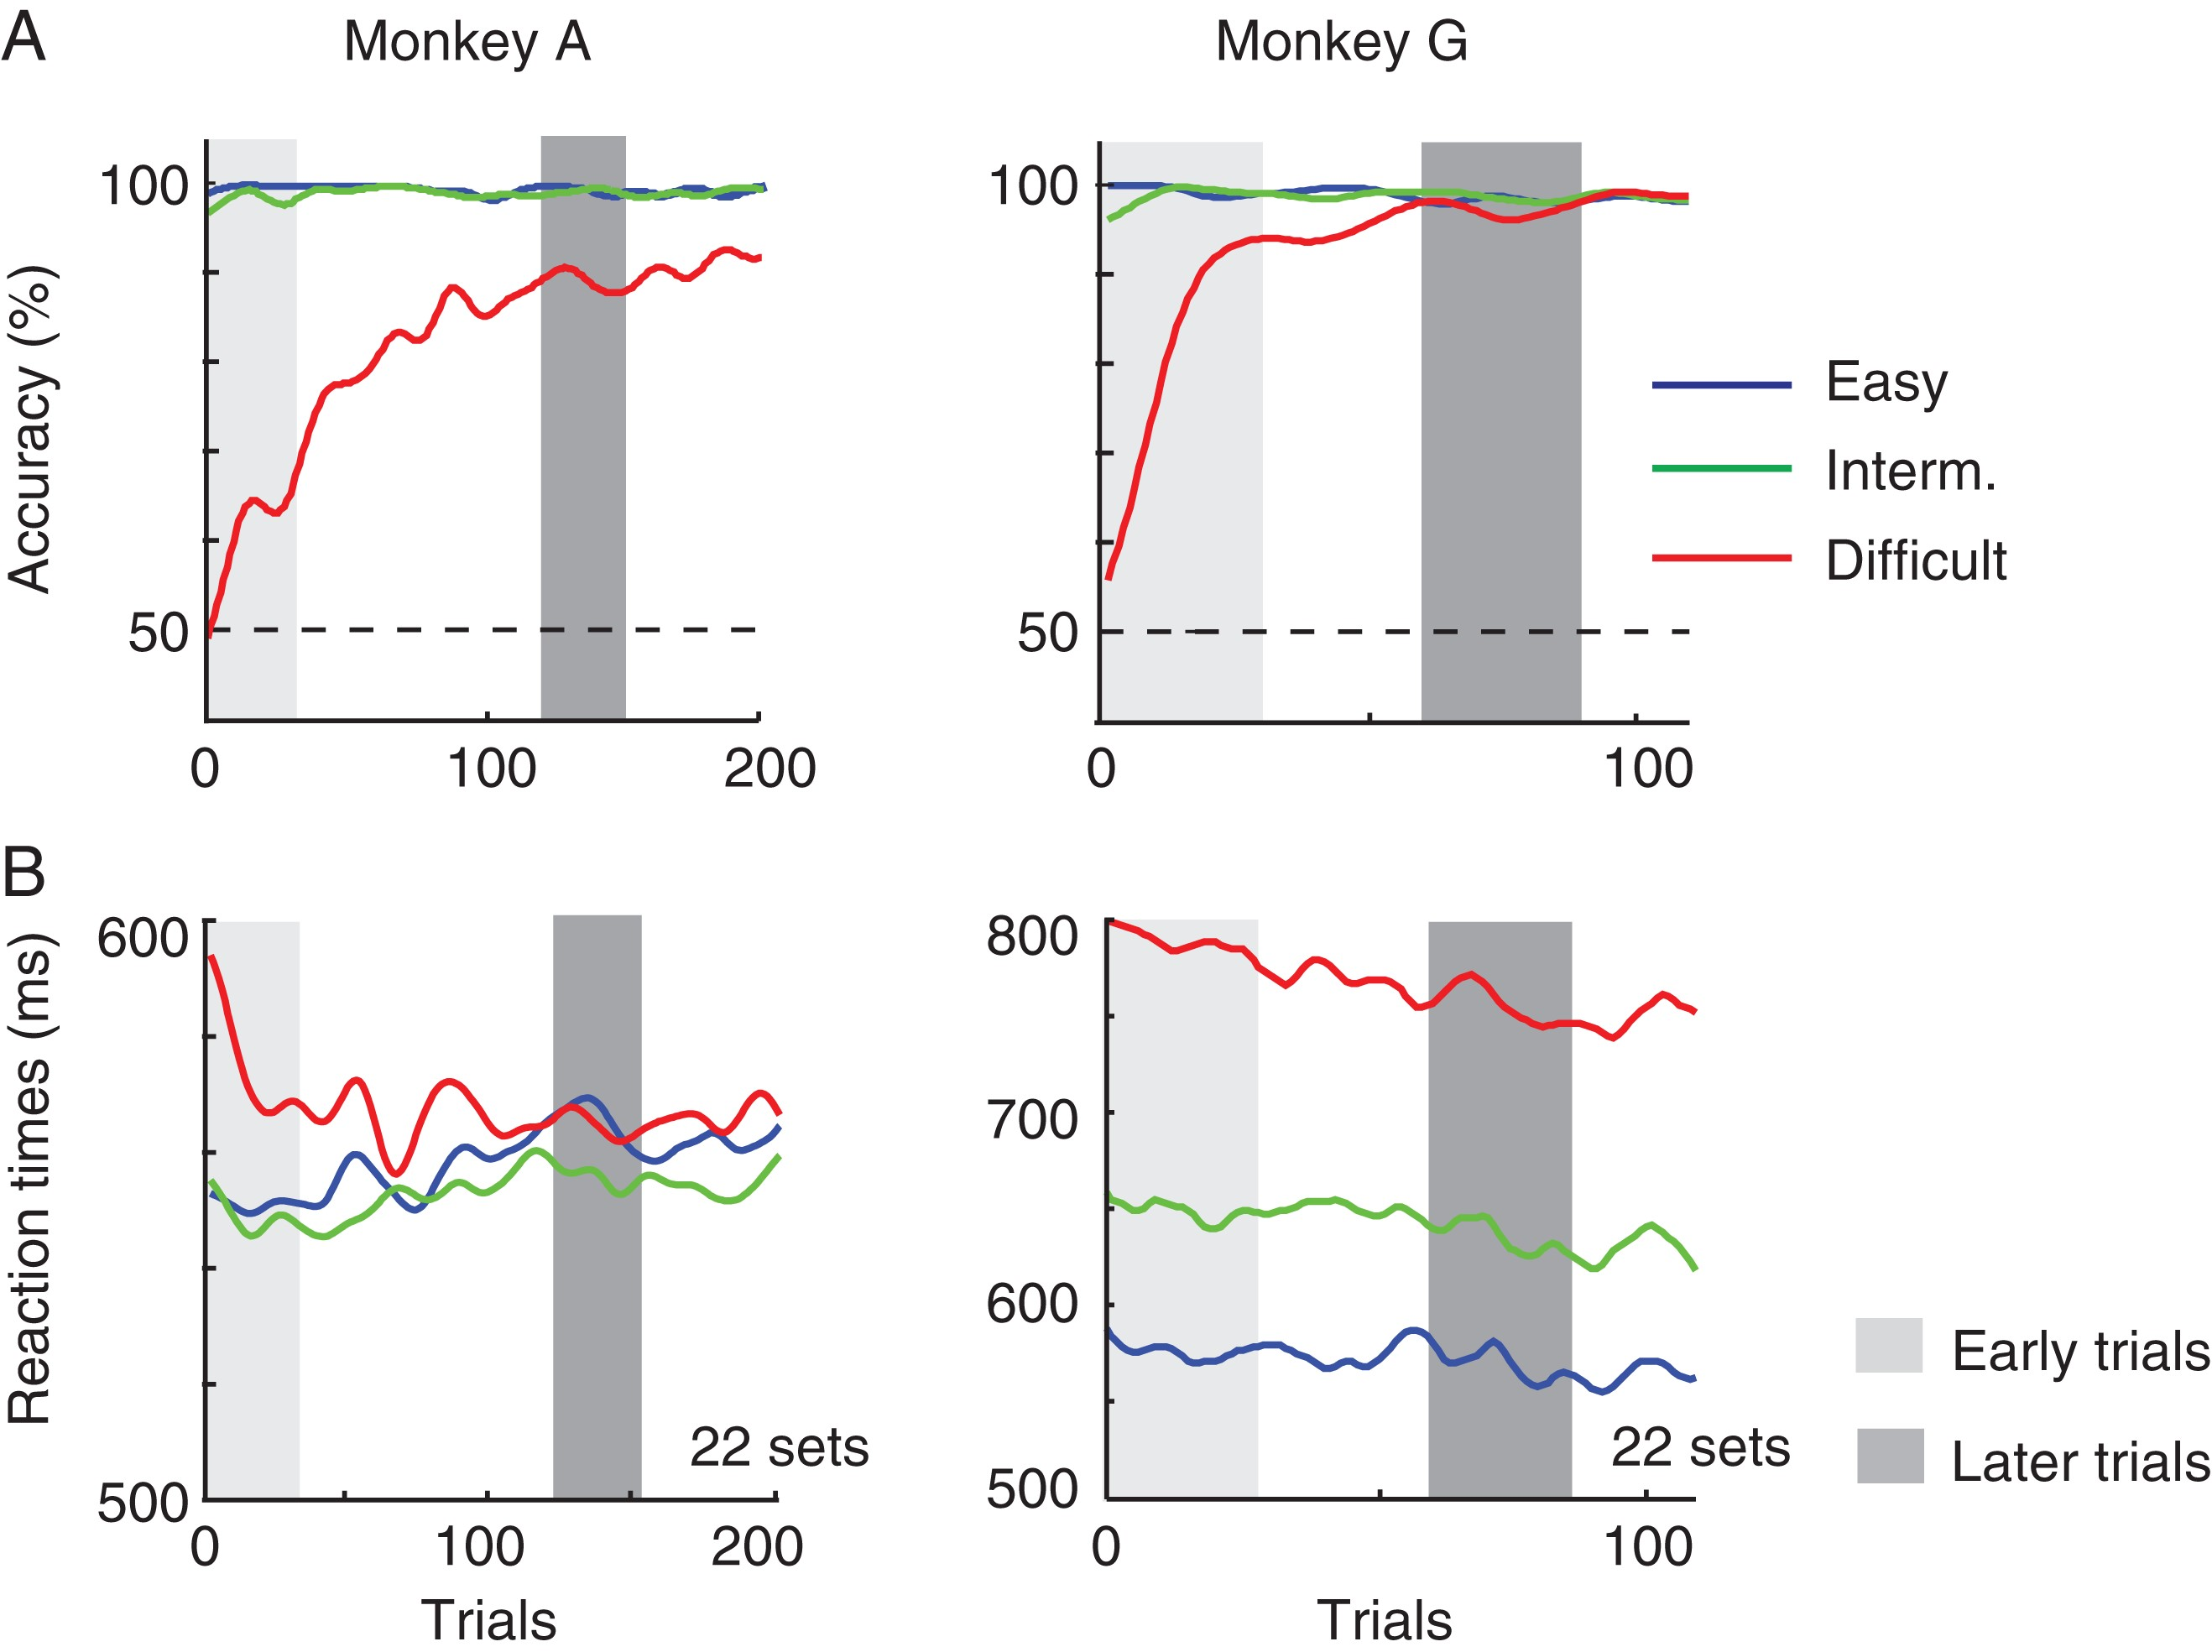
Figure 7. Behavioral performance in the delayed response task. (A) Accuracy as a function of trial number in the easy ...
Notes:
Figure 7. Behavioral performance in the delayed response task. (A) Accuracy as a function of trial number in the easy (blue), intermediate (green), and difficult condition (red). Gray bars illustrate bins of 30 trials (early: light gray and late: dark gray) that were selected for further analysis. (B) Reaction times in trials with the 3 difficulty levels.
Unless provided in the caption above, the following copyright applies to the content of this slide: © The Author 2016. Published by Oxford University Press.This is an Open Access article distributed under the terms of the Creative Commons Attribution Non-Commercial License (http://creativecommons.org/licenses/by-nc/4.0/), which permits non-commercial re-use, distribution, and reproduction in any medium, provided the original work is properly cited. For commercial re-use, please contact journals.permissions@oup.com

Slide 8
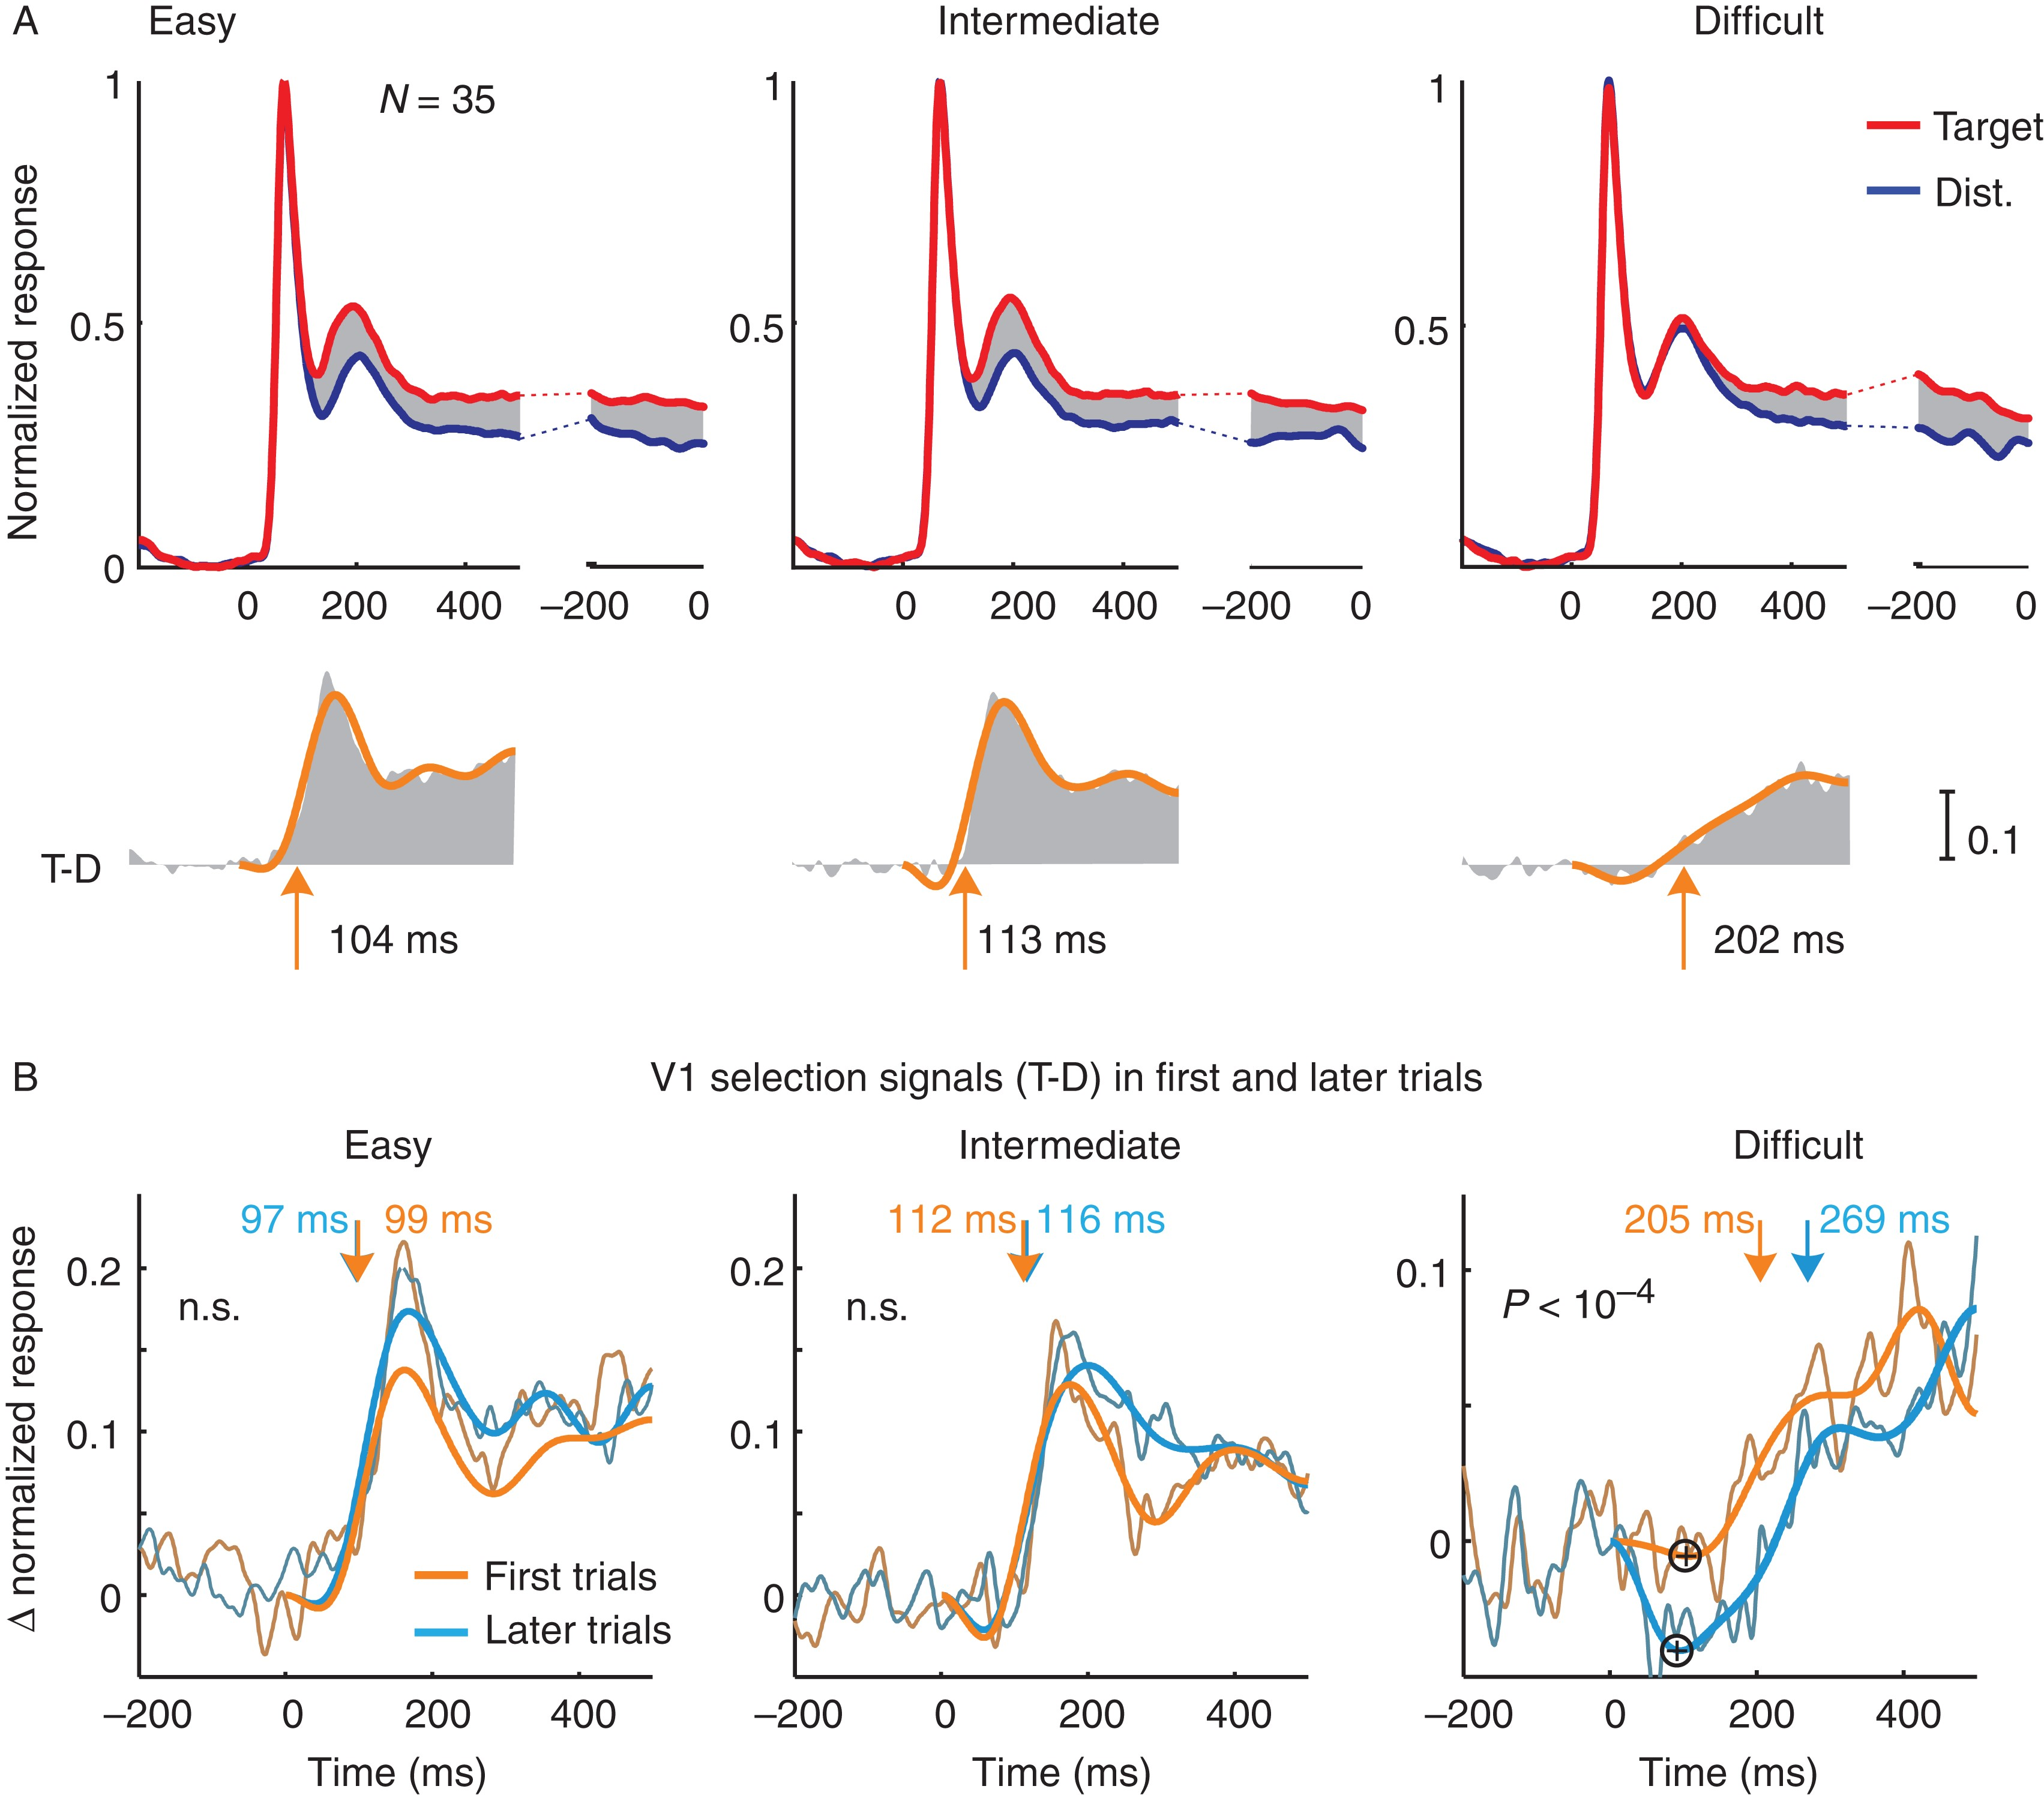
Figure 8. Neuronal activity in V1 in the icon-selection task. (A) Activity elicited by the target (red trace) and ...
Notes:
Figure 8. Neuronal activity in V1 in the icon-selection task. (A) Activity elicited by the target (red trace) and distractor curve (blue trace), averaged across all V1 recoding sites in the easy, intermediate, and difficult condition and over both monkeys, aligned on stimulus onset (left panels) and saccade (right). Lower insets show the selection signal and a curve that was fitted to determine latency. Arrows depict latency measured as the time point where the fitted function reached 33% of its maximum. (B) Selection signal (target minus distractor response) in the first (orange) trials and later (blue) trials of the easy, intermediate, and difficult condition. The influence of learning on the onset of the selection signal in the difficult condition was significant, but it was not significant in the easy and intermediate conditions (n.s.). Plus signs in the panel of the difficult condition mark the inversion of the selection signal, that is, when the target curve elicits weaker activity than the distractor.
Unless provided in the caption above, the following copyright applies to the content of this slide: © The Author 2016. Published by Oxford University Press.This is an Open Access article distributed under the terms of the Creative Commons Attribution Non-Commercial License (http://creativecommons.org/licenses/by-nc/4.0/), which permits non-commercial re-use, distribution, and reproduction in any medium, provided the original work is properly cited. For commercial re-use, please contact journals.permissions@oup.com

Slide 9
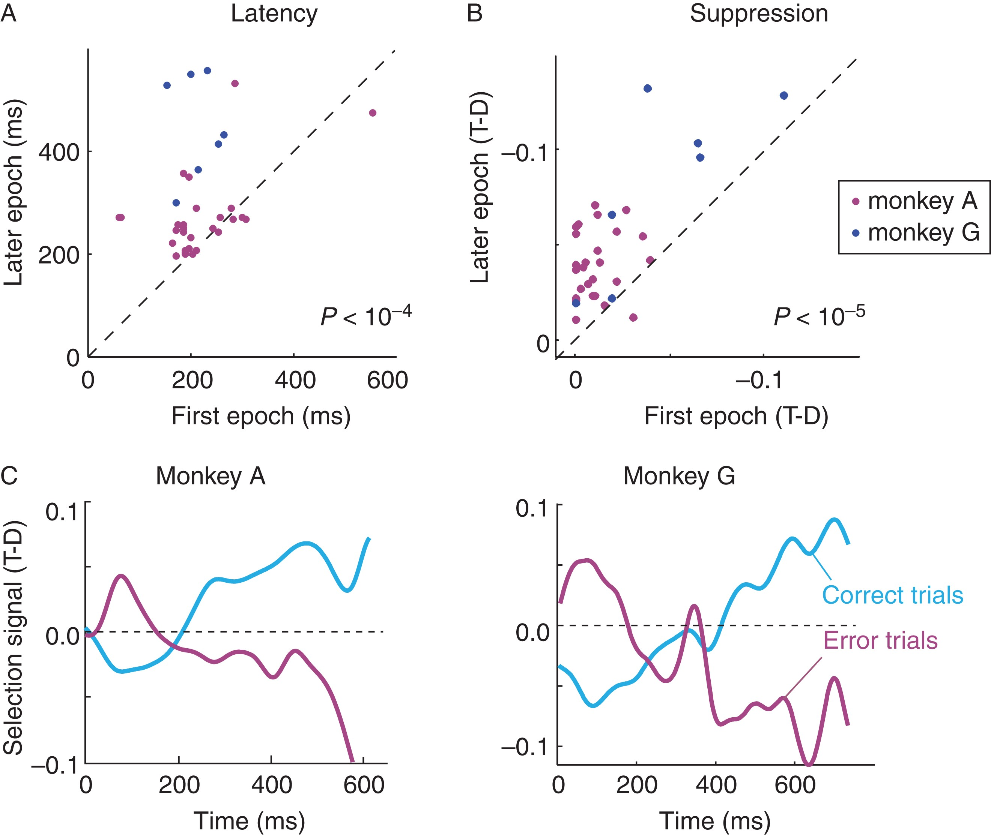
Figure 9. Influence of learning and errors on the V1 selection signal in the difficult condition. (A) Latency of the ...
Notes:
Figure 9. Influence of learning and errors on the V1 selection signal in the difficult condition. (A) Latency of the selection signal (onset of positive modulation) at individual V1 recording sites at the start of the sessions (x-axis) and at a later epoch when the monkeys' accuracy had increased (y-axis). Magenta, monkey A, Blue, monkey G. (B) Strength of suppression, quantified as the difference in activity elicited by the target and distractor curve (T-D, note the negative values on the axes, these values were normalized to the peak response; time window from 100 to 200 ms after stimulus onset) at the start of the session (x-axis) and in the later epoch (y-axis). (C) Time course of the selection signal in correct (light blue) and erroneous trials (magenta).
Unless provided in the caption above, the following copyright applies to the content of this slide: © The Author 2016. Published by Oxford University Press.This is an Open Access article distributed under the terms of the Creative Commons Attribution Non-Commercial License (http://creativecommons.org/licenses/by-nc/4.0/), which permits non-commercial re-use, distribution, and reproduction in any medium, provided the original work is properly cited. For commercial re-use, please contact journals.permissions@oup.com

Slide 10
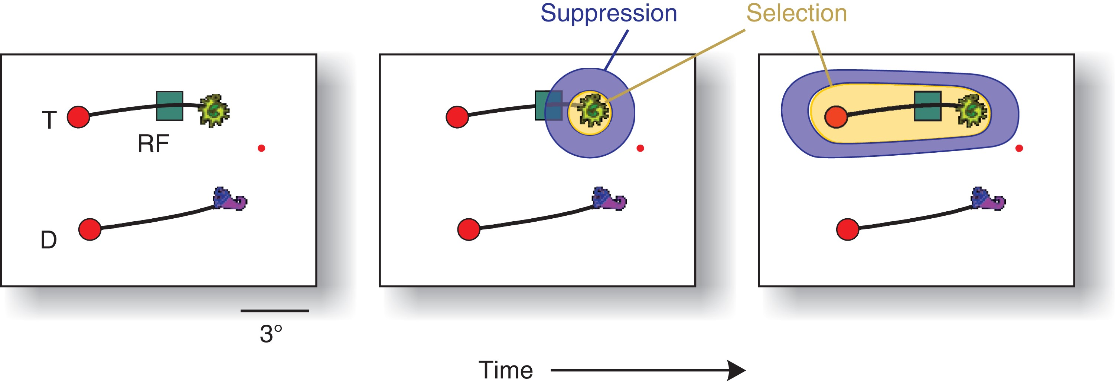
Figure 10. Hypothetical 2-step selection process that emerged during learning in the difficult condition. When the ...
Notes:
Figure 10. Hypothetical 2-step selection process that emerged during learning in the difficult condition. When the monkeys became proficient, the selection of the relevant icon initially suppressed the activity elicited by the adjacent target curve, because the animal first selected the relevant icon (yellow), which may have caused a suppressive zone (blue; Mexican hat profile) of attention. In the subsequent phase, V1 neurons select the target curve and FEF cells the correct target for an eye movement.
Unless provided in the caption above, the following copyright applies to the content of this slide: © The Author 2016. Published by Oxford University Press.This is an Open Access article distributed under the terms of the Creative Commons Attribution Non-Commercial License (http://creativecommons.org/licenses/by-nc/4.0/), which permits non-commercial re-use, distribution, and reproduction in any medium, provided the original work is properly cited. For commercial re-use, please contact journals.permissions@oup.com

