Slide 1
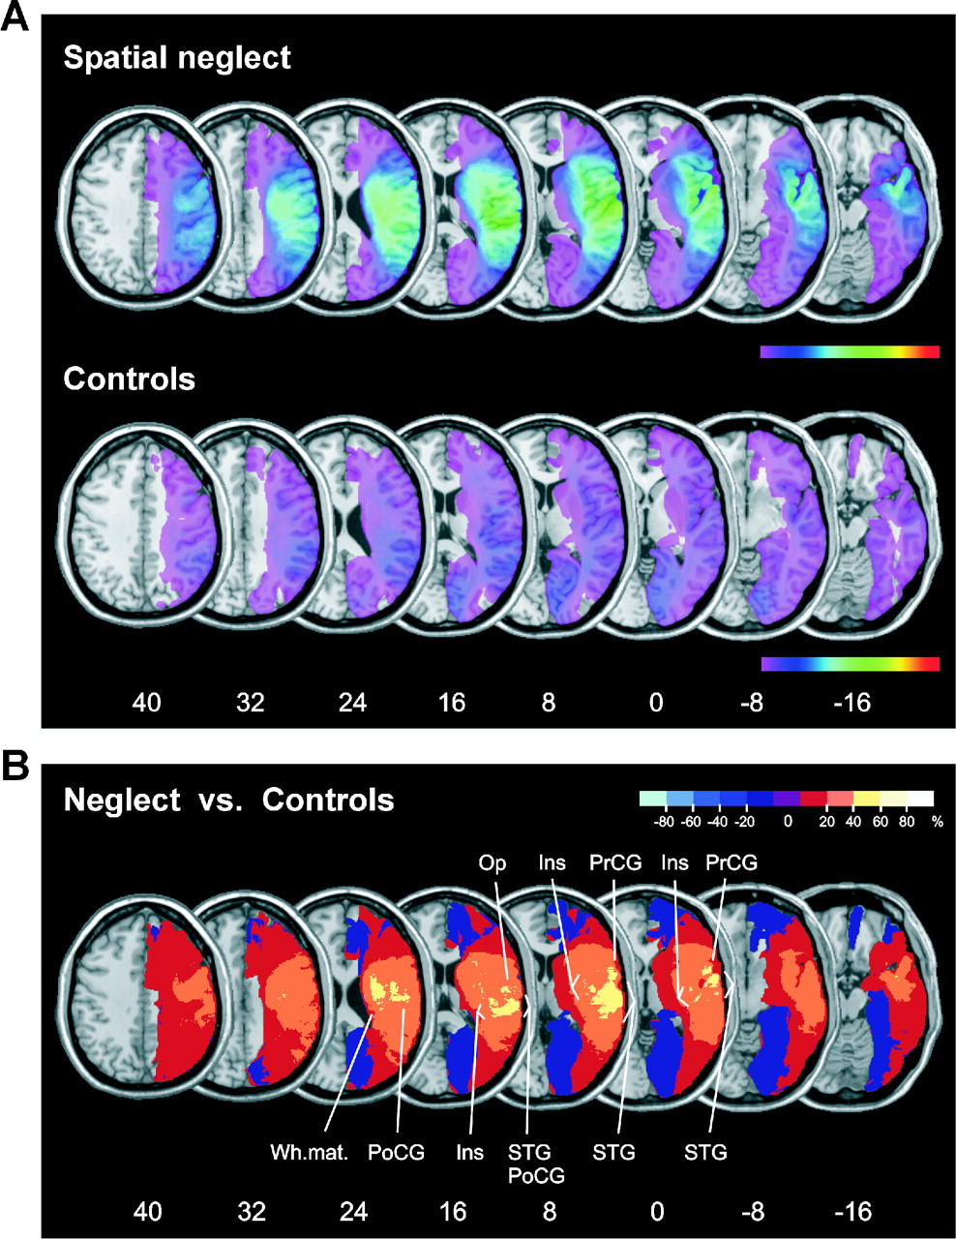
Figure 1. (A) Overlay lesion plots of the patients with spatial neglect (n = 78) and of the patients with ...
Notes:
Figure 1. (A) Overlay lesion plots of the patients with spatial neglect (n = 78) and of the patients with right brain damage without spatial neglect (controls; n = 62). The number of overlapping lesions is illustrated by different colors coding increasing frequencies from violet (n = 1) to red (n = 78, spatial neglect; n = 62, controls). Talairach z-coordinates (Talairach and Tournoux, 1988) of each transverse section are given. (B) Overlay plot of the subtracted superimposed lesions of the patients with spatial neglect minus the control group. The percentage of overlapping lesions of the neglect patients after subtraction of controls is illustrated by five different colors coding increasing frequencies from dark red (difference = 1–20%) to white-yellow (difference = 81–100%). Each color represents 20% increments. The center of overlap represents regions that are damaged at least 40% more frequently in neglect patients than in controls. The different colors from dark blue (difference = –1 to –20%) to light blue (difference = –81 to –100%) indicate regions damaged more frequently in control patients than in neglect patients. Purple (middle of the color bar) designates regions where there is an identical percent of lesions in the neglect and the control groups (=0%). STG, superior temporal gyrus; Ins, insula; Op, operculum; PrCG, precentral gyrus; PoCG, postcentral gyrus; Wh.mat., white matter.
Unless provided in the caption above, the following copyright applies to the content of this slide:

Slide 2
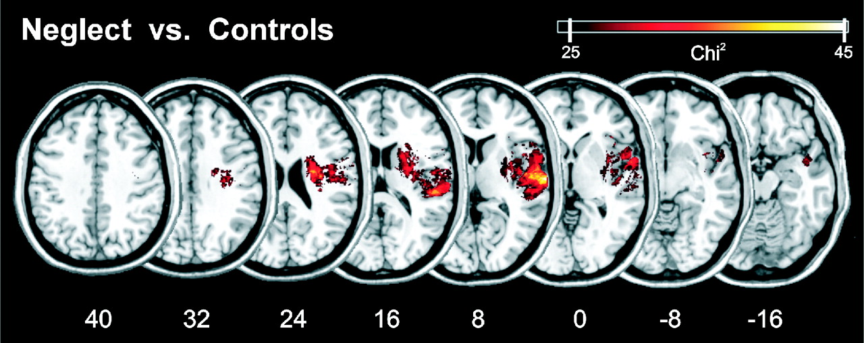
Figure 2. Voxelwise statistical analysis comparing all 78 neglect patients with 62 control patients. ...
Notes:
Figure 2. Voxelwise statistical analysis comparing all 78 neglect patients with 62 control patients. Presented are all voxels that were damaged significantly more often in neglect patients than in control patients following a Bonferroni corrected alpha level of P < 0.05. The orange-yellow colour gradient corresponds with the χ2 value. No voxels were found that were significantly more likely to be damaged in control patients than in patients with neglect. Talairach z-coordinates (Talairach and Tournoux, 1988) of each transverse section are given.
Unless provided in the caption above, the following copyright applies to the content of this slide:

Slide 3
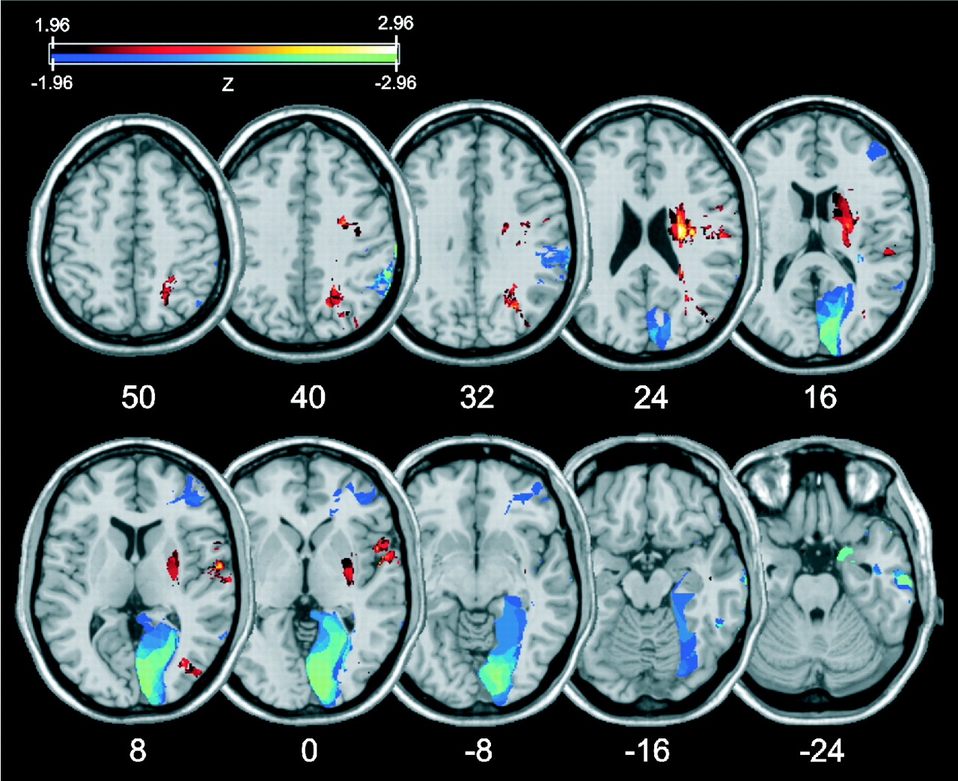
Figure 3. Voxelwise logistic regression. This analysis was computed for all voxels, with overall lesion ...
Notes:
Figure 3. Voxelwise logistic regression. This analysis was computed for all voxels, with overall lesion volume as a covariate. Presented are all voxels that exceed an uncorrected P < 0.05. The colours correspond to the Z-score, with orange-yellow regions indicating regions that predict the presence of neglect and blue-green regions indicating regions associated with the absence of neglect.
Unless provided in the caption above, the following copyright applies to the content of this slide:

