Slide 1
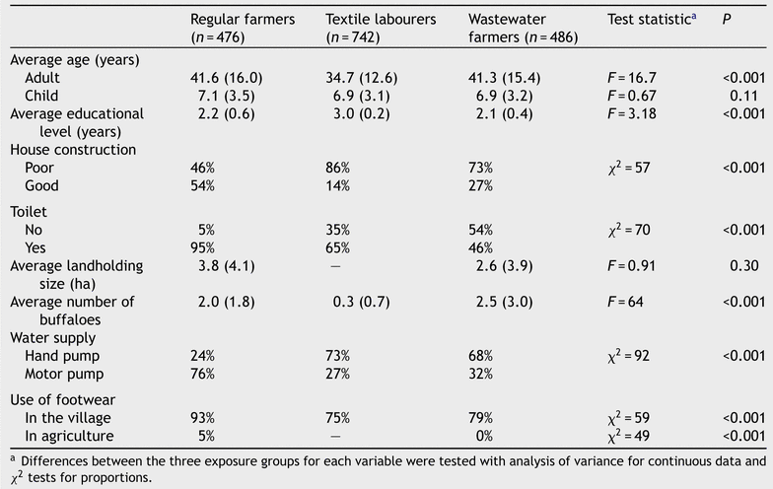
Table 1 Exposure group characteristics
Notes:
Table 1 Exposure group characteristics
Unless provided in the caption above, the following copyright applies to the content of this slide: © Royal Society of Tropical Medicine and Hygiene 2005

Slide 2
Table 2 Nematode prevalence by exposure and age group
Notes:
Table 2 Nematode prevalence by exposure and age group
Unless provided in the caption above, the following copyright applies to the content of this slide: © Royal Society of Tropical Medicine and Hygiene 2005

Slide 3
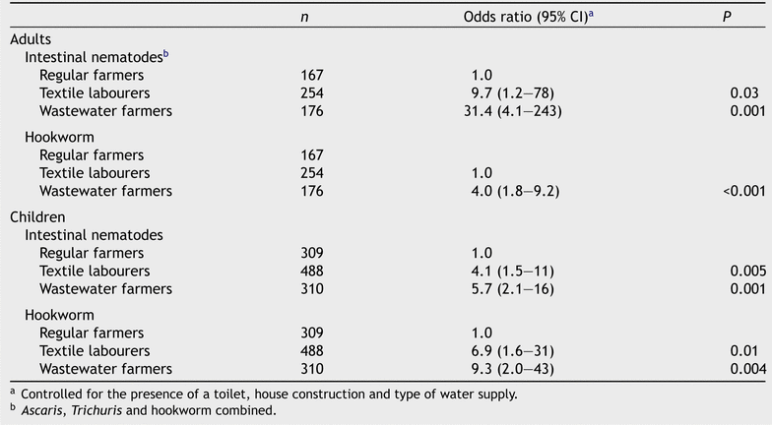
Table 3 Risk of nematode and hookworm infection, among textile labourers, wastewater and regular farming households
Notes:
Table 3 Risk of nematode and hookworm infection, among textile labourers, wastewater and regular farming households
Unless provided in the caption above, the following copyright applies to the content of this slide: © Royal Society of Tropical Medicine and Hygiene 2005

Slide 4
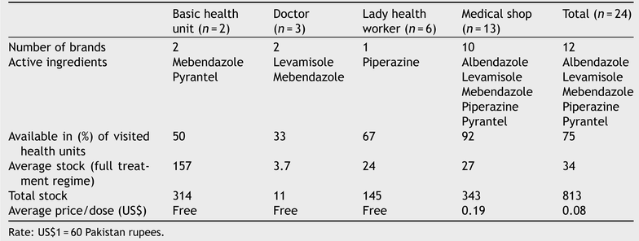
Table 4 Type, availability and price of anthelminthic medication from basic health units, medical doctors, lady ...
Notes:
Table 4 Type, availability and price of anthelminthic medication from basic health units, medical doctors, lady health workers and medical shops in a radius of 5 km of the study villages
Unless provided in the caption above, the following copyright applies to the content of this slide: © Royal Society of Tropical Medicine and Hygiene 2005

Slide 5
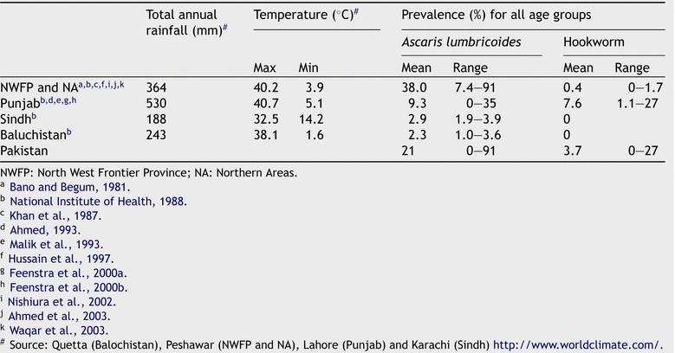
Table 5 Prevalence of Ascaris and hookworm infections in the four major provinces of Pakistan as reported by other ...
Notes:
Table 5 Prevalence of Ascaris and hookworm infections in the four major provinces of Pakistan as reported by other studies
Unless provided in the caption above, the following copyright applies to the content of this slide: © Royal Society of Tropical Medicine and Hygiene 2005

