Slide 1
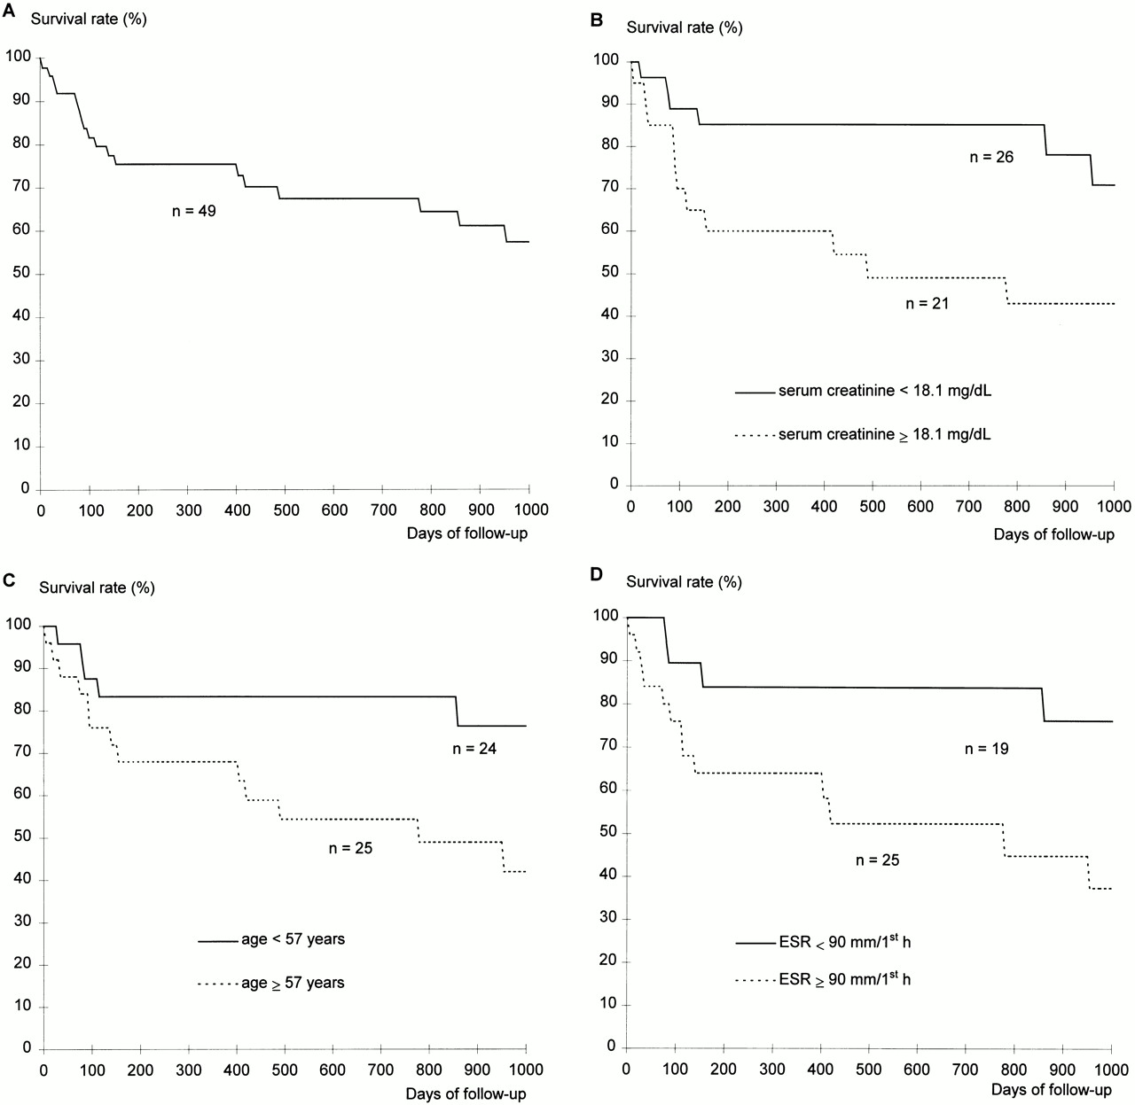
Fig. 1. (A) Overall survival curve for the 49 patients with systemic WG. (B–D) Survival rate as a function of (B) ...
Notes:
Fig. 1. (A) Overall survival curve for the 49 patients with systemic WG. (B–D) Survival rate as a function of (B) serum creatinine level (P=0.03), (C) age (P=0.04) and (D) ESR (P=0.02) at diagnosis.
Unless provided in the caption above, the following copyright applies to the content of this slide: © British Society for Rheumatology

