Slide 1
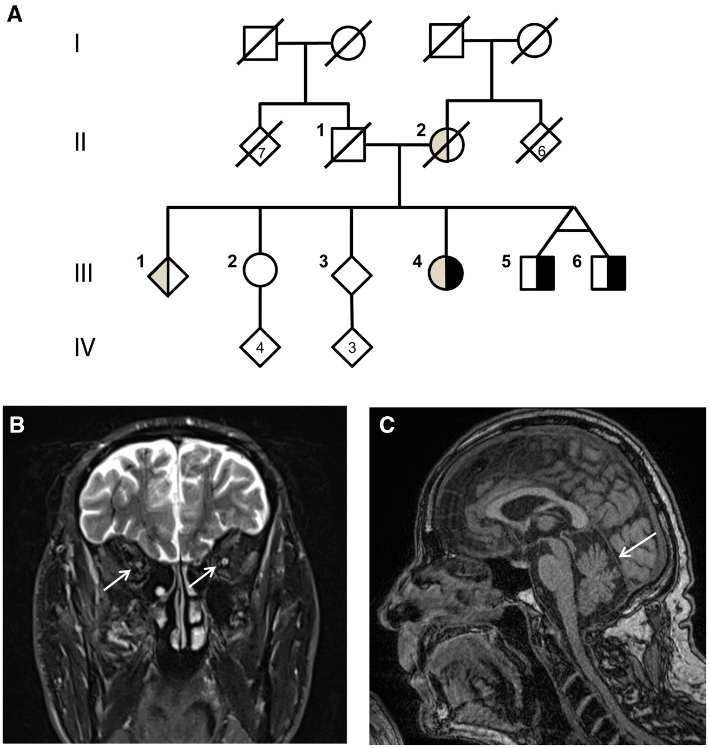
Figure 1. Pedigree and brain MRI. (A) Pedigree of the family. Black symbol = affected with spastic ataxia and optic ...
Notes:
Figure 1. Pedigree and brain MRI. (A) Pedigree of the family. Black symbol = affected with spastic ataxia and optic atrophy; grey symbol = affected with tremor; square = male; circle = female; diamond = masked gender (for anonymization purposes); diagonal line = deceased. (B and C) Brain MRI of patient III-5 at age 63: (B) Coronal T2 image showing optical atrophy (arrows), and (C) midsagittal T1 image showing mild atrophy of the superior vermis (arrow). Clinical findings and results of supplementary investigations in the patients in this study (patients III-4, III-5 and III-6), and in the patients described by Bilguvar et al. (NG 1024-1, NG 1024-2, NG 1024-3) (14) Patient III-4Patient III-5Patient III-6NG 1024-1aNG 1024-2aNG1024-3aAge at examination656262283334Age at onset101010575First symptomVisual lossVisual lossVisual lossVisual lossVisual lossBalance problemsVision0,1 o.u.Light perceptionLight perception–––Optical atrophy++++++SPRS134445nananaSARA182726nananaStanding without assistance––––––Gaze evoked nystagmus++++++Head titubation+––+++Postural tremor+––nananaIntention tremor UL+++nananaBrisk deep tendon reflexes (UL/LL)–/+–/+–/++/++/++/+Inverted plantar responses–+++++Hoffman responses–––+––Grade of reduced muscle strength (UL/LL)Mild/mildMild/severeMild/moderateNormal/mildNormal/mildNormal/mildImpaired superficial sensation (UL/LL)–/+–/+–/++/++/++/+Impaired positional sense++++++Impaired vibration sense (UL/LL)–/+–/+–/++++Spasticity LL–+++++Abnormal cerebellar tests, dysmetria (UL/LL)+/nt+/nt+/nt+++Ophthalmoplegia–Paresis upward gaze–nananaHand myotonia––++––Myokymia+––nananaCognitive impairment–––naIQ 74IQ 71Fasciculations–++nananaPectus carinatum–++nananaPes cavus+++nananaEMG/neurography (ageb)Chronic neurogenic axonal changes (65)Axonal sensorimotor neuropathy (62)Axonal sensorimotor neuropathy (62)Normal nerve conduction velocity, myokymic activity (in all)Brain MRI (ageb)Optic atrophy (63)Optic atrophy. Mild cbl.atr. (63)Optic atrophy (62)Bilateral optic nerve and chiasm atrophy, Wallerian degeneration of the optic radiations, cbl. and mild cerebral atr. (in all)Visual evoked potentials (VEP) flashnaInc. lat., red. amp.cInc. lat., red. amp.cNearly absent response o.u. (in all)VEP electroretinogramnaNormalNormalNormalNormalNormalMuscle biopsy (ageb)Normal (56)naChronic denervation (48)nananaaExamination findings in patients NG 1024-1, NG 1024-2 and NG 1024-3 are adapted from Bilguvar et al., including Supporting Information. bAge at examination, in years. cIncreased latency time and reduced amplitude both eyes. LL = lower limbs; UL = upper limbs; − = absent; + = present; o.u. = both eyes; cbl.atr. = cerebellar atrophy; nt = not testable; na = not available.
Unless provided in the caption above, the following copyright applies to the content of this slide: © The Author 2016. Published by Oxford University Press. All rights reserved. For Permissions, please email: journals.permissions@oup.com

Slide 2
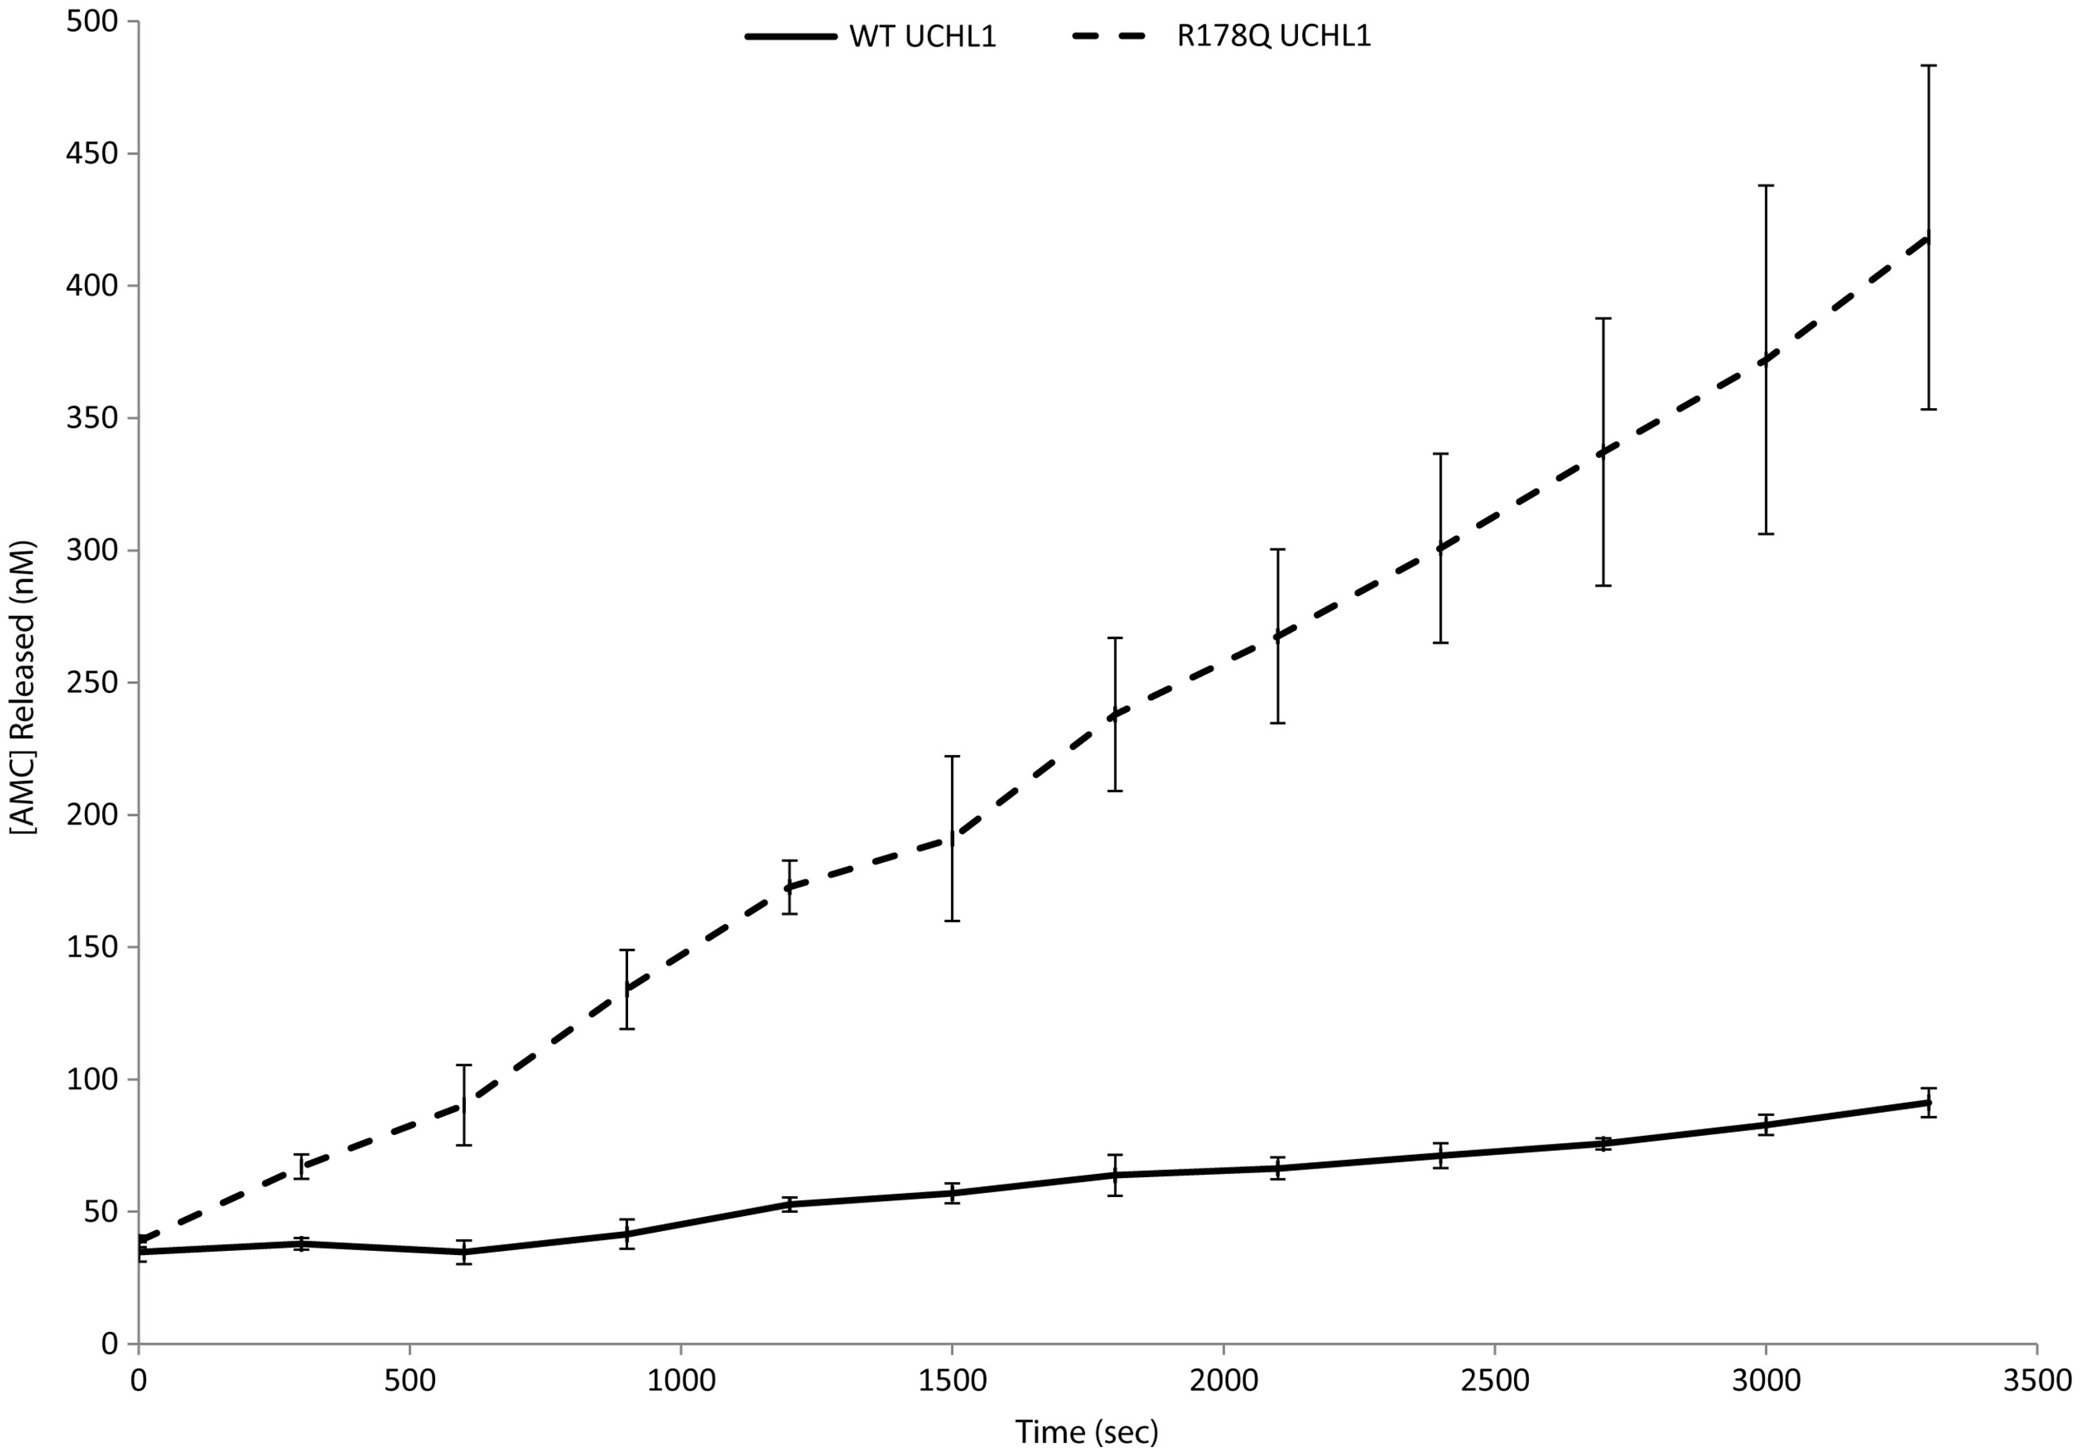
Figure 2. Enzymatic activity assay. Comparison of the enzymatic activity of WT UCHL1 and the Arg178Gln (R178Q) mutant ...
Notes:
Figure 2. Enzymatic activity assay. Comparison of the enzymatic activity of WT UCHL1 and the Arg178Gln (R178Q) mutant protein (n = 3). Real time release of fluorescent AMC is shown for WT UCHL1 (black line) and Arg178Gln UCHL1 (dashed line). The substrate and enzyme concentrations for all reactions were 2500 and 4 nM, respectively.
Unless provided in the caption above, the following copyright applies to the content of this slide: © The Author 2016. Published by Oxford University Press. All rights reserved. For Permissions, please email: journals.permissions@oup.com

Slide 3
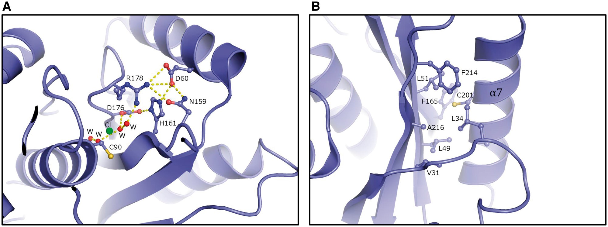
Figure 3. The crystal structure of human UCHL1 (19). (A) Close-up of the hydrogen pattern in the vicinity of Arg178 ...
Notes:
Figure 3. The crystal structure of human UCHL1 (19). (A) Close-up of the hydrogen pattern in the vicinity of Arg178 close to the catalytic triad. (B) Close-up of the hydrophobic core between the β-sheet and the α-helix α7. Ala216 is one of several hydrophobic amino acids constituting the hydrophobic core. The figure was made using the program PyMol [DeLano, W.L. The PyMOL Molecular Graphics System (2002) DeLano Scientific, San Carlos, CA, USA.].
Unless provided in the caption above, the following copyright applies to the content of this slide: © The Author 2016. Published by Oxford University Press. All rights reserved. For Permissions, please email: journals.permissions@oup.com

Slide 4
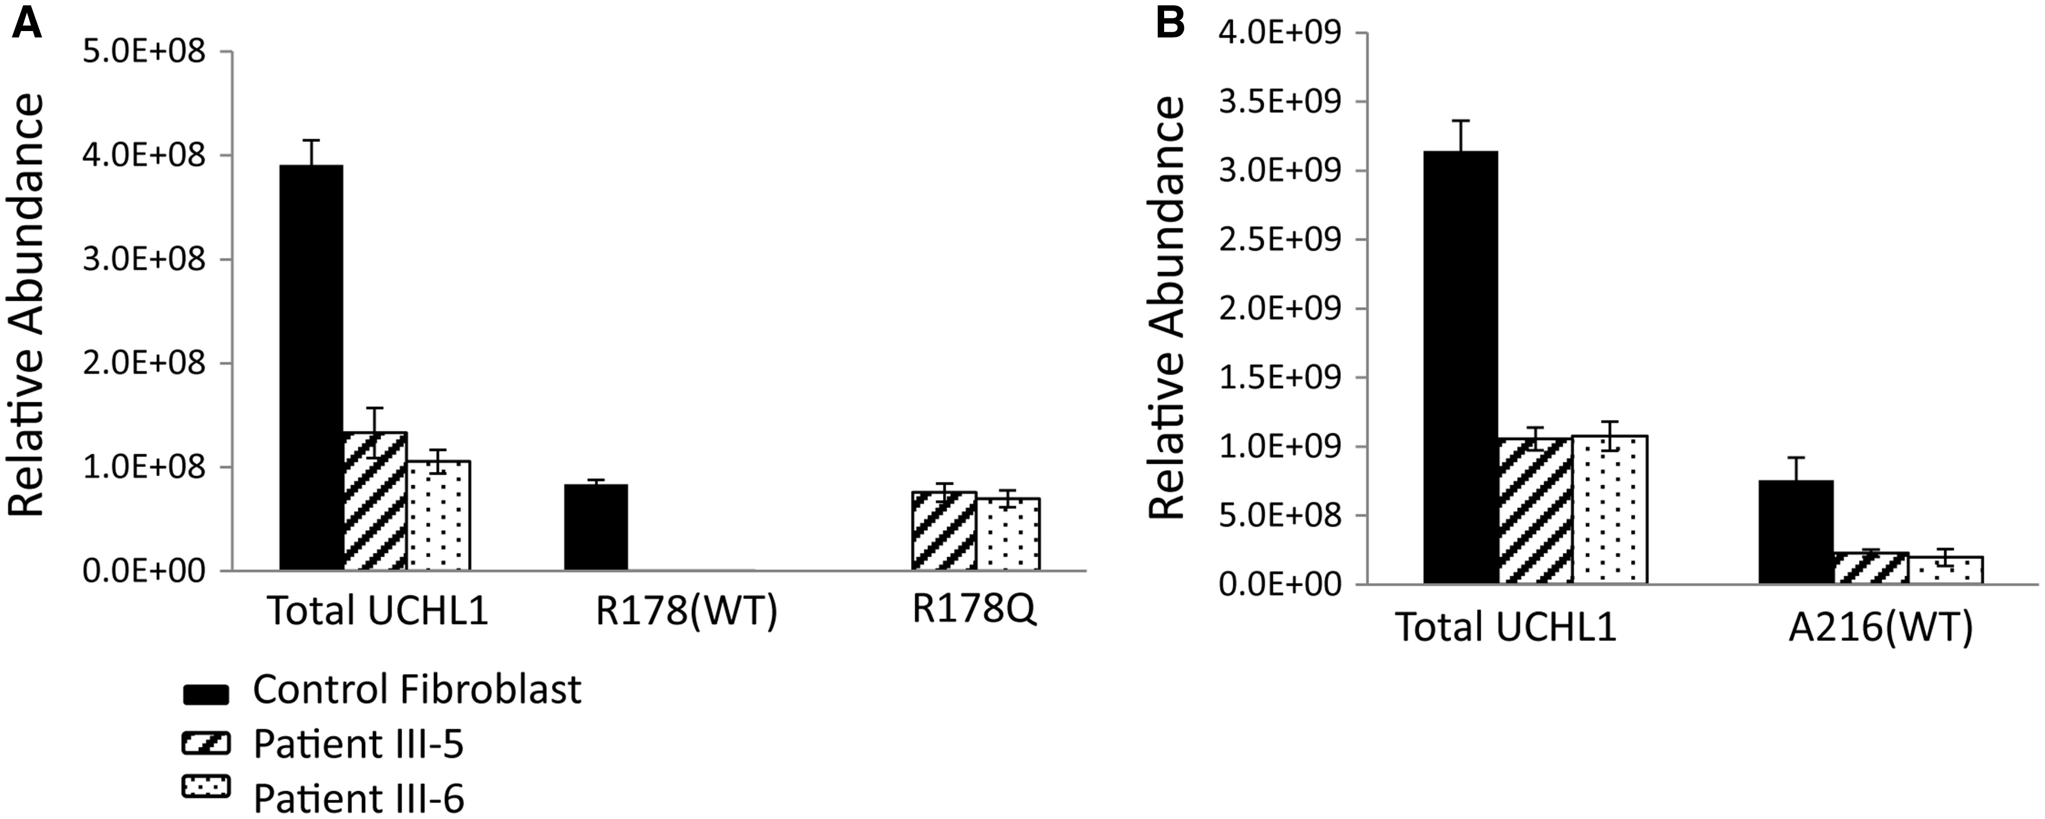
Figure 4. Quantification of wild type (WT) and mutated UCHL1 protein in fibroblast samples from patients. Relative ...
Notes:
Figure 4. Quantification of wild type (WT) and mutated UCHL1 protein in fibroblast samples from patients. Relative abundance of total UCHL1 protein was calculated by summing the peak area values of 4 unique UCHL1 peptides for each sample. Levels of WT Arg178 and Ala216 and mutant Arg178Gln correspond to peak areas of single peptides carrying the respective residues. (A) Quantification of peptides containing the residue Arg178 (WT UCHL1) and the point mutation Arg178Gln was achieved through enzymatic digestion using Glu-C. (B) Quantification of the peptide containing the Ala216 (WT UCHL1) residue was performed via tryptic digestion. Peptides containing the mutation Ala216Asp were not detectable in trypsin- or Glu-C treated samples. Protein and peptide area values are normalized against β-actin levels. Error bars represent standard deviation from 3 technical replicates. Black = control fibroblasts; stripes = patient III-5; dots = patient III-6.
Unless provided in the caption above, the following copyright applies to the content of this slide: © The Author 2016. Published by Oxford University Press. All rights reserved. For Permissions, please email: journals.permissions@oup.com

