Slide 1
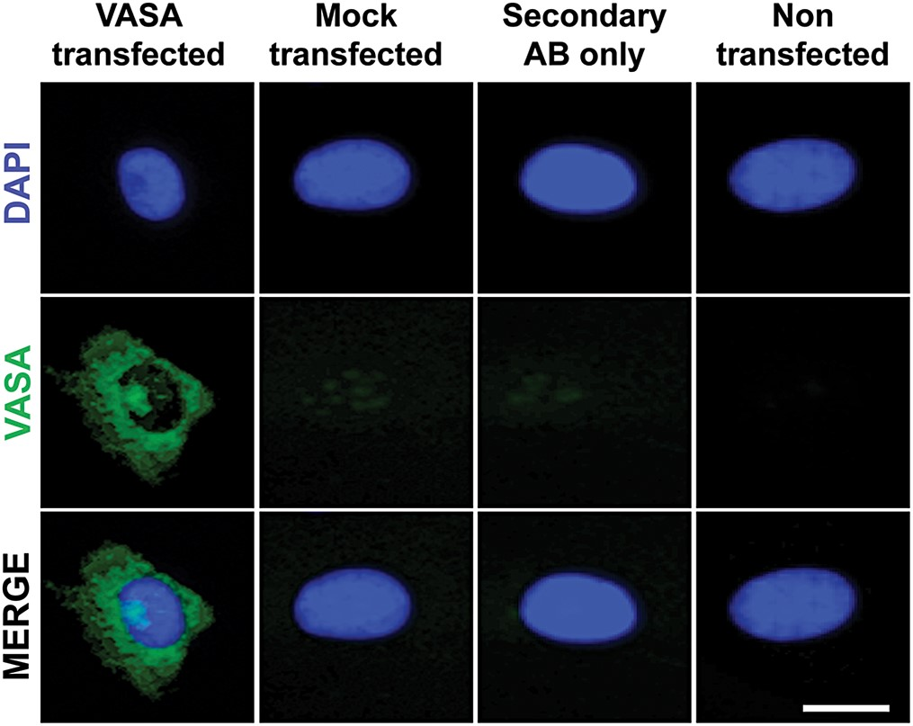
Figure 1. Functional validation of mRNA expression encoding for VASA. Immunostaining of VASA in mRNA-transfected ...
Notes:
Figure 1. Functional validation of mRNA expression encoding for VASA. Immunostaining of VASA in mRNA-transfected fibroblasts 24 h after transfection. VASA protein localized correctly in the cytoplasm. Mock transfected, secondary antibody stained only and non-transfected samples served as negative controls. Scale bar, 10 µm.
Unless provided in the caption above, the following copyright applies to the content of this slide: © The Author 2014. Published by Oxford University Press.This is an Open Access article distributed under the terms of the Creative Commons Attribution Non-Commercial License (http://creativecommons.org/licenses/by-nc/3.0/), which permits non-commercial re-use, distribution, and reproduction in any medium, provided the original work is properly cited. For commercial re-use, please contact journals.permissions@oup.com

Slide 2
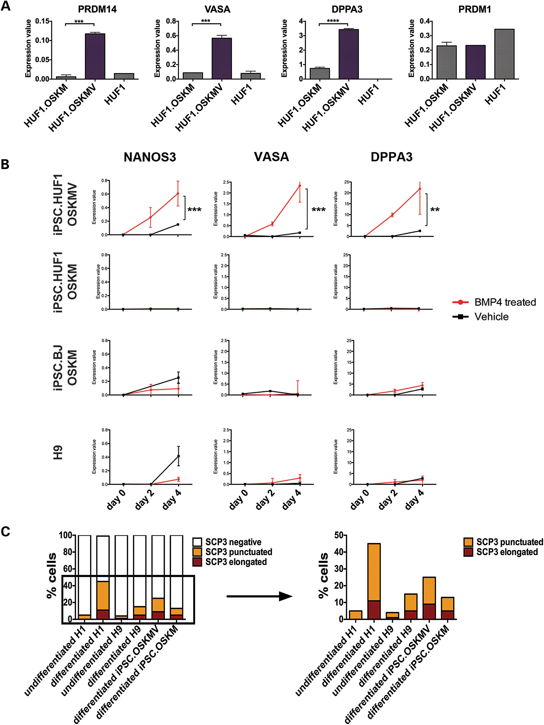
Figure 2. Functional and molecular studies of iPSC.HUF1 derived with OSKM and OSKMV. (A) Gene expression analysis of ...
Notes:
Figure 2. Functional and molecular studies of iPSC.HUF1 derived with OSKM and OSKMV. (A) Gene expression analysis of markers associated with the germline lineage in an undifferentiated state. Three genes (PRDM14, VASA, DPPA3) showed significantly higher expression in OSKMV-derived clones (purple bar) compared with OSKM (Student's t-test, mean ± SD; n ≥ 16 for each gene and sample *P < 0.05, **P < 0.01, ***P < 0.001, ****P < 0.0001). (B) Gene expression analysis of clones derived with OSKM and OSKMV, iPSC.BJ line and H9 during in vitro differentiation into primordial germ cells with BMP4. Samples were isolated at day 0, 2 and 4 post-BMP4/vehicle treatment. Three key markers (NANOS3, VASA, DPPA3) were upregulated in OSKMV-derived clones (Student's t-test, mean ± SD; n ≥ 16 for each gene and sample *P < 0.05, **P < 0.01, ***P < 0.001, ****P < 0.0001). (C) Quantification of meiotic spreads. Approximately 200–300 cells were counted for each line. Staining patterns were classified as negative, punctuated or elongated.
Unless provided in the caption above, the following copyright applies to the content of this slide: © The Author 2014. Published by Oxford University Press.This is an Open Access article distributed under the terms of the Creative Commons Attribution Non-Commercial License (http://creativecommons.org/licenses/by-nc/3.0/), which permits non-commercial re-use, distribution, and reproduction in any medium, provided the original work is properly cited. For commercial re-use, please contact journals.permissions@oup.com

Slide 3
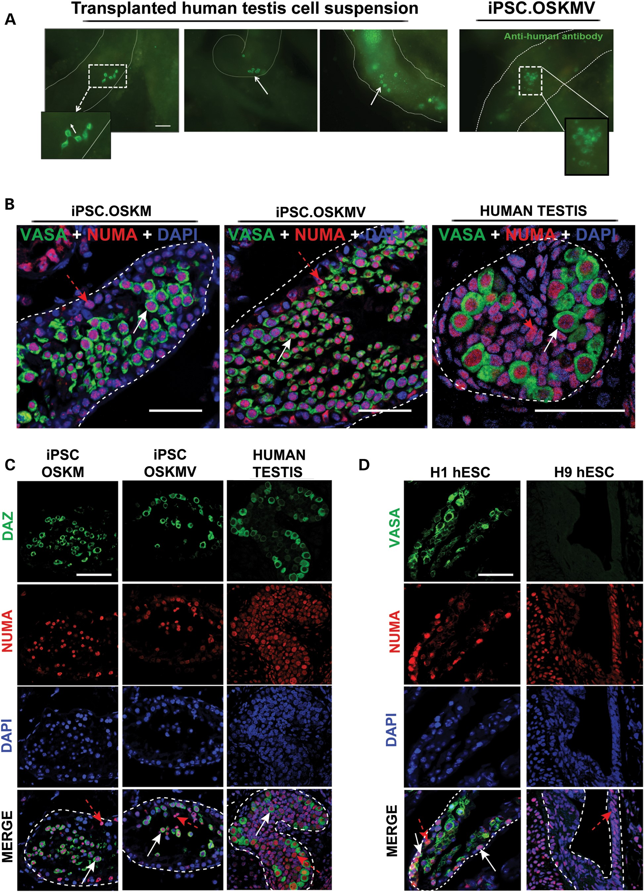
Figure 3. Transplantation of OSKM and OSKMV cells into busulfan-treated mouse testes. (A) Whole-mount analysis on ...
Notes:
Figure 3. Transplantation of OSKM and OSKMV cells into busulfan-treated mouse testes. (A) Whole-mount analysis on transplanted human fetal testis cells and OSKMV cells into mouse testes. Chain (white dashed rectangle) and cluster formation (white arrows) visible in human fetal testis control cells. Transplanted OSKMV cells gave rise to cluster formation indicated by white dashed rectangle. Scale bar, 50 µm. (B) Histology cross sections of tubules inside mouse testes stained with co-localizing human-specific NUMA (red) and VASA (green). White arrows indicate transplanted cells positive for VASA germ cell marker; red dashed arrows indicate VASA-negative transplanted donor cells. Scale bar, 50 µm. (C) Histology cross sections of tubules of mouse testes stained with additional germ cell-specific marker DAZ demonstrating NUMA co-localization. Scale bar, 50 µm. (D) H1 and H9 hESC controls. H1 cells are positive for VASA/NUMA co-staining; H9 cells are negative for germ cell marker selection. White arrows indicate transplanted cells positive for VASA germ cell marker; red dashed arrows indicate VASA-negative donor cells. Scale bar, 50 µm.
Unless provided in the caption above, the following copyright applies to the content of this slide: © The Author 2014. Published by Oxford University Press.This is an Open Access article distributed under the terms of the Creative Commons Attribution Non-Commercial License (http://creativecommons.org/licenses/by-nc/3.0/), which permits non-commercial re-use, distribution, and reproduction in any medium, provided the original work is properly cited. For commercial re-use, please contact journals.permissions@oup.com

Slide 4
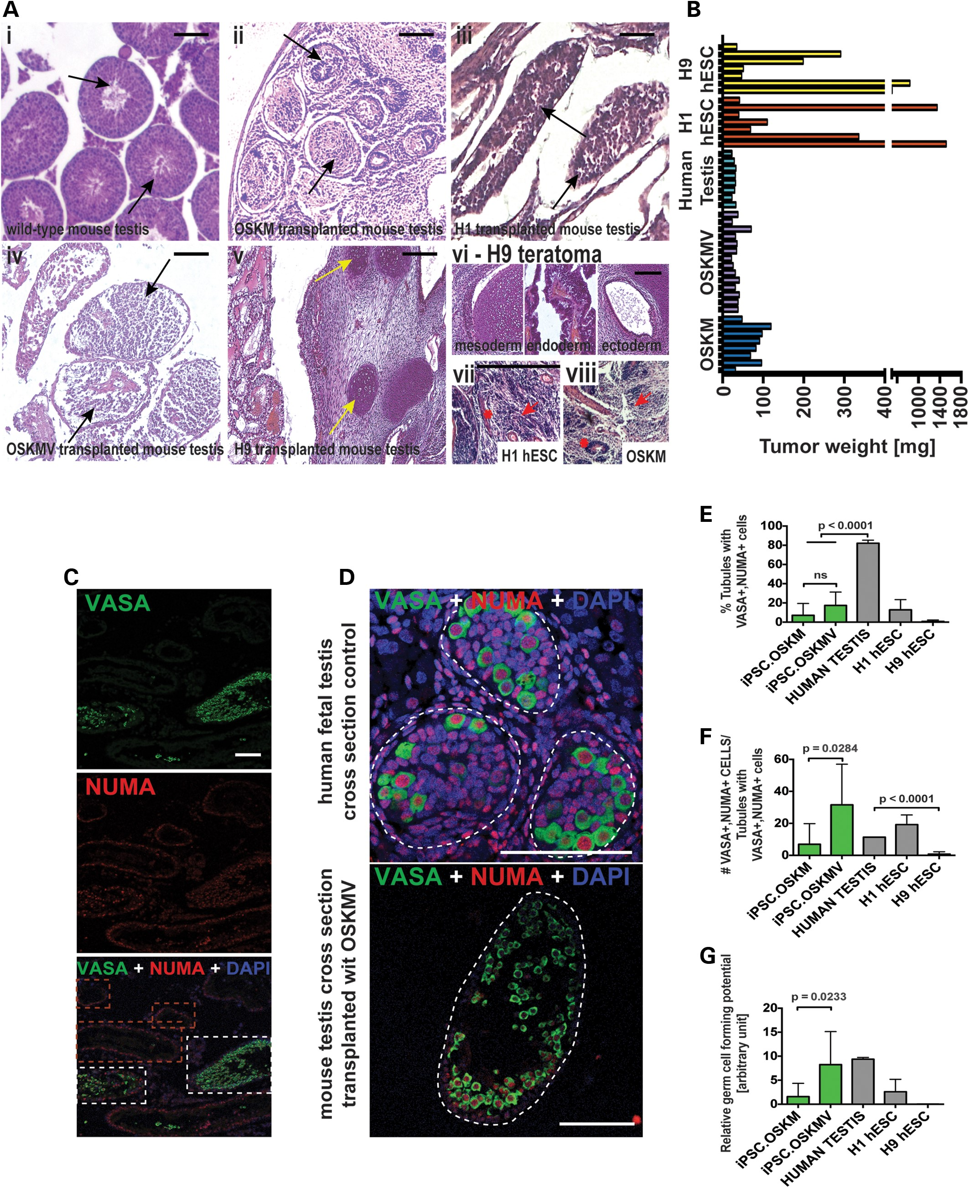
Figure 4. Transplantation of OSKM and OSKMV followed by quantification analysis. (A) Hematoxylin and eosin staining of ...
Notes:
Figure 4. Transplantation of OSKM and OSKMV followed by quantification analysis. (A) Hematoxylin and eosin staining of histology cross sections of tubules inside mouse testes. (i–v) Black arrows indicate individual tubules. Yellow arrows indicate cartilage formation in H9 transplanted cells as example for teratoma formation. Scale bar, 100 µm. (vi) H9 transplanted cells formed teratomas indicated by three germ layers. (vii and viii) H1 and OSKM cells formed fibrotic structures that resembled embryonal carcinoma (EC) cells and yolk sac tumors. (B) Weight of testis 2 months after transplantation of cells (OSKM and OSKMV cells with three controls: human testis, H1 hESC and H9 hESC line). (C) Representative low-magnification image of histology cross section of multiple tubules stained with NUMA and VASA indicating that only a fraction of tubules formed VASA-positive cells. Red dashed rectangle indicates tubules with NUMA only cells along the basement membrane. White rectangle indicates NUMA/VASA-positive tubules. Scale bar, 50 µm. (D) Representative image of histology cross section of one single tubule. Single NUMA/VASA-positive cells were counted for quantification. Scale bar, 50 µm. (E–G) Quantification of immunohistochemistry results of cross sections from OSKM and OSKMV cells compared with both controls. All serial sections were subject to counting (see Materials and Methods) Scale bar, 80 µm. (E) Percentage of tubules with positive VASA/NUMA co-staining calculated (against total number of counted tubules). iPSC.OSKMV is also significantly different from H9 control (P = 0.0432) (F) For each positive tubule, VASA-positive cells that co-stained with NUMA were counted and calculated against positively stained tubules. iPSC.OSKMV is also significantly different from H9 control (P = 0.0397) (G) Relative germ cell forming potential calculated by multiplying fraction of positively stained tubules with number of VASA/NUMA co-stained cells for each sample. iPSC.OSKMV is also significantly different from H9 control (P = 0.0417).
Unless provided in the caption above, the following copyright applies to the content of this slide: © The Author 2014. Published by Oxford University Press.This is an Open Access article distributed under the terms of the Creative Commons Attribution Non-Commercial License (http://creativecommons.org/licenses/by-nc/3.0/), which permits non-commercial re-use, distribution, and reproduction in any medium, provided the original work is properly cited. For commercial re-use, please contact journals.permissions@oup.com

Slide 5
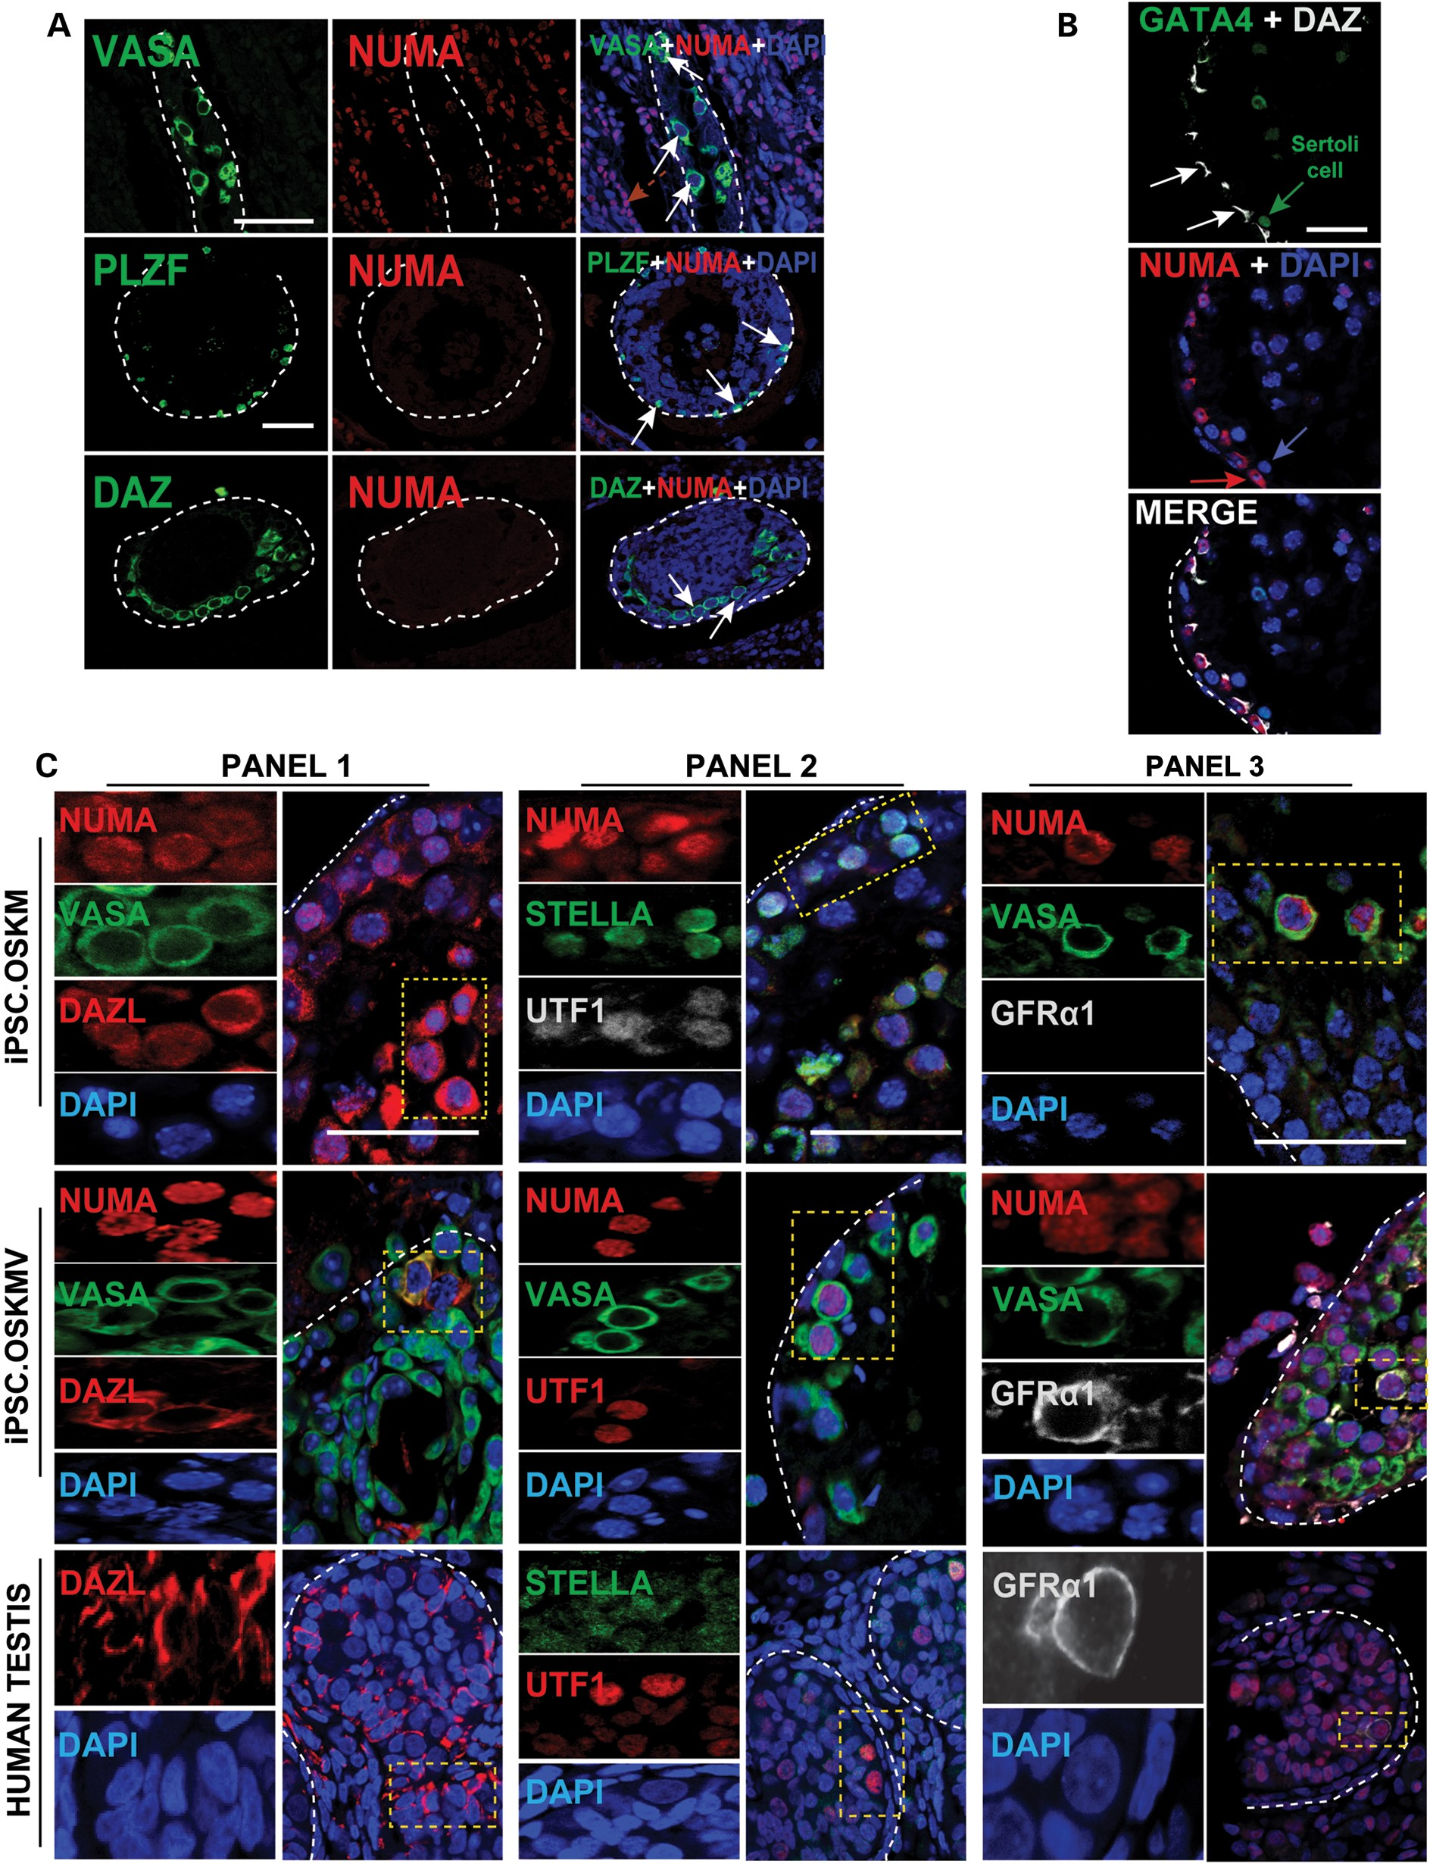
Figure 5. Germ cell formation of OSKM- and OSKMV-transplanted cells in vivo. (A) Observed endogenous germ cell activity ...
Notes:
Figure 5. Germ cell formation of OSKM- and OSKMV-transplanted cells in vivo. (A) Observed endogenous germ cell activity inside the basement membrane of transplanted mouse testes. Cells stained positive for VASA, PLZF and DAZ but do not co-localize with NUMA indicating residual germ cells after busulfan treatment. Scale bar, 50 µm. (B) Detection of Sertoli cells indicated by GATA4 staining that is of mouse origin and near OSKMV-transplanted cells at the basement membrane of mouse testes. Scale bar, 50 µm. (C) Additional germ cell markers stain positive with NUMA in OSKM- and OSKMV-transplanted cells in mouse testes and co-localize with each other. GFRα1 was only detected in OSKMV-transplanted cells and human fetal testis control sections. Yellow dashed rectangles indicate magnified snapshots in each panel and for each sample. Each panel shows single individual protein and DAPI (left) and a zoomed out merged image (right). Scale bar, 80 µm.
Unless provided in the caption above, the following copyright applies to the content of this slide: © The Author 2014. Published by Oxford University Press.This is an Open Access article distributed under the terms of the Creative Commons Attribution Non-Commercial License (http://creativecommons.org/licenses/by-nc/3.0/), which permits non-commercial re-use, distribution, and reproduction in any medium, provided the original work is properly cited. For commercial re-use, please contact journals.permissions@oup.com

Slide 6
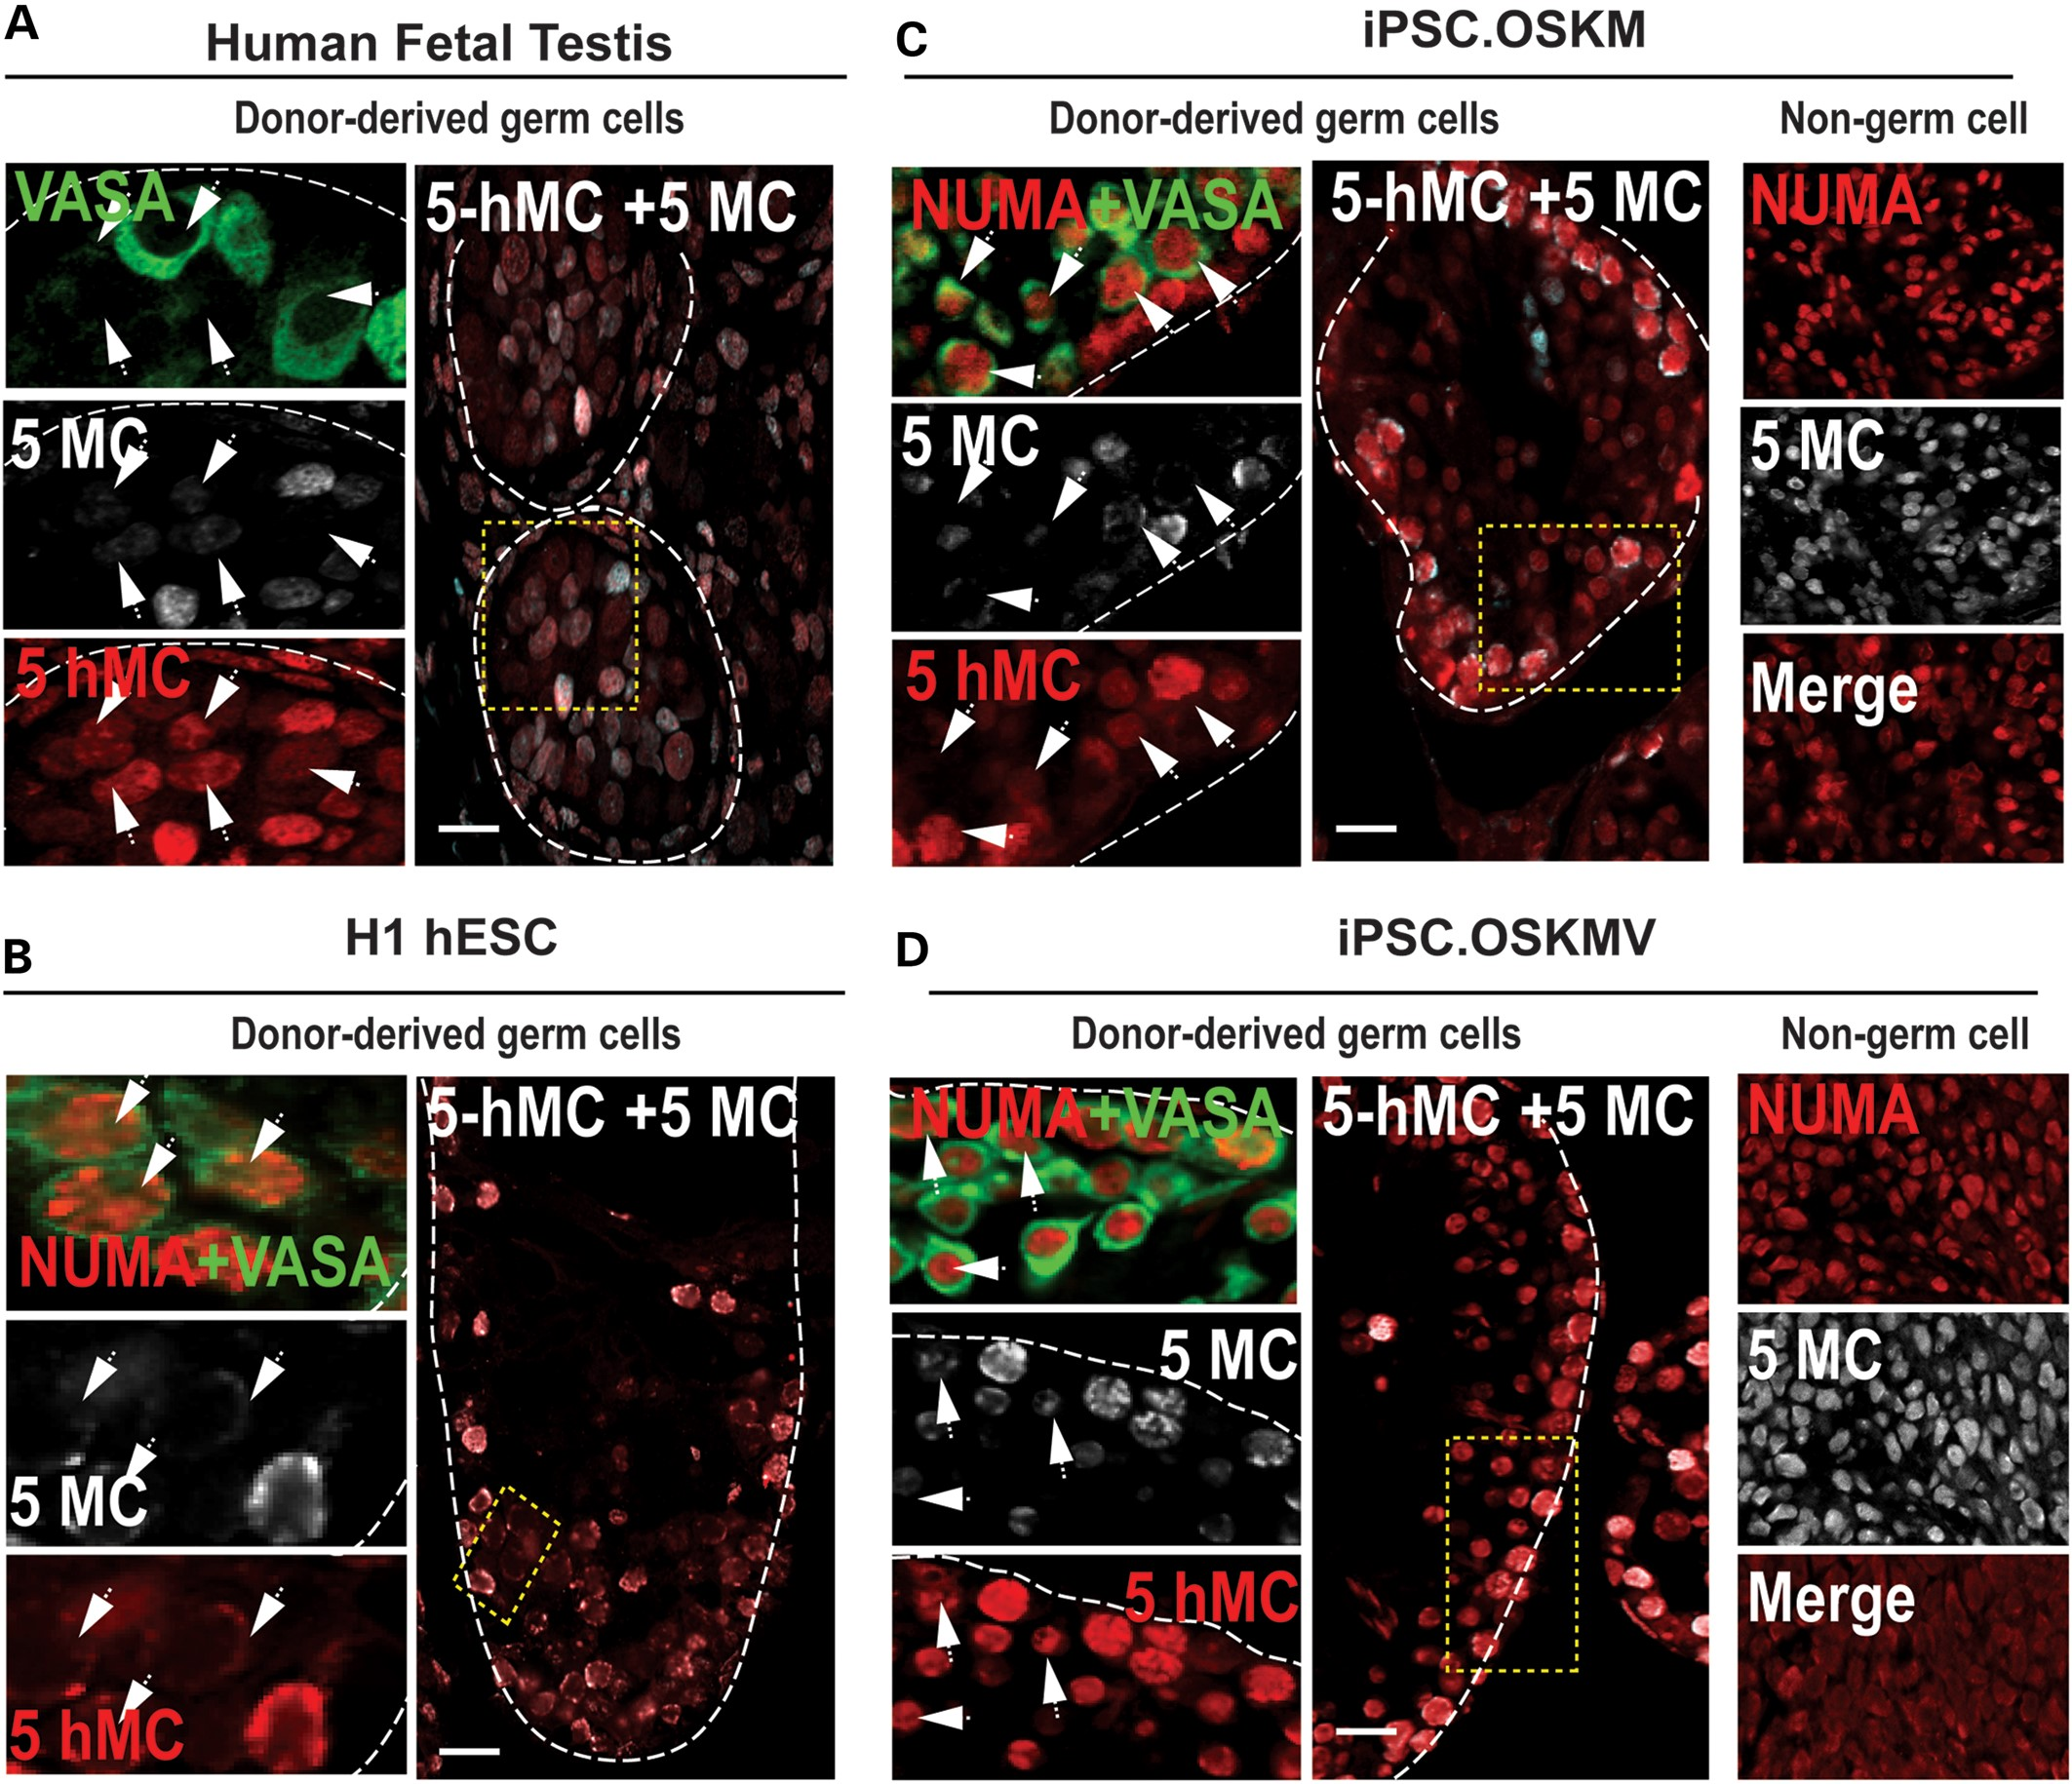
Figure 6. DNA demethylation in xenotransplanted hESCs and iPSCs. Human fetal testis section (22 weeks) and testis ...
Notes:
Figure 6. DNA demethylation in xenotransplanted hESCs and iPSCs. Human fetal testis section (22 weeks) and testis xenografts of H1 hESCs, OSKM and OSKMV human iPSCs were stained for VASA, 5-methylcytosine (5-MC) and 5-hydroxymethlcytosine (5-hMC) in NUMA+ regions. (A) Cross section of a human fetal testis with positive immunostaining for VASA, 5-MC and 5-hMC. Areas in dotted yellow rectangles are shown in higher magnification on the left of each panel. White arrows indicate germ cells with low to none 5-MC signal relative to 5-hMC. (B–D) Cross sections of mouse testes xenografts after transplantation of undifferentiated H1 hESCs, OSKM and OSKMV cells, respectively, immunostained for NUMA, VASA, 5-MC and 5-hMC. Areas in dotted yellow rectangles are shown in higher magnification on the left of each panel. White arrows indicate NUMA + VASA-positive donor cells with low to none 5-MC signal relative to 5-hMC. Non-germ cell containing regions of the xenografts are shown in far right column for OSKM and OSKMV cells. Scale bar, 50 µm.
Unless provided in the caption above, the following copyright applies to the content of this slide: © The Author 2014. Published by Oxford University Press.This is an Open Access article distributed under the terms of the Creative Commons Attribution Non-Commercial License (http://creativecommons.org/licenses/by-nc/3.0/), which permits non-commercial re-use, distribution, and reproduction in any medium, provided the original work is properly cited. For commercial re-use, please contact journals.permissions@oup.com

Slide 7
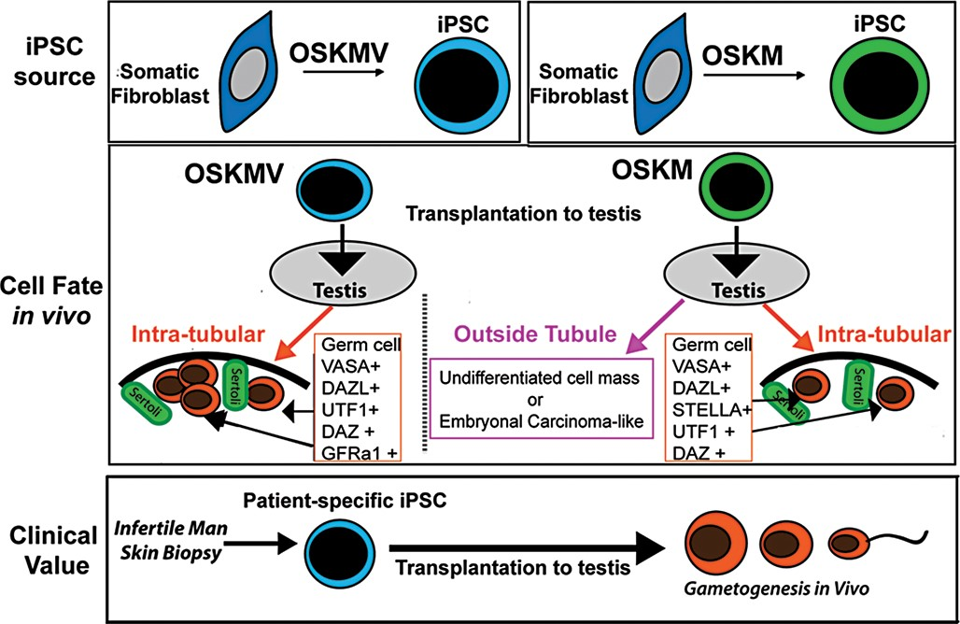
Figure 7. Model of transplantation of undifferentiated iPSCs into mouse testes. A schematic summarizing the major ...
Notes:
Figure 7. Model of transplantation of undifferentiated iPSCs into mouse testes. A schematic summarizing the major findings of this study. iPSCs reprogrammed with OSKM and OSKMV displayed differences in their phenotype after derivation. When transplanted, iPSC.OSKMV cells specifically differentiate to PGCs inside the spermatogonial tubule niche where they contact sertoli cells and were positive for a set of different stage-specific germ cell markers including GFRα1. iPSC.OSKM cells also localized inside the mouse testis niche and expressed key germ cell markers but to a lower extend and frequency. In addition, iPSC.OSKM cells developed enlarged cell masses inside mouse testes that resembled embryonal carcinoma-like tissue. This is in contrast to iPSC.OSKMV where all transplanted mouse testes kept their naïve structure. The transplantation strategies proposed here offer a potential avenue for fertility restoration for infertile men.
Unless provided in the caption above, the following copyright applies to the content of this slide: © The Author 2014. Published by Oxford University Press.This is an Open Access article distributed under the terms of the Creative Commons Attribution Non-Commercial License (http://creativecommons.org/licenses/by-nc/3.0/), which permits non-commercial re-use, distribution, and reproduction in any medium, provided the original work is properly cited. For commercial re-use, please contact journals.permissions@oup.com

