Slide 1
Fig. 1 Schematic of study design. After 14 weeks of training, eight patients were randomly selected to undergo ...
Notes:
Fig. 1 Schematic of study design. After 14 weeks of training, eight patients were randomly selected to undergo continued training or discontinue training for an additional 14 weeks. Asterisk denotes evaluation of outcome measures.
Unless provided in the caption above, the following copyright applies to the content of this slide: © 2006 The Author(s)This is an Open Access article distributed under the terms of the Creative Commons Attribution Non-Commercial License (http://creativecommons.org/licenses/by-nc/2.0/uk/) which permits unrestricted non-commercial use, distribution, and reproduction in any medium, provided the original work is properly cited.

Slide 2
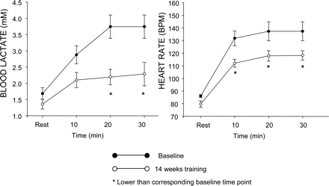
Fig. 2 Changes in blood lactate (left) and heart rate (right) during 30 min of constant workload submaximal exercise ...
Notes:
Fig. 2 Changes in blood lactate (left) and heart rate (right) during 30 min of constant workload submaximal exercise before and after 14 weeks of training in eight mitochondrial myopathy patients.
Unless provided in the caption above, the following copyright applies to the content of this slide: © 2006 The Author(s)This is an Open Access article distributed under the terms of the Creative Commons Attribution Non-Commercial License (http://creativecommons.org/licenses/by-nc/2.0/uk/) which permits unrestricted non-commercial use, distribution, and reproduction in any medium, provided the original work is properly cited.

Slide 3
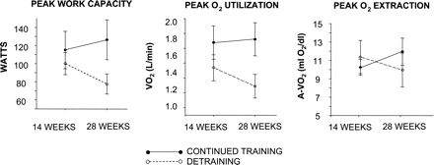
Fig. 3 Physiological changes in maximal exercise capacity after 14 weeks of training, followed by further training ...
Notes:
Fig. 3 Physiological changes in maximal exercise capacity after 14 weeks of training, followed by further training or deconditioning, in patients with mitochondrial myopathy.
Unless provided in the caption above, the following copyright applies to the content of this slide: © 2006 The Author(s)This is an Open Access article distributed under the terms of the Creative Commons Attribution Non-Commercial License (http://creativecommons.org/licenses/by-nc/2.0/uk/) which permits unrestricted non-commercial use, distribution, and reproduction in any medium, provided the original work is properly cited.

Slide 4
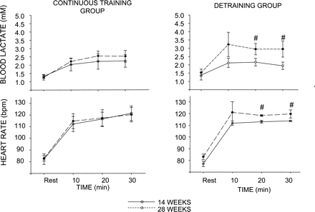
Fig. 4 Physiological changes in exercise tolerance during submaximal workloads after 14 weeks of training in the two ...
Notes:
Fig. 4 Physiological changes in exercise tolerance during submaximal workloads after 14 weeks of training in the two subgroups of mitochondrial myopathy patients. Note that data shown from the detraining group are for three patients (denoted by #) as one patient was unable to complete >10 min of submaximal exercise at 28 weeks.
Unless provided in the caption above, the following copyright applies to the content of this slide: © 2006 The Author(s)This is an Open Access article distributed under the terms of the Creative Commons Attribution Non-Commercial License (http://creativecommons.org/licenses/by-nc/2.0/uk/) which permits unrestricted non-commercial use, distribution, and reproduction in any medium, provided the original work is properly cited.

Slide 5
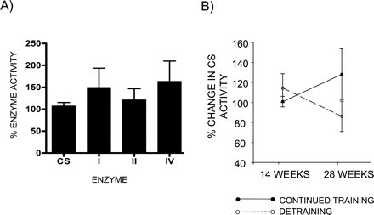
Fig. 5 Changes in respiratory chain enzyme complexes I, II and IV and citrate synthase activities with training. (A) ...
Notes:
Fig. 5 Changes in respiratory chain enzyme complexes I, II and IV and citrate synthase activities with training. (A) The mean change in the group of eight mitochondrial myopathy patients (±SE) in enzyme activity of biopsy sampled after 14 weeks of training relative to baseline sample. (B) The mean change in citrate synthase activity in the two subgroups that underwent continued training or detraining.
Unless provided in the caption above, the following copyright applies to the content of this slide: © 2006 The Author(s)This is an Open Access article distributed under the terms of the Creative Commons Attribution Non-Commercial License (http://creativecommons.org/licenses/by-nc/2.0/uk/) which permits unrestricted non-commercial use, distribution, and reproduction in any medium, provided the original work is properly cited.

