Slide 1
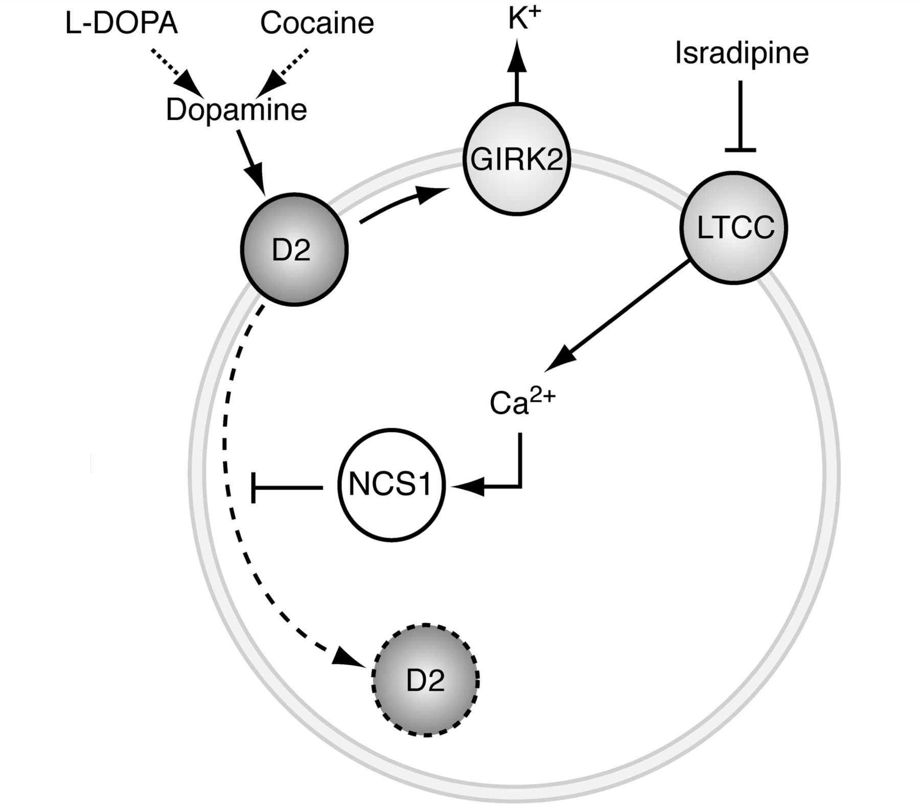
Figure 1 Proposed mechanism by which L-type calcium channels stabilize autoreceptor function in dopamine neurons. ...
Notes:
Figure 1 Proposed mechanism by which L-type calcium channels stabilize autoreceptor function in dopamine neurons. Dopamine D2 receptors are prototypical autoreceptors that control the firing rate of pacemaking substantia nigra dopamine neurons via activation of inhibitory GIRK channels. In response to stimulation by dopamine or indirect ligands such as cocaine, the inhibitory effect on dopamine neuron firing is reduced due to internalization of D2 receptors. This D2-desensitization is prevented by the neuronal calcium sensor protein NCS1, which is regulated by calcium supplied via Cav1.3 L-type calcium channels active during autonomous firing of dopamine neurons. The L-type calcium channel (LTCC) blocker isradipine, which is currently being evaluated as a neuroprotective therapy for Parkinson’s disease, facilitates desensitization of the D2 receptor and disrupts the ability of dopamine to inhibit neuronal activity.
Unless provided in the caption above, the following copyright applies to the content of this slide: © The Author (2014). Published by Oxford University Press on behalf of the Guarantors of Brain. All rights reserved. For Permissions, please email: journals.permissions@oup.com

