Slide 1
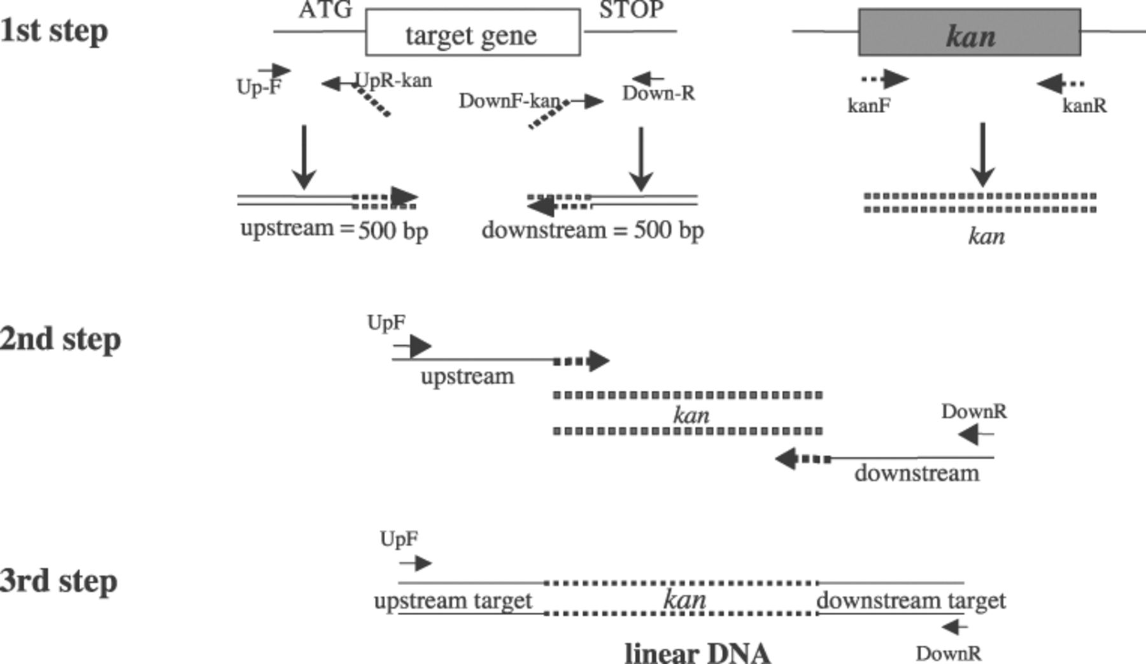
Figure 1 Principle of the three-step PCR. The first step consists of amplifying independently the upstream and ...
Notes:
Figure 1 Principle of the three-step PCR. The first step consists of amplifying independently the upstream and downstream regions of the target gene and the kanamycin cassette. Primers UpR-kan and DownF-kan contain at their 3′ end an extension of 20 nucleotides homologous to the primers kanF and kanR respectively. The three PCR products obtained in step one are mixed at equimolar concentrations and subjected to a second PCR to generate a kan cassette flanked by upstream and downstream long homologous regions. The third step is required to obtain large amounts of the desired linear DNA.
Unless provided in the caption above, the following copyright applies to the content of this slide: © 2003 Federation of European Microbiological Societies.

Slide 2
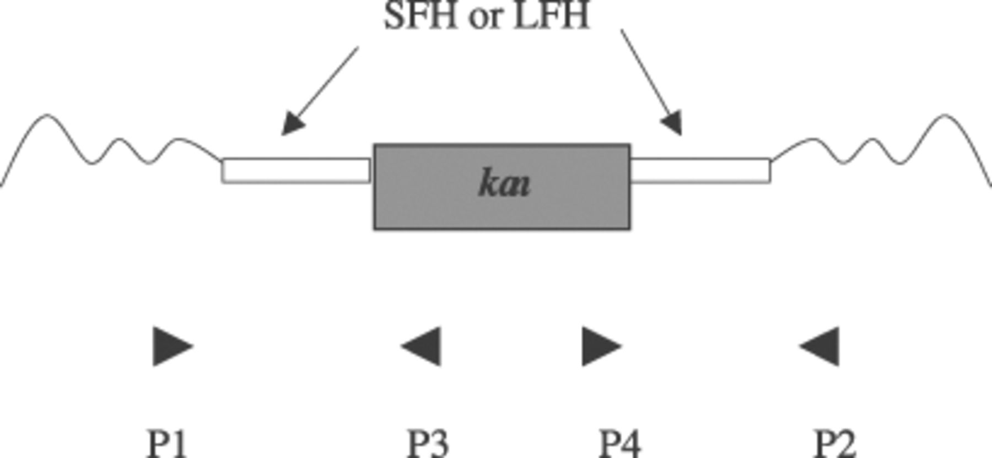
Figure 2 Strategy used to confirm the insertion of the kanamycin resistance cassette and the deletion of the ...
Notes:
Figure 2 Strategy used to confirm the insertion of the kanamycin resistance cassette and the deletion of the chromosomal target sequences. Three PCRs are done using the following combinations of primers: (i) P1/P2 external to and on each side of the SFH or LFH regions, (ii) P1/P3 and (iii) P4/P2, where P3 and P4 are located in the kanamycin gene.
Unless provided in the caption above, the following copyright applies to the content of this slide: © 2003 Federation of European Microbiological Societies.

