Slide 1
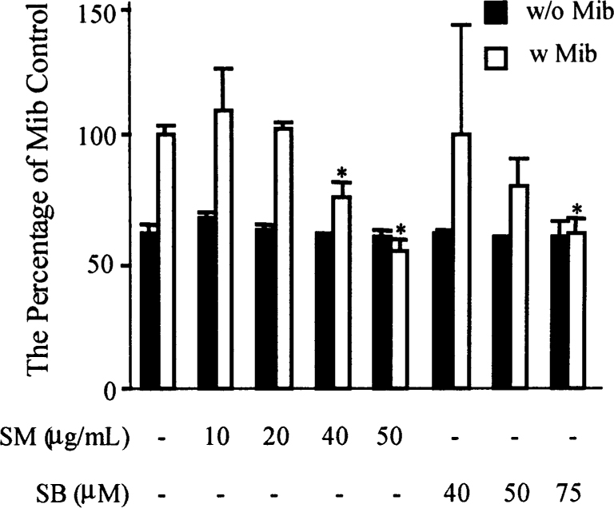
Fig. 1. Effects of SM and SB on androgen-regulated LNCaP cell growth. LNCaP cells were treated with SM and SB at ...
Notes:
Fig. 1. Effects of SM and SB on androgen-regulated LNCaP cell growth. LNCaP cells were treated with SM and SB at designated concentrations in the absence or presence of 1 nM Mib for 5 days and cell proliferation was measured by MTS assay. Error bars indicate the standard errors of four separate experiments. * P < 0.05, when compared with the group treated with Mib alone.
Unless provided in the caption above, the following copyright applies to the content of this slide: © Oxford University Press

Slide 2
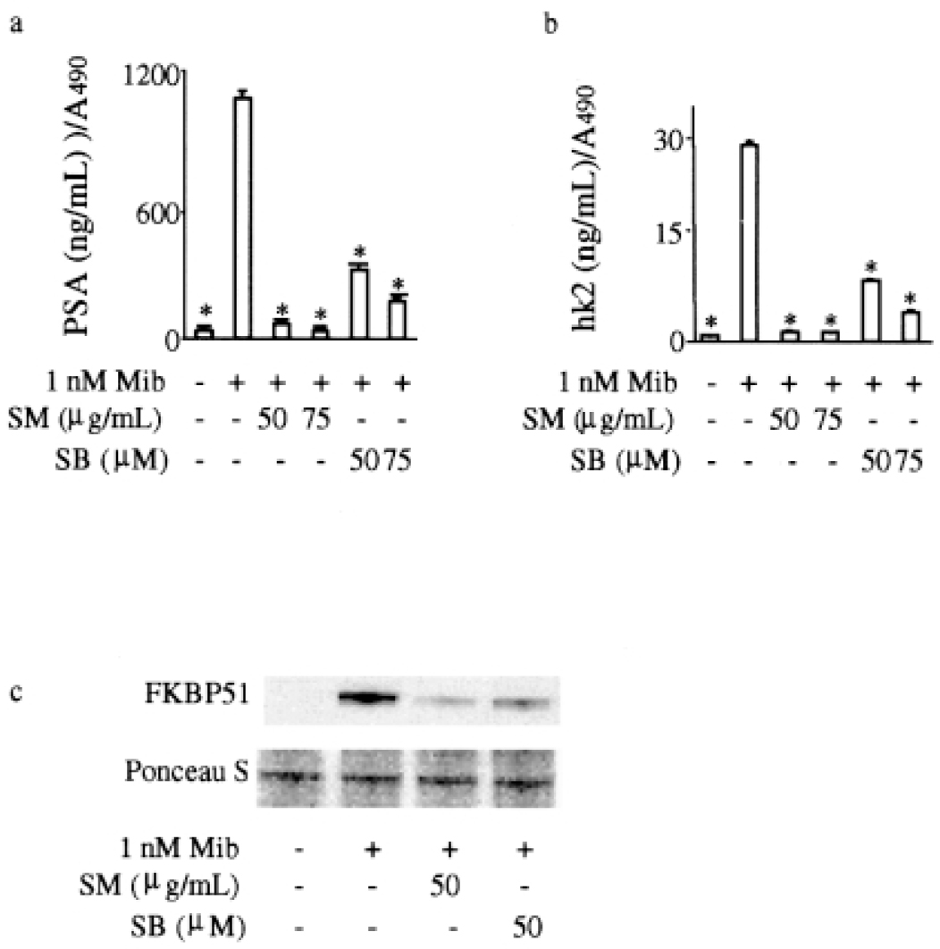
Fig. 2. Effects of SM and SB on expression of androgen-regulated proteins PSA, hk2 and fkbp51. ( a ) Secretion level ...
Notes:
Fig. 2. Effects of SM and SB on expression of androgen-regulated proteins PSA, hk2 and fkbp51. ( a ) Secretion level of PSA; ( b ) secretion level of hK2; ( c ) western blot analysis of FKBP51 protein level. In the PSA and hK2 quantification assays LNCaP cells were treated with SM and SB at designated concentrations in the presence of 1 nM Mib for 5 days and PSA and hK2 secretion levels were normalized by variable cell number. Error bars indicate the standard errors of four separate experiments. * P < 0.05, when compared with the group treated with Mib alone. In western blot analysis LNCaP cells were treated with SM and SB in the presence of 1 nM Mib for 24 h.
Unless provided in the caption above, the following copyright applies to the content of this slide: © Oxford University Press

Slide 3
Fig. 3. Effects of SM and SB on 6 kb PSA promoter androgenic inducibility ( a ) and hk2 ARE-mediated transcriptional ...
Notes:
Fig. 3. Effects of SM and SB on 6 kb PSA promoter androgenic inducibility ( a ) and hk2 ARE-mediated transcriptional activity ( b ) in LNCaP cells. LNCaP cells were transiently co-transfected with a β-gal expression vector and a designated construct and then treated with SM and SB in the presence of 1 nM Mib for 24 h. Cell lysates were prepared for measurement of luciferase activities. Luciferase activities were measured and normalized to β-gal activities and expressed as relative light units/unit β-gal. Error bars indicate the SEM of three separate experiments. * P < 0.05, when compared with the group treated with Mib alone. A percentage of activities are also expressed at the top of some histograms as shown using the PSA promoter or hK2-ARE construct treated with Mib as a reference (expressed as 100). PGL3, a pGL3-Basic luciferase vector; PGL3-p, a pGL3-Promoter luciferase vector.
Unless provided in the caption above, the following copyright applies to the content of this slide: © Oxford University Press

Slide 4
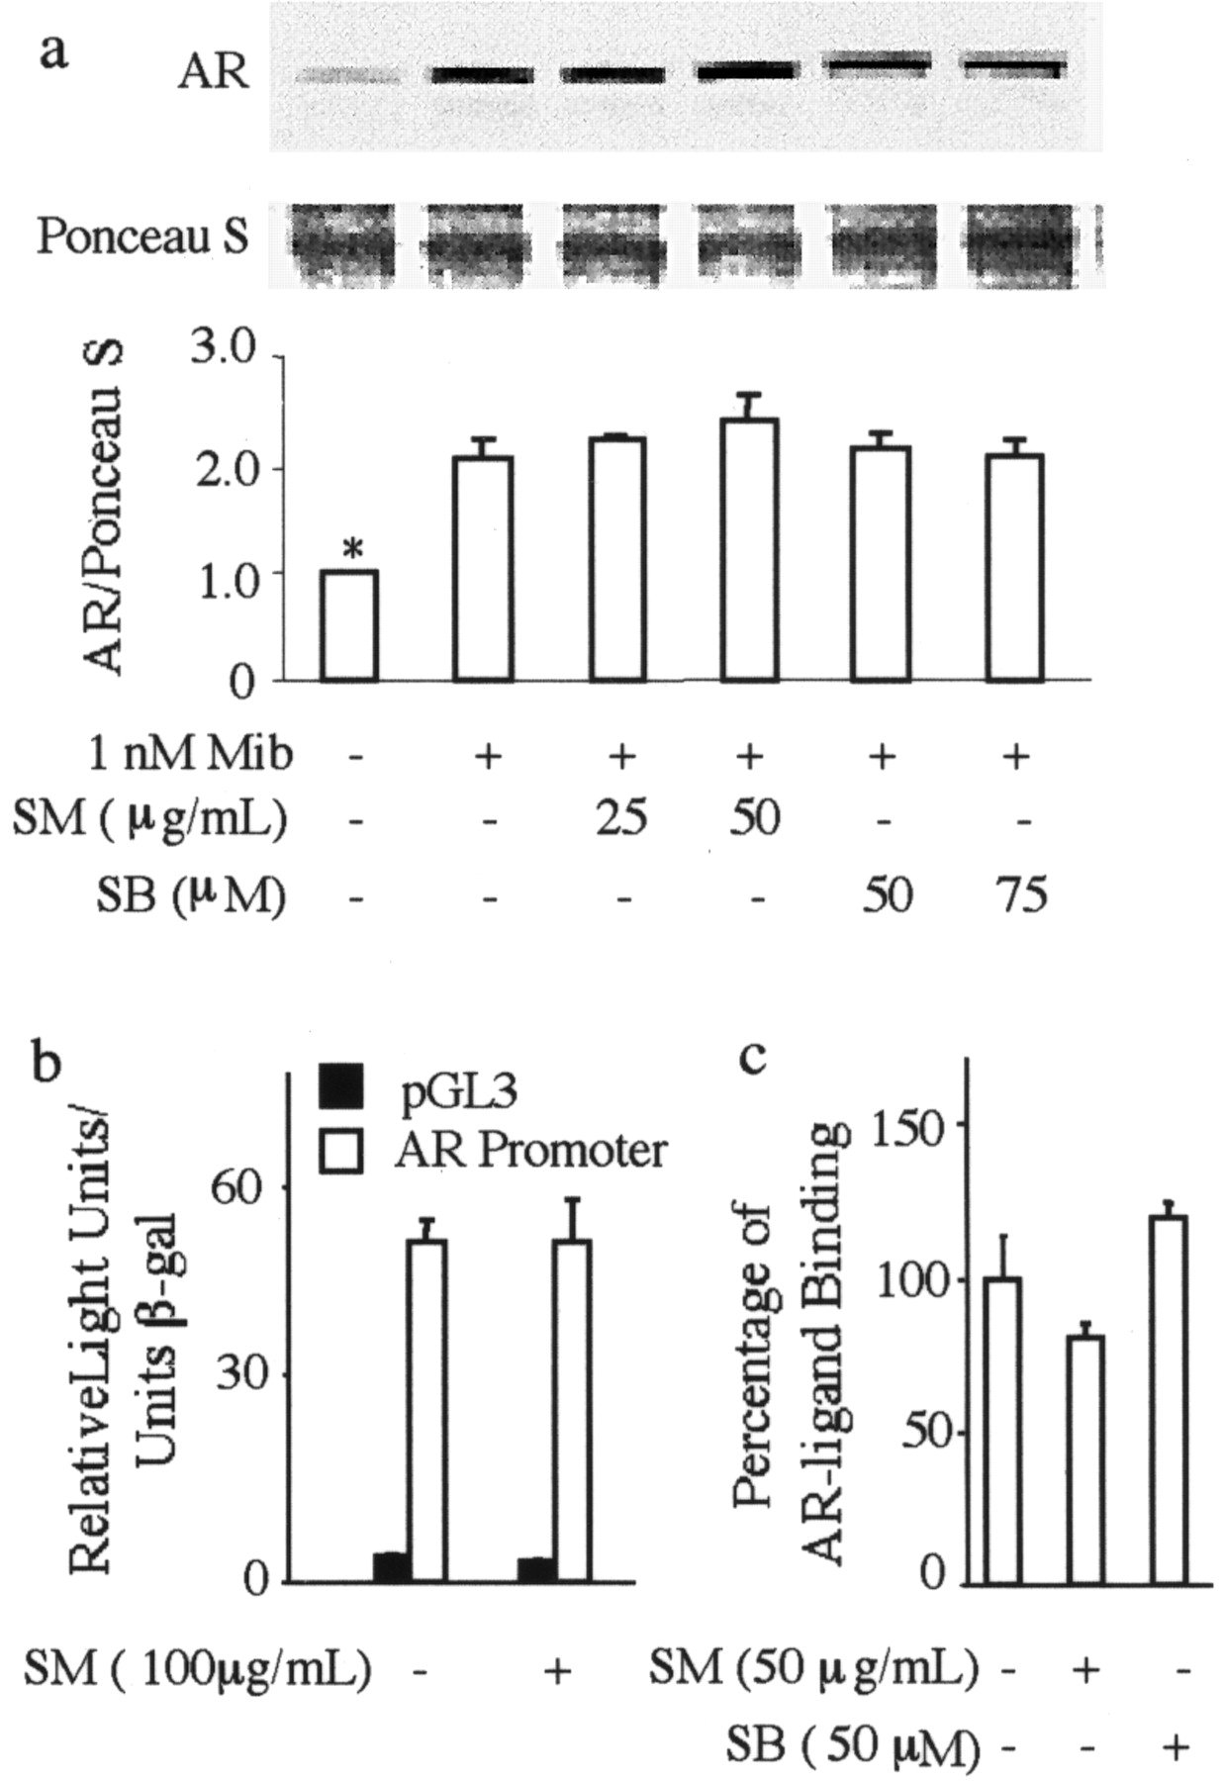
Fig. 4. Effects of SM and SB on whole cell AR levels ( a ), transcription activity of the AR promoter ( b ) and ...
Notes:
Fig. 4. Effects of SM and SB on whole cell AR levels ( a ), transcription activity of the AR promoter ( b ) and ligand-binding activity of the AR ( c ). The upper panel in (a) shows a representative western blot analysis of total AR protein levels in LNCaP cells and Ponceau S staining, representing protein loading. The lower panel in (a) is a densitometric analysis of total AR protein levels from three independent experiments. * P < 0.05, when compared with the group treated with Mib alone. LNCaP cells were treated with SM and SB in the presence of 1 nM Mib for 24 h in the above analyses. The transcription activities in (b) are expressed as relative light units/unit β-gal. pGL3 denotes a pGL3-Basic luciferase vector as a control.
Unless provided in the caption above, the following copyright applies to the content of this slide: © Oxford University Press

Slide 5
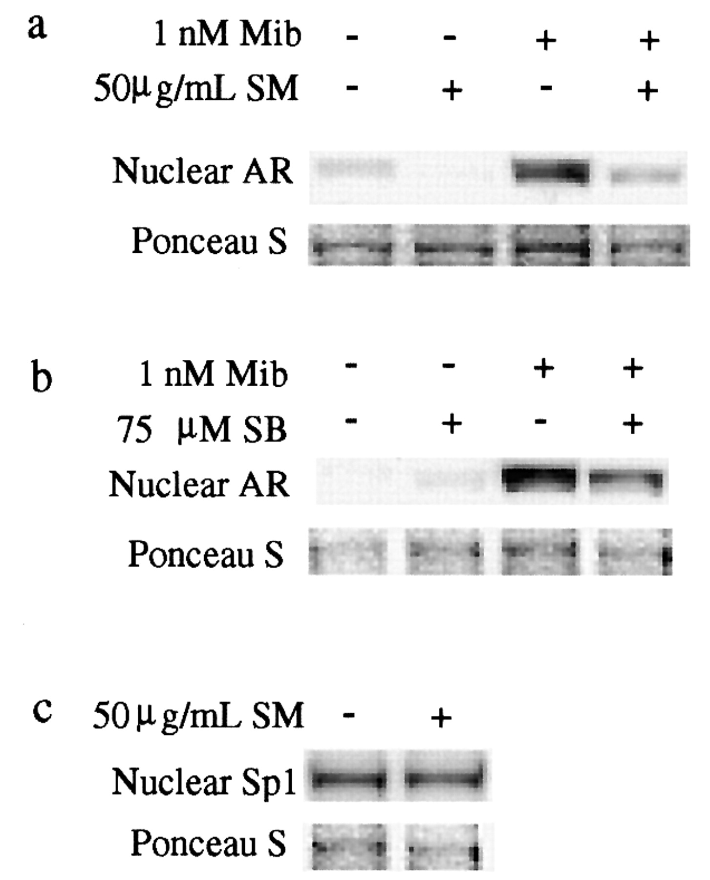
Fig. 5. Western blot analysis of the effects of SM and SB on nuclear AR levels in LNCaP cells after 24 h treatment. ...
Notes:
Fig. 5. Western blot analysis of the effects of SM and SB on nuclear AR levels in LNCaP cells after 24 h treatment. ( a and b ) Nuclear AR levels; ( c ) nuclear level of transcriptional factor Sp1. LNCaP cells were treated with SM and SB in the presence of 1 nM Mib for 24 h and nuclear extracts were prepared for western analysis. Antibodies against human AR and Sp1 were used.
Unless provided in the caption above, the following copyright applies to the content of this slide: © Oxford University Press

Slide 6
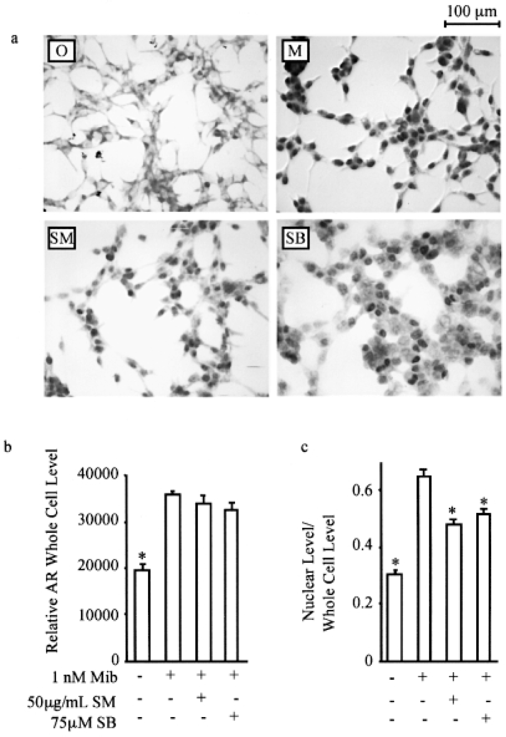
Fig. 6. Immunohistochemical staining of the AR. ( a ) AR staining. O, vehical control; M, 1 nM Mib; SM, 1 nM Mib + ...
Notes:
Fig. 6. Immunohistochemical staining of the AR. ( a ) AR staining. O, vehical control; M, 1 nM Mib; SM, 1 nM Mib + 50 μg/ml SM; SB, 1 nM Mib + 75 μM SB. ( b ) Bar graph showing whole cell AR levels from (a). ( c ) The ratio of nuclear AR levels over whole cell AR levels in (a). LNCaP cells were treated with SM and SB in the presence of 1 nM Mib for 24 h and stained for AR with a monoclonal antibody against the human AR. Error bars indicate the standard errors of 20–25 cells in each treatement. * P < 0.05, when compared with the group treated with Mib alone.
Unless provided in the caption above, the following copyright applies to the content of this slide: © Oxford University Press

