Slide 1
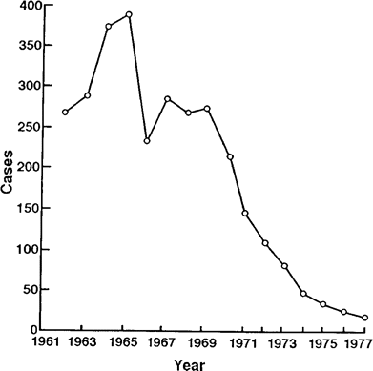
Figure 1 Number of cases of acute rheumatic fever reported yearly to the Chicago Board of Health registry from 1961 ...
Notes:
Figure 1 Number of cases of acute rheumatic fever reported yearly to the Chicago Board of Health registry from 1961 until it was discontinued in 1977. Reprinted with permission from [3].
Unless provided in the caption above, the following copyright applies to the content of this slide: © 2006 by the Infectious Diseases Society of America

Slide 2
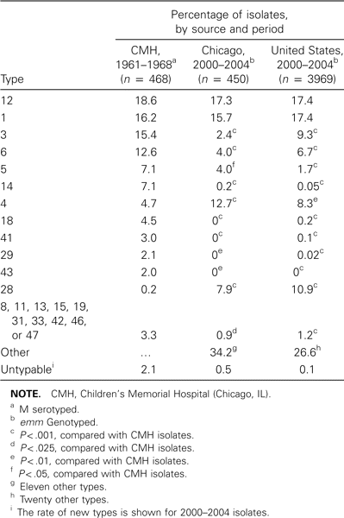
Table 1 Serotype/genotype of group A streptococci isolates recovered from subjects with pharyngitis.
Notes:
Table 1 Serotype/genotype of group A streptococci isolates recovered from subjects with pharyngitis.
Unless provided in the caption above, the following copyright applies to the content of this slide: © 2006 by the Infectious Diseases Society of America

Slide 3
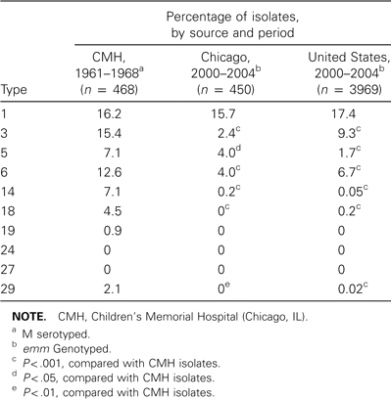
Table 2 Serotype/genotype of rheumatogenic group A streptococci isolates.
Notes:
Table 2 Serotype/genotype of rheumatogenic group A streptococci isolates.
Unless provided in the caption above, the following copyright applies to the content of this slide: © 2006 by the Infectious Diseases Society of America

Slide 4
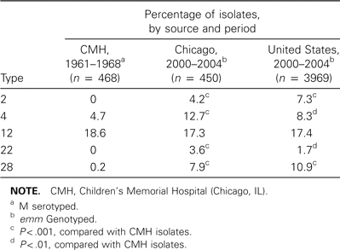
Table 3 Nonrheumatogenic group A streptococci pharyngitis types.
Notes:
Table 3 Nonrheumatogenic group A streptococci pharyngitis types.
Unless provided in the caption above, the following copyright applies to the content of this slide: © 2006 by the Infectious Diseases Society of America

