Slide 1
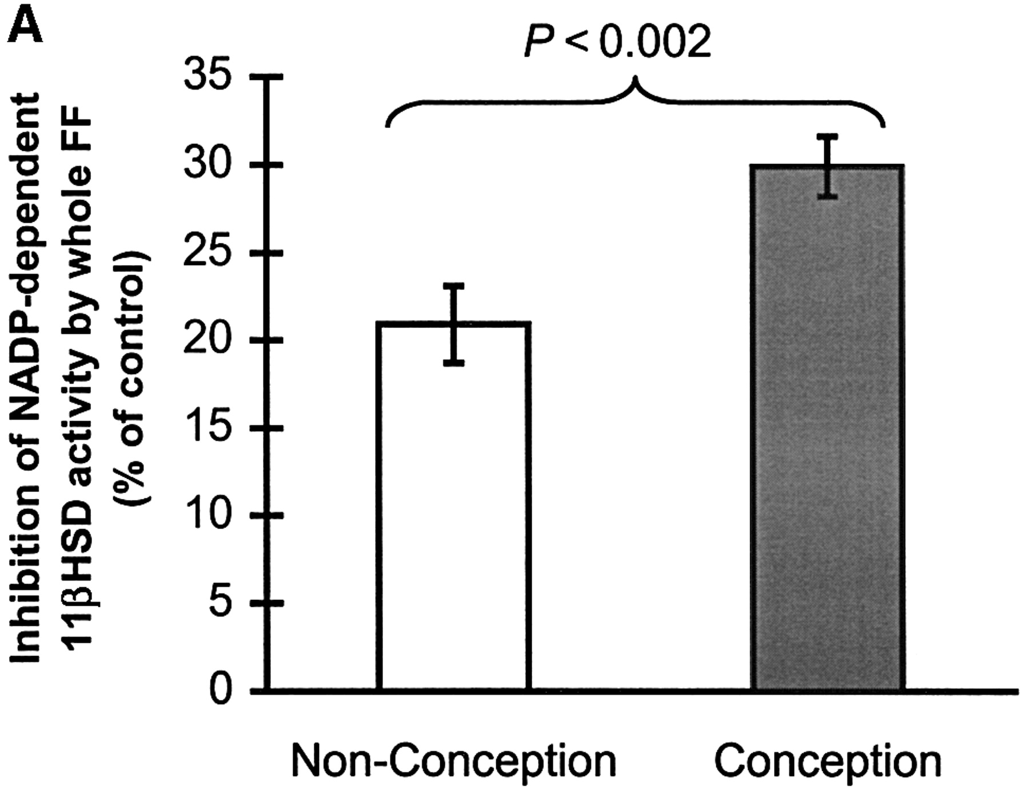
Figure 1. Relationship of clinical outcome for 132 IVF cycles to (A) the inhibition of ...
Notes:
Figure 1. Relationship of clinical outcome for 132 IVF cycles to (A) the inhibition of NADP+‐dependent 11βHSD activities by whole FF samples, (B) the stimulation of NADP+‐dependent 11βHSD activities by the hydrophilic FF fractions [eluted at 0% (v/v) methanol], and (C) the inhibition of NADP+‐dependent 11βHSD activities by the hydrophobic FF fractions [eluted at 80% (v/v) methanol]. In each panel, the vertical bars represent the mean (± SEM) inhibition exerted by 88 FF samples obtained from non‐conception cycles (open bar) and 44 FF samples obtained from conception cycles (filled bar).
Unless provided in the caption above, the following copyright applies to the content of this slide:

Slide 2
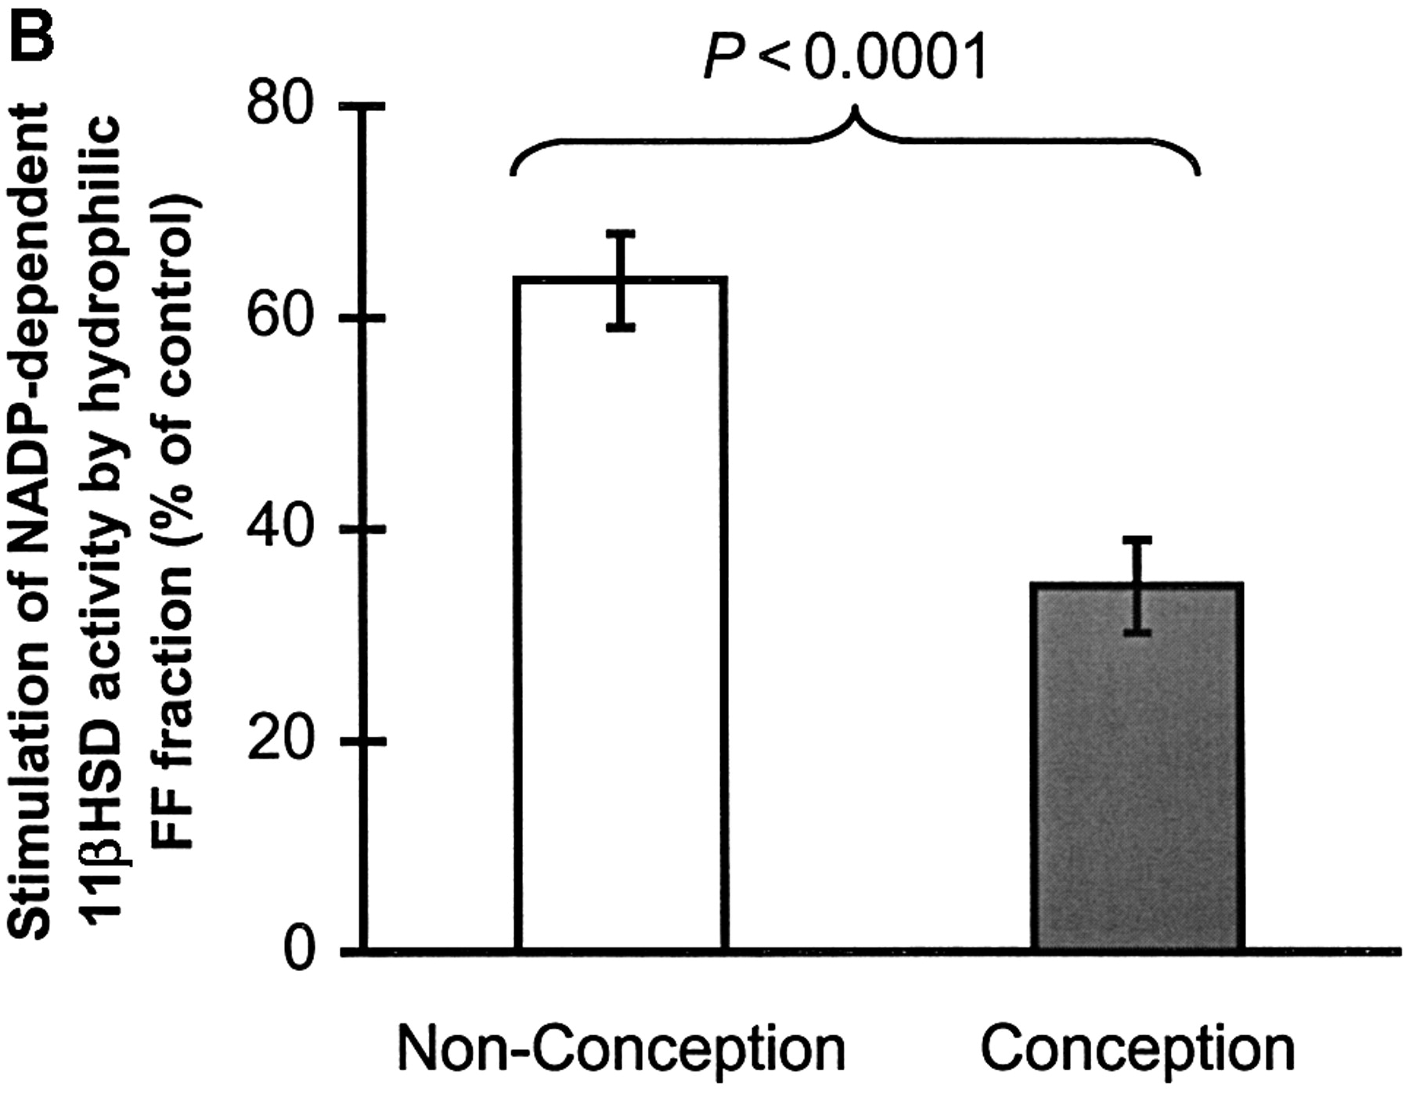
Figure 1. Relationship of clinical outcome for 132 IVF cycles to (A) the inhibition of ...
Notes:
Figure 1. Relationship of clinical outcome for 132 IVF cycles to (A) the inhibition of NADP+‐dependent 11βHSD activities by whole FF samples, (B) the stimulation of NADP+‐dependent 11βHSD activities by the hydrophilic FF fractions [eluted at 0% (v/v) methanol], and (C) the inhibition of NADP+‐dependent 11βHSD activities by the hydrophobic FF fractions [eluted at 80% (v/v) methanol]. In each panel, the vertical bars represent the mean (± SEM) inhibition exerted by 88 FF samples obtained from non‐conception cycles (open bar) and 44 FF samples obtained from conception cycles (filled bar).
Unless provided in the caption above, the following copyright applies to the content of this slide:

Slide 3
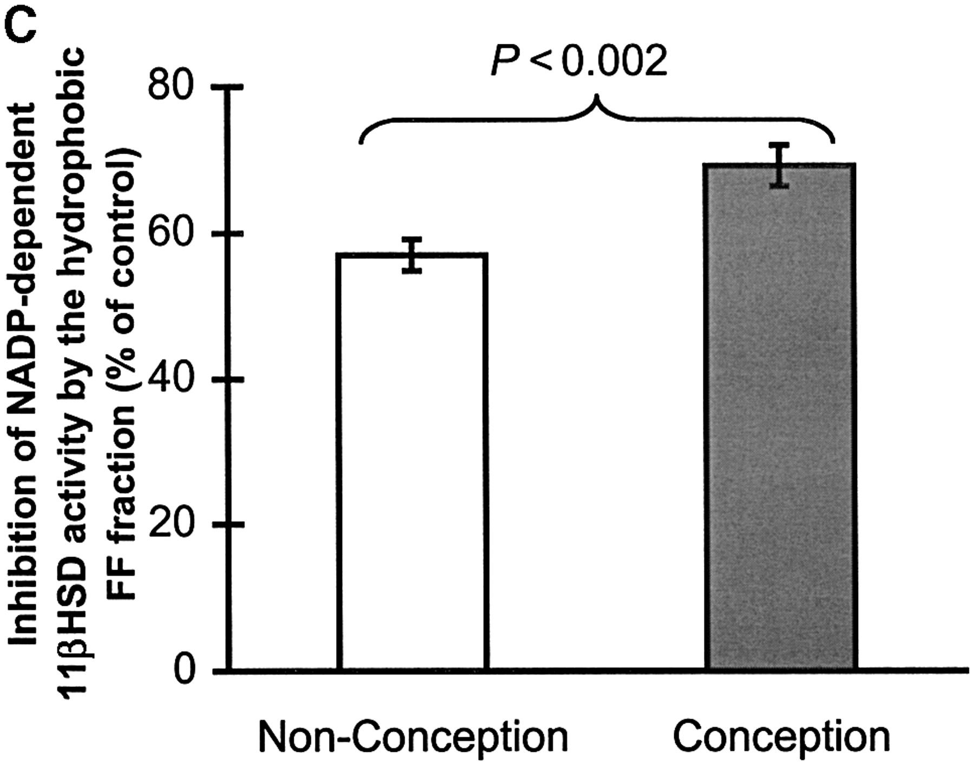
Figure 1. Relationship of clinical outcome for 132 IVF cycles to (A) the inhibition of ...
Notes:
Figure 1. Relationship of clinical outcome for 132 IVF cycles to (A) the inhibition of NADP+‐dependent 11βHSD activities by whole FF samples, (B) the stimulation of NADP+‐dependent 11βHSD activities by the hydrophilic FF fractions [eluted at 0% (v/v) methanol], and (C) the inhibition of NADP+‐dependent 11βHSD activities by the hydrophobic FF fractions [eluted at 80% (v/v) methanol]. In each panel, the vertical bars represent the mean (± SEM) inhibition exerted by 88 FF samples obtained from non‐conception cycles (open bar) and 44 FF samples obtained from conception cycles (filled bar).
Unless provided in the caption above, the following copyright applies to the content of this slide:

Slide 4
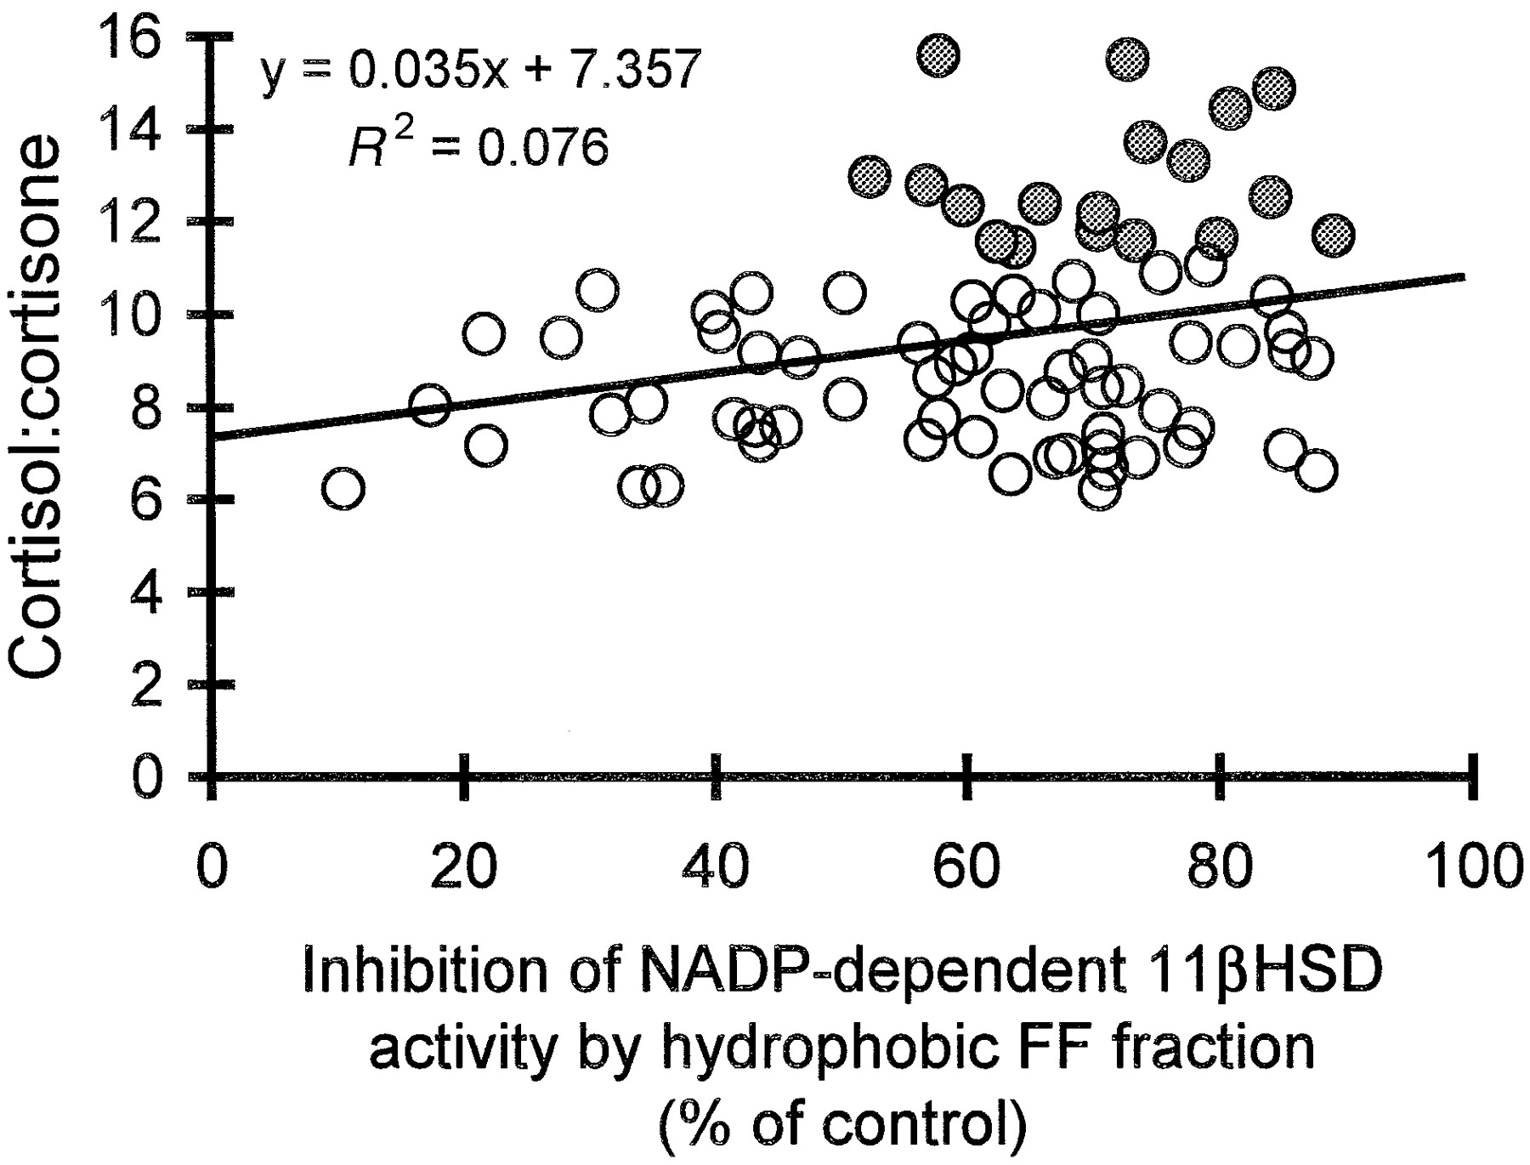
Figure 2. Correlation between intra‐follicular cortisol:cortisone ratios and the degree of inhibition of ...
Notes:
Figure 2. Correlation between intra‐follicular cortisol:cortisone ratios and the degree of inhibition of NADP+‐dependent 11βHSD activities in renal homogenates by the hydrophobic FF fractions [eluted at 80% (v/v) methanol]. Open symbols indicate FF samples obtained from 61 non‐conception cycles; filled symbols indicate FF samples obtained from 18 conception cycles.
Unless provided in the caption above, the following copyright applies to the content of this slide:

Slide 5
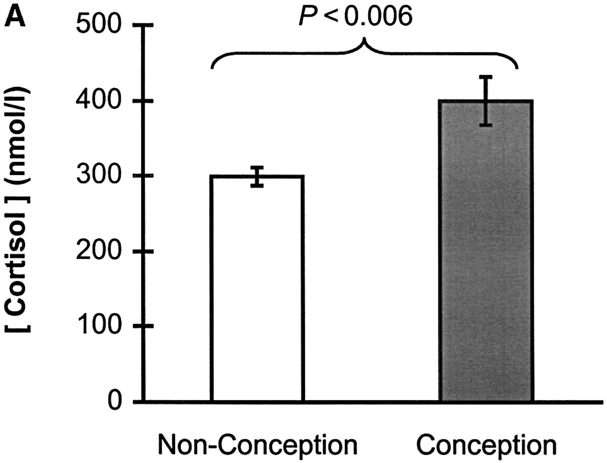
Figure 3. Relationship of IVF cycle outcome to (A) intra‐follicular cortisol concentrations, (B) ...
Notes:
Figure 3. Relationship of IVF cycle outcome to (A) intra‐follicular cortisol concentrations, (B) intra‐follicular cortisone concentrations and (C) intra‐follicular cortisol:cortisone ratios. In each panel, the vertical bars represent the mean (± SEM) inhibition exerted by 61 FF samples obtained from non‐conception cycles (open bar) and 18 FF samples obtained from conception cycles (filled bar).
Unless provided in the caption above, the following copyright applies to the content of this slide:

Slide 6
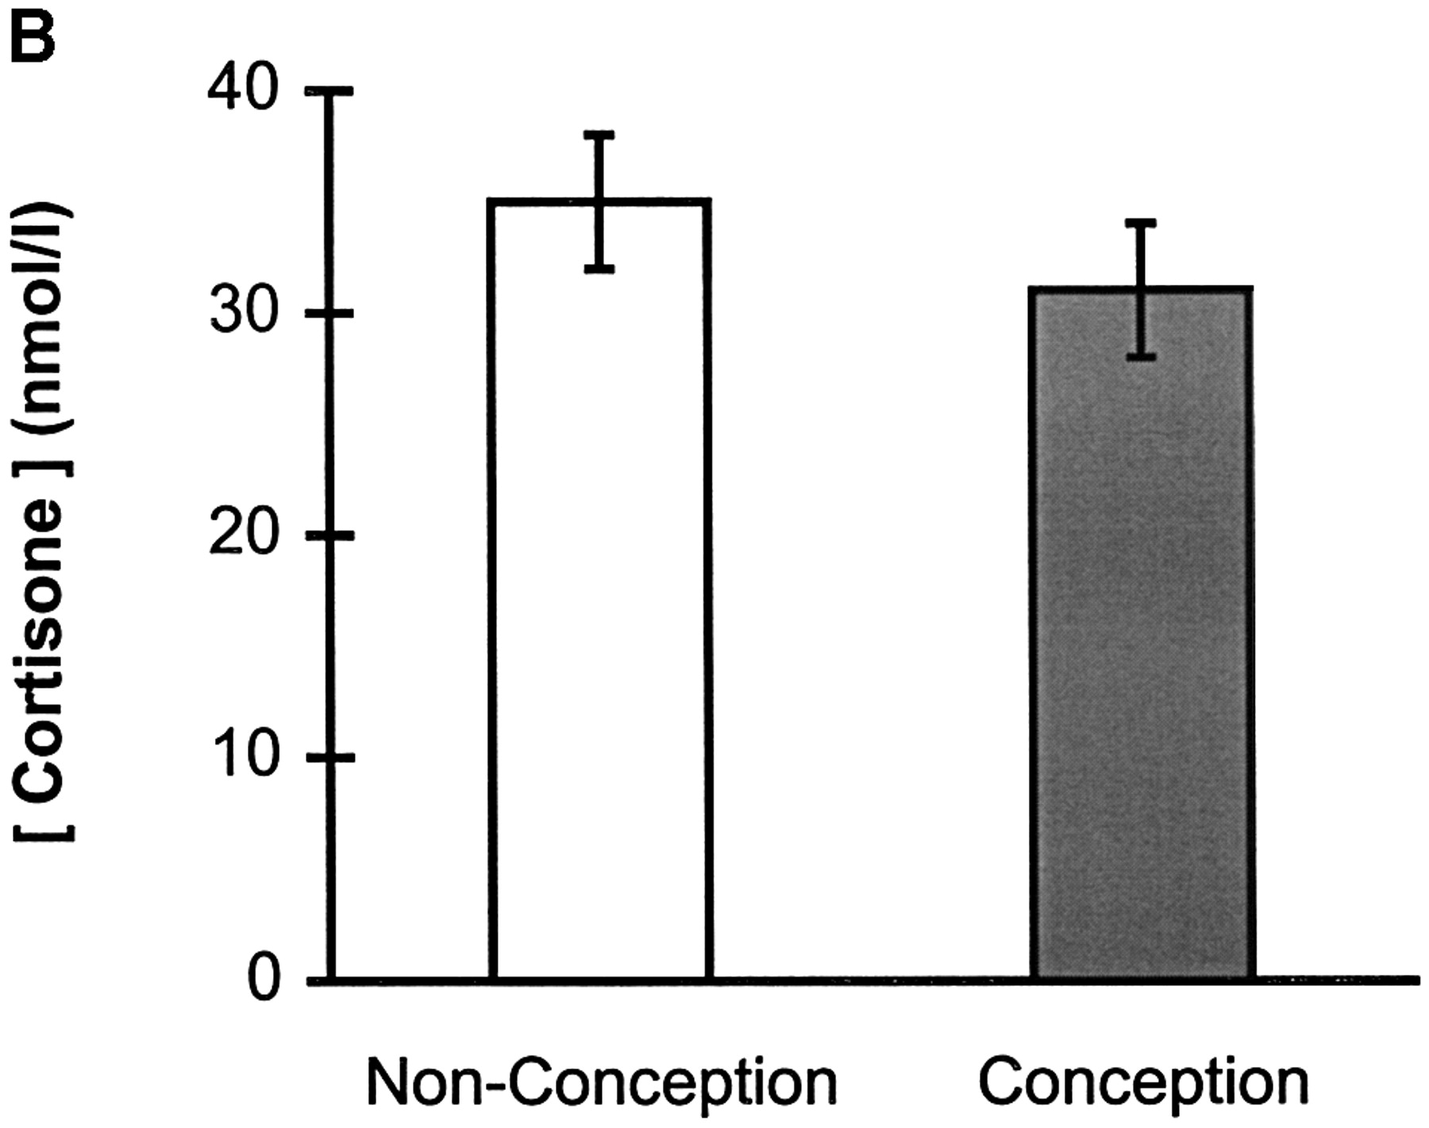
Figure 3. Relationship of IVF cycle outcome to (A) intra‐follicular cortisol concentrations, (B) ...
Notes:
Figure 3. Relationship of IVF cycle outcome to (A) intra‐follicular cortisol concentrations, (B) intra‐follicular cortisone concentrations and (C) intra‐follicular cortisol:cortisone ratios. In each panel, the vertical bars represent the mean (± SEM) inhibition exerted by 61 FF samples obtained from non‐conception cycles (open bar) and 18 FF samples obtained from conception cycles (filled bar).
Unless provided in the caption above, the following copyright applies to the content of this slide:

Slide 7
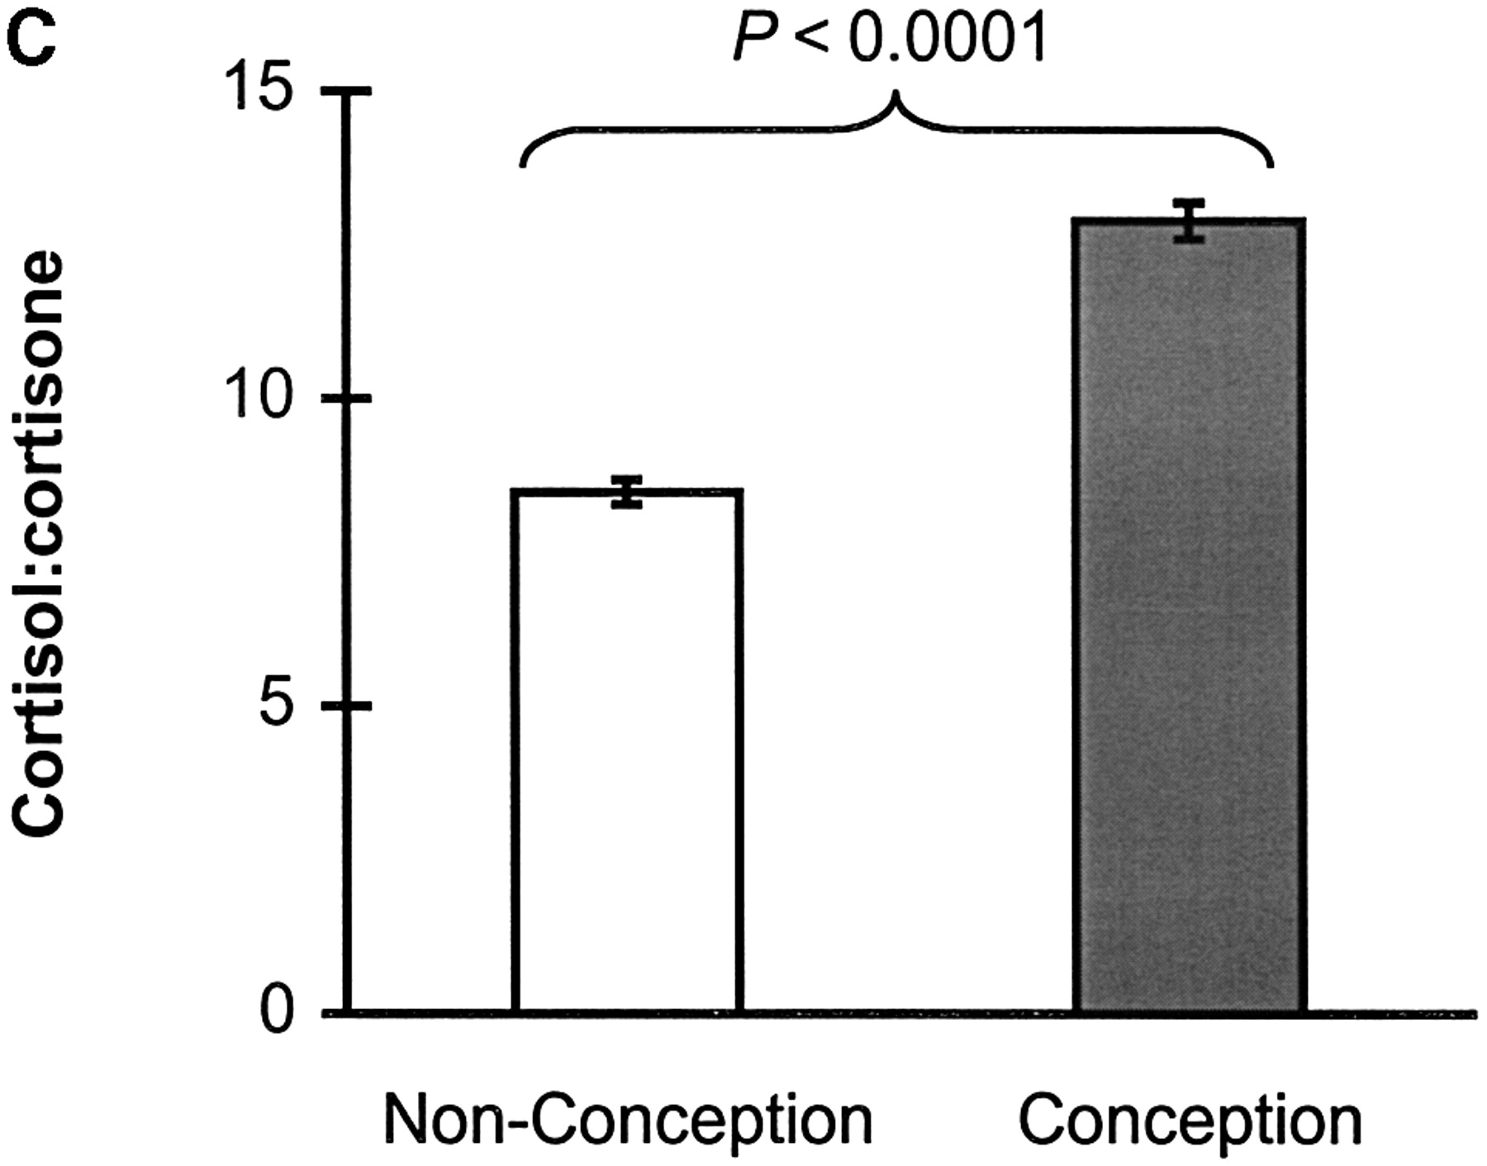
Figure 3. Relationship of IVF cycle outcome to (A) intra‐follicular cortisol concentrations, (B) ...
Notes:
Figure 3. Relationship of IVF cycle outcome to (A) intra‐follicular cortisol concentrations, (B) intra‐follicular cortisone concentrations and (C) intra‐follicular cortisol:cortisone ratios. In each panel, the vertical bars represent the mean (± SEM) inhibition exerted by 61 FF samples obtained from non‐conception cycles (open bar) and 18 FF samples obtained from conception cycles (filled bar).
Unless provided in the caption above, the following copyright applies to the content of this slide:

