Slide 1
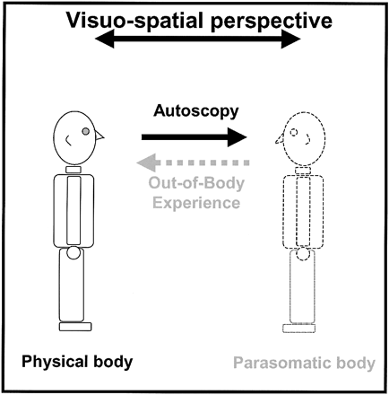
Fig. 1 Phenomenology of OBE and AS. An OBE is defined as the experience in which a person seems to see ...
Notes:
Fig. 1 Phenomenology of OBE and AS. An OBE is defined as the experience in which a person seems to see his/her body and the world from a location outside the physical body. During an OBE, the experient appears to ‘see’ himself (physical body, depicted on the left) and the world from a location other than his physical body (parasomatic body and visuo‐spatial perspective, depicted on the right). AS is defined as the experience of seeing one’s body (depicted on the right) in extrapersonal space, but from the habitual physical visuo‐spatial perspective. During AS, the observer thus remains within the boundaries of his physical body (depicted on the left). Both experiences are classified as autoscopic phenomena since, during OBE and AS, the observer sees himself as a part of the extrapersonal world. The direction of the visuo‐spatial perspective is indicated by an arrow for both experiences.
Unless provided in the caption above, the following copyright applies to the content of this slide: The Guarantors of Brain 2004

Slide 2
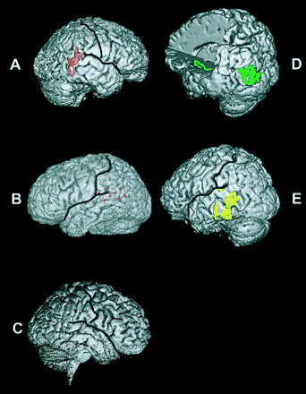
Fig. 2 Individual lesion analysis. In the five patients in whom a lesion could be defined, the results of ...
Notes:
Fig. 2 Individual lesion analysis. In the five patients in whom a lesion could be defined, the results of lesion overlap analysis are shown on the individual 3D MRIs. (A–C) Lesion overlap for patients with OBE (note that Patient 2 initially experienced OBE, but after partial resection of her epileptic focus, she experienced AS). (D–E) Lesion overlap for patients with AS. In Patient 1 (A), lesion overlap (pink) is centred on the posterior part of the superior and middle temporal gyri and the angular gyrus in the right hemisphere. In Patient 2 (B), seizure onset (red) was localized to the posterior part of the superior temporal gyrus, the angular gyrus and the inferior postcentral gyrus in the left hemisphere. In Patient 3 (C, blue), electrical cortical stimulation of the junction of the posterior part of the superior temporal gyrus and the angular gyrus in the right hemisphere induced an OBE. In Patient 4 (D), lesion overlap (green) is centred in two regions in the left hemisphere. One region included the angular gyrus and the lateral occipital gyrus; the other region was localized to the insula. Lesion overlap in Patient 5 (E, yellow) included the posterior parts of the superior and middle temporal gyrus, and the adjacent angular gyrus in the left hemisphere.
Unless provided in the caption above, the following copyright applies to the content of this slide: The Guarantors of Brain 2004

Slide 3
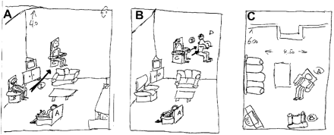
Fig. 3 Graphical depiction of experienced AS (as drawn by Patient 4). The patient divided his experience in ...
Notes:
Fig. 3 Graphical depiction of experienced AS (as drawn by Patient 4). The patient divided his experience in two periods (A,B). In the initial period, he experienced being elevated in his living room chair into the air by ∼3 m in the direction of the arrow (A). In the second period, he experienced a ‘second’ body, which continued to be elevated, but left the patient’s body from the elevated position in the chair (see text). (C) depicts the visual scene as Patient 4 experienced seeing it from his elevated position in the chair. Numbers indicate the dimensions of the patient’s living room in metres. The position of the patient’s wife is indicated by (A) and the successive locations of Patient 3 during the he‐autoscopic period by (B), (C) and (D).
Unless provided in the caption above, the following copyright applies to the content of this slide: The Guarantors of Brain 2004

Slide 4
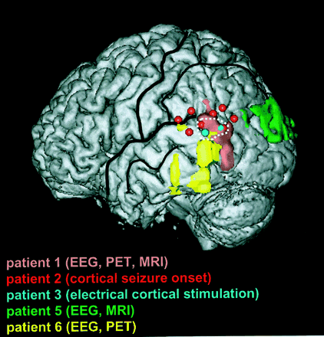
Fig. 4 Mean lesion overlap analysis of the five patients in whom a lesion could be defined (Patients 1, 2, 3, ...
Notes:
Fig. 4 Mean lesion overlap analysis of the five patients in whom a lesion could be defined (Patients 1, 2, 3, 5 and 6). Each patient is indicated in the same colour as in Fig. 2. The results of the individual lesion analysis of each patient were transposed onto the left hemisphere of Patient 5 (see Methods). Mean overlap analysis centred on the TPJ (area indicated by dashed white line). Thick black lines indicate sylvian fissure and central sulcus; thin lines indicate superior temporal sulcus, postcentral sulcus and intraparietal sulcus.
Unless provided in the caption above, the following copyright applies to the content of this slide: The Guarantors of Brain 2004

Slide 5
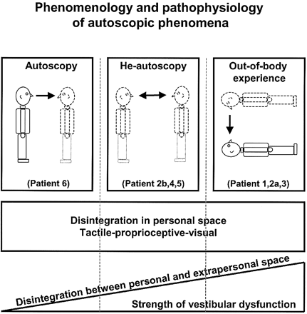
Fig. 5 The phenomenology of AS (left), he‐autoscopy (middle) and OBE (right) are represented schematically in ...
Notes:
Fig. 5 The phenomenology of AS (left), he‐autoscopy (middle) and OBE (right) are represented schematically in the upper part of the figure. The position and posture of the physical body for each autoscopic phenomenon is indicated by black lines and that of the parasomatic body in dashed lines. We found that AS and he‐autoscopy occurred primarily in a sitting/standing position and OBE in a supine position. The fact that patients with AS and he‐autoscopy frequently only see their upper bodies is also included (the absence of the lower body is indicated by a pointed lower contour of the body). The visuo‐spatial perspective is indicated by the arrow pointing away from the location in space from which the patient had the impression he/she saw from AS: from the physical body; OBE: from the parasomatic body; He‐autoscopy: alternating between physical and parasomatic body. The pathophysiology of AS, he‐autoscopy and OBE are represented schematically in the middle and lower parts of the figure. The square in the middle of the figure indicates that all three autoscopic phenomena are characterized by a disintegration of tactile‐proprioceptive‐visual information in personal space. In the lower part of the figure, we indicate that the different forms of autoscopic phenomena are associated to different degrees with a vestibular dysfunction leading to disintegration between personal (vestibular) and extrapersonal (visual) space. Whereas, an OBE is characterized by a strong vestibular dysfunction, a vestibular dysfunction is weak or may be absent in AS. He‐autoscopy represents, pathophysiologically, an intermediate state between OBE and AS.
Unless provided in the caption above, the following copyright applies to the content of this slide: The Guarantors of Brain 2004

