Slide 1
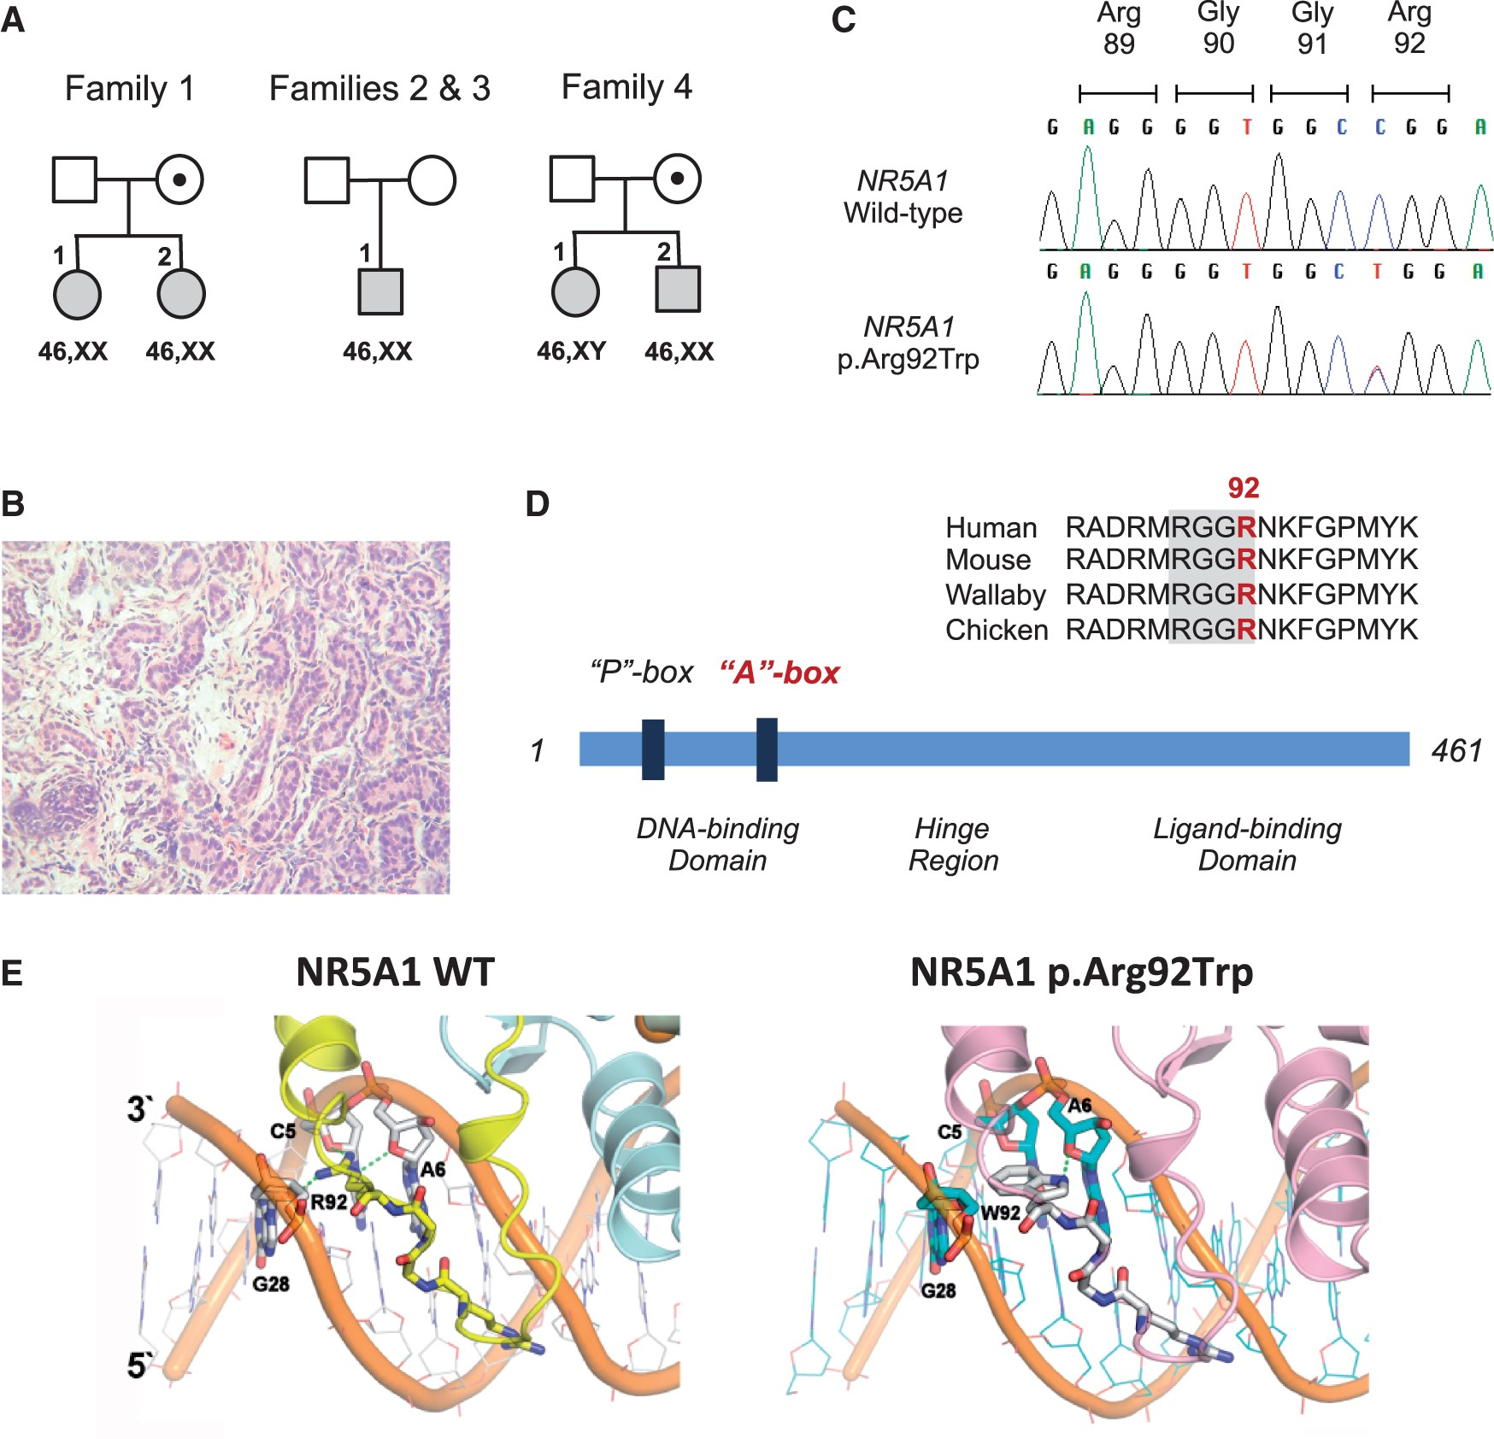
Figure 1. Identification and modelling of the NR5A1 p.Arg92Trp variant. (A) Shows the pedigrees of the four families ...
Notes:
Figure 1. Identification and modelling of the NR5A1 p.Arg92Trp variant. (A) Shows the pedigrees of the four families with the affected members shaded. Squares denote individuals brought up as boys and circles denote individuals brought up as girls, with respective karyotypes shown below. (B) Shows testicular histology from individual 4.2 with 46,XX testicular DSD. (C) Shows sequence chromatograms of the wild-type and p.Arg92Trp NR5A1. (D) Shows the sequence alignment of the A-box motif in selected vertebrae, together with a schematic representation of the NR5A1 protein. (E) Shows the model of wild-type NR5A1 and p.Arg92Trp DNA-binding domain in complex with DNA. The RGGR motif of the A-box interacts with the minor groove of DNA. The basic arginine residue (Arg, R) in wild-type NR5A1 (left panel) is replaced by a neutral tryptophan residue (Trp, W) with a bulky indole side chain (right panel). Overview of the genetic and phenotypic features of children and adults with ovotesticular and testicular DSD Individual1.11.22.13.14.14.2Karyotype46,XX46,XX46,XX46,XX46,XY46,XXSRY––––+–NR5A1p.Arg92Trpp.Arg92Trpp.Arg92Trpp.Arg92Trpp.Arg92Trpp.Arg92TrpInheritanceMaternalMaternalde novoade novoMaternalMaternalSex assignmentFemaleFemaleMaleMaleFemaleMalePresentation“Ambiguous” genitalia“Ambiguous” genitaliaSmall penis; retractile testesSmall testes; low testosteroneMild clitoromegaly; labial fusionPenoscrotal hypospadiasGonad positionL: inguinoscrotal; R: inguinalIntra-abdominalScrotal (retractile)ScrotalInguinalScrotalGonad histologyL: dysgenetic testis; R: ovotestisb Bilateral ovotestesc N/AN/ADysgenetic testesDysgenetic testesUterusR: hemiuterusUterusNo uterusNo uterusNo uterusNo uterusDIagnosis46,XX ovotesticular DSD46,XX ovotesticular DSD46,XX testicular DSD46,XX testicular DSD46,XY partial gonadal dysgenesis46,XX testicular DSDainferred from paternal haplotype (see Supplemental data and Fig. S2); bhistology reported primitive ova structures; cultrasound reported two testes with normal colour Doppler blood flow/spectral waveforms and biochemistry was consistent with the presence of testicular tissue. N/A. not available.
Unless provided in the caption above, the following copyright applies to the content of this slide: © The Author 2016. Published by Oxford University Press.This is an Open Access article distributed under the terms of the Creative Commons Attribution License (http://creativecommons.org/licenses/by/4.0/), which permits unrestricted reuse, distribution, and reproduction in any medium, provided the original work is properly cited.

Slide 2
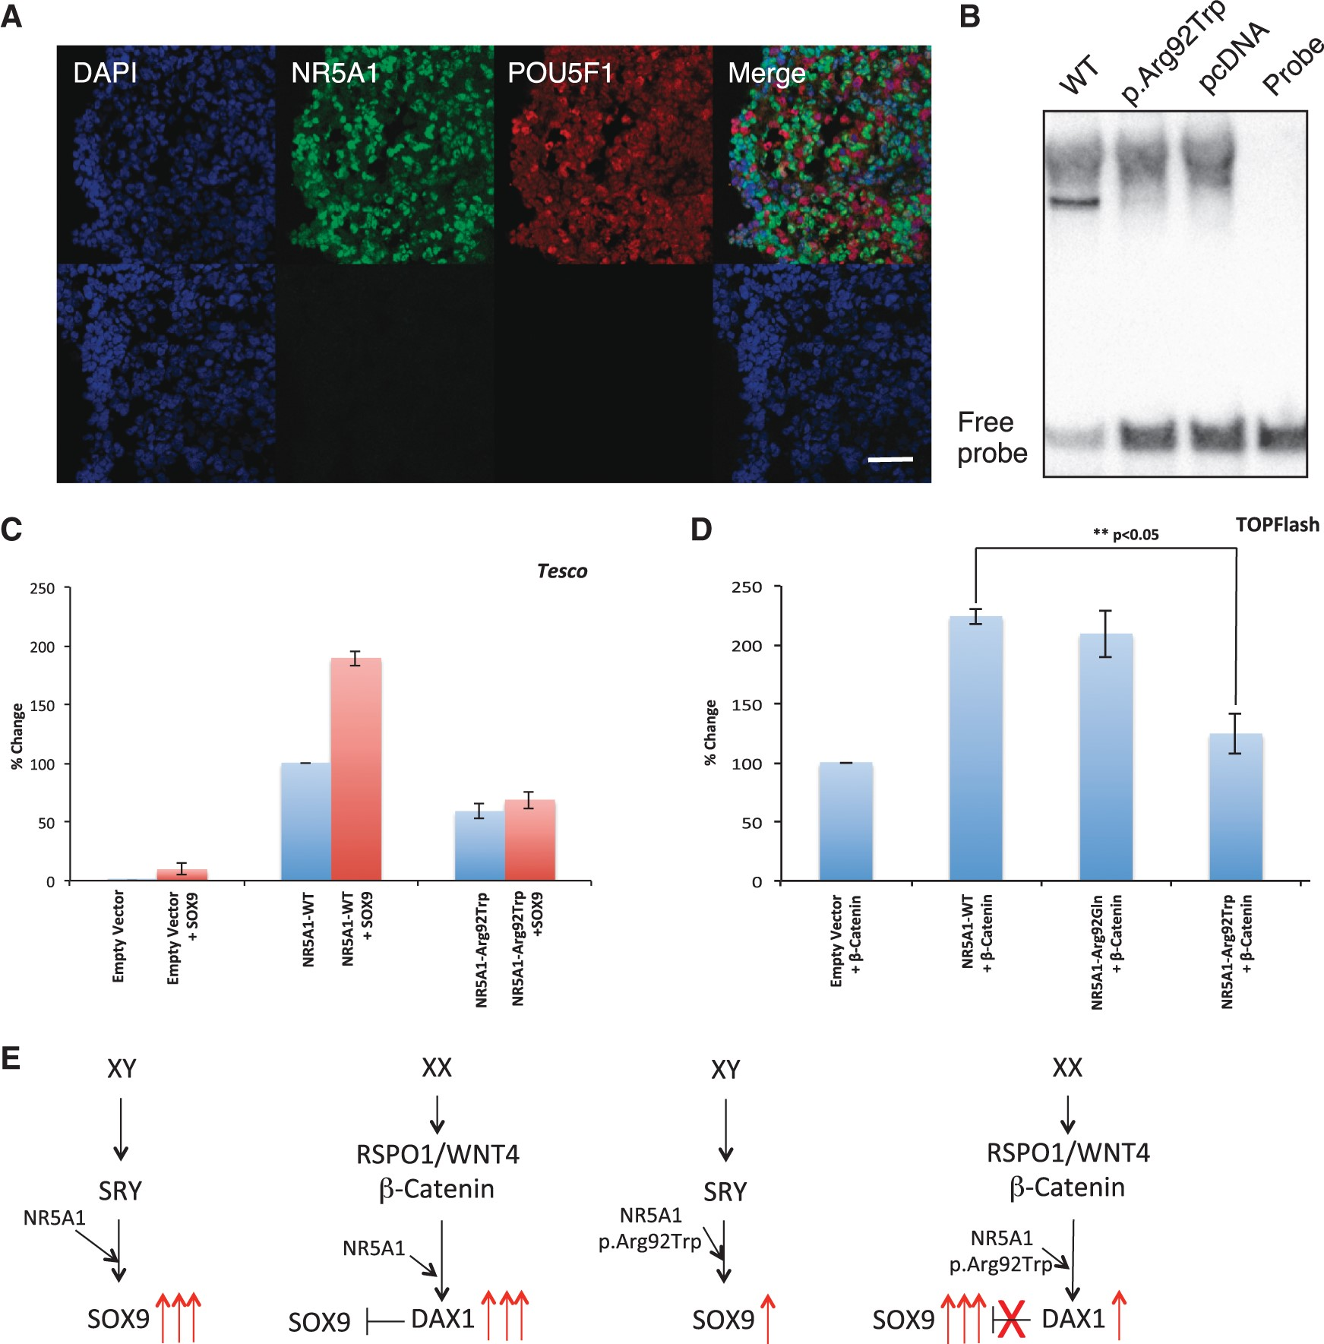
Figure 2. Expression, functional analyses and model of NR5A1 p.Arg92Trp acting as a cell fate switch. (A) Shows ...
Notes:
Figure 2. Expression, functional analyses and model of NR5A1 p.Arg92Trp acting as a cell fate switch. (A) Shows expression of NR5A1 in somatic cells of the developing ovary with germ cells shown by POU5F1 (OCT4) (9 wpc) (upper panel). Negative controls without primary antibody are shown below. Nuclei are stained blue with DAPI. Scale bar denotes 50 µm. (B) Demonstrates that the mutant NR5A1 p.Arg92Trp lacks the ability to bind to a known consensus target sequence. (C) Shows a reduced ability of the NR5A1 mutant protein to activate reporter activity using the Tesco enhancer element as a target in HEK 293-T cells. (D) HEK 293-T cells were transfected with multimerized TCF/LEF1 binding sites containing the luciferase reporter construct (TOPFlash). Co-transfection with the vectors pCSβ-catenin with pCMX-NR5A1 WT, pCMX-NR5A1p.Arg92Gln or pCMX-NR5A1p.Arg92Trp showed that in contrast to both the NR5A1 WT and NR5A1 p.Arg92Gln proteins the NR5A1 p.Arg92Trp showed a reduced ability to synergise with β-catenin to up-regulate reporter gene activity. Similar results were obtained using KGN cells (data not shown). All results are expressed as mean +/- S.D. of at least three experiments. (E) shows a potential model based on the in vitro data. Left: in a 46,XY individual NR5A1 synergises with SRY to upregulate SOX9 expression leading to testis formation. Left centre: in 46,XX individuals, NR5A1 syngerises with β-catenin to upregulate the expression of anti-testis genes (e.g. DAX-1/NR0B1). Right centre: In the 46,XY DSD case (4.1) the p.Arg92Trp mutant shows a reduced ability to up-regulate SOX9 gene expression leading to a lack of testis formation. Right: In a 46,XX child with TDSD/OTDSD, the same mutant shows reduced ability to synergise with β-catenin to up-regulate the expression of anti-testis genes. As a consequence of this lack of repression, the expression of pro-testis genes (e.g. SOX9) leads to testis formation.
Unless provided in the caption above, the following copyright applies to the content of this slide: © The Author 2016. Published by Oxford University Press.This is an Open Access article distributed under the terms of the Creative Commons Attribution License (http://creativecommons.org/licenses/by/4.0/), which permits unrestricted reuse, distribution, and reproduction in any medium, provided the original work is properly cited.

