Slide 1
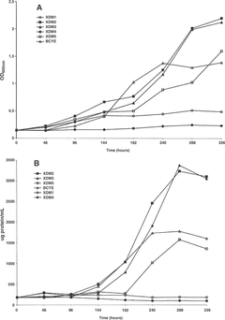
1 Growth curves of X. fastidiosa 9a5c in different defined media. A: Protein content determination; B: ...
Notes:
1 Growth curves of X. fastidiosa 9a5c in different defined media. A: Protein content determination; B: OD600 during 14 days of growth at 28°C at 140 rpm.
Unless provided in the caption above, the following copyright applies to the content of this slide: © 2003 Federation of European Microbiological Societies

Slide 2
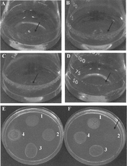
2 Growth of X. fastidiosa 9a5c on liquid media XDM₁ (A), XDM₂ (B), XDM₃ (C), ...
Notes:
2 Growth of X. fastidiosa 9a5c on liquid media XDM1 (A), XDM2 (B), XDM3 (C), XDM4 (D). X. fastidiosa growth on solid versions of XDM2 (E) and XDM3 (F): 9a5c-CVC (1), JAB1-CLS (2), 6747-Plum (3) and Temecula-PD (4).
Unless provided in the caption above, the following copyright applies to the content of this slide: © 2003 Federation of European Microbiological Societies

Slide 3
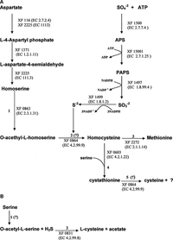
3 Proposed pathways for the biosynthesis of methionine and cysteine in X. fastidiosa. Enzyme steps: (A) 1. ...
Notes:
3 Proposed pathways for the biosynthesis of methionine and cysteine in X. fastidiosa. Enzyme steps: (A) 1. homoserine O-acetyltransferase; 2. cystathionine-γ-synthase 3. methionine synthase; 4. cystathionine-β-synthase; 5. cystathionine-γ-synthase; (B) 1. serine acetyltransferase; 2. O-acetylserine sulfhydrylase. The question marks indicate a step that is incompletely characterized (A) or a missing enzyme (B).
Unless provided in the caption above, the following copyright applies to the content of this slide: © 2003 Federation of European Microbiological Societies

