Slide 1
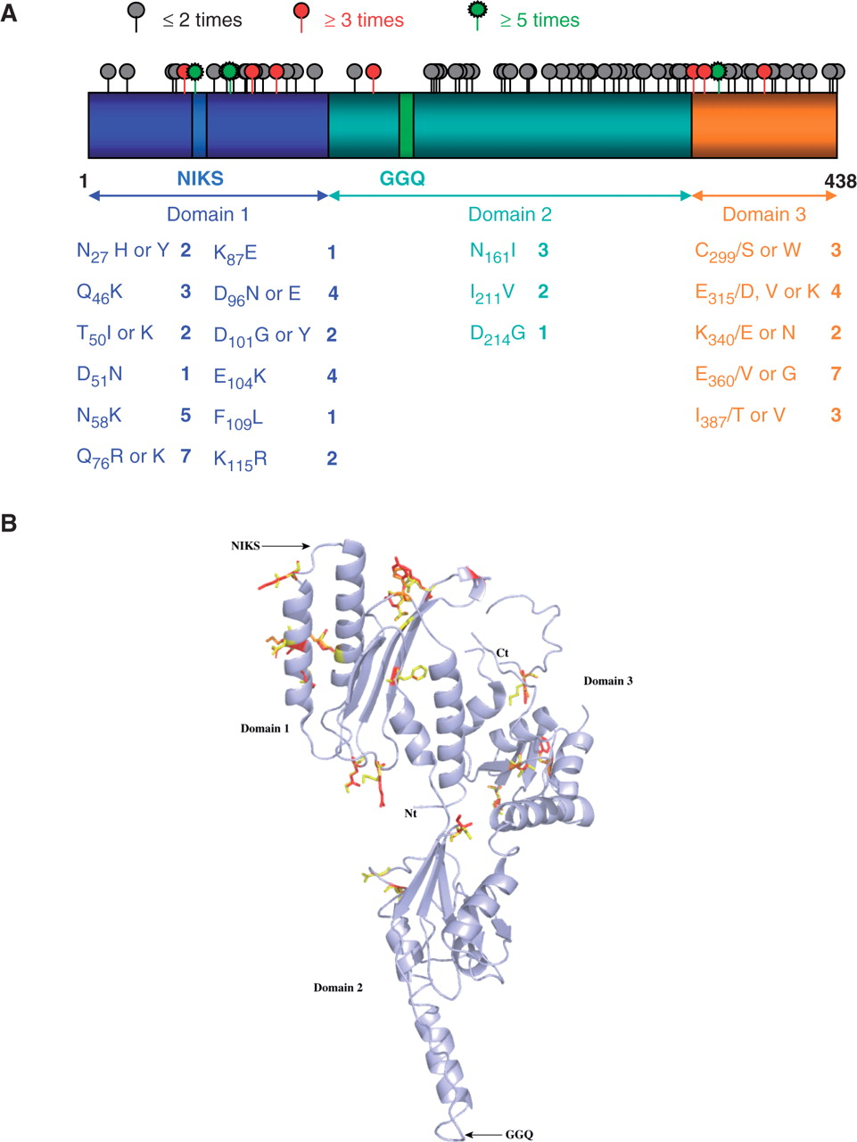
Figure 1. Distribution of the mutations in the SUP45 gene and eRF1 protein. (A) Schematic representation of the SUP45 ...
Notes:
Figure 1. Distribution of the mutations in the SUP45 gene and eRF1 protein. (A) Schematic representation of the SUP45 gene divided into three functional domains. The mutations identified in this study are represented alongside the gene by a gray circle for positions at which mutations were found once or twice, a red circle for mutations found three to five times, and a green circle for mutations found at least five times. All mutants studied are shown below, with the number of times they were found. Mutations found only once are indicated when they are the only mutation identified in the gene. (B) Schematic 3D representation of the eRF1 protein using 1DT9 pdb file. Amino- and carboxy-terminal extremities and each domain are indicated. Functional motifs (GGQ and NIKS) are also shown. Mutated residues are shown in stick representation in yellow and mutations are displayed in red or orange.
Unless provided in the caption above, the following copyright applies to the content of this slide: © 2009 The Author(s)This is an Open Access article distributed under the terms of the Creative Commons Attribution Non-Commercial License (http://creativecommons.org/licenses/by-nc/2.0/uk/) which permits unrestricted non-commercial use, distribution, and reproduction in any medium, provided the original work is properly cited.

Slide 2
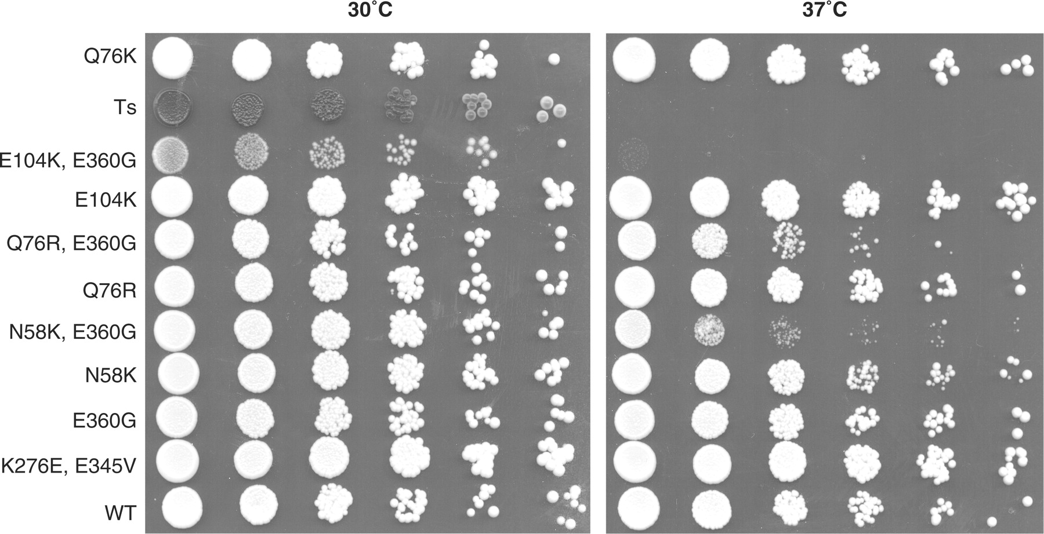
Figure 2. Hyperactive eRF1 mutants can complement the deletion of the SUP45 gene. The FS1ΔS strain was transformed with ...
Notes:
Figure 2. Hyperactive eRF1 mutants can complement the deletion of the SUP45 gene. The FS1ΔS strain was transformed with a plasmid carrying sup45 mutants and plated on selective media for this plasmid. Rescue plasmid carrying wild-type SUP45 gene was shuffled by plating the colonies on media containing 5FOA. The growing cells were transferred to a selective liquid culture until they reached 1 OD600 and were serially diluted. Plates were incubated either at 30 °C or 37 °C to test for thermosensitivity. Ts denotes the MT557/3b strain carrying a thermosensitive sup45 allele; E104K, E360G; Q76R, E360G; N58K, E360G; are double mutants created by directed mutagenesis, combining mutations identified independently during the screen within the same molecule.
Unless provided in the caption above, the following copyright applies to the content of this slide: © 2009 The Author(s)This is an Open Access article distributed under the terms of the Creative Commons Attribution Non-Commercial License (http://creativecommons.org/licenses/by-nc/2.0/uk/) which permits unrestricted non-commercial use, distribution, and reproduction in any medium, provided the original work is properly cited.

Slide 3
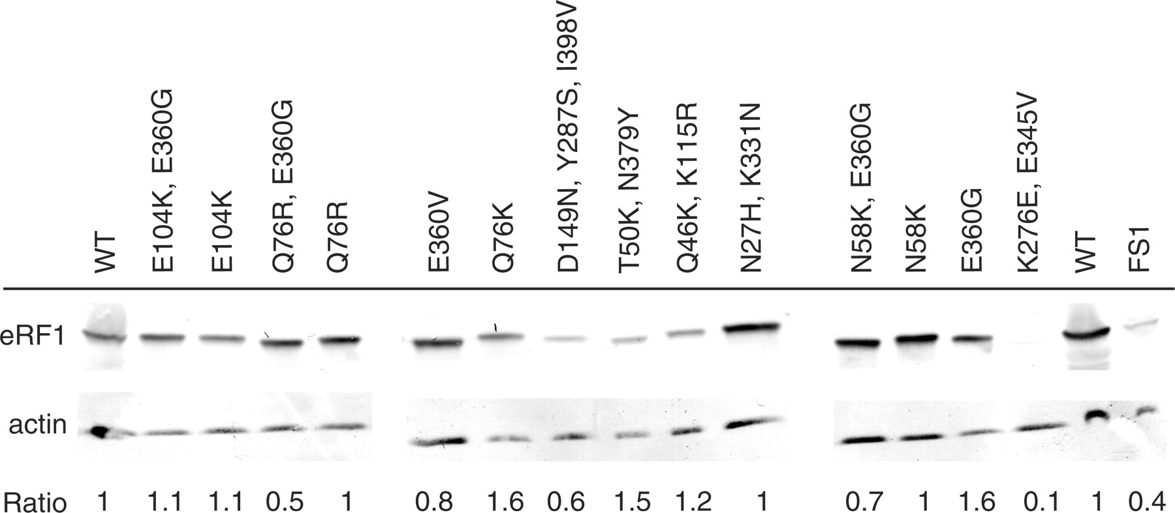
Figure 3. Analysis of the expression of eRF1 variant alleles. Yeast cells carrying the various eRF1 alleles were grown ...
Notes:
Figure 3. Analysis of the expression of eRF1 variant alleles. Yeast cells carrying the various eRF1 alleles were grown to mid log phase. Equivalent amounts of proteins were incubated with antibodies directed against either eRF1 or actin. Ratio of eRF1 to actin proteins is indicated for each mutant. WT denotes the FS1ΔS strain carrying the SUP45wt gene. FS1 denotes the WT strain without the deletion of the SUP45 gene. All the mutants are named by their mutations. The ratios are equivalent for all the mutants, but K276E, E345V which is 10-fold lower than in the wild-type. Despite this low level of eRF1 this mutant still displays a strong termination phenotype.
Unless provided in the caption above, the following copyright applies to the content of this slide: © 2009 The Author(s)This is an Open Access article distributed under the terms of the Creative Commons Attribution Non-Commercial License (http://creativecommons.org/licenses/by-nc/2.0/uk/) which permits unrestricted non-commercial use, distribution, and reproduction in any medium, provided the original work is properly cited.

Slide 4
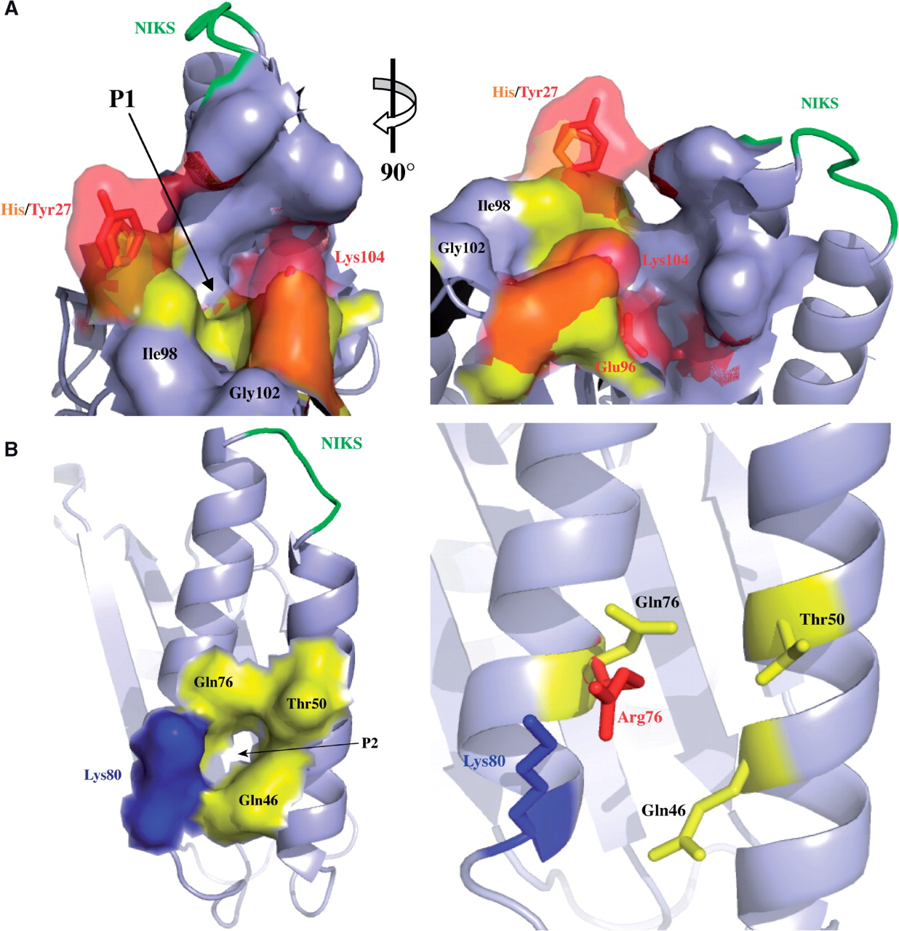
Figure 4. Structural model of mutations identified in eRF1. (A) The left panel shows P1 in the same orientation as ...
Notes:
Figure 4. Structural model of mutations identified in eRF1. (A) The left panel shows P1 in the same orientation as shown in Supplementary Figure S3B. Wild-type amino acids are displayed in yellow, whereas mutated residues are shown in red and orange. The changes induced by these mutations at the surface of the protein are shown in transparency surface mode. The right panel is rotated as indicated to give a more detailed view. (B) The left panel is a surface representation of P2 with labeling of the four residues creating the pocket 2. The three residues found mutated are shown in yellow; the residue with no associated mutation is shown in blue. The right panel is a magnification of the image showing P2 with the same orientation. The residue Arg76 found in our screen is shown in red.
Unless provided in the caption above, the following copyright applies to the content of this slide: © 2009 The Author(s)This is an Open Access article distributed under the terms of the Creative Commons Attribution Non-Commercial License (http://creativecommons.org/licenses/by-nc/2.0/uk/) which permits unrestricted non-commercial use, distribution, and reproduction in any medium, provided the original work is properly cited.

