Slide 1
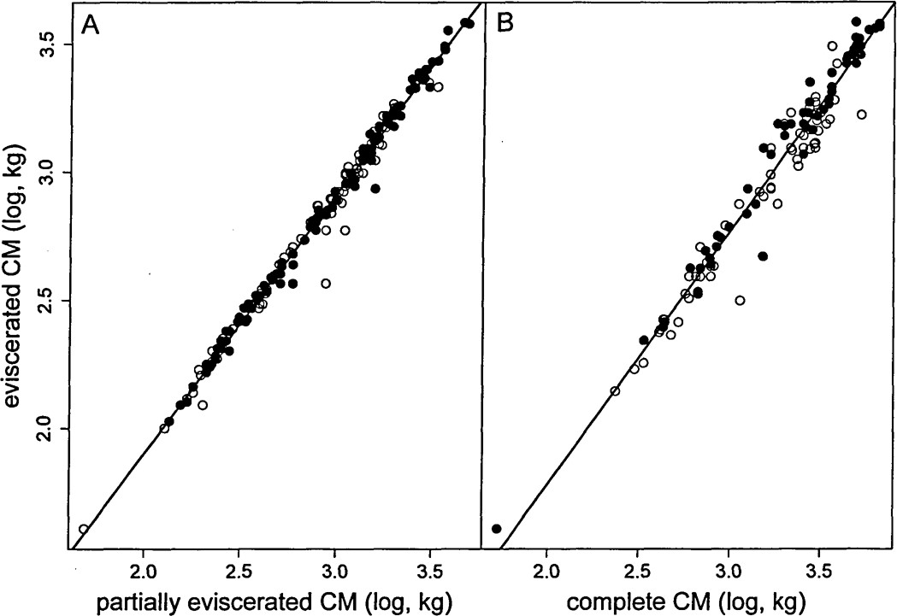
Fig. 1 Isometric relationships between eviscerated carcass mass (CM, kg, log-transformed) and A) partially ...
Notes:
Fig. 1 Isometric relationships between eviscerated carcass mass (CM, kg, log-transformed) and A) partially eviscerated carcass mass (kg, log-transformed) and B) complete carcass mass (kg, log-transformed) in harvested alpine chamois (Rupicapra rupicapra) in the Bauges mountain range, French Alps (filled circles = males; open circles = females). Plain lines were estimated by linear regressions (A: intercept = –0.112 [–0.154; –0.070]95%, slope = 1.008 [0.994; 1.023]95%, n = 209, r = 0.995; B: intercept = –0.357 [–0.488; –0.226]95%, slope = 1.008 [0.968; 1.048]95%, n = 121, r = 0.977).
Unless provided in the caption above, the following copyright applies to the content of this slide: © 2009 American Society of Mammalogists

Slide 2
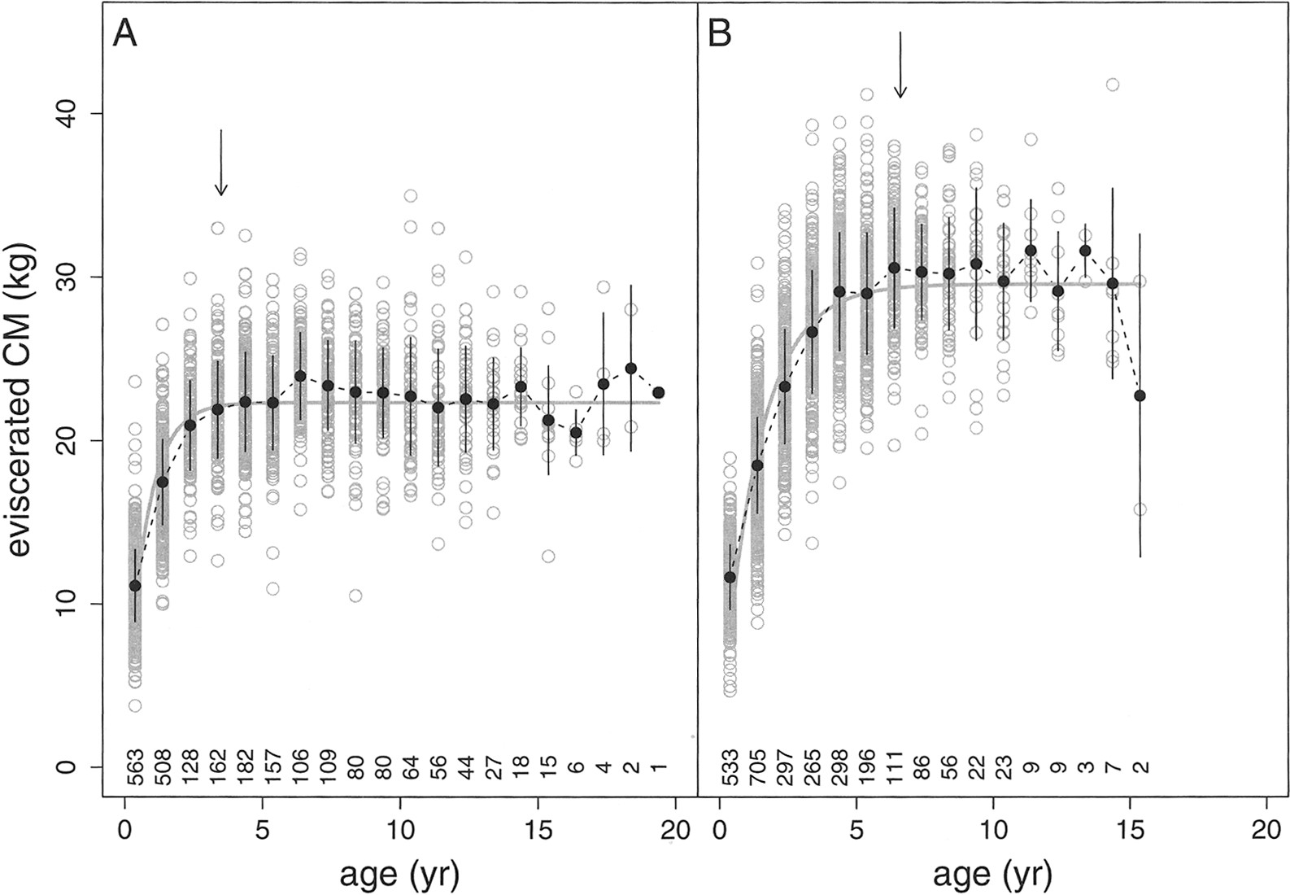
Fig. 2 Growth pattern of harvested alpine chamois (Rupicapra rupicapra; A: females n = 2,312; B: males n = 2,622) in ...
Notes:
Fig. 2 Growth pattern of harvested alpine chamois (Rupicapra rupicapra; A: females n = 2,312; B: males n = 2,622) in the Bauges mountain range, French Alps, period 1977–2007. Plain line corresponds to the monomolecular growth curve fitted to carcass mass data (see Table 1 for parameter estimates). Deleting the very low body mass value of a male of 15.5 years has no effect on the fit of male growth curve. Filled black circles correspond to mean values (± SD). Arrows indicated age at which animals reach 99% of the asymptotic body mass estimated from the growth curve (i.e., end of the period of active body growth). Numbers below the curves correspond to the sample size for each age class.
Unless provided in the caption above, the following copyright applies to the content of this slide: © 2009 American Society of Mammalogists

