Slide 1
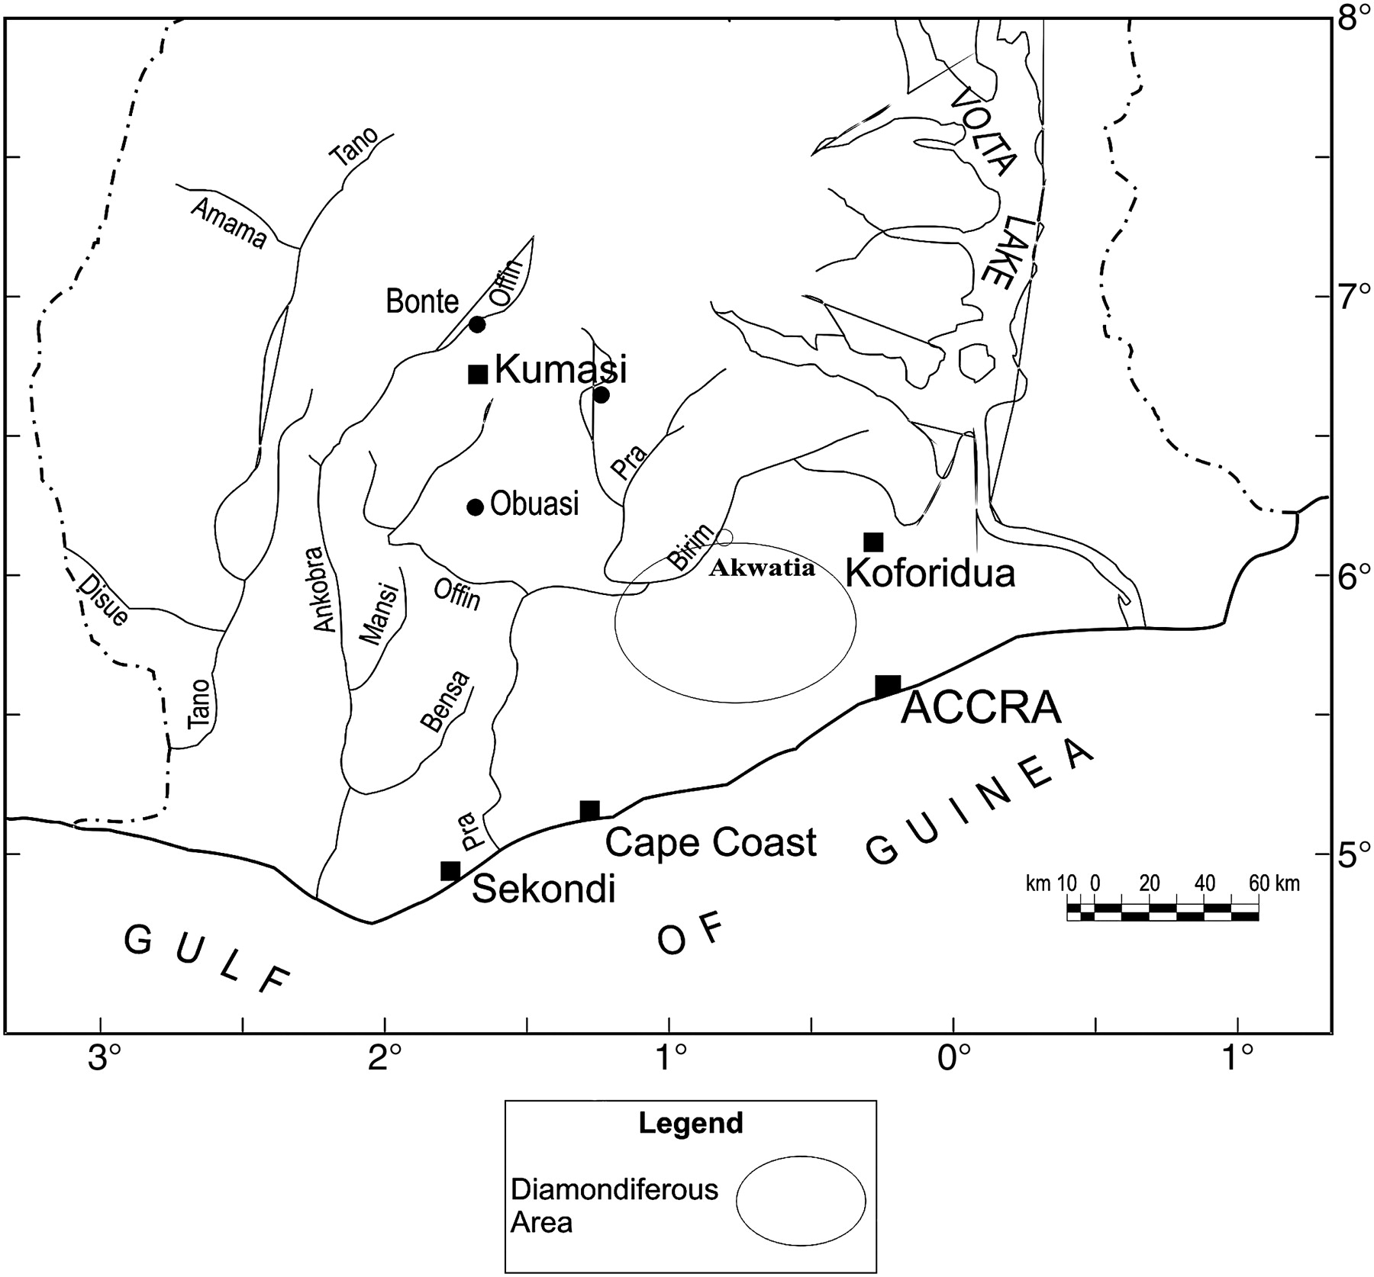
Figure 1 Location of Akwatia, Ghana’s main diamondiferous area.
Notes:
Figure 1 Location of Akwatia, Ghana’s main diamondiferous area.
Unless provided in the caption above, the following copyright applies to the content of this slide: © Oxford University Press 2010

