Slide 1
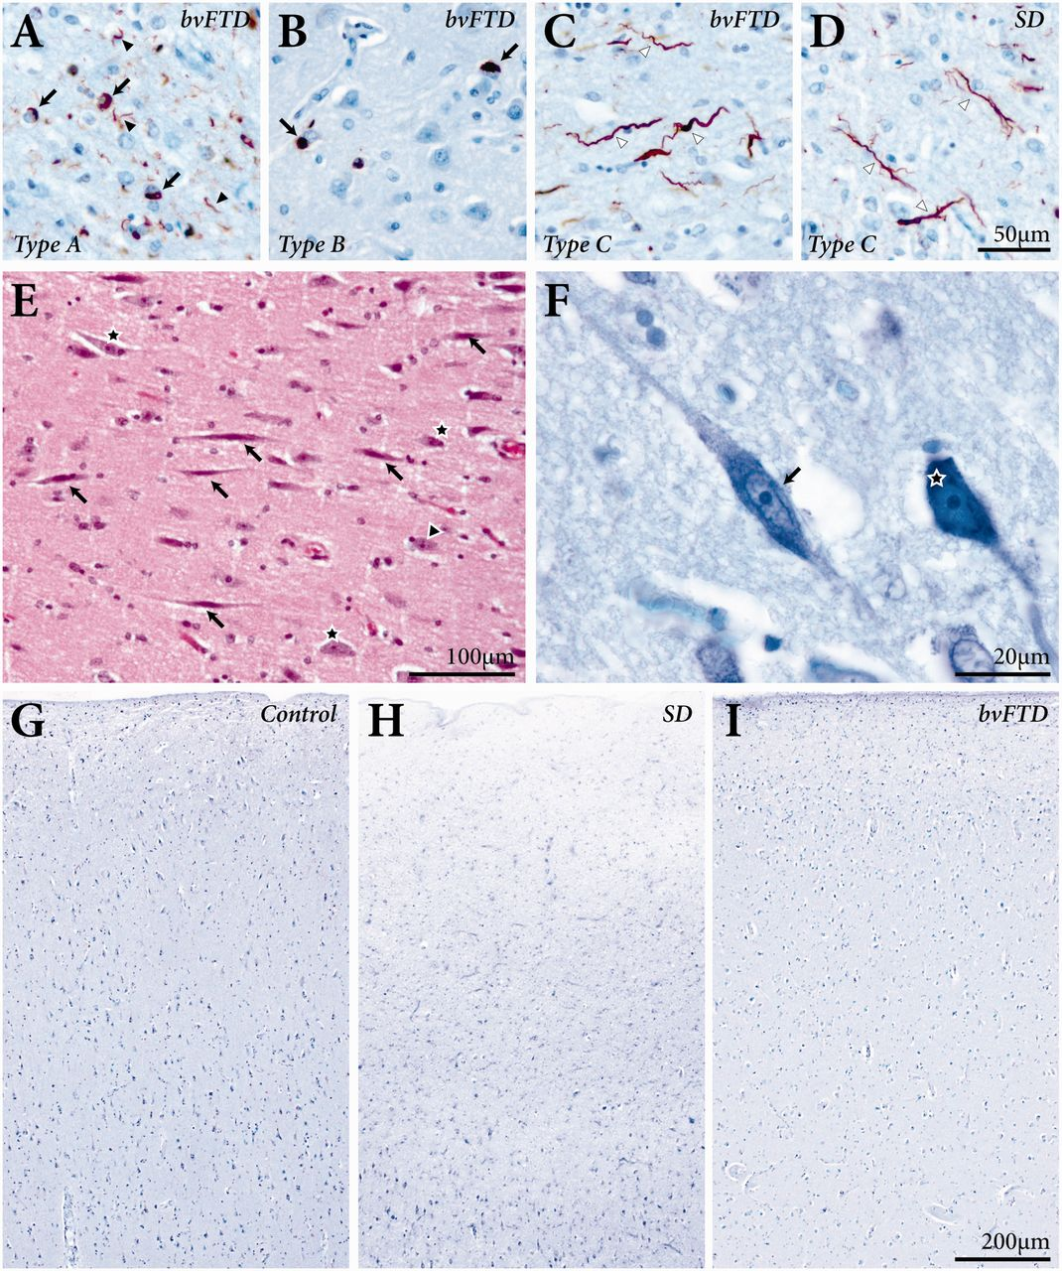
Figure 2 Photomicrographs of TDP pathology in sections from the anterior cingulate cortex in cases with behavioural ...
Notes:
Figure 2 Photomicrographs of TDP pathology in sections from the anterior cingulate cortex in cases with behavioural variant FTD (bvFTD) and with semantic variant PPA (SD). Behavioural variant FTD cases with TDP subtypes A have upper layer neuronal intracytoplasmic inclusions (arrows in A) and short neurites (arrowheads in A), subtype B have neuronal inclusions (arrows in B) throughout the cortex, and subtype C have long neurites (white arrowheads in C). All cases with semantic variant PPA showed TDP subtype C pathology (white arrowheads in D). Haematoxylin and eosin stained section showing von Economo neurons (E: arrows) and pyramidal neurons (E: star) in layer V of the anterior cingulate cortex in an elderly control. High resolution photomicrograph of a Cresyl violet stained section showing a von Economo neuron (F: arrow) and pyramidal neuron (F: star) in a case with semantic variant PPA. Photomicrographs of cresyl violet stained sections showing the significant neuronal loss in the anterior temporal cortex in semantic variant PPA (H) compared with elderly controls (G) and behavioural variant FTD cases (I).
Unless provided in the caption above, the following copyright applies to the content of this slide: © The Author (2014). Published by Oxford University Press on behalf of the Guarantors of Brain. All rights reserved. For Permissions, please email: journals.permissions@oup.com

Slide 2
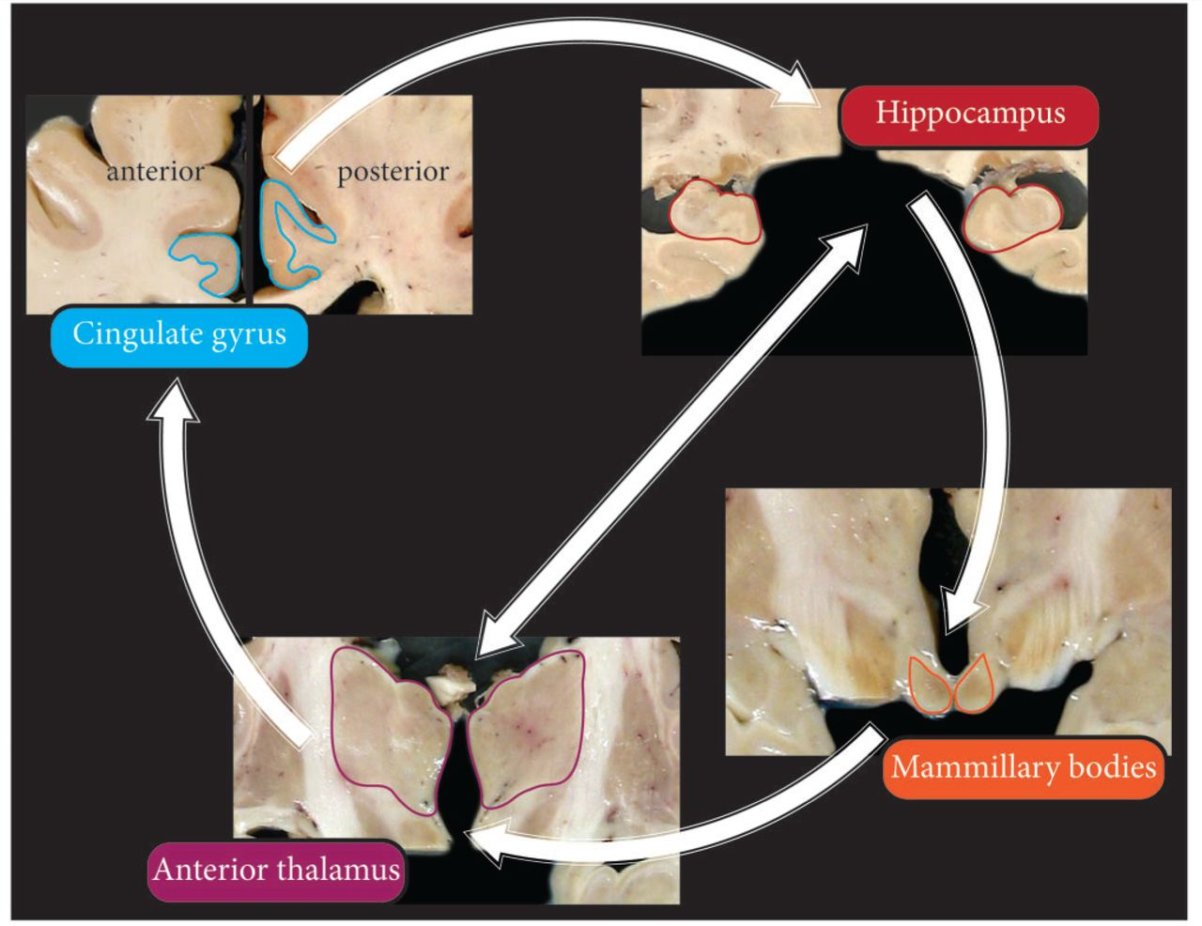
Figure 1 Photographs of coronal brain slices showing the regions of interest (outlined) identified in the Papez memory ...
Notes:
Figure 1 Photographs of coronal brain slices showing the regions of interest (outlined) identified in the Papez memory network (Vogt et al., 2006; Aggleton et al., 2010; Shah et al., 2012) in which volumetric analysis was performed. The connections between the regions of interest are also shown (white arrows). The level at which these brain sections are taken is listed in the ‘Materials and methods’ section.
Unless provided in the caption above, the following copyright applies to the content of this slide: © The Author (2014). Published by Oxford University Press on behalf of the Guarantors of Brain. All rights reserved. For Permissions, please email: journals.permissions@oup.com

