Slide 1
Figure 1 Locations of the WRN mutations. The rectangular box indicates the predicted WRN protein. The light shadowed ...
Notes:
Figure 1 Locations of the WRN mutations. The rectangular box indicates the predicted WRN protein. The light shadowed segment indicates the highly acidic repeat region; dark shadows indicate the locations of the helicase consensus motifs. The locations of the WRN mutations are grouped based upon the type of mutation and are shown underneath the f Parentheses indicate the heterozygous mutations. ZM and MH mutations were previously described (1).
Unless provided in the caption above, the following copyright applies to the content of this slide: © 1993 Oxford University Press

Slide 2
Table 1 Primer sequences for the RT-PCR sequencing template
Notes:
Table 1 Primer sequences for the RT-PCR sequencing template
Unless provided in the caption above, the following copyright applies to the content of this slide: © 1993 Oxford University Press

Slide 3
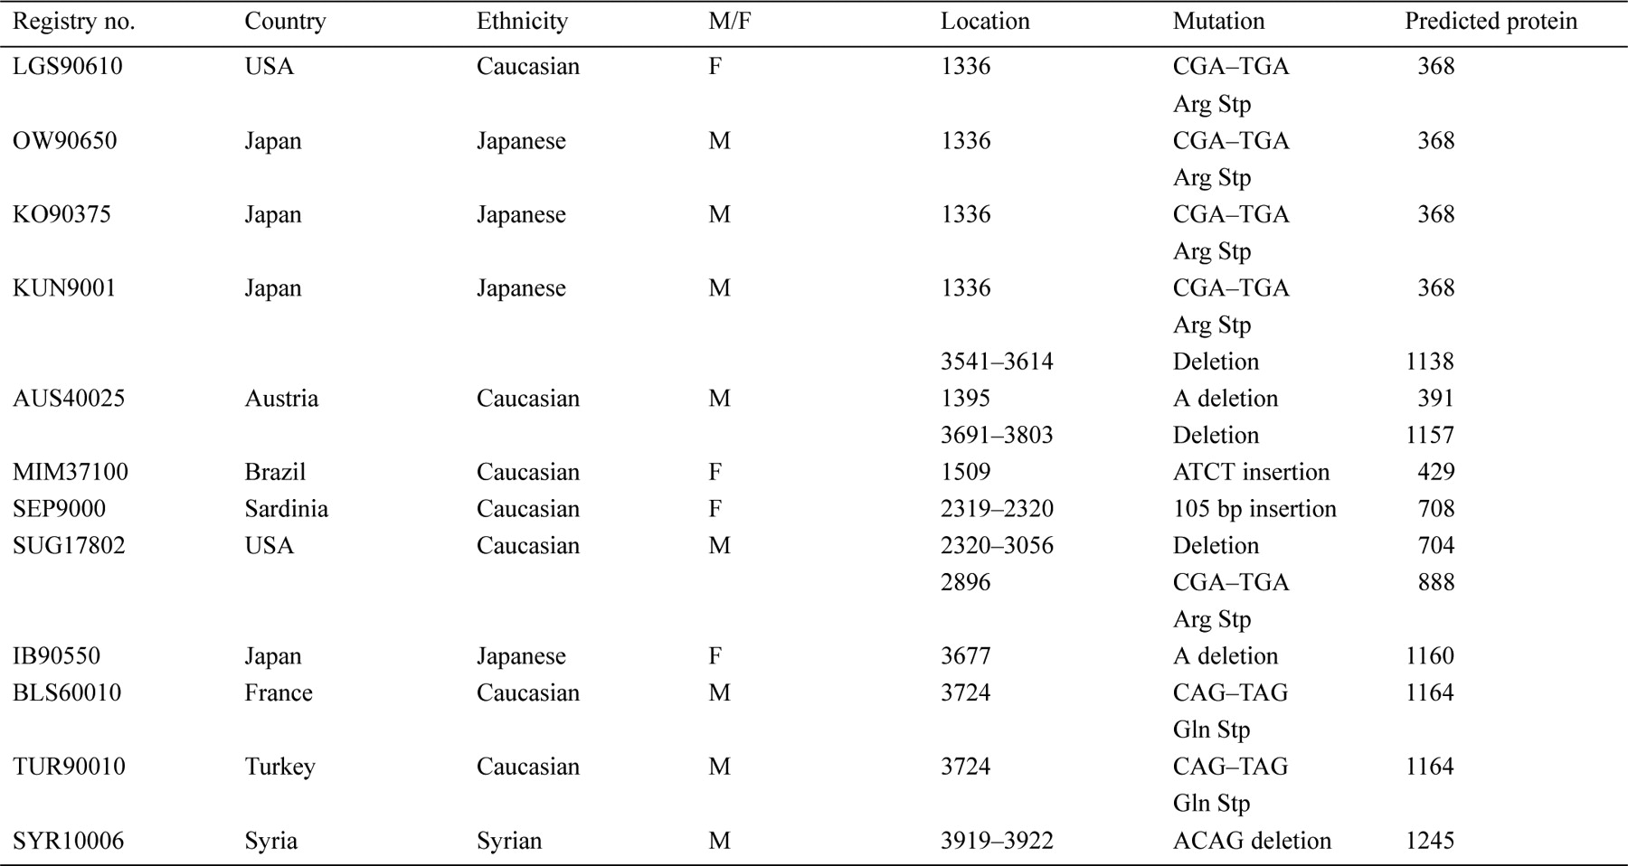
Table 2 WRN mutations in Japanese and Caucasian WS patients
Notes:
Table 2 WRN mutations in Japanese and Caucasian WS patients
Unless provided in the caption above, the following copyright applies to the content of this slide: © 1993 Oxford University Press

