Slide 1
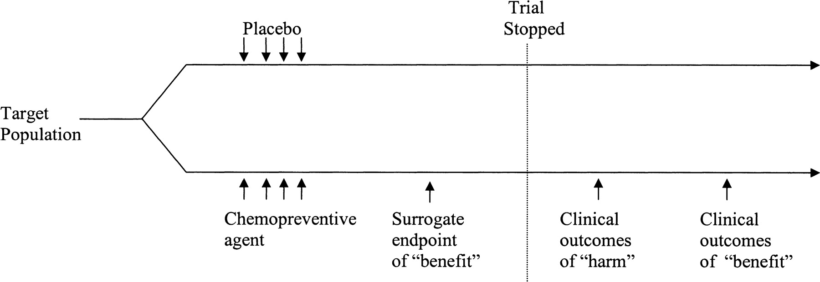
Fig. 1. Time line of evaluation of surrogate endpoints associated with chemopreventive studies.
Notes:
Fig. 1. Time line of evaluation of surrogate endpoints associated with chemopreventive studies.
Unless provided in the caption above, the following copyright applies to the content of this slide: © Oxford University Press

