Slide 1
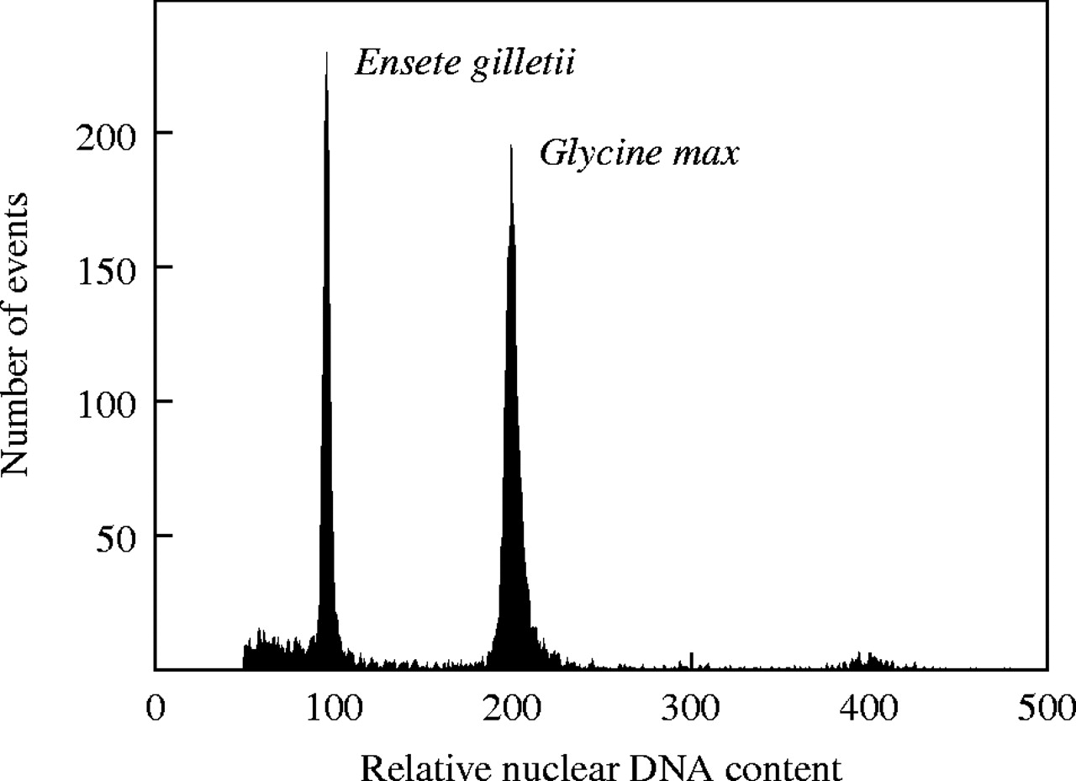
Fig. 1. Estimation of absolute nuclear DNA amount (genome size) in Ensete gilletii. The histogram of relative DNA ...
Notes:
Fig. 1. Estimation of absolute nuclear DNA amount (genome size) in Ensete gilletii. The histogram of relative DNA content was obtained after flow cytometric analysis of propidium iodide-stained nuclei of Ensete and soybean, which were isolated, stained and analysed simultaneously. Soybean (Glycine max ‘Polanka’, 2C = 2·50 pg DNA) served as internal reference standard. The gain of the cytometer was adjusted so that the G1 peak of soybean was positioned on channel 200. The ratio of G1 peak means (Ensete : soybean) was equal to 0·484 and hence the 2C DNA amount of E. gilletii was estimated as 1·210 pg. Note that a reliable estimation of genome size of a species requires that several randomly selected plants are analysed, each of them several times and on different days. The replicate measurements of the same plant facilitate the detection of variation in the procedure and estimation of variation between plants.
Unless provided in the caption above, the following copyright applies to the content of this slide: Annals of Botany 95/1 © Annals of Botany Company 2005; all rights reserved

