Slide 1
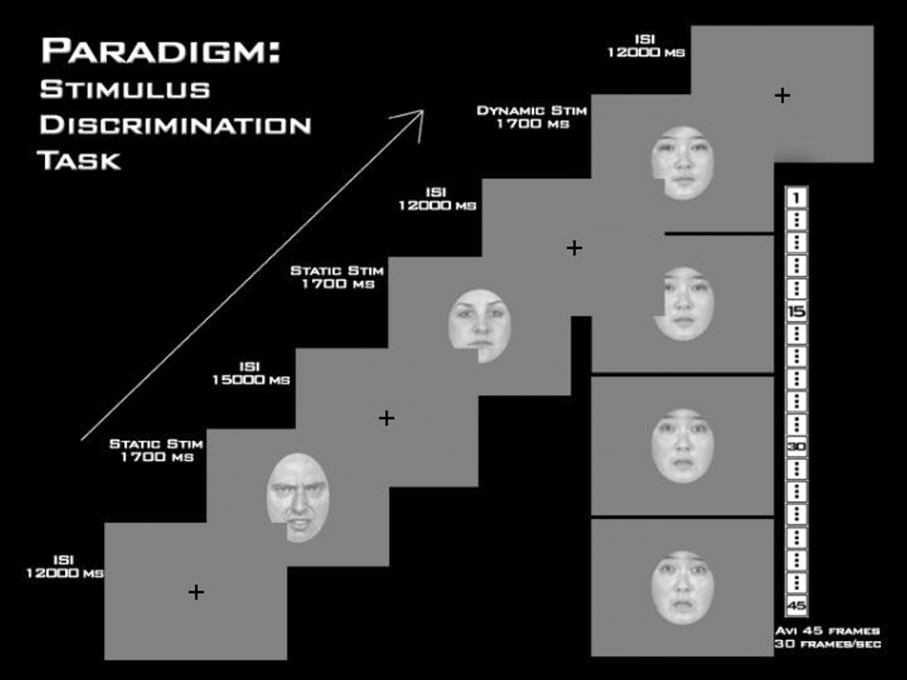
Figure 1. Experimental paradigm. Examples of static angry and neutral expressions and four frames of a fear morph are ...
Notes:
Figure 1. Experimental paradigm. Examples of static angry and neutral expressions and four frames of a fear morph are depicted. ISI = interstimulus interval.
Unless provided in the caption above, the following copyright applies to the content of this slide: © Oxford University Press

Slide 2
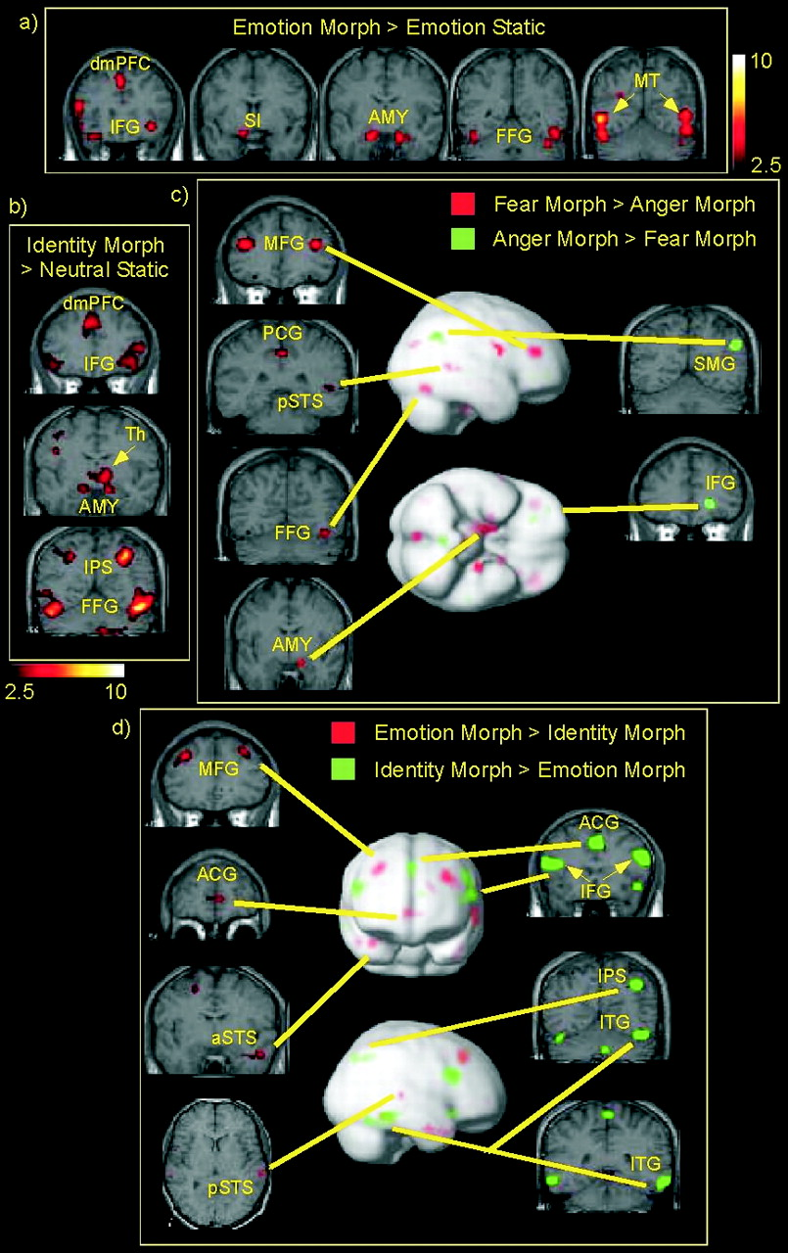
Figure 2. Random-effects analysis of the group-averaged fMRI results. (a) Brain regions showing greater activity to ...
Notes:
Figure 2. Random-effects analysis of the group-averaged fMRI results. (a) Brain regions showing greater activity to dynamic emotional expression changes than to static faces portraying a fixed emotion (fear and anger combined). Color bar indicates T values. (b) Brain regions showing greater activity to dynamic changes in facial identity than to static faces with neutral expression. Color bar indicates T values. (c) Dissociable brain regions for the perception of fearful (red) versus angry (green) emotional expression changes. T values are thresholded and truncated at T = 2.5 for illustration purposes. (d) Dissociable brain regions for the perception of changes in facial affect (red; fear and anger combined) versus changes in facial identity (green). T values are thresholded and truncated at T = 2.5 for illustration purposes. Note that emotion morphs and identity morphs engage different sectors within frontal, temporal and cingulate cortices. Abbreviations: ACG = anterior cingulate gyrus, AMY = amygdala, aSTS = anterior superior temporal sulcus, dmPFC = dorsomedial prefrontal cortex, FFG = fusiform gyrus, IFG = inferior frontal gyrus, IPS = intraparietal sulcus, ITG = inferior temporal gyrus, MFG = middle frontal gyrus, MT = motion-sensitive area of middle temporal gyrus, PCG = posterior cingulate gyrus, pSTS = posterior superior temporal sulcus, SI = substantia innominata, SMG = supramarginal gyrus, Th = thalamus.
Unless provided in the caption above, the following copyright applies to the content of this slide: © Oxford University Press

