Slide 1
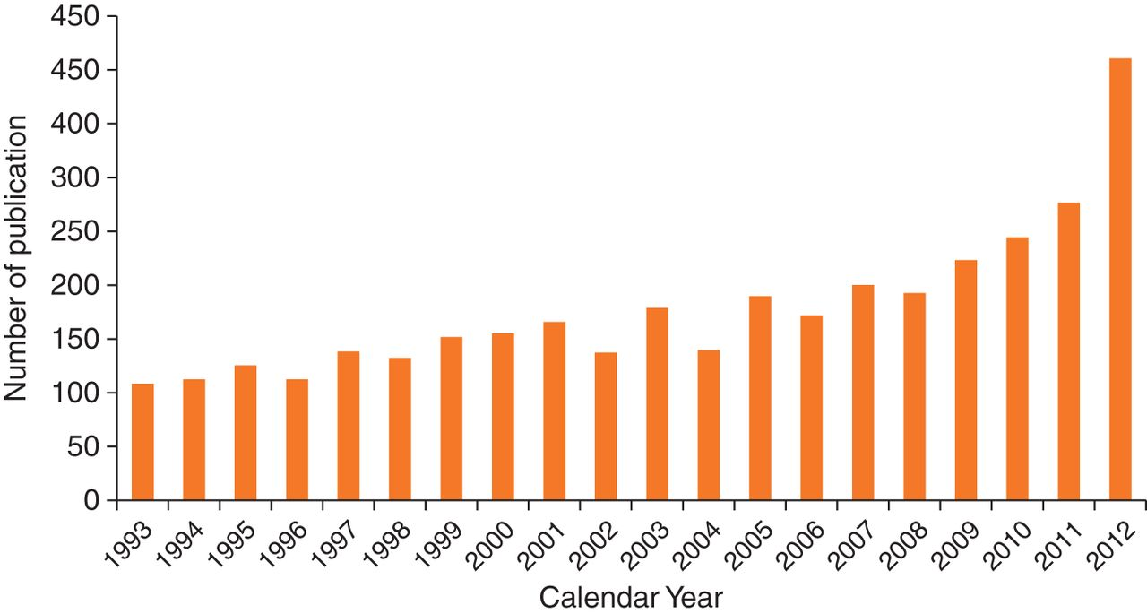
Figure 1 Yearly publications on treatment-resistant hypertension in the last two decades.
Notes:
Figure 1 Yearly publications on treatment-resistant hypertension in the last two decades.
Unless provided in the caption above, the following copyright applies to the content of this slide: Published on behalf of the European Society of Cardiology. All rights reserved. © The Author 2013. For permissions please email: journals.permissions@oup.com

