Slide 1
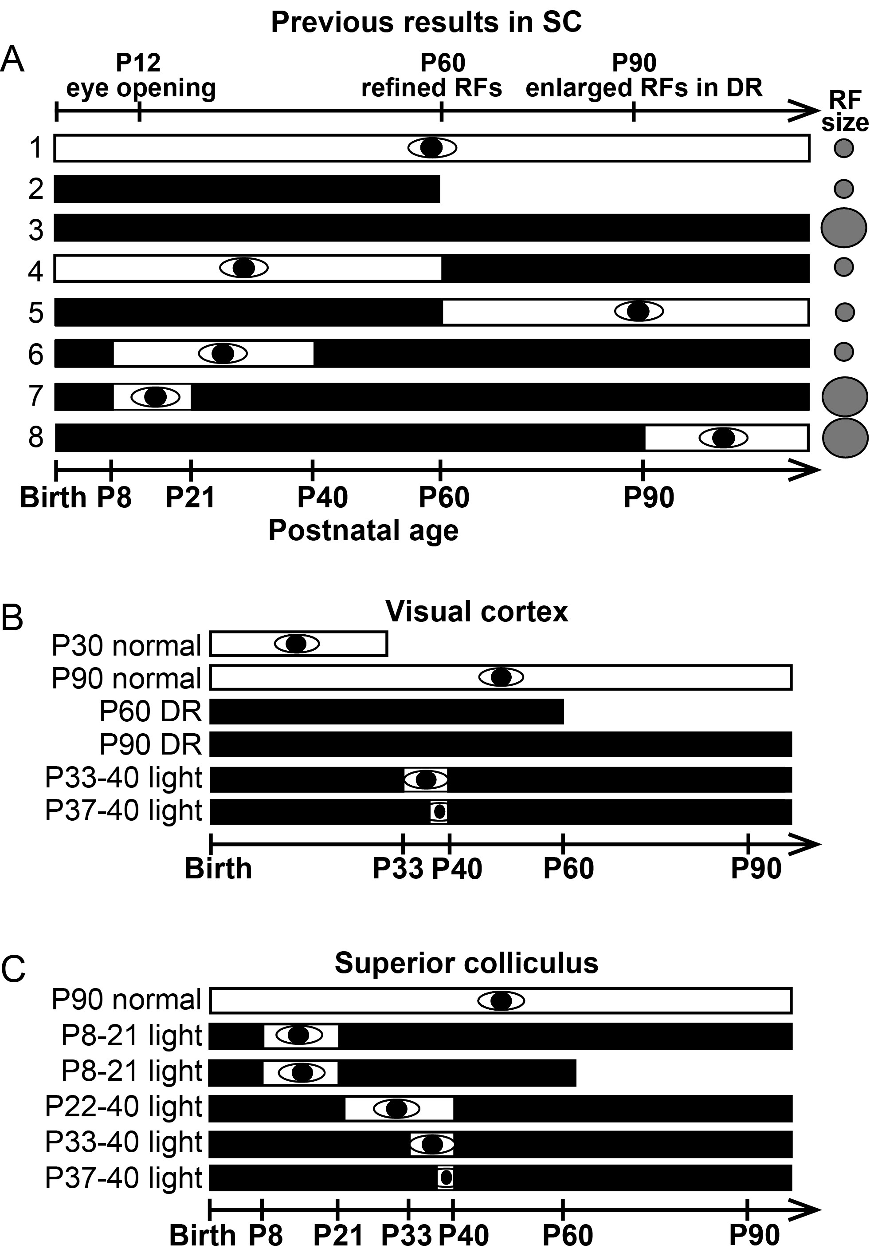
Figure 1. (A) Summary of previous findings in the SC (Carrasco et al. 2005; Carrasco and Pallas 2006). The black bars ...
Notes:
Figure 1. (A) Summary of previous findings in the SC (Carrasco et al. 2005; Carrasco and Pallas 2006). The black bars represent DR, the white bars with eye symbol represent rearing under a normal light cycle, and the gray circles represent RF size. These experiments showed that RFs in the SC refine without visual experience, but that a period of early visual experience is necessary for maintenance of the refined RFs during DR that continues into adulthood. (B) Experimental design for V1 experiments. (C) Experimental design for SC experiments.
Unless provided in the caption above, the following copyright applies to the content of this slide: © The Author 2013. Published by Oxford University Press. All rights reserved. For Permissions, please e-mail: journals.permissions@oup.com

Slide 2
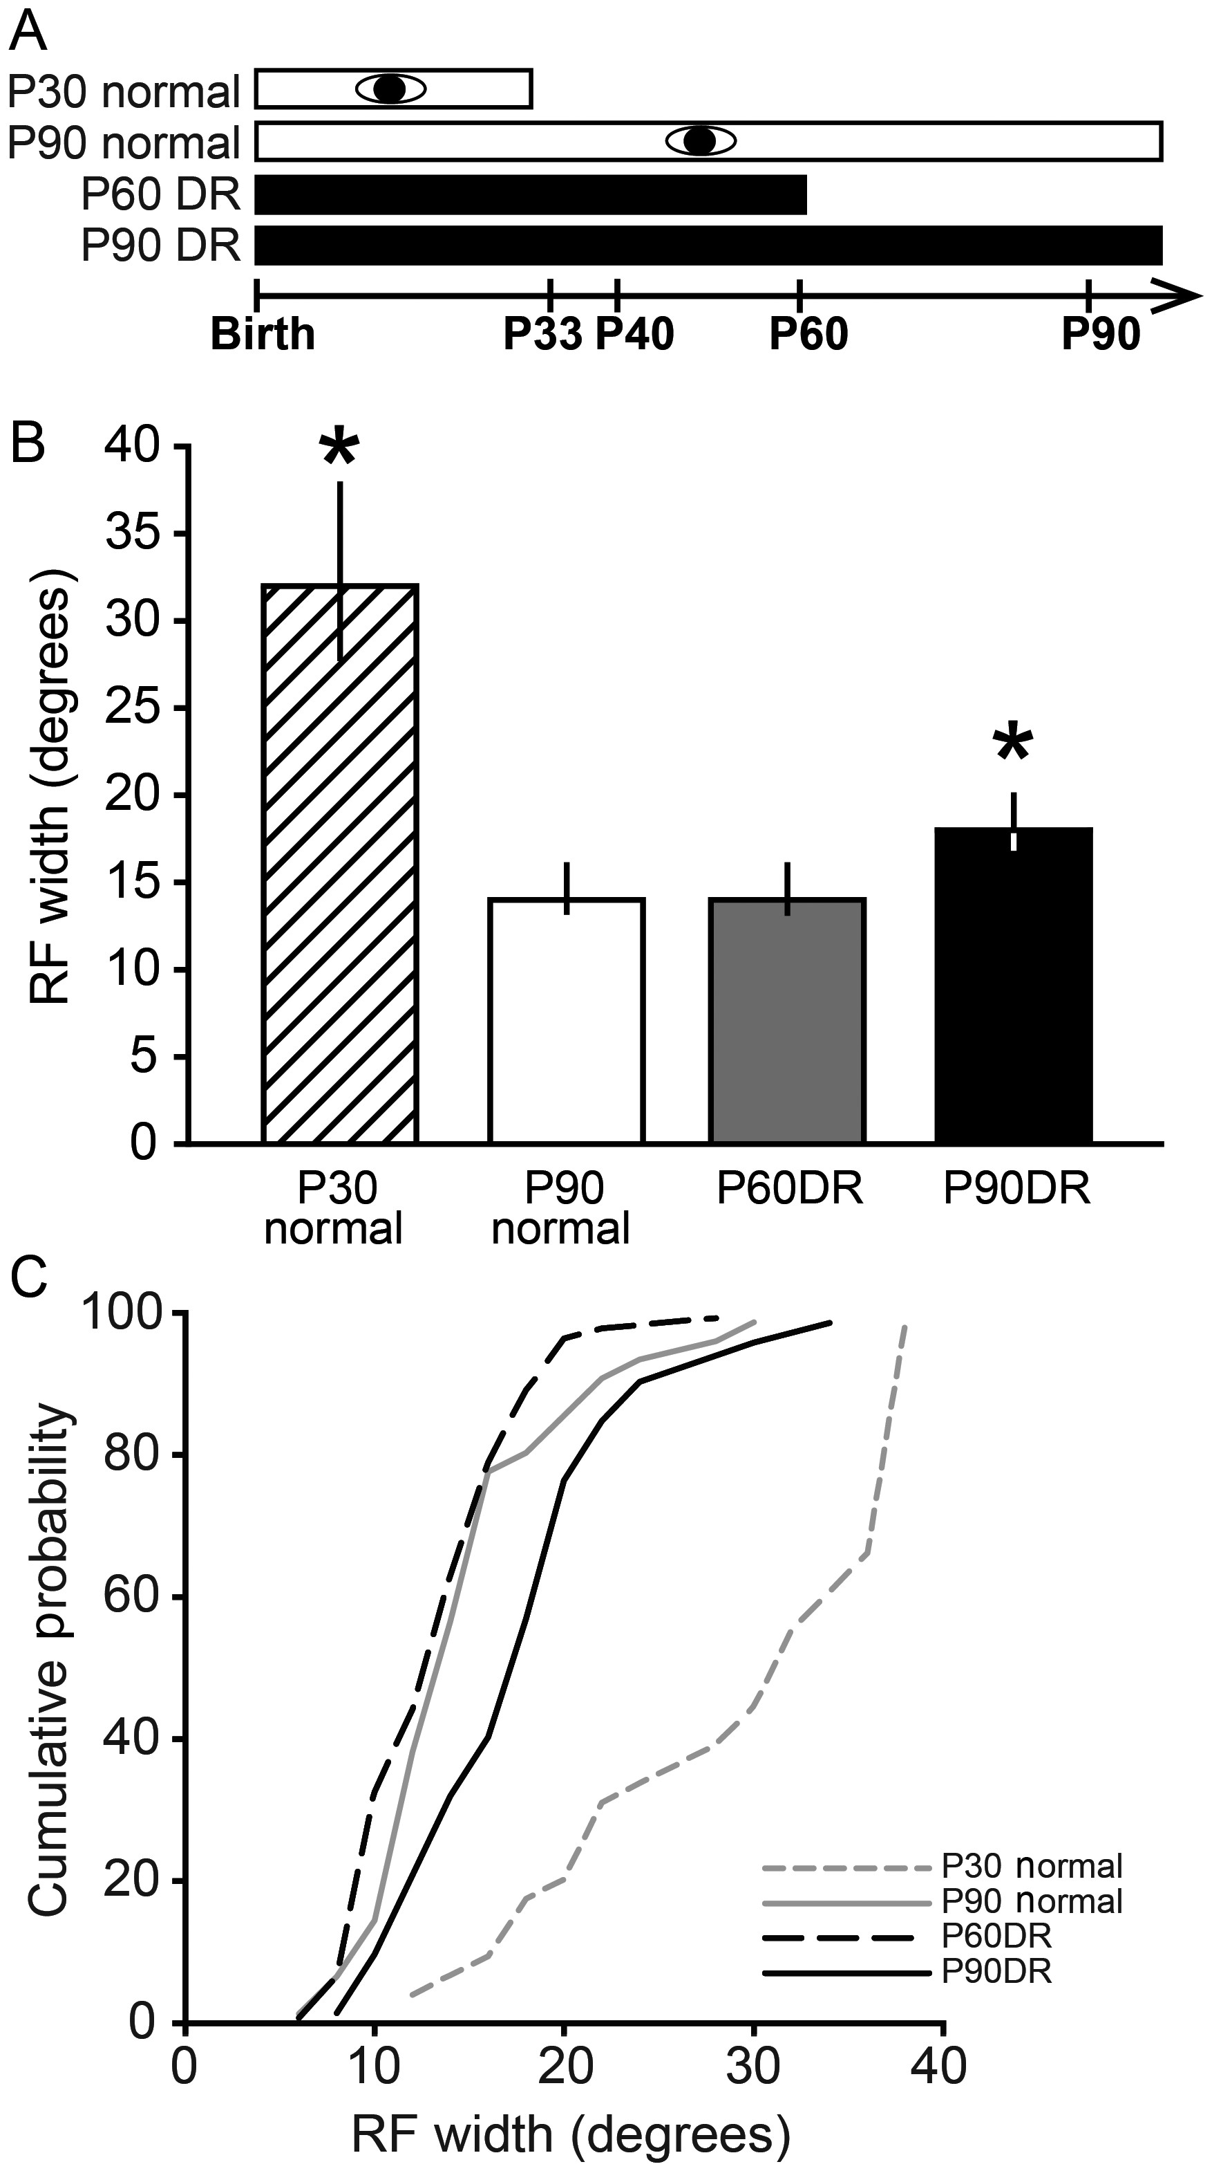
Figure 2. Visual experience is necessary for adult maintenance, but not developmental refinement, of RFs in V1. (A) ...
Notes:
Figure 2. Visual experience is necessary for adult maintenance, but not developmental refinement, of RFs in V1. (A) Experimental design for V1 experiments. Conventions as in Figure 1. (B) To test whether visual experience is necessary for refinement and maintenance of RFs in V1, a flashing square stimulus was presented in different locations across the visual field to plot the RFs. RFs were larger at P30 than at P90 (*P < 0.05), showing that refinement of cortical RFs occurs in the hamster cortex. DR from birth to P60 did not alter the width of RFs compared with normally reared animals, suggesting that visual experience is not necessary for refinement of visual cortical RFs during development. In contrast, DR until P90 caused an expansion of RFs (*P < 0.05) compared with the P90 normal and P60 DR groups, indicating that DR causes enlargement of previously refined RFs. Data are presented as median ± IQR. (C) Cumulative probability plots showing the distribution of data in B.
Unless provided in the caption above, the following copyright applies to the content of this slide: © The Author 2013. Published by Oxford University Press. All rights reserved. For Permissions, please e-mail: journals.permissions@oup.com

Slide 3
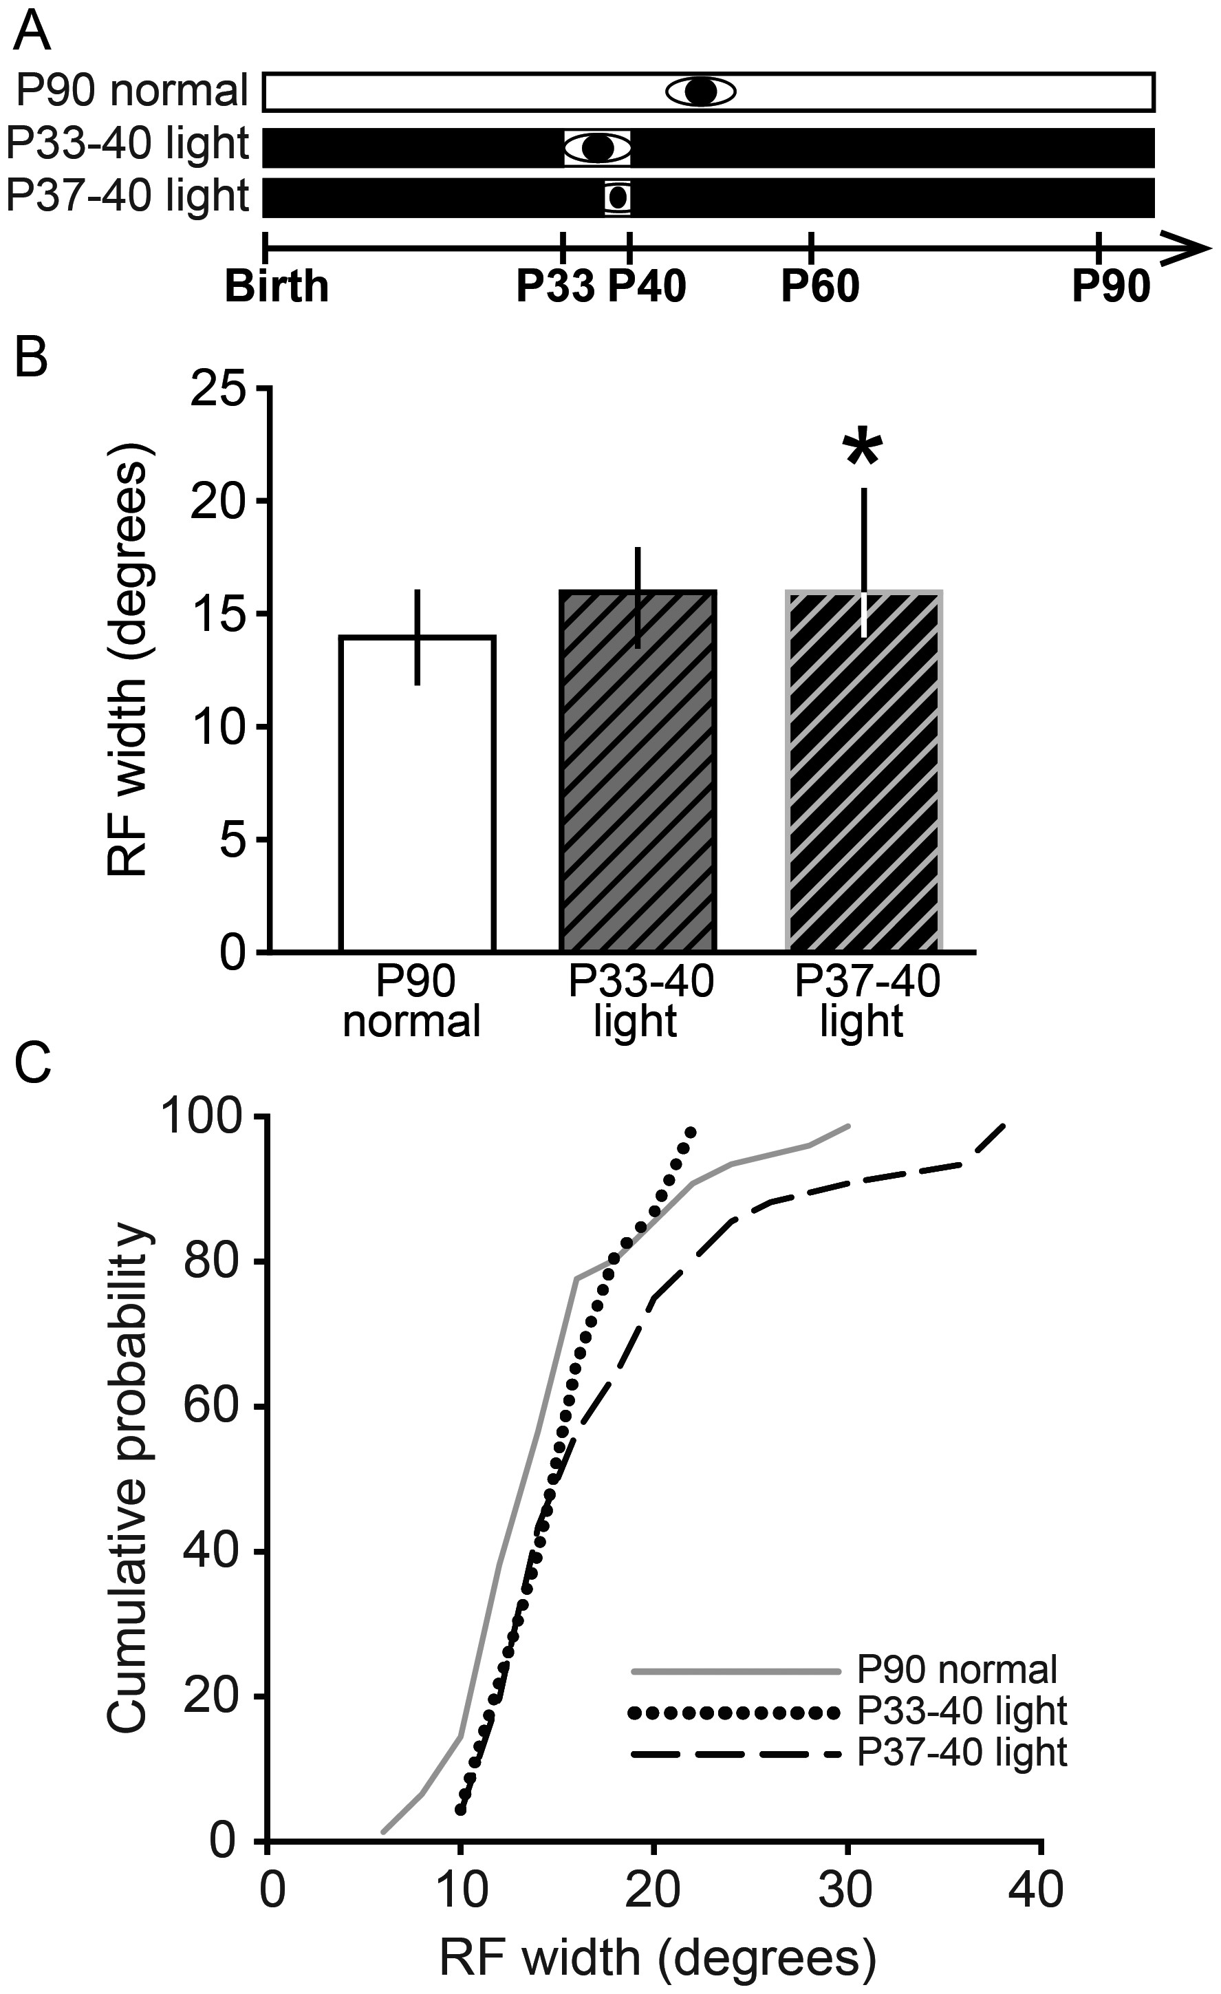
Figure 3. One week of late juvenile visual experience prevents deprivation-induced RF enlargement in adulthood. (A) ...
Notes:
Figure 3. One week of late juvenile visual experience prevents deprivation-induced RF enlargement in adulthood. (A) Experimental design. Conventions as in Figure 1. (B) Effect of a brief period of normal light cycle from P33 to 40 or P37 to 40 on DR-induced RF enlargement. The P33–40 light group had RFs that were normal in width. However, the P37–40 light group had significantly enlarged RFs (*P < 0.05, compared with P90 Normal). Data are presented as median ± IQR. (C) Cumulative probability plots showing the distribution of data in B. Note that the difference between groups is due to an increased proportion of large RFs.
Unless provided in the caption above, the following copyright applies to the content of this slide: © The Author 2013. Published by Oxford University Press. All rights reserved. For Permissions, please e-mail: journals.permissions@oup.com

Slide 4
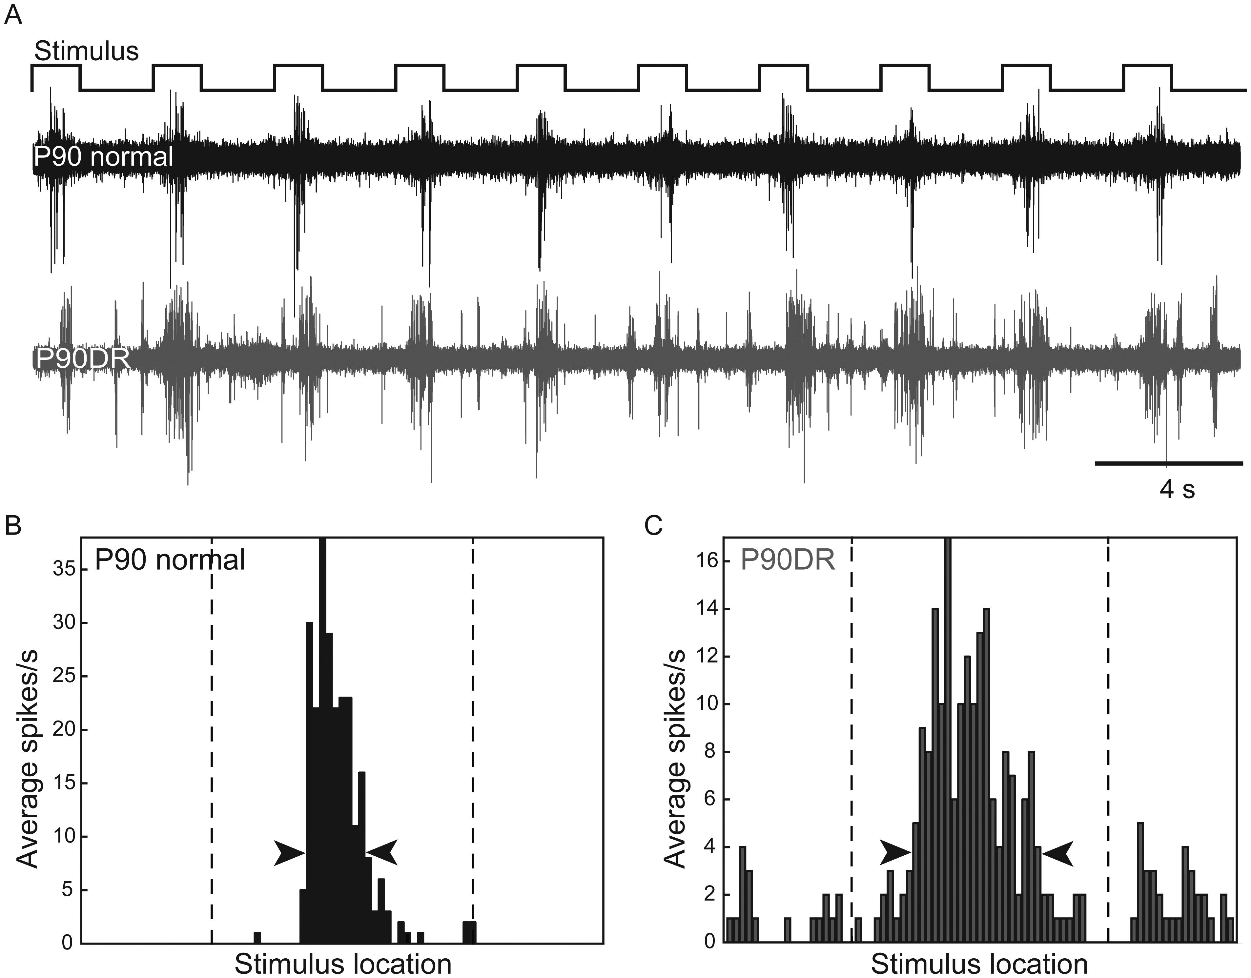
Figure 4. Examples of extracellular recordings and RF plots from P90 normal and P90DR V1. (A) Typical responses to a ...
Notes:
Figure 4. Examples of extracellular recordings and RF plots from P90 normal and P90DR V1. (A) Typical responses to a moving bar. The visual receptive field (RF) of a neuron in the P90 normal case (black trace) is narrower compared with that of a neuron in the P90DR case (gray trace). RF PSTHs of the P90 normal (B) and P90DR (C) shown in A, after single-unit isolation. The dashed vertical lines represent onset and offset of the moving bar stimulus. The arrowheads indicate the 20% peak threshold used to calculate RF width.
Unless provided in the caption above, the following copyright applies to the content of this slide: © The Author 2013. Published by Oxford University Press. All rights reserved. For Permissions, please e-mail: journals.permissions@oup.com

Slide 5
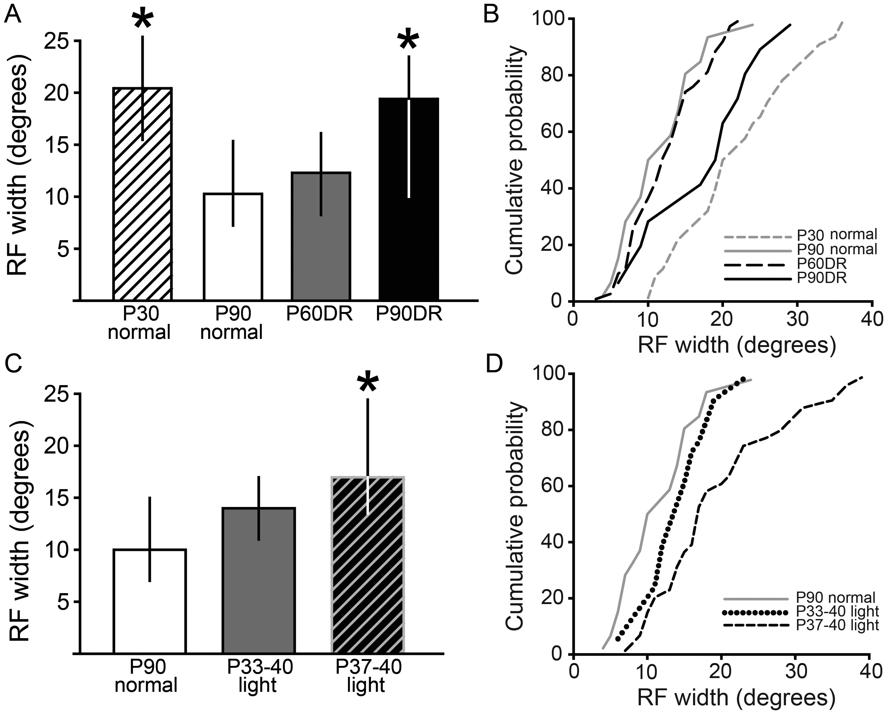
Figure 5. Type of visual stimulus did not influence RF width measurements in V1. To test whether the motion or shape of ...
Notes:
Figure 5. Type of visual stimulus did not influence RF width measurements in V1. To test whether the motion or shape of the visual stimulus used to plot the RF had an effect on the RF width estimates, we repeated the experiment using a moving light bar stimulus. (A) As with the flashing square stimulus, RF width estimates using the moving bar stimulus were significantly larger in the P30 normal and P90DR groups (*P < 0.05) compared with the P90 normal group. These experiments suggest that visual experience is necessary for adult maintenance, but not for developmental refinement, of RFs. (B) Cumulative probability plots showing the distribution of data in A. (C) As with the flashing square stimulus, RF width estimates were significantly larger in the P37–40 light group. These experiments suggest that the type of visual stimulus used to estimate RF width did not affect our results, and support the conclusion that 7 days of visual experience beginning at P33 is sufficient to maintain V1 RFs in a refined state despite chronic DR into adulthood, but 3 days beginning at P37 is not. (D) Cumulative probability plots showing the distribution of data in C. Data are presented as median ± IQR.
Unless provided in the caption above, the following copyright applies to the content of this slide: © The Author 2013. Published by Oxford University Press. All rights reserved. For Permissions, please e-mail: journals.permissions@oup.com

Slide 6
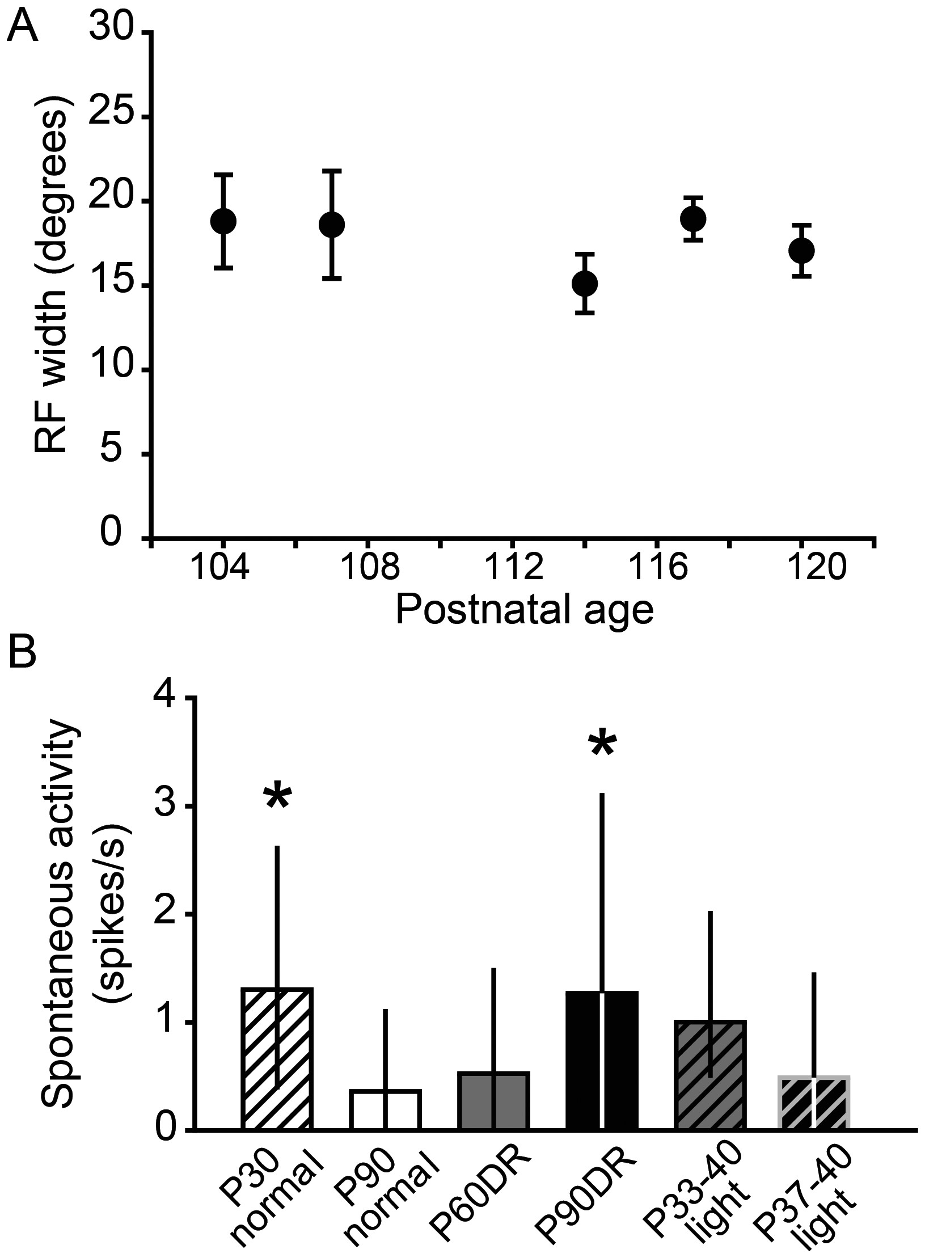
Figure 6. (A) There was no correlation between age after P90DR and RF width, suggesting that RFs do not continue to ...
Notes:
Figure 6. (A) There was no correlation between age after P90DR and RF width, suggesting that RFs do not continue to enlarge after P90. Data are presented as mean ± SEM. (B) Spontaneous activity was higher in P30 normal and P90DR animals compared with P90 normal animals (*P < 0.05). Data are presented as median ± IQR.
Unless provided in the caption above, the following copyright applies to the content of this slide: © The Author 2013. Published by Oxford University Press. All rights reserved. For Permissions, please e-mail: journals.permissions@oup.com

Slide 7
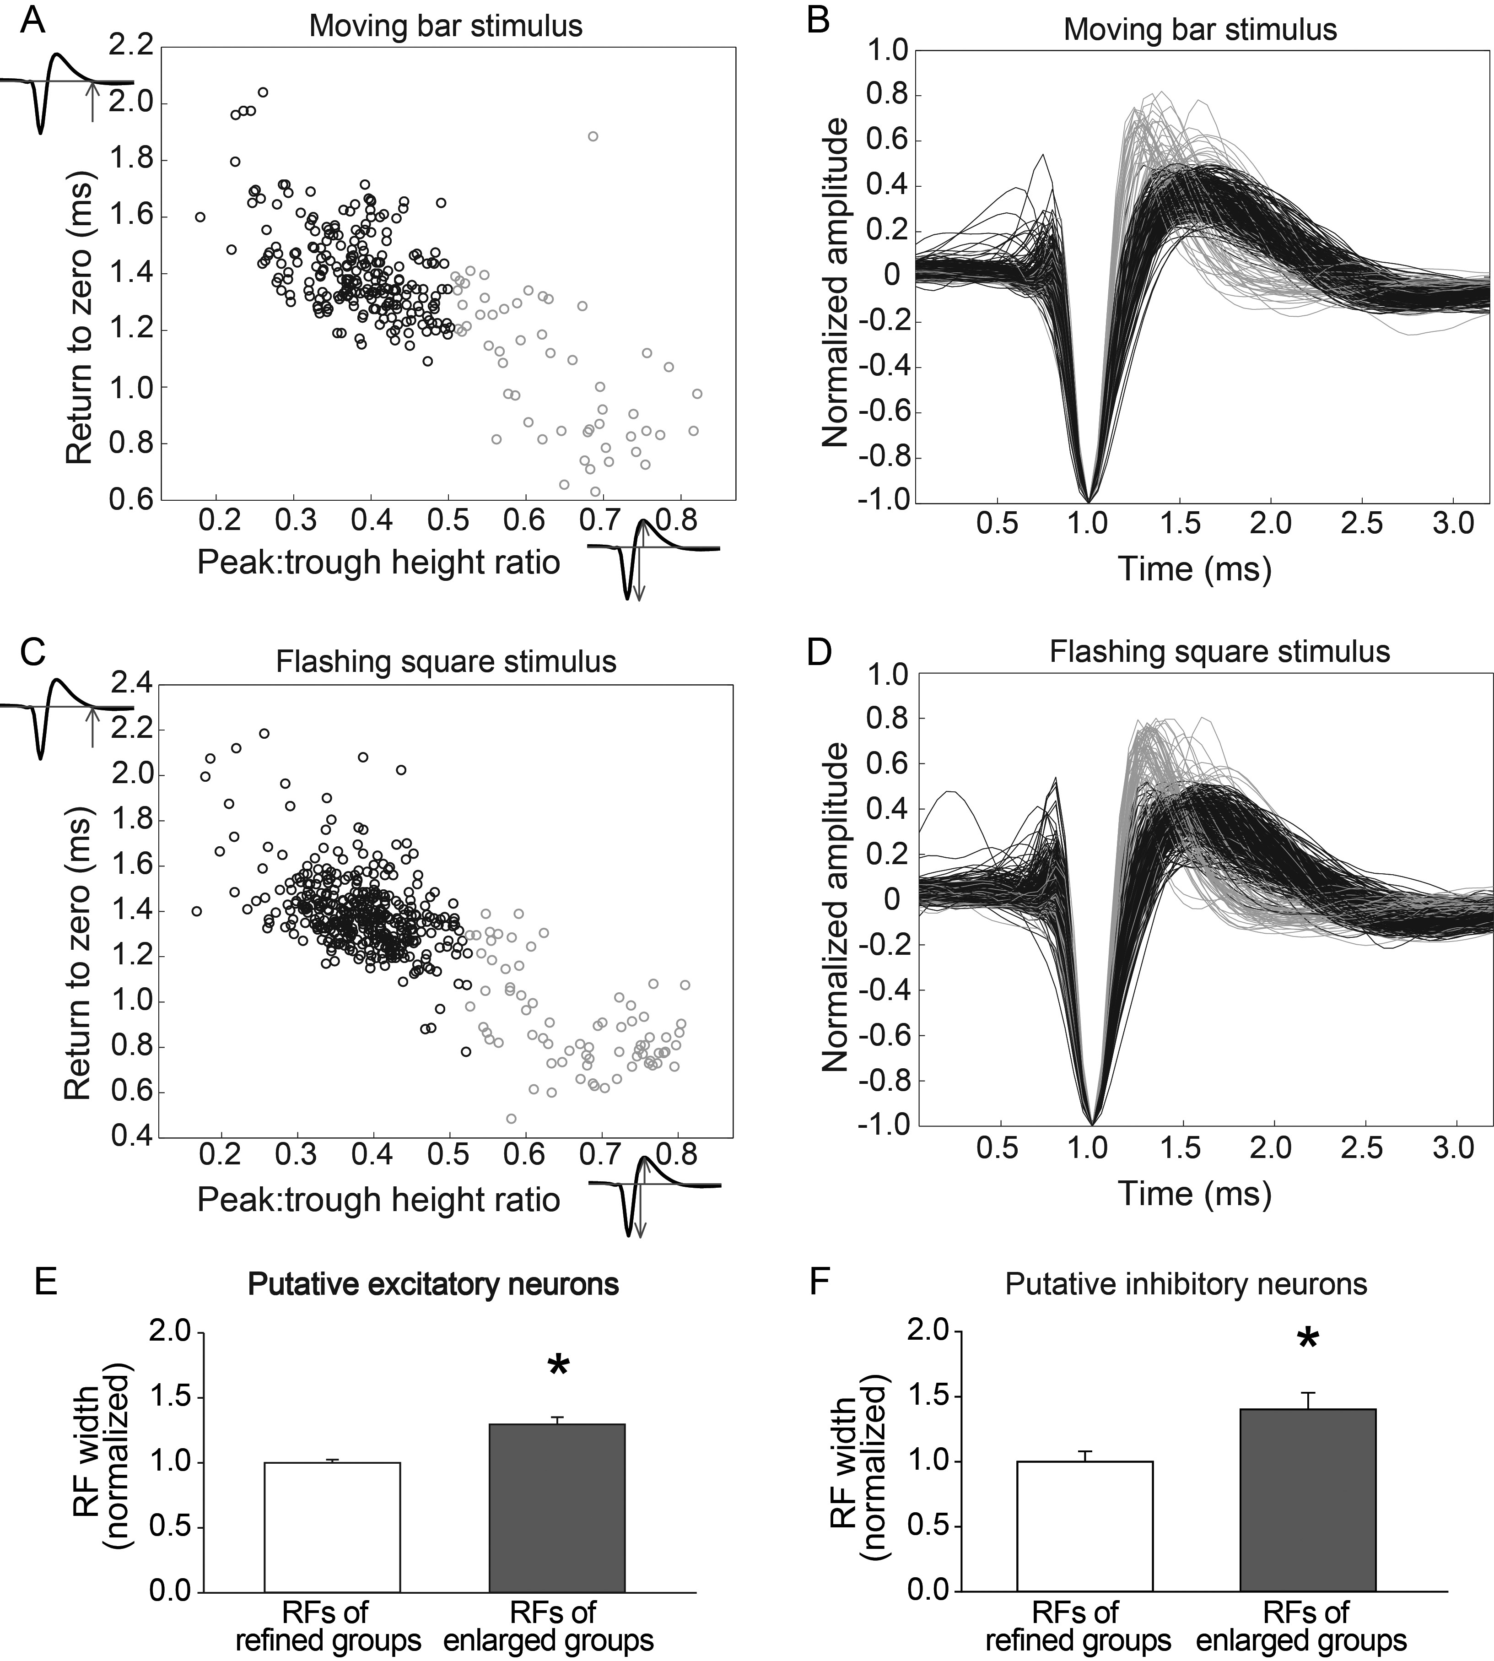
Figure 7. Both putative excitatory and putative inhibitory units have expanded RFs in the absence of sufficient ...
Notes:
Figure 7. Both putative excitatory and putative inhibitory units have expanded RFs in the absence of sufficient postnatal visual experience. Scatter plots of waveform discrimination parameters for moving bar data (A) and flashing square data (C) demonstrate categorization of broad-spiking (putative excitatory units, black) and narrow-spiking (putative inhibitory units, gray) neurons. Normalized waveforms of all units using moving bar (B) or flashing square (D) stimuli. RFs of both putative excitatory units (E) and putative inhibitory units (F) contribute to enlarged RFs in the P90DR and P37–40 light groups compared with groups with refined RFs (P90 normal, P60DR, and P33–40 light groups, *P < 0.05). Data are presented as mean ± SEM.
Unless provided in the caption above, the following copyright applies to the content of this slide: © The Author 2013. Published by Oxford University Press. All rights reserved. For Permissions, please e-mail: journals.permissions@oup.com

Slide 8
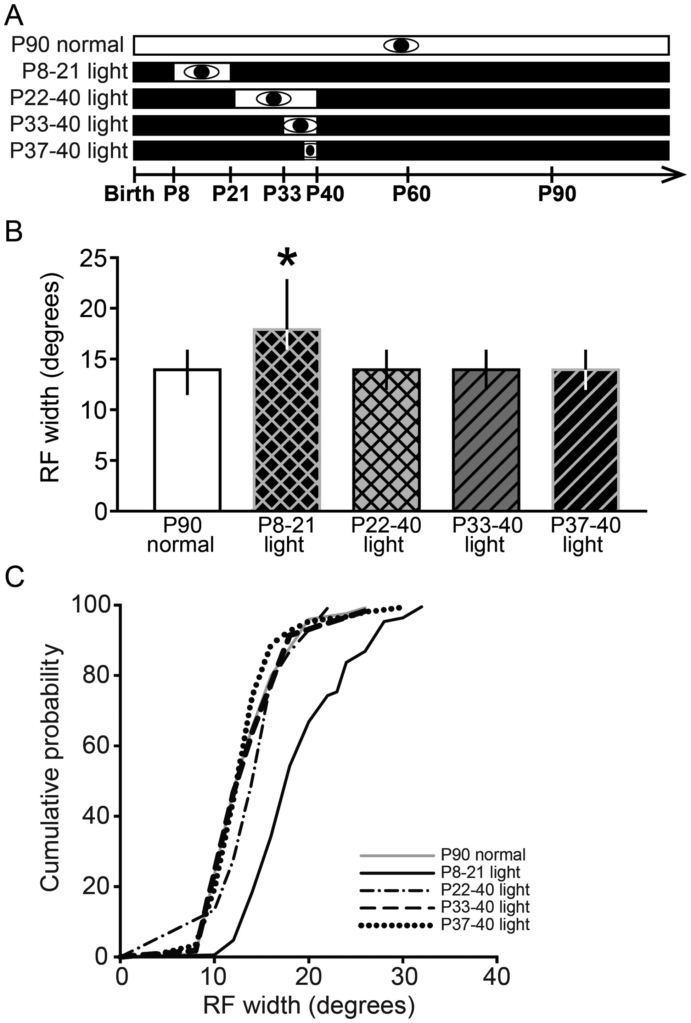
Figure 8. Late but not early juvenile visual experience was sufficient to maintain refined RFs in SC. (A) Experimental ...
Notes:
Figure 8. Late but not early juvenile visual experience was sufficient to maintain refined RFs in SC. (A) Experimental design for the SC study. Conventions as in Figure 1. (B) Maintenance of RF width in the SC during DR requires precise timing of visual experience. Animals were DR from before birth and exposed to light from P8 to 21, P22 to 40, or P33 to 40, followed by DR until >P90, when RFs would become enlarged during continuous DR. Late visual experience from P22 to 40, P33 to 40, or P37 to 40 was sufficient to maintain RF width in adulthood (>P90), but early visual experience from P8 to 21 was not sufficient, compared with the P90 normal group (*P < 0.05). Data are presented as median ± IQR. (C) Cumulative probability plots showing the distribution of data in B.
Unless provided in the caption above, the following copyright applies to the content of this slide: © The Author 2013. Published by Oxford University Press. All rights reserved. For Permissions, please e-mail: journals.permissions@oup.com

Slide 9
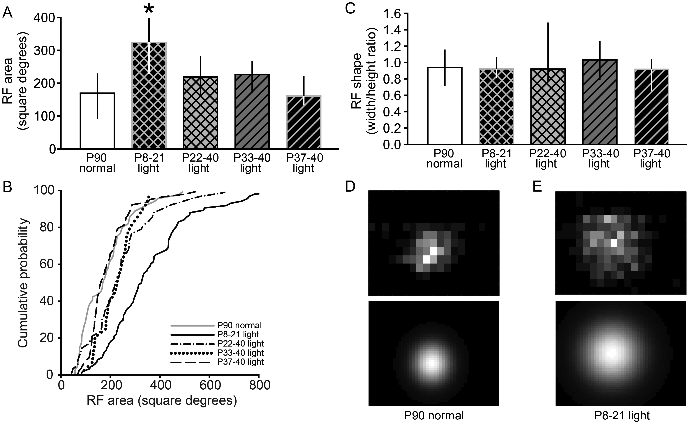
Figure 9. Maintenance of RF area in the SC during DR requires late visual experience. (A) Late juvenile visual ...
Notes:
Figure 9. Maintenance of RF area in the SC during DR requires late visual experience. (A) Late juvenile visual experience from P22 to 40, P33 to 40, or P37 to 40 was sufficient to maintain the RF area in adulthood (>P90) despite DR, but early visual experience from P8 to 21 was not sufficient (compared with the P90 normal group; *P < 0.05). (B) Cumulative probability plots showing the distribution of data in A. (C) The shape of RFs is maintained in groups that have expanded RFs. The width/height ratios of the RFs were not affected, even though the RF sizes were larger in the group that received light from P8 to 21, compared with all other groups. This suggests that RFs expanded equally in horizontal and vertical directions. (D and E) Example RF area plots: refined RF of a neuron from a normal adult (D, upper panel) and enlarged RF of a neuron from a P8–21 light case (E, upper panel) and their fitted 2D Gaussians used to calculate the area and width/height ratio (D and E, lower panels). Gray level represents the response level, with white corresponding to peak response and black corresponding to zero. Data are presented as median ± IQR.
Unless provided in the caption above, the following copyright applies to the content of this slide: © The Author 2013. Published by Oxford University Press. All rights reserved. For Permissions, please e-mail: journals.permissions@oup.com

Slide 10
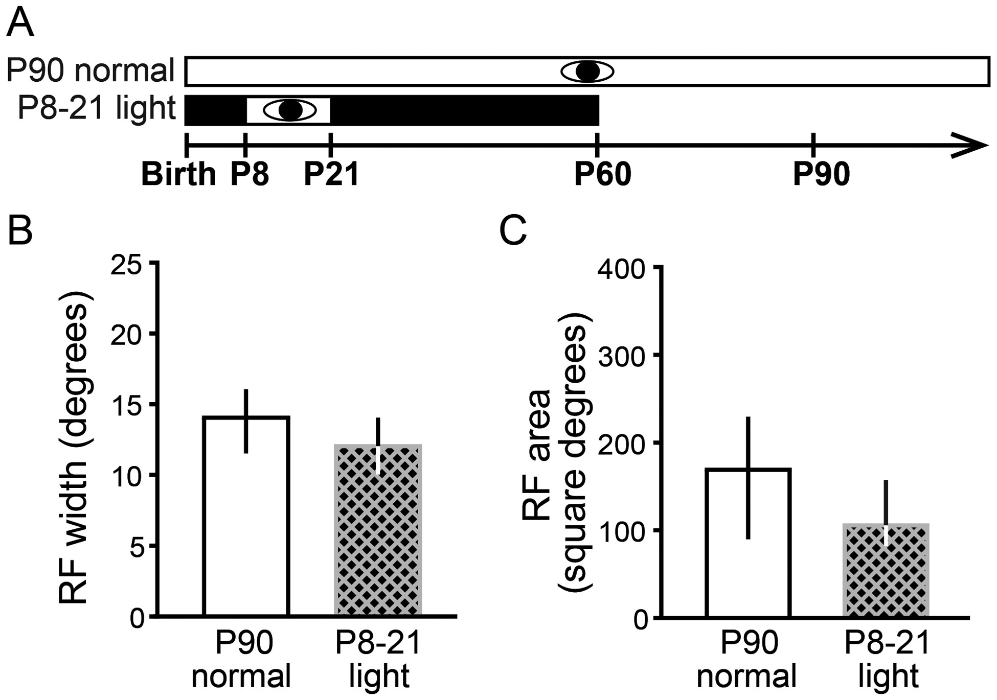
Figure 10. Early visual experience does not prevent the refinement of RFs in the SC. This experiment tested the ...
Notes:
Figure 10. Early visual experience does not prevent the refinement of RFs in the SC. This experiment tested the alternative hypothesis that enlarged RFs in animals that received early visual experience from P8 to 21 were caused by a failure of RFs to refine rather than a failure to maintain their refined state. Single-unit RFs were measured at P60 in animals that had visual experience from P8 to 21 preceded and followed by DR. (A) Experimental design. Conventions as in Figure 1. We found that RF width (B) and RF area (C) were not different than in P90 normal controls, refuting the alternate hypothesis that early light exposure prevented RF refinement. Data are presented as median ± IQR.
Unless provided in the caption above, the following copyright applies to the content of this slide: © The Author 2013. Published by Oxford University Press. All rights reserved. For Permissions, please e-mail: journals.permissions@oup.com

Slide 11
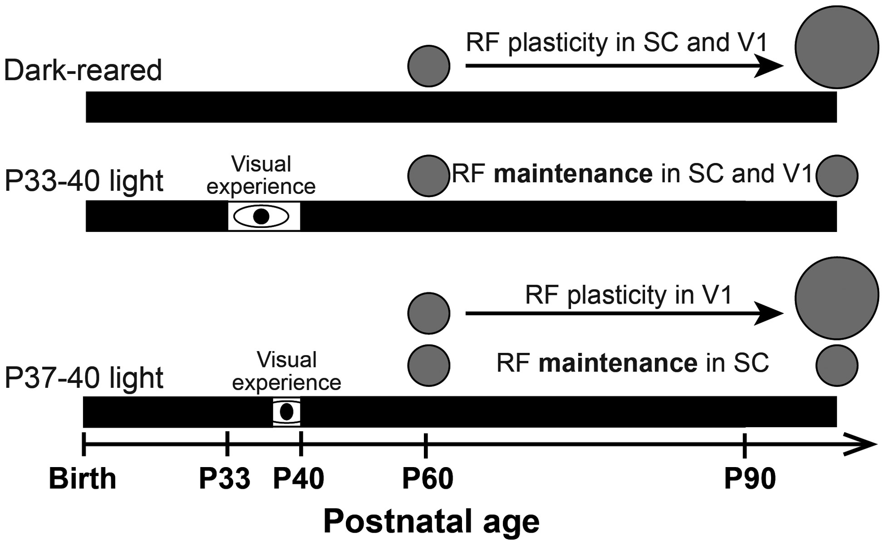
Figure 11. Summary of findings: Precise timing of visual experience prevents deprivation-induced RF plasticity. Our ...
Notes:
Figure 11. Summary of findings: Precise timing of visual experience prevents deprivation-induced RF plasticity. Our results show that DR does not prevent RF refinement, but rather causes RFs to expand after P90 in V1, as in the SC. This RF plasticity can be prevented by visual experience from P33 to 40 in both SC and V1 and from P37 to 40 in SC only.
Unless provided in the caption above, the following copyright applies to the content of this slide: © The Author 2013. Published by Oxford University Press. All rights reserved. For Permissions, please e-mail: journals.permissions@oup.com

