Slide 1
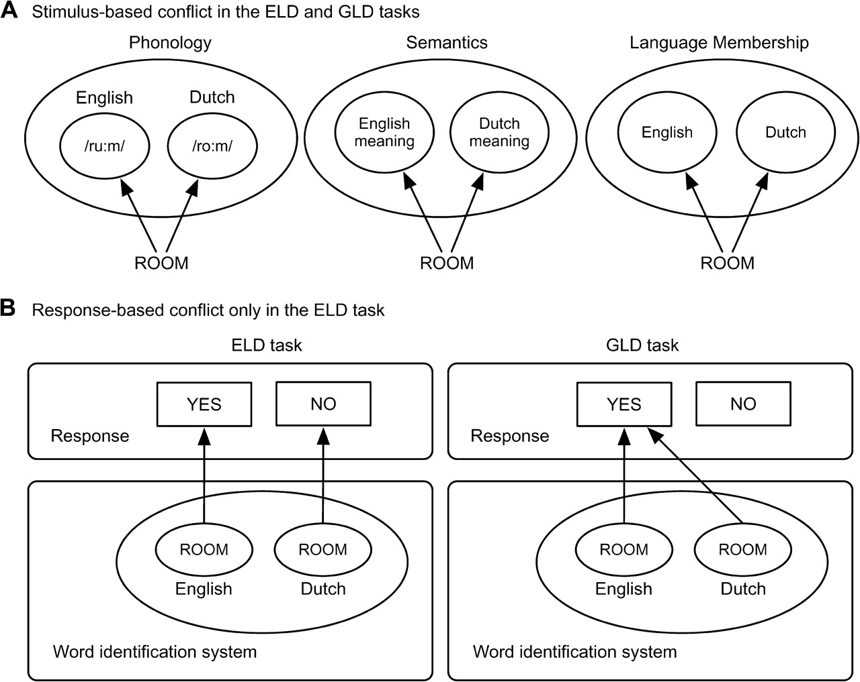
Figure 1. Sources of stimulus-based and response-based language conflicts for interlingual homographs in the ELD task ...
Notes:
Figure 1. Sources of stimulus-based and response-based language conflicts for interlingual homographs in the ELD task and the GLD task. (A) For Dutch–English bilinguals a stimulus-based language conflict is present in both tasks at the level of phonology (e.g., phonology of ROOM in English is /ru:m/, and in Dutch /ro:m/), semantics (ROOM has different meanings in Dutch (meaning “cream”) and English), and different language memberships (ROOM is both a Dutch and an English word). (B) For Dutch–English bilinguals a response-based language conflict is present for interlingual homographs (e.g., ROOM) in the ELD task, because they can be interpreted as an English word (requiring a “Yes” response), and as a Dutch word (requiring a “No” response). In contrast, in a GLD task both interpretations of the homograph require a “Yes” response and therefore no response-based language conflict arises in this task.
Unless provided in the caption above, the following copyright applies to the content of this slide: © 2008 The AuthorsThis is an Open Access article distributed under the terms of the Creative Commons Attribution Non-Commercial License (http://creativecommons.org/licenses/by-nc/2.0/uk/) which permits unrestricted non-commercial use, distribution, and reproduction in any medium, provided the original work is properly cited.

Slide 2
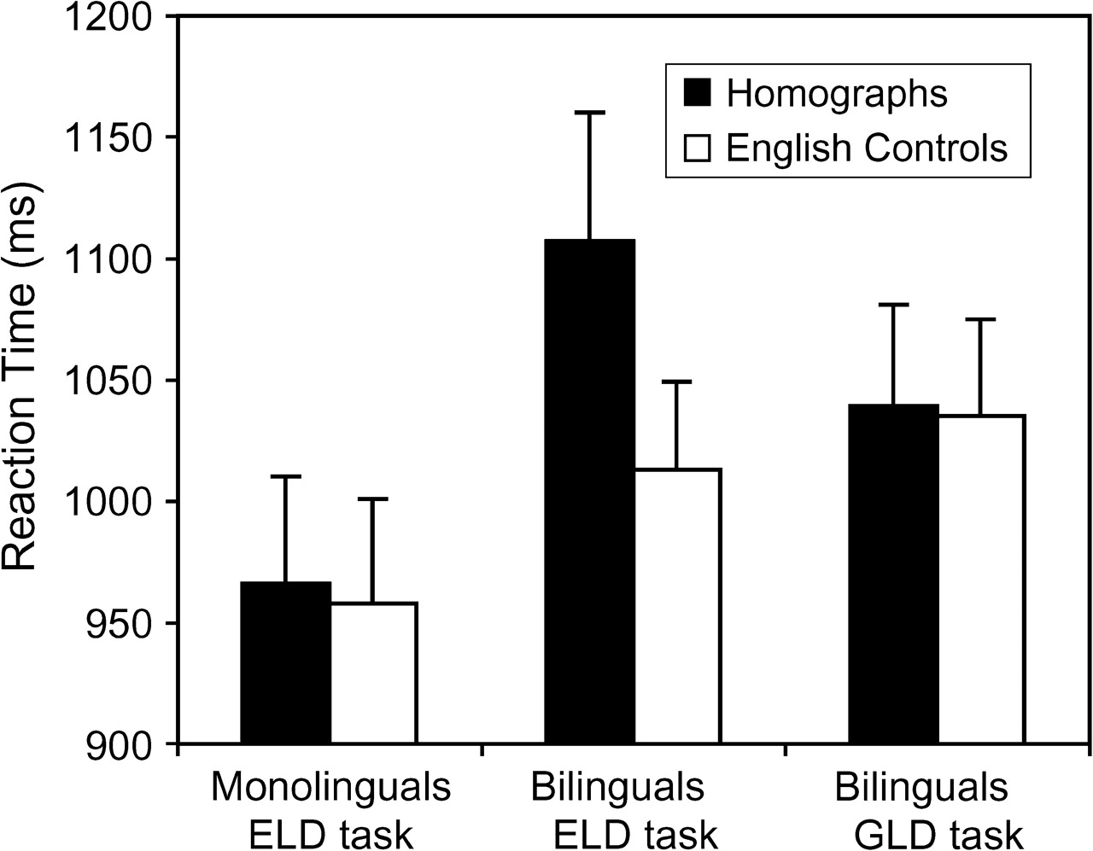
Figure 2. Behavioral results of English monolinguals in the ELD task, and Dutch–English bilinguals in the ELD task and ...
Notes:
Figure 2. Behavioral results of English monolinguals in the ELD task, and Dutch–English bilinguals in the ELD task and the GLD task. Error bars indicate standard error of the mean.
Unless provided in the caption above, the following copyright applies to the content of this slide: © 2008 The AuthorsThis is an Open Access article distributed under the terms of the Creative Commons Attribution Non-Commercial License (http://creativecommons.org/licenses/by-nc/2.0/uk/) which permits unrestricted non-commercial use, distribution, and reproduction in any medium, provided the original work is properly cited.

Slide 3
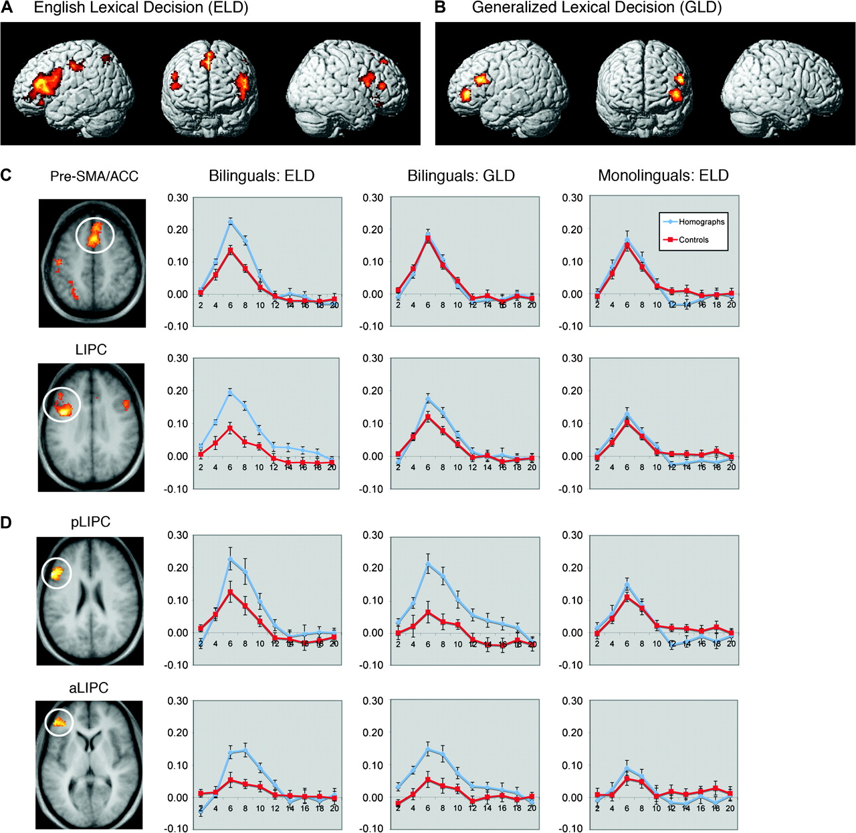
Figure 3. Dutch–English bilingual brain activations showing greater activations for interlingual homographs than for ...
Notes:
Figure 3. Dutch–English bilingual brain activations showing greater activations for interlingual homographs than for English control words in (A) ELD task (Table S1), and (B), the GLD task (Table S2). Brain activations projected on averaged anatomical axial slices, and the BOLD response for Dutch–English homographs and English controls words of the monolinguals and bilinguals in (C) 2 clusters activated by bilinguals in the ELD task: the pre-SMA/ACC (peaks at 2, 20, 43; Z score = 4.45; 2, 1, 55; Z score = 4.38; 8, 35, 46; Z score = 4.20) and the LIPC (peaks at −42, 5, 27; Z score = 4.93; −48, 18, 6; Z score = 4.61; −40, 36, 11; Z score = 4.50), and (D), in 2 clusters activated by bilinguals in the GLD task in the posterior/superior LIPC (pLIPC with peaks at −55, 22, 21; Z score = 4.60; −44, 26, 21; Z score = 4.08; −44, 14, 18; Z score = 3.52) and the more anterior part of the LIPC (aLIPC with peaks at −50, 41, 2; Z score = 4.11; −38, 41, 3; Z score = 3.95; −42, 45, −4; Z score = 3.94). Error bars indicate standard error of the mean.
Unless provided in the caption above, the following copyright applies to the content of this slide: © 2008 The AuthorsThis is an Open Access article distributed under the terms of the Creative Commons Attribution Non-Commercial License (http://creativecommons.org/licenses/by-nc/2.0/uk/) which permits unrestricted non-commercial use, distribution, and reproduction in any medium, provided the original work is properly cited.

Slide 4
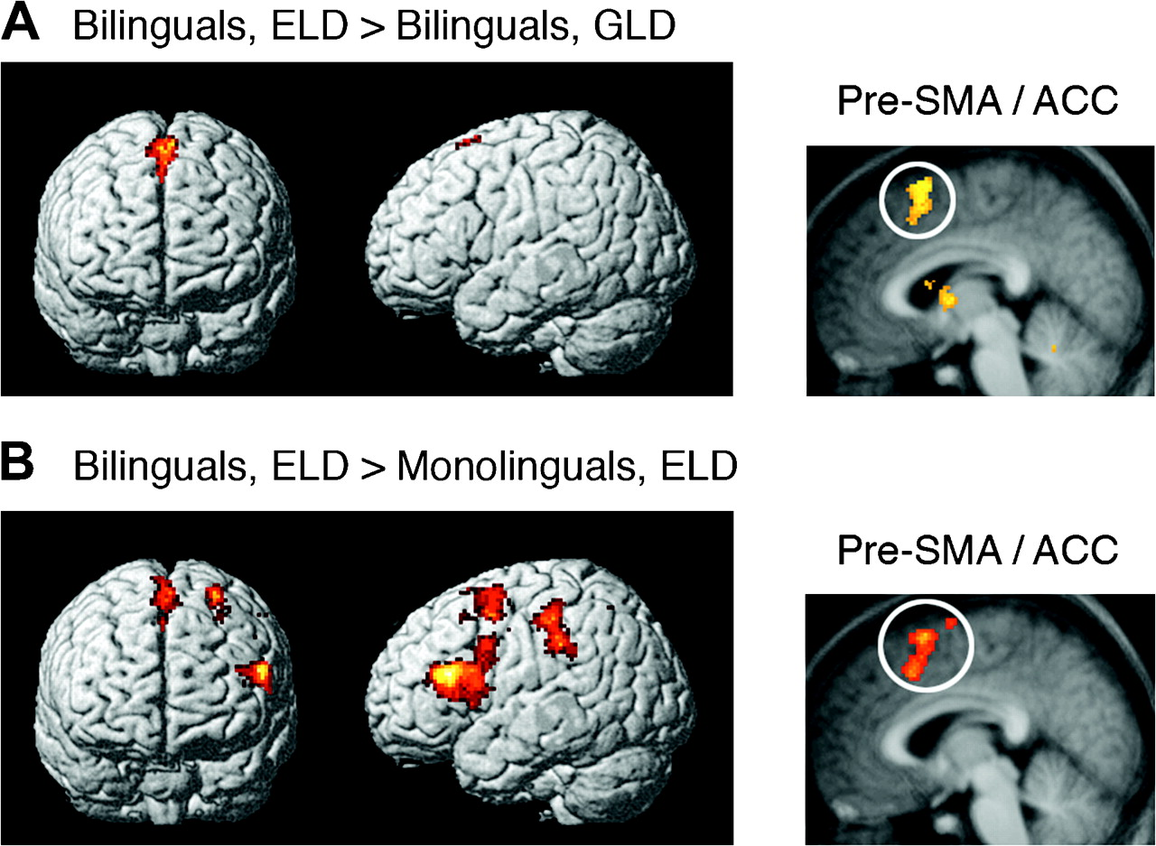
Figure 4. (A) Bilingual brain activations showing greater activations in the ELD task than the GLD task for the ...
Notes:
Figure 4. (A) Bilingual brain activations showing greater activations in the ELD task than the GLD task for the contrast between interlingual homographs and English control words (Table S4). Brain activation projected on an averaged anatomical sagittal slice. Cluster with peak coordinates in the pre-SMA (−2, 16, 54; Z score = 3.83; −4, 14, 49; Z score = 3.66) and the ACC (2, 21, 41; Z score = 3.61). (B) Brain activations showing greater activations for bilinguals than monolinguals in the ELD task for the contrast between interlingual homographs and English control words (Table S5). Cluster with peak coordinates in the pre-SMA (−2, 15, 58; Z score = 3.51; −4, 16, 49; Z score = 3.16) and the ACC (−4, 21, 39; Z score = 3.39).
Unless provided in the caption above, the following copyright applies to the content of this slide: © 2008 The AuthorsThis is an Open Access article distributed under the terms of the Creative Commons Attribution Non-Commercial License (http://creativecommons.org/licenses/by-nc/2.0/uk/) which permits unrestricted non-commercial use, distribution, and reproduction in any medium, provided the original work is properly cited.

Slide 5
Figure 5. (A) Brain areas that show greater activation for words than for pseudowords in Dutch–English bilinguals ...
Notes:
Figure 5. (A) Brain areas that show greater activation for words than for pseudowords in Dutch–English bilinguals performing an ELD task and a GLD task, and English monolinguals performing an ELD task (coordinates in Tables S6, S7, S8). (B) Brain activation differences between Dutch–English bilinguals in the ELD task and English monolinguals for the contrast between words and pseudowords (Table S9). (C) Brain activation differences between English monolinguals and Dutch–English bilinguals in the ELD task for the contrast between words and pseudowords (Table S9). (D) Brain activation differences between English monolinguals and Dutch–English bilinguals in the GLD task for the contrast between words and pseudowords (Table S9).
Unless provided in the caption above, the following copyright applies to the content of this slide: © 2008 The AuthorsThis is an Open Access article distributed under the terms of the Creative Commons Attribution Non-Commercial License (http://creativecommons.org/licenses/by-nc/2.0/uk/) which permits unrestricted non-commercial use, distribution, and reproduction in any medium, provided the original work is properly cited.

