Slide 1
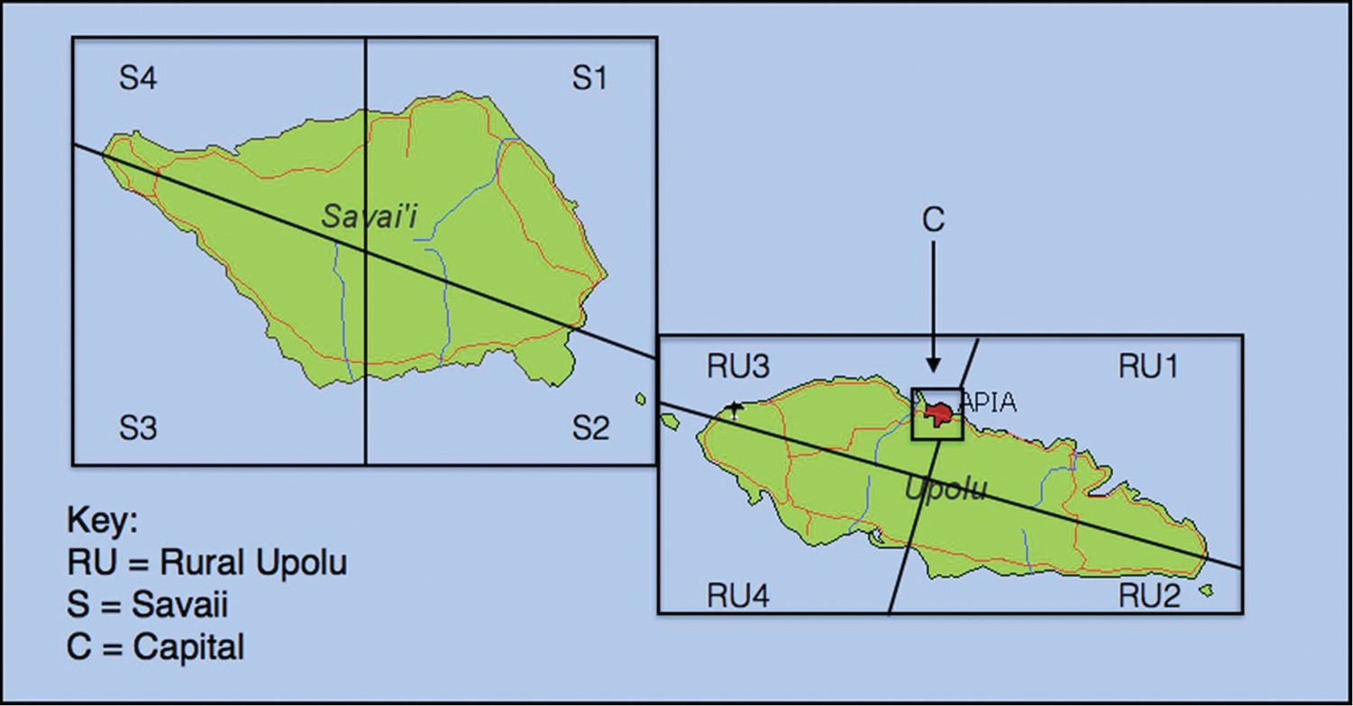
Figure 1 Geographic survey sample distributions. Source: Wikimedia commons, with modifications by the author
Notes:
Figure 1 Geographic survey sample distributions. Source: Wikimedia commons, with modifications by the author
Unless provided in the caption above, the following copyright applies to the content of this slide: © The Author (2016). Published by Oxford University Press on behalf of the International Studies Association. All rights reserved. For permissions, please e-mail: journals.permissions@oup.com

