Slide 1
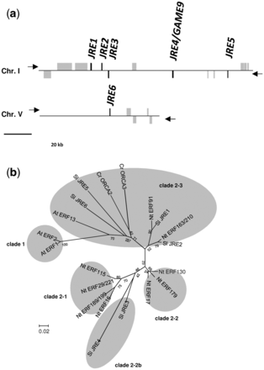
Fig. 1 Tomato JRE genes. (a) Schematic presentation of the cluster of five JRE genes on chromosome I and JRE6 on ...
Notes:
Fig. 1 Tomato JRE genes. (a) Schematic presentation of the cluster of five JRE genes on chromosome I and JRE6 on chromosome V. JRE and other genes are represented as black and gray boxes, respectively. Strands on which each gene resides are indicated with arrowheads. (b) Phylogenetic tree of tomato JREs and related ERF proteins from Arabidopsis, Catharanthus roseus and tobacco. Two clade 1 ERF proteins of group IXa, AtERF1 and AtERF2, were included as an outgroup. Amino acid sequences of the DNA-binding domain were aligned using ClustalW (Thompson et al. 1994). An unrooted phylogenetic tree was constructed using the Neighbor–Joining algorithm with MEGA6 (Tamura et al. 2013). Bootstrap values are indicated at branch nodes, and the scale bar indicates the number of amino acid substitution per site. Species names are denoted with prefixes. At, Arabidopsis; Cr, C. roseus; Nt, tobacco; Sl, tomato.
Unless provided in the caption above, the following copyright applies to the content of this slide: © The Author 2016. Published by Oxford University Press on behalf of Japanese Society of Plant Physiologists. All rights reserved. For permissions, please email: journals.permissions@oup.com

Slide 2
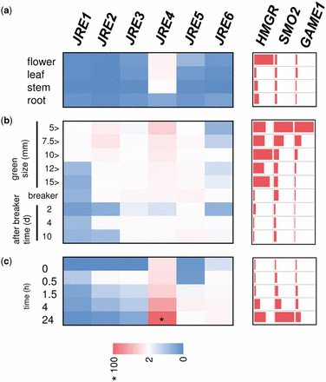
Fig. 2 Expression patterns of JRE genes in tomato. Tomato flower, leaf, stem and root (a) and fruits of different ...
Notes:
Fig. 2 Expression patterns of JRE genes in tomato. Tomato flower, leaf, stem and root (a) and fruits of different ripening stages (b) were examined. Wild-type tomato hairy roots were treated with 100 μM MeJA for 0, 0.5, 1, 4 and 24 h (c). Transcript levels were analyzed by qRT–PCR. Heat maps were drawn using average values (Supplementary Table S1) of three biological replicates. For JRE genes, values are calculated relative to those of EF1α, and are shown relative to the value (set to 100, marked with asterisk) of JRE4 in hairy roots treated with MeJA for 24 h. For HMGR1, SMO2 and GAME1, levels are shown relative to those in leaf, in fruit at stages with the highest expression for each, or in hairy roots at 0 h.
Unless provided in the caption above, the following copyright applies to the content of this slide: © The Author 2016. Published by Oxford University Press on behalf of Japanese Society of Plant Physiologists. All rights reserved. For permissions, please email: journals.permissions@oup.com

Slide 3
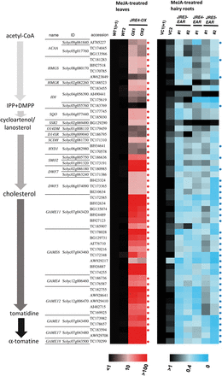
Fig. 3 JRE-regulated SGA biosynthesis genes identified by cDNA microarray analysis. Probes corresponding to SGA ...
Notes:
Fig. 3 JRE-regulated SGA biosynthesis genes identified by cDNA microarray analysis. Probes corresponding to SGA biosynthesis genes up-regulated by JRE4 overexpression or down-regulated by dominant suppression of JRE genes are shown. Signal intensities relative to those of one of the controls (WT1 or VC1) are represented as heat maps (values available in Supplementary Table S5). Probes with Rox >5 and Q <0.85 are marked with red and blue asterisks, respectively. A schematic view of the SGA biosynthesis pathway is on the left. ACAA, acetyl-CoA C-acetyltransferase; HMGS, hydroxymethylglutaryl-CoA synthase; HMGR, 3-hydroxy-3-methylglutaryl CoA reductase: IDI, isopentenyl-diphosphate Δ-isomerase; SQO, squalene monooxygenase; SSR2, sterol side chain reductase 2; O14DM, obtsuifoliol 14α -demethylase; D14SR, Δ14-sterol reductase; SCDH, sterol-4α -carboxylate 3-dehydrogenase; HYD1, 3β-hydroxysteroid-Δ8Δ7-isomerase; SMO2, sterol 4α -methyl oxidase 2; DWF7, sterol C-5 desaturase; DWF5, sterol reductase; GAME, glycoalkaloid metabolism; IPP, isopentenyl pyrophosphate; DMPP, dimethylallyl pyrophosphate.
Unless provided in the caption above, the following copyright applies to the content of this slide: © The Author 2016. Published by Oxford University Press on behalf of Japanese Society of Plant Physiologists. All rights reserved. For permissions, please email: journals.permissions@oup.com

Slide 4
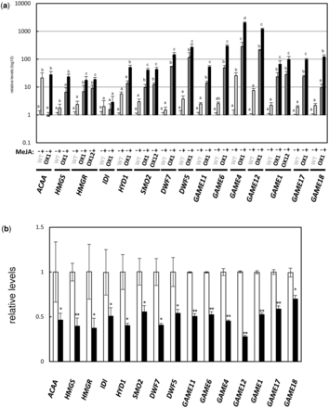
Fig. 4 Expression levels of SGA biosynthesis genes in transgenic tomato JRE4-OX plant and JRE4-EAR hairy root lines. ...
Notes:
Fig. 4 Expression levels of SGA biosynthesis genes in transgenic tomato JRE4-OX plant and JRE4-EAR hairy root lines. Transcript levels were analyzed by qRT–PCR. The error bars indicate the SD for three biological replicates. Levels are shown relative to the controls. See the legend of Fig. 3 for abbreviations of gene names. (a) Levels in leaves from JRE4-OX plant lines treated with MeJA for 24 h. (b) Levels in hairy roots of JRE4-EAR (line #1) treated with MeJA for 24 h.
Unless provided in the caption above, the following copyright applies to the content of this slide: © The Author 2016. Published by Oxford University Press on behalf of Japanese Society of Plant Physiologists. All rights reserved. For permissions, please email: journals.permissions@oup.com

Slide 5
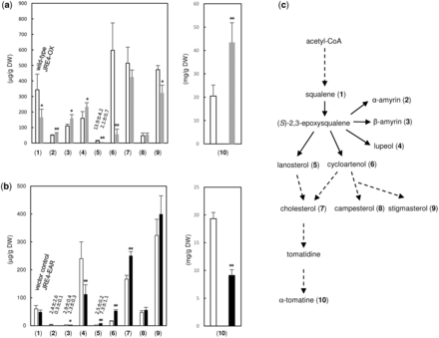
Fig. 5 Metabolite levels in transgenic tomato JRE4-OX plants and JRE4-EAR hairy root lines. Metabolite levels were ...
Notes:
Fig. 5 Metabolite levels in transgenic tomato JRE4-OX plants and JRE4-EAR hairy root lines. Metabolite levels were analyzed by LC-QTOF-MS for α-tomatine and by GC-MS for other compounds. The error bars represent the SD from four (for a) or five (for b) biological replicates. Levels of other SGAs are available in Supplementary Table S6. (a) Levels in leaves from JRE4-OX plants (line OX1) exposed to MeJA vapor for 4 d. (b) Levels in hairy roots of JRE4-EAR (line #1) treated with MeJA for 4 d. (c) Metabolites are schematically indicated in the SGA biosynthesis pathway.
Unless provided in the caption above, the following copyright applies to the content of this slide: © The Author 2016. Published by Oxford University Press on behalf of Japanese Society of Plant Physiologists. All rights reserved. For permissions, please email: journals.permissions@oup.com

Slide 6
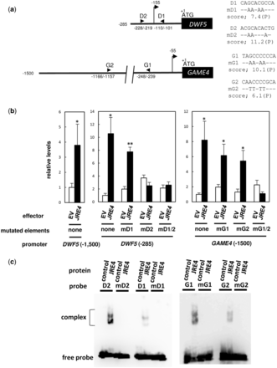
Fig. 6 JRE4-mediated activation of DWF5 and GAME4 is dependent on JRE-binding elements found in the promoter ...
Notes:
Fig. 6 JRE4-mediated activation of DWF5 and GAME4 is dependent on JRE-binding elements found in the promoter regions. (a) Schematic representation of 5′-flanking regions of DWF5 and GAME4. The positions of JRE-binding elements (arrowheads) and transcriptional start sites (arrows with vertical lines) are shown. On the right, nucleotide sequences of the elements are shown, while only the substituted nucleotides are indicated in mutated versions. (b) Transient transactivation assays in tomato fruits. The GUS reporter gene, fused with 5′-flanking regions of DWF5 (−1,500 to − 1 or − 285 to − 1; counted from the first ATG) and GAME4 (−1,500 to − 1) or their mutated versions, was delivered into tomato fruits by agroinjection with JRE4 effector plasmid or empty vector (EV) and GFP reference plasmid. Expression levels of the GUS reporter gene were normalized to those of the GFP reference gene, and are shown as relative values against the values of each wild-type reporter with EV. The bars indicate the SD from four independent experiments. Significant differences between EV and JRE4 effector for each reporter were determined by Student’s t-test: *P < 0.05; **P < 0.01. (c) EMSA showing in vitro binding of recombinant JRE4 to the predicted elements. Probes were incubated with proteins from EV control or recombinant JRE4. Probe sequences are available in Supplementary Table S10.
Unless provided in the caption above, the following copyright applies to the content of this slide: © The Author 2016. Published by Oxford University Press on behalf of Japanese Society of Plant Physiologists. All rights reserved. For permissions, please email: journals.permissions@oup.com

Slide 7
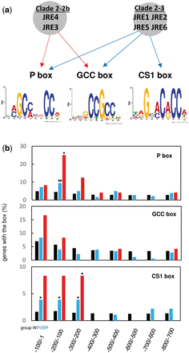
Fig. 7 Computational prediction of putative JRE-binding elements in promoter regions of genes regulated by JRE ...
Notes:
Fig. 7 Computational prediction of putative JRE-binding elements in promoter regions of genes regulated by JRE genes. (a) Presumed binding elements of JREs. DNA-binding specificities of JRE4 and related ERFs from other species had been studied (Shoji et al. 2013); the binding of JRE4 to P and GCC boxes was experimentally validated, while those for other JREs are presumed based on the results of clade 2–2b JRE4 for JRE3 and those of clade 2–3 ORCA3 from C. roseus for the remaining four JREs. Sequence logos representing P , CS1 and GCC boxes were generated by WebLogo (Crooks et al. 2004) based on position-specific probability matrices (Supplementary Table S7), which were determined using the sequences predicted in the 5′-flanking regions (−300 to − 1) of group R genes. (b) Genes predicted with JRE-binding elements (scores >7.0) for the indicated region in groups W (black), R (blue) and SR (red). The genes of group R (180 JRE-regulated genes) and of group SR (JRE-regulated 24 SGA biosynthesis genes) are given in Supplementary Table S4 and in Fig. 3, respectively. Significant differences of values (shown in %) from those for group W (all 34,725 protein-coding genes inthe tomato genome) were determined by one-sided Fisher’s exact test; *P < 0.05, **P < 0.01.
Unless provided in the caption above, the following copyright applies to the content of this slide: © The Author 2016. Published by Oxford University Press on behalf of Japanese Society of Plant Physiologists. All rights reserved. For permissions, please email: journals.permissions@oup.com

