Slide 1
Figure 1. A typical ‘performance’ sequence of Euphlyctis hexadactylus, recorded at 50 Hz, in which the remarkable ...
Notes:
Figure 1. A typical ‘performance’ sequence of Euphlyctis hexadactylus, recorded at 50 Hz, in which the remarkable capacity of this species to jump out of the water is shown. The water surface is indicated with a horizontal white line.
Unless provided in the caption above, the following copyright applies to the content of this slide:

Slide 2
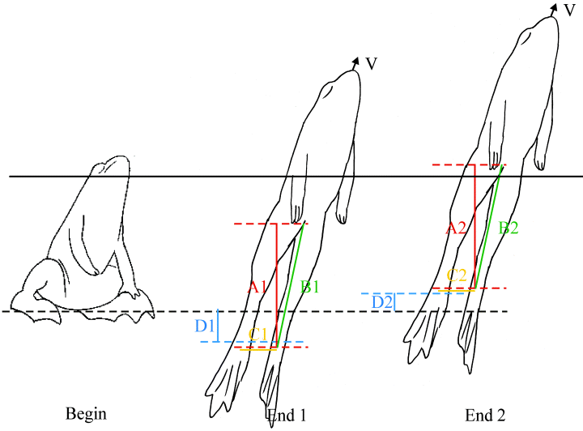
Figure 2. This figure illustrates how the different propulsive distances were measured. At the beginning of the ...
Notes:
Figure 2. This figure illustrates how the different propulsive distances were measured. At the beginning of the propulsion, the ankles are held at a certain height. At the end of the propulsion phase, several distances can be measured: the potential functional propulsion A, the 3D length of the extended leg B, the distance between the legs C and the functional propulsion distance D. The second case (End 2: a drawing from a real sequence) shows how the distance D can become negative if the ankles end up higher at the end of the propulsion phase, compared to the height at the start.
Unless provided in the caption above, the following copyright applies to the content of this slide:

Slide 3
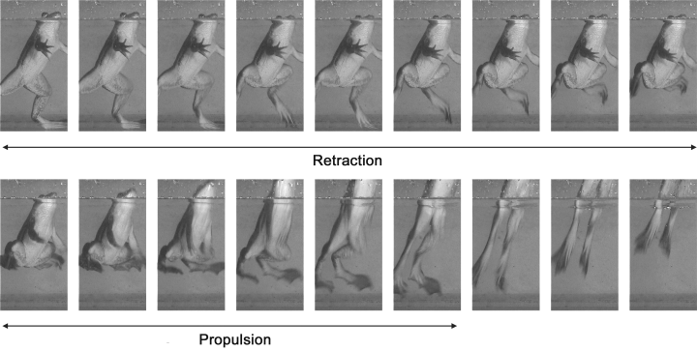
Figure 3. A typical ‘kinematics’ sequence, a lateral view on the leg extension kinematics of an individual of ...
Notes:
Figure 3. A typical ‘kinematics’ sequence, a lateral view on the leg extension kinematics of an individual of Euphlyctis cyanophlyctis, recorded at 100 Hz, in which the two major phases of the jumping sequence are shown.
Unless provided in the caption above, the following copyright applies to the content of this slide:

Slide 4
Figure 4. The slip factor throughout the propulsion phase is shown for the three species. A slip factor of one means ...
Notes:
Figure 4. The slip factor throughout the propulsion phase is shown for the three species. A slip factor of one means that the slip is small, the snout tip gains height, but this does not result in a loss of height of the ankles. In contrast, a slip of zero means that the feet move downwards, but this does not result in the snout tip moving upwards. In these graphs, the resulting performance velocity is taken into account. Overall, more slip (lower slip factor) is found in the higher region of the performance range. This figure also shows that the slip is higher for Rana esculenta at the beginning of the propulsion phase and that slip is already high at low performance.
Unless provided in the caption above, the following copyright applies to the content of this slide:

