Slide 1
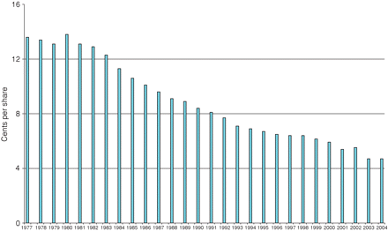
Figure 1 Historical commissions per share Institutional investor average cents-per-share commission, 1977–2004. Data ...
Notes:
Figure 1 Historical commissions per share Institutional investor average cents-per-share commission, 1977–2004. Data are from Greenwich Associates and represent the unweighted average commission that is calculated from proprietary survey data.
Unless provided in the caption above, the following copyright applies to the content of this slide: © Oxford University Press 2009

Slide 2
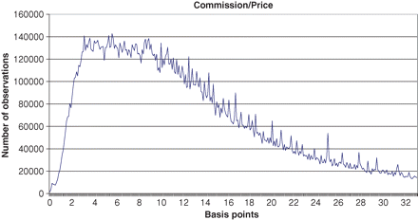
Figure 2 Institutional percentage commission costs on the NYSE The distribution of commissions in Abel/Noser’s ...
Notes:
Figure 2 Institutional percentage commission costs on the NYSE The distribution of commissions in Abel/Noser’s NYSE-listed institutional trading data 1999–2003, as a percentage of stock price. Commissions per share are divided by the reported execution price to calculate percentage commission transactions cost. Zero cents per share commissions are not analyzed and the distribution is truncated at 33 bps.
Unless provided in the caption above, the following copyright applies to the content of this slide: © Oxford University Press 2009

Slide 3
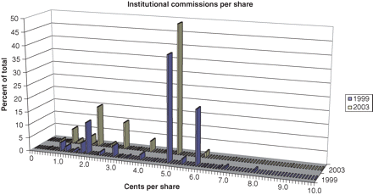
Figure 3 Per share institutional commissions for the NYSE-listed stocks in 1999 and 2003 All commissions per share are ...
Notes:
Figure 3 Per share institutional commissions for the NYSE-listed stocks in 1999 and 2003 All commissions per share are rounded to the nearest one-tenth of one cent. Zero cents per share commissions are not analyzed in this distribution, and the distribution is truncated above ten cents per share, where only a few observations reside. The resulting distribution of commissions is presented below. Few of the possible pricing nodes are actively used; institutions rely on whole number pricing, primarily at 2 and 5 cents per share.
Unless provided in the caption above, the following copyright applies to the content of this slide: © Oxford University Press 2009

Slide 4
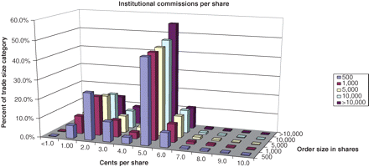
Figure 4 Per share institutional commissions for the NYSE-listed stocks in 1999–2003 by trade size All commissions per ...
Notes:
Figure 4 Per share institutional commissions for the NYSE-listed stocks in 1999–2003 by trade size All commissions per share are rounded to the nearest cent. Zero cents per share commissions are not included, and the distribution is truncated above ten cents per share, losing only a few observations. Overall frequency of trades at each commission price is presented for five trade-size categories.
Unless provided in the caption above, the following copyright applies to the content of this slide: © Oxford University Press 2009

Slide 5
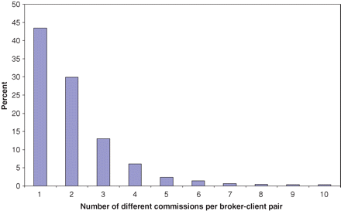
Figure 5 Frequency of number of different commissions per share by institutional client-broker pairs in ...
Notes:
Figure 5 Frequency of number of different commissions per share by institutional client-broker pairs in 1999–2003 Percent represents the average over 20 quarters of the distribution of the number of commissions executed by a client-broker pair. Each institutional-client executed at least five trades with each broker during a quarter. Truncation at ten commissions removes 2.2% of the data from this graph.
Unless provided in the caption above, the following copyright applies to the content of this slide: © Oxford University Press 2009

Slide 6
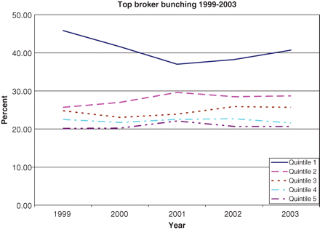
Figure 6 Institutional bunching over time Top broker bunching is the average allocation to a client’s most important ...
Notes:
Figure 6 Institutional bunching over time Top broker bunching is the average allocation to a client’s most important broker. Cross-sectional averages for each client quintile and year are exhibited below.
Unless provided in the caption above, the following copyright applies to the content of this slide: © Oxford University Press 2009

Slide 7
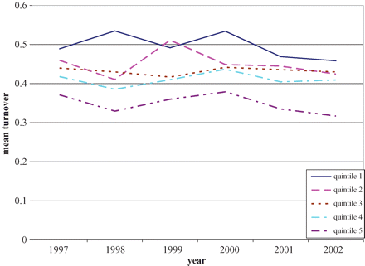
Figure 7 Mutual funds’ turnover by year and size This figure uses Thompson’s mutual fund quarterly holding data from ...
Notes:
Figure 7 Mutual funds’ turnover by year and size This figure uses Thompson’s mutual fund quarterly holding data from 1997 to 2002. We remove all observations where the fund was smaller than $10M at the beginning of the quarter, or grew by more than 50% during the quarter. For each fund we calculate the change in the number of shares of every security held by the fund over the course of the quarter, and treat it as the fund’s trading volume. We then multiply trading volume by the average quarterly price and aggregate over all securities, yielding the estimate of total dollar trading volume. We then divide by the NAV at the beginning of the quarter to obtain an estimate of the turnover. Each fund is then assigned a NAV quintile and the average turnover statistics for each quintile are presented in the figure (Quintile 1 is the smallest institutions).
Unless provided in the caption above, the following copyright applies to the content of this slide: © Oxford University Press 2009

