Slide 1
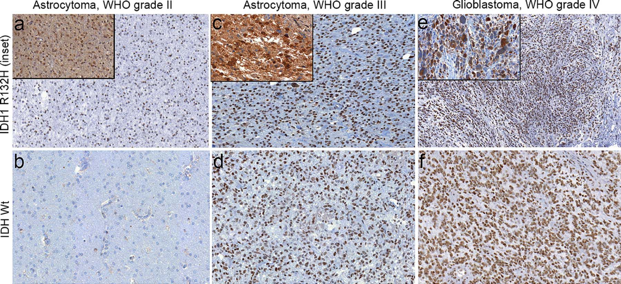
FIGURE 3 Histone 3 lysine 9 trimethylation (H3K9me3) immunostaining patterns in astrocytic tumors. ...
Notes:
FIGURE 3 Histone 3 lysine 9 trimethylation (H3K9me3) immunostaining patterns in astrocytic tumors. Immunohistochemistry of H3K9me3 was assessed in WHO grade II astrocytomas, grade III astrocytomas, and glioblastomas. Isocitrate dehydrogenase 1 R132H mutational status was assessed using immunohistochemistry in a blinded manner and compared with H3K9me3 staining in each case. Cases that were negative for IDH1 R132H were sequenced for other IDH1/2 mutations. (A) Representative images from an IDH1 R132H mutant (inset, 20×) grade II astrocytoma that was positive for H3K9me3 (10×). (B) Representative image from an IDH wild-type grade II astrocytoma that was negative for H3K9me3 (10×). (C) Representative images from an IDH1 R132H mutant (inset, 20×) grade III astrocytoma that was positive for H3K9me3 (10×). (D) Representative image from an IDH wild-type grade III astrocytoma that was positive for H3K9me3 (10×). (E) Representative images from an IDH1 R132H mutant (inset, 20×) glioblastoma that was positive for H3K9me3 (10×). (F) Representative image from an IDH wild-type glioblastoma that was positive for H3K9me3 (10×).
Unless provided in the caption above, the following copyright applies to the content of this slide: © 2013, by the American Association of Neuropathologists, Inc.

Slide 2
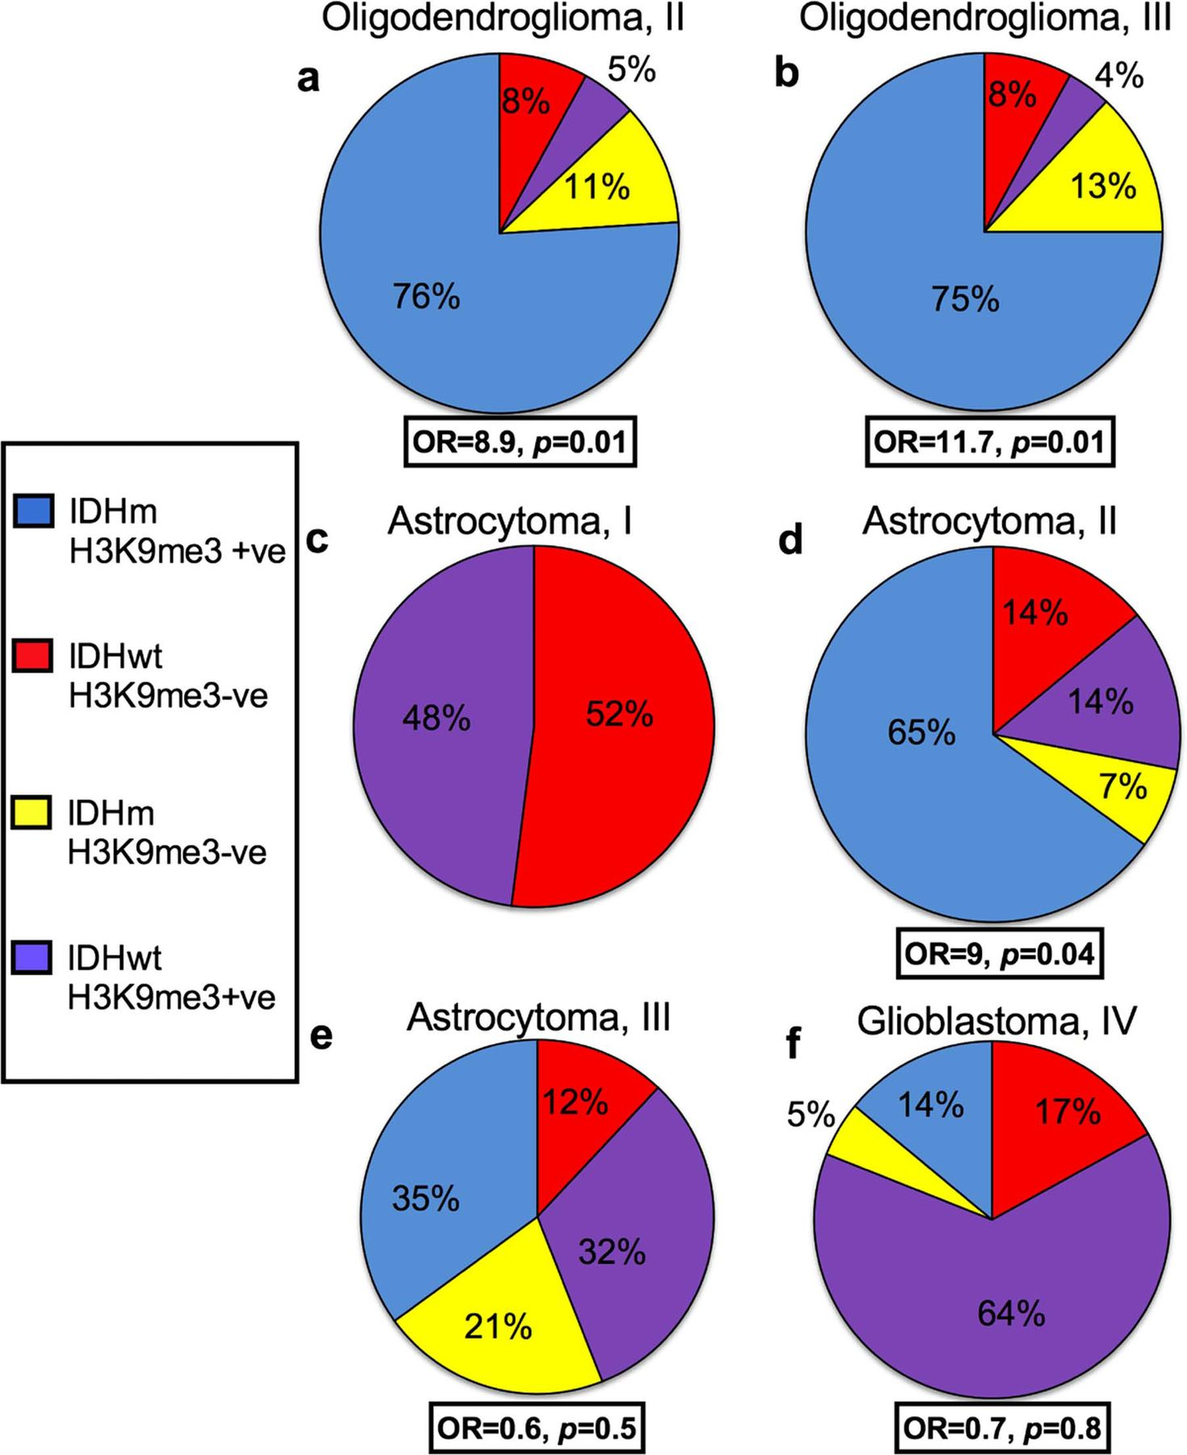
FIGURE 2 Histone 3 lysine 9 trimethylation (H3K9me3) is associated with isocitrate dehydrogenase 1/2 (IDH1/2) mutant ...
Notes:
FIGURE 2 Histone 3 lysine 9 trimethylation (H3K9me3) is associated with isocitrate dehydrogenase 1/2 (IDH1/2) mutant oligo-dendrogliomas but not high-grade astrocytic tumors. Positivity of H3K9me3 was compared with IDH1/2 mutational status. Data were analyzed using Fisher exact test with 95% confidence intervals to evaluate the odds ratios reflective of the strength of association between H3K9me3 and IDH mutational status in (A) WHO grade II oligodendrogliomas, (B) grade III oligodendrogliomas, (C) pilocytic astrocytomas, (D) grade II astrocytomas, (E) grade III astrocytomas, and (F) glioblastomas. OR, odds ratio; +ve, positive; −ve, negative; IDHm, mutant IDH; IDHwt, wild-type IDH.
Unless provided in the caption above, the following copyright applies to the content of this slide: © 2013, by the American Association of Neuropathologists, Inc.

Slide 3
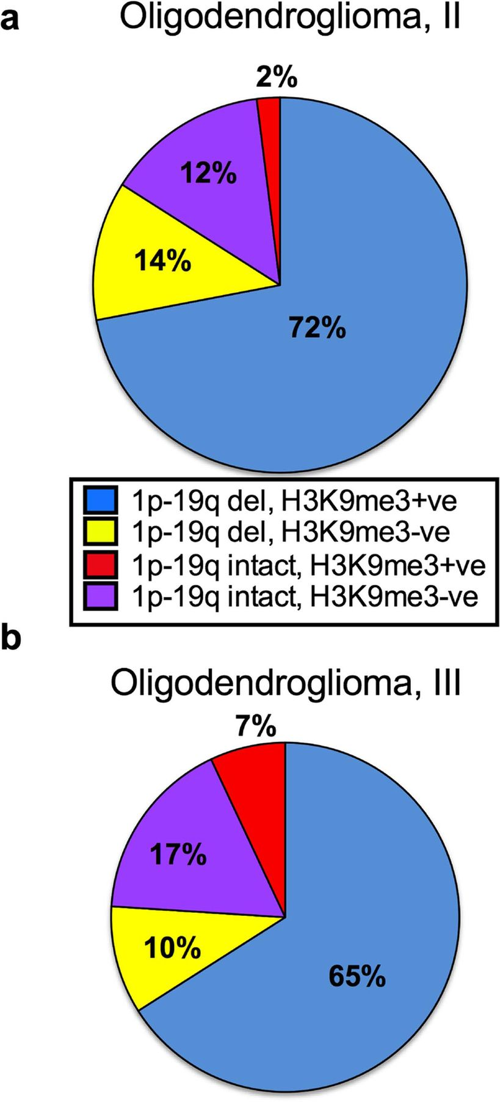
FIGURE 4 Histone 3 lysine 9 trimethylation (H3K9me3) is more frequent but not significantly associated with loss of ...
Notes:
FIGURE 4 Histone 3 lysine 9 trimethylation (H3K9me3) is more frequent but not significantly associated with loss of heterozygosity of chromosomes 1p and 19q in oligodendrogliomas. Positivity of H3K9me3 was compared in oligodendrogliomas with and without 1p-19q loss of heterozygosity. (A) WHO grade II oligodendrogliomas. (B) Grade III oligodendrogliomas. +ve, positive; −ve, negative.
Unless provided in the caption above, the following copyright applies to the content of this slide: © 2013, by the American Association of Neuropathologists, Inc.

Slide 4
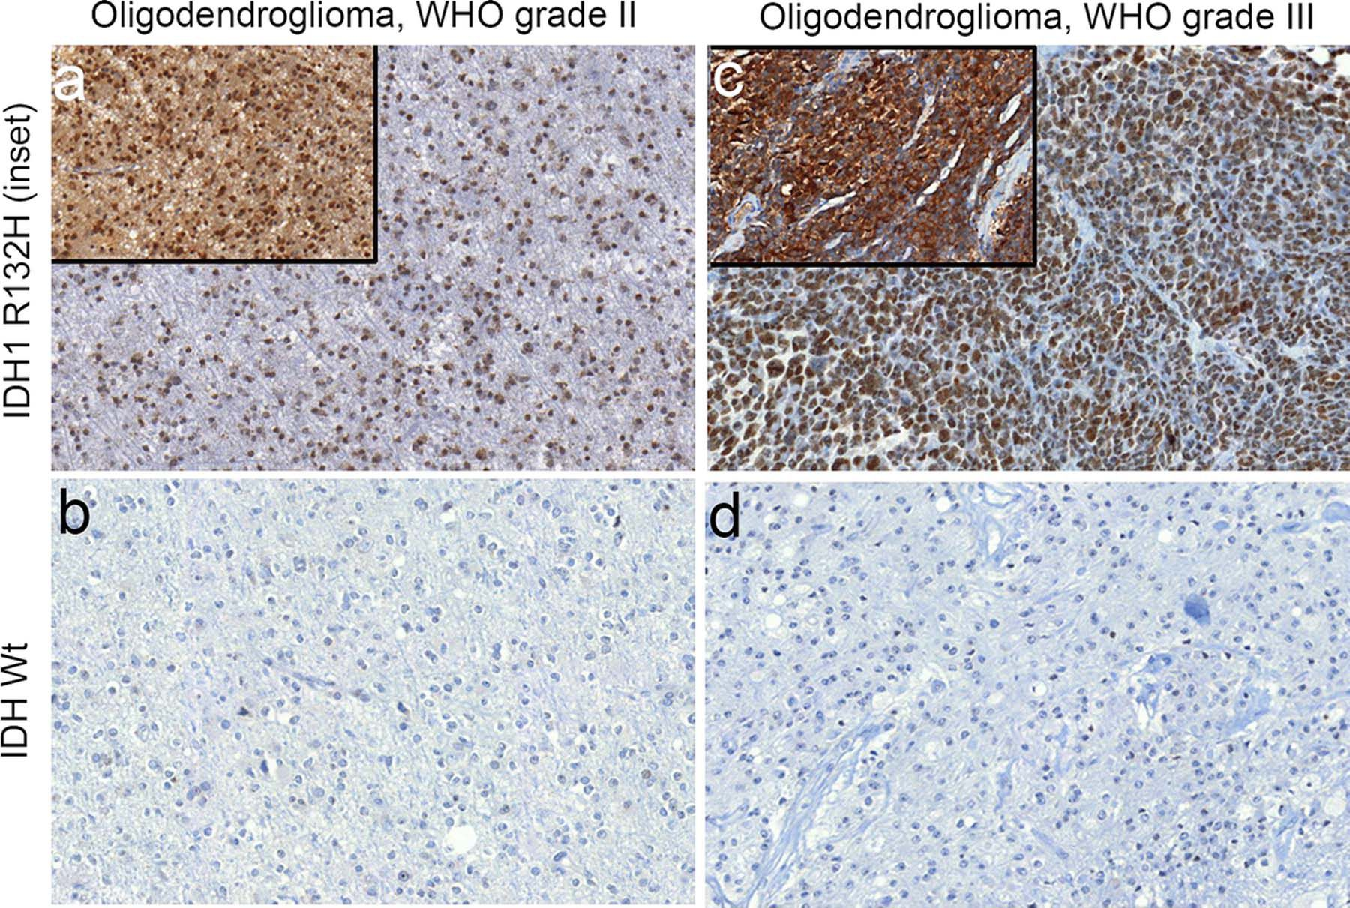
FIGURE 1 Histone 3 lysine 9 trimethylation (H3K9me3) is associated with isocitrate dehydrogenase 1/2 (IDH1/2) ...
Notes:
FIGURE 1 Histone 3 lysine 9 trimethylation (H3K9me3) is associated with isocitrate dehydrogenase 1/2 (IDH1/2) mutations in oligodendrogliomas. Immunohistochemistry of H3K9me3 was assessed in WHO grade II oligodendrogliomas and grade III anaplastic oligodendrogliomas. Isocitrate dehydrogenase 1 R132H mutational status was assessed using immunohistochemistry (insets) in a blinded manner and compared with H3K9me3 staining in each case. Cases that were negative for IDH1 R132H were sequenced for other IDH1/2 mutations. (A) Representative images from an IDH1 R132H mutant (inset, 20×) grade II oligodendroglioma that was positive for H3K9me3 (10×). (B) Representative image from an IDH wild-type grade II oligodendroglioma that was negative for H3K9me3 (10×). (C) Representative images from an IDH1 R132H (inset, 20×) mutant grade III oligodendroglioma that was positive for H3K9me3 (10×). (D) Representative image from an IDH wild-type grade III oligodendroglioma that was negative for H3K9me3 (10×).
Unless provided in the caption above, the following copyright applies to the content of this slide: © 2013, by the American Association of Neuropathologists, Inc.

Slide 5
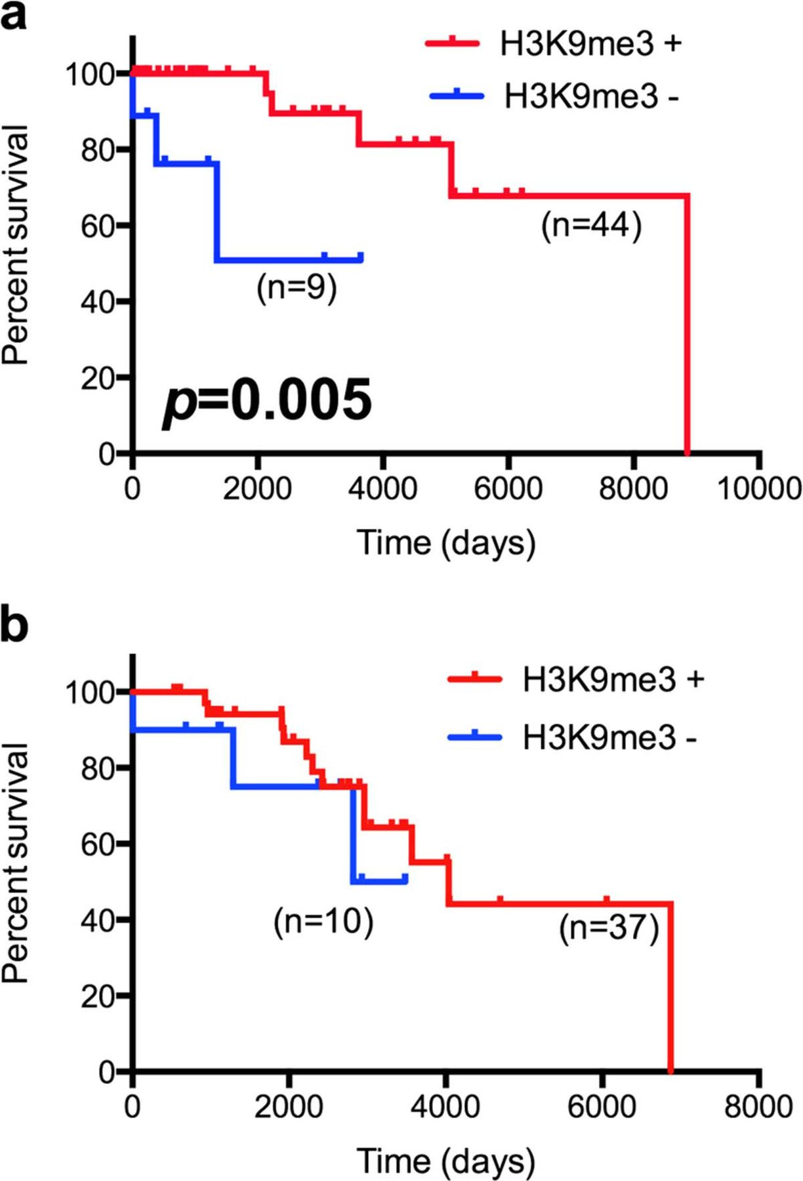
FIGURE 5 Histone 3 lysine 9 trimethylation (H3K9me3) is associated with improved overall survival in WHO grade II ...
Notes:
FIGURE 5 Histone 3 lysine 9 trimethylation (H3K9me3) is associated with improved overall survival in WHO grade II oligo-dendrogliomas. Patients with grade II or grade III anaplastic oligodendrogliomas were stratified according to H3K9me3 positivity (red, H3K9me3 positive; blue, H3K9me3 negative). Percent survival was graphed using Kaplan-Meier curves and analyzed using the log-rank (Mantel-Cox) test with 95% confidence intervals. (A) Grade II oligodendrogliomas. (B) Grade III anaplastic oligodendrogliomas.
Unless provided in the caption above, the following copyright applies to the content of this slide: © 2013, by the American Association of Neuropathologists, Inc.

