Slide 1
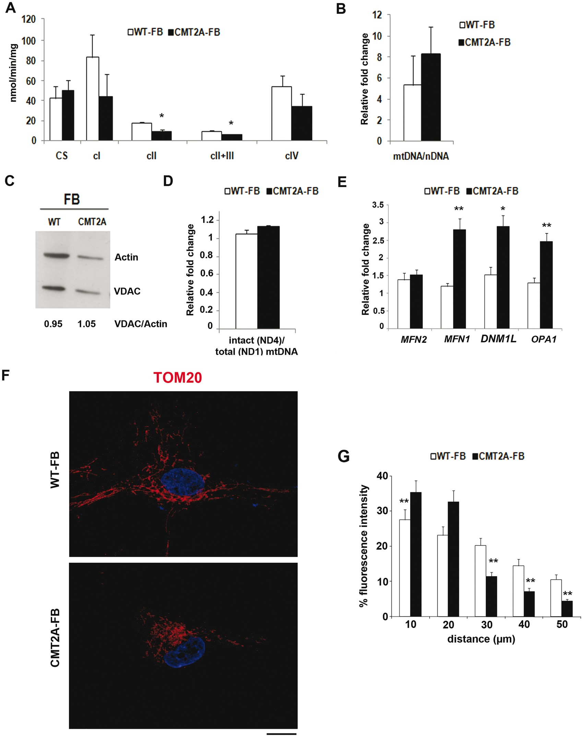
Figure 1. CMT2A fibroblasts exhibit slight mitochondrial alterations without any difference in total mitochondrial ...
Notes:
Figure 1. CMT2A fibroblasts exhibit slight mitochondrial alterations without any difference in total mitochondrial content. (A) Respiratory chain activity in WT and CMT2A fibroblasts (WT-FBs and CMT2A-FBs). The enzymatic activity of respiratory complexes I-IV (cI-IV) were determined in WT-FBs and CMT2A-FBs and normalized to citrate synthase (CS) activity. The combined defect in respiratory chain activity was observed in CMT2A cells. Values are expressed as nmoles/min/mg protein. Error bars indicate SEM. *P<0.05. (B) Quantitative PCR analysis of mtDNA in WT-FBs and CMT2A-FBs. Levels of mtDNA in patient and control cells referred to the same reference sample. No decrease in mtDNA content was observed in CMT2A cells. Error bars indicate SEM. (C) Western blot analysis of the mitochondrial protein VDAC in WT-FBs and CMT2A-FBs. Numbers indicate the VDAC signal normalized to actin. No differences were observed in the level of VDAC protein between CMT2A and WT cells. (D) A quantitative PCR assay was developed to assess the relative amount of non-deleted (ND4) and total (ND1) mtDNA molecules in WT-FBs and CMT2A-FBs. The ND4/ND1 ratio indicates the amount of normal (non-deleted) molecules with respect to the total number of amplified mitochondrial genomes. No gross deletions of mtDNA were observed in CMT2A cells. Error bars indicate SEM. (E) Quantitative RT-PCR analysis of MFN2, MFN1, OPA1, and DMN1L expression in WT-FBs and CMT2A-FBs. CMT2A-FBs expressed significantly higher levels of MFN1, OPA1, and DMN1L. **P<0.001, *P<0.05. Error bars indicate SEM. (F) Representative image of WT- and CMT2A-FBs, labelled with antibody to TOM20 (red). Nuclei were stained with DAPI (blue). Scale bar = 20 µm. (G) TOM20 fluorescence signals represented as a function of the distance measured from the center of the cells. The data indicated that the mitochondria were concentrating around the nucleus in CMT2A-FBs vs WT-FBs. Error bars indicate SEM. **P<0.001.
Unless provided in the caption above, the following copyright applies to the content of this slide: © The Author 2016. Published by Oxford University Press. All rights reserved. For Permissions, please email: journals.permissions@oup.com

Slide 2
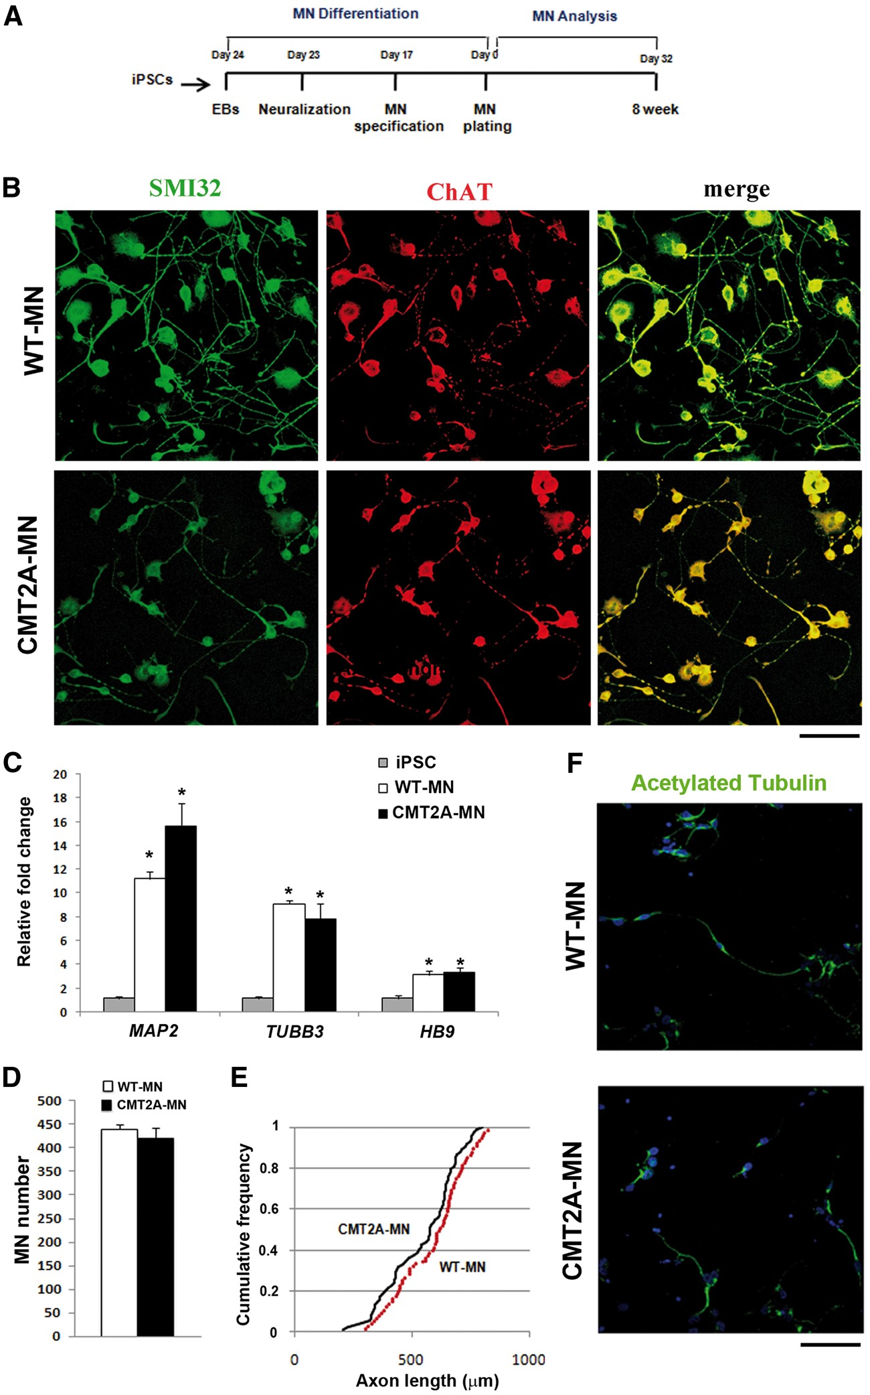
Figure 2. CMT2A iPSC-derived MNs not exhibit survival and morphometric defects. (A) Experimental outline for WT and ...
Notes:
Figure 2. CMT2A iPSC-derived MNs not exhibit survival and morphometric defects. (A) Experimental outline for WT and CMT2A-MN differentiation and characterization. (B) Immunocytochemistry of WT-MNs and CMT2A-MNs. After 5 weeks of differentiation, the following MN markers were expressed: SMI32 (green) and ChAT (red). Double-positive MNs were observed (merged, yellow). Scale bars = 100 µm. (C) Quantitative RT-PCR analysis of MAP2, TUBB3, and HB9 in iPSCs and MNs. WT-MNs and CMT2A-MNs expressed significantly higher levels of neuronal and motor neuron markers. *P<0.05. Error bars indicate SEM. The graph shows the relative expression level with respect to a pool of iPSCs used as reference samples with the value set to 1. (D-F) Morphometric analysis of WT-MNs and CMT2A-MNs. (D) Eight weeks after differentiation, MN quantification did not have a reduced number of CMT2A-MNs compared to WT (one-way ANOVA followed by a Tukey’s post hoc test). Error bars indicate SEM. (E) CMT2A-MNs did not exhibit significantly smaller and shorter axon lengths compared to WT-MNs. The maximum difference between the cumulative distributions is: 0.1600, with a corresponding P = 0.268. Five independent experiments were performed in triplicate. (F) WT-MNs and CMT2A-MNs were labelled with antibodies to acetylated tubulin (green). Nuclei were labelled with DAPI (blue). No differences were observed in microtubule networks. Scale bar = 100 μm.
Unless provided in the caption above, the following copyright applies to the content of this slide: © The Author 2016. Published by Oxford University Press. All rights reserved. For Permissions, please email: journals.permissions@oup.com

Slide 3
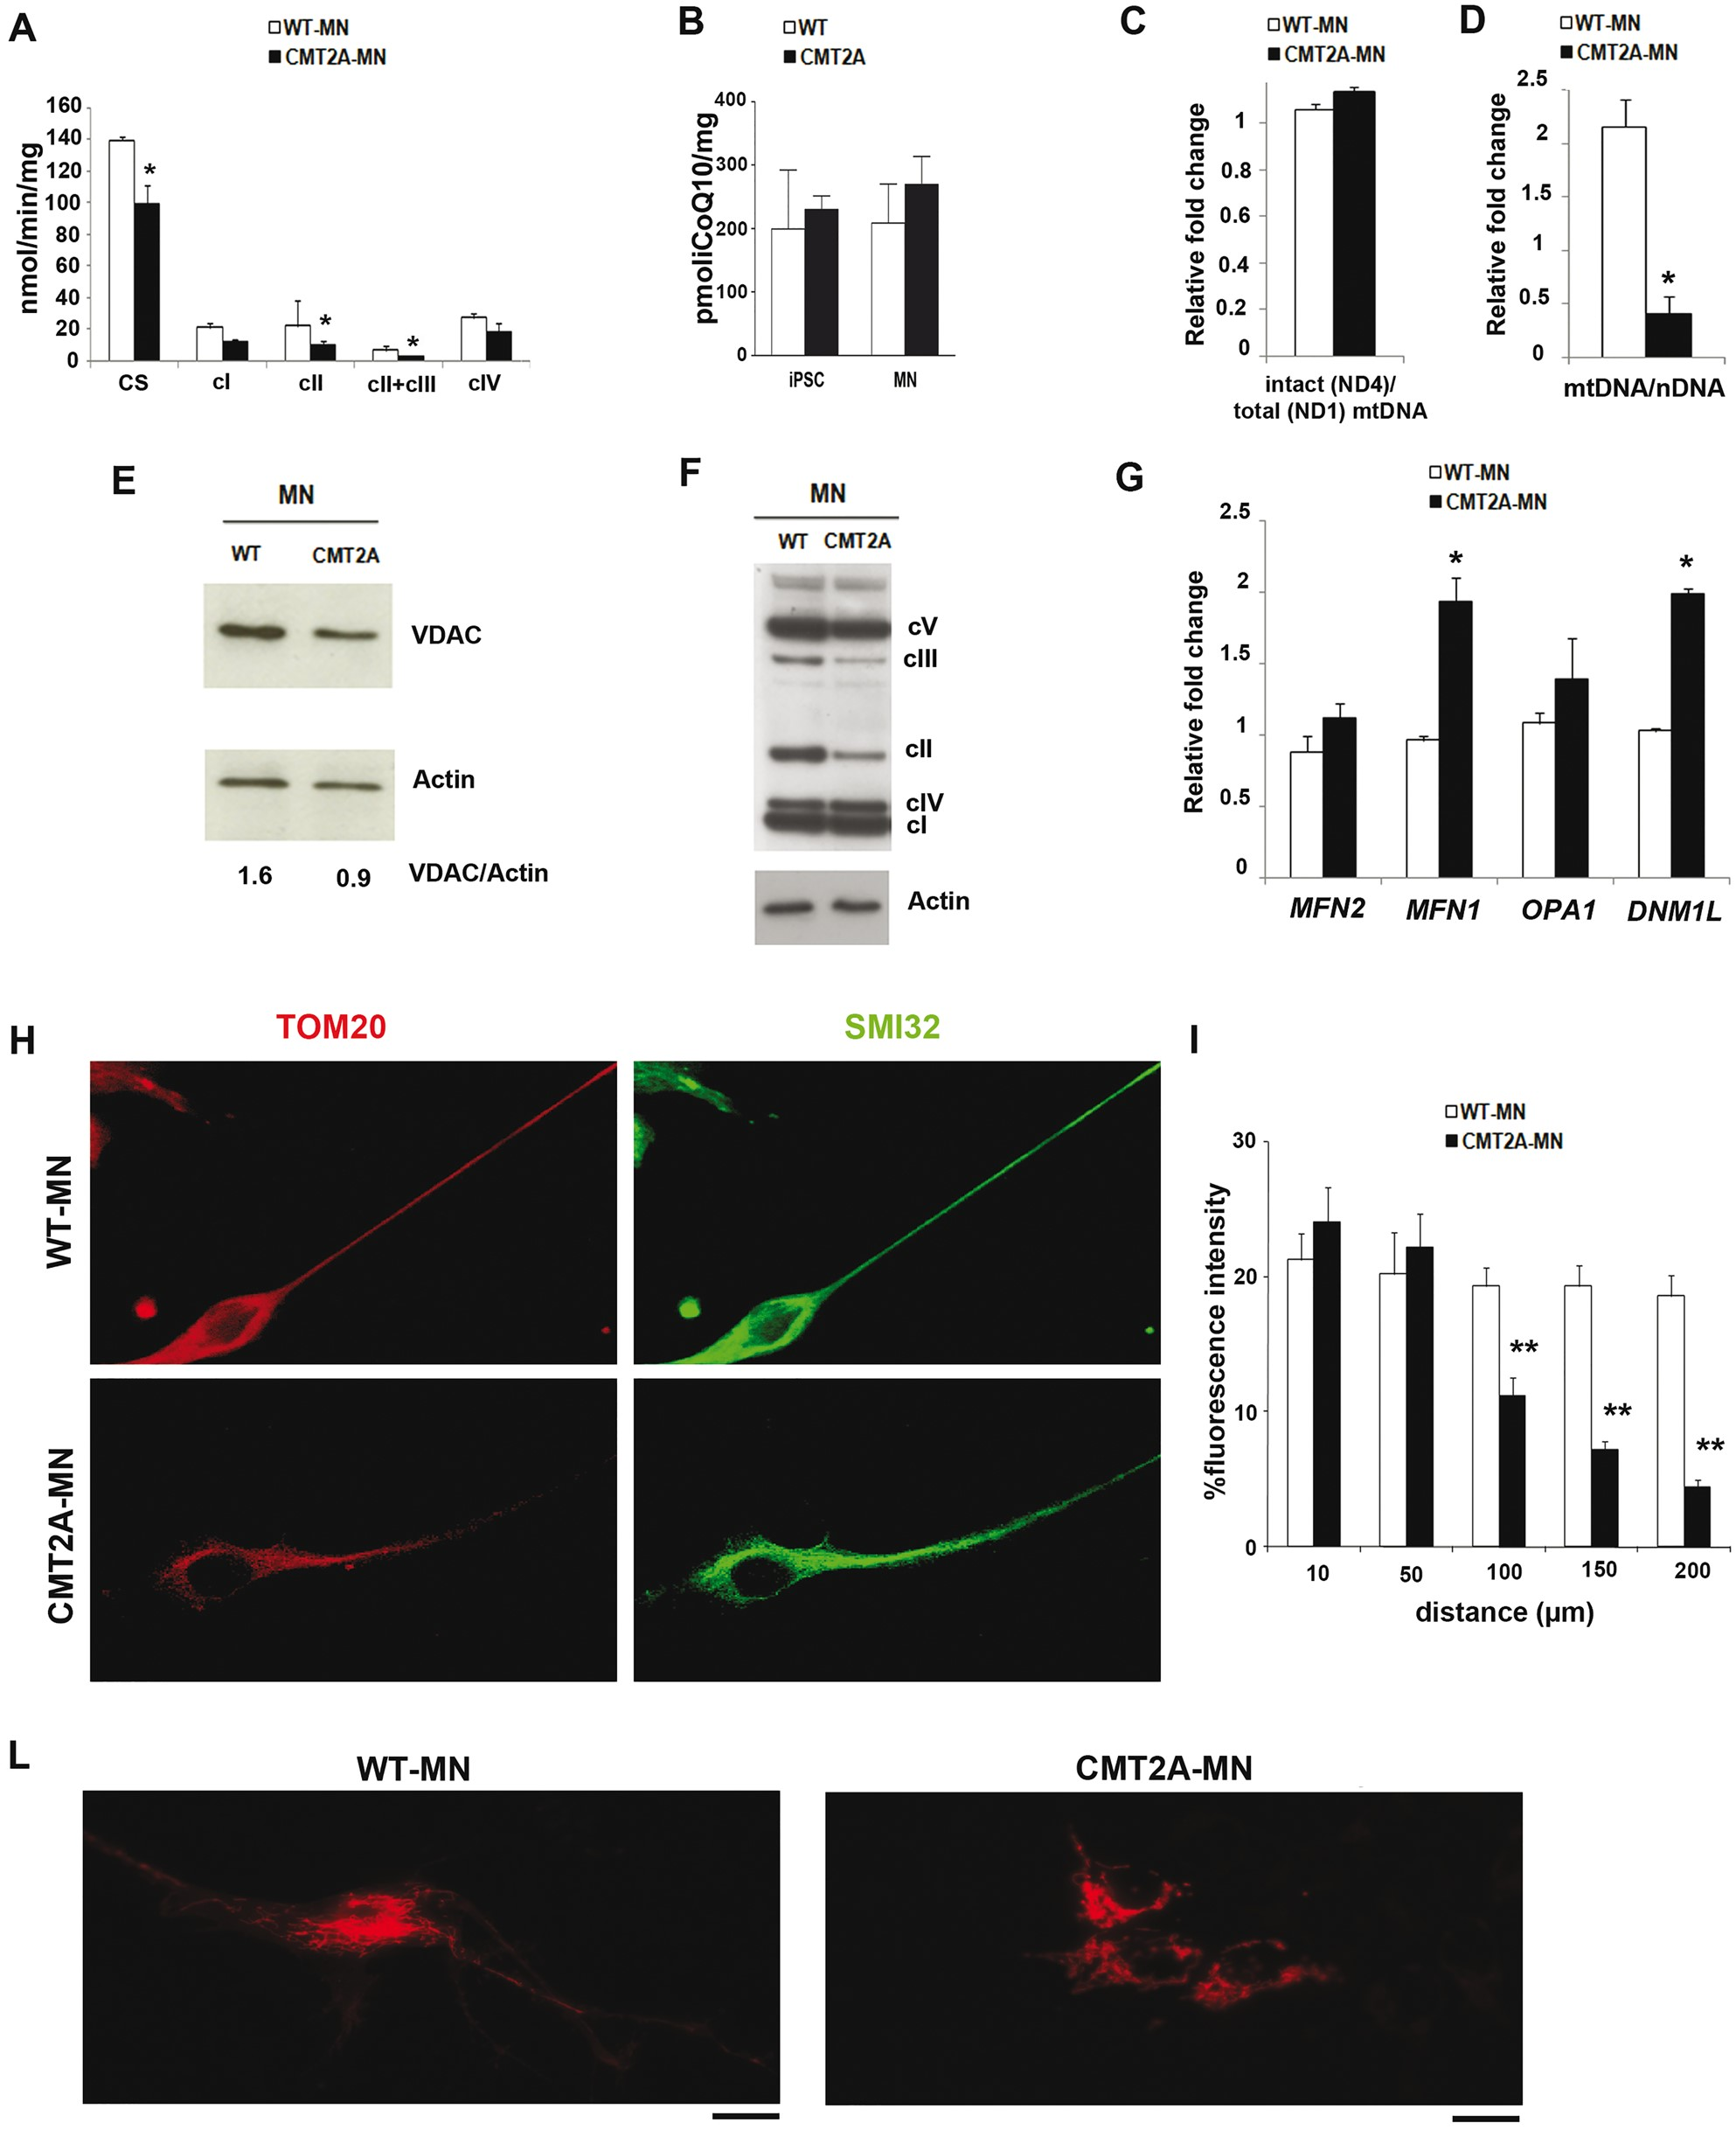
Figure 3. CMT2A-MNs have reduced mitochondrial content and altered mitochondrial distribution. (A) Respiratory chain ...
Notes:
Figure 3. CMT2A-MNs have reduced mitochondrial content and altered mitochondrial distribution. (A) Respiratory chain complex activity in WT-MNs and CMT2A-MNs. The enzymatic activities of respiratory complexes I-IV (cI-IV) were analysed and normalized to citrate synthase (CS) levels. A combined defect in respiratory chain activity was observed in CMT2A-MNs. The CS activity was significantly reduced in CMT2A-MNs. Values are expressed as nmoles/min/mg protein. Error bars indicate SEM. *P<0.05. (B) Coenzyme Q10 (CoQ10) content in iPSCs and MNs. The quantification units were expressed in pmoliQ10/mg of protein. No differences were observed between CMT2A vs WT cells. Error bars indicate SEM. (C) Quantitative PCR assay developed to assess the relative amount of non-deleted (ND4) and total (ND1) mitochondrial DNA molecules (mtDNA) in WT-MNs and CMT2AMNs. The ND4/ND1 ratio indicates the amount of intact (non-deleted) molecules with respect to the total number of mitochondrial genomes assayed. No mtDNA deletion was observed in CMT2A-MNs. Error bars indicate SEM. (D) Quantitative PCR analysis of mtDNA content in WT-MNs and CMT2A-MNs. The significant reduction of mtDNA content was observed in CMT2A-MNs. Levels of mtDNA in patients and control cells were referred to as the same reference sample. Error bars indicate SEM. *P<0.05. (E) Western blot analysis of the mitochondrial protein VDAC in WT-MNs and CMT2A-MNs. Numbers indicate VDAC levels normalized to actin. The level of VDAC protein was significantly reduced in CMT2A-MNs. (F) SDS-PAGE of respiratory chain complexes (cI-V) in WT-MNs and CMT2A-MNs. The analysis revealed widespread reduction of OXPHOS complex expression, which is more evident for complexes II and III. (G) Quantitative RT-PCR analysis of MFN2, MFN1, OPA1, and DNM1L transcripts in WT-MNs and CMT2AMNs. CMT2A-MNs express a significantly higher level of MFN1 and DNM1L transcripts. Error bars indicate SEM. *P<0.05. (H-L) Immunocytochemical studies of WT-MNs and CMT2A-MNs. (H) Representative image of WT-MNs and CMT2A-MNs stained with TOM20 (red) and SMI32 (green). Scale bar = 50 µm. (I) TOM20 fluorescence signals represented as a function of the distance measured from the center of the cells. The data showed that the number of mitochondria were reduced along the axon in CMT2A-MNs vs WT-MNs. Error bars indicate SEM. **P<0.001. (L) WT-MNs and CMT2A-MNs were stained with cell light Mitochondria BacMan (red) and visualized by fluorescence microscopy, confirming the abnormal distribution in CMT2A-MNs compared to WT. Scale bar = 40 µm.
Unless provided in the caption above, the following copyright applies to the content of this slide: © The Author 2016. Published by Oxford University Press. All rights reserved. For Permissions, please email: journals.permissions@oup.com

Slide 4
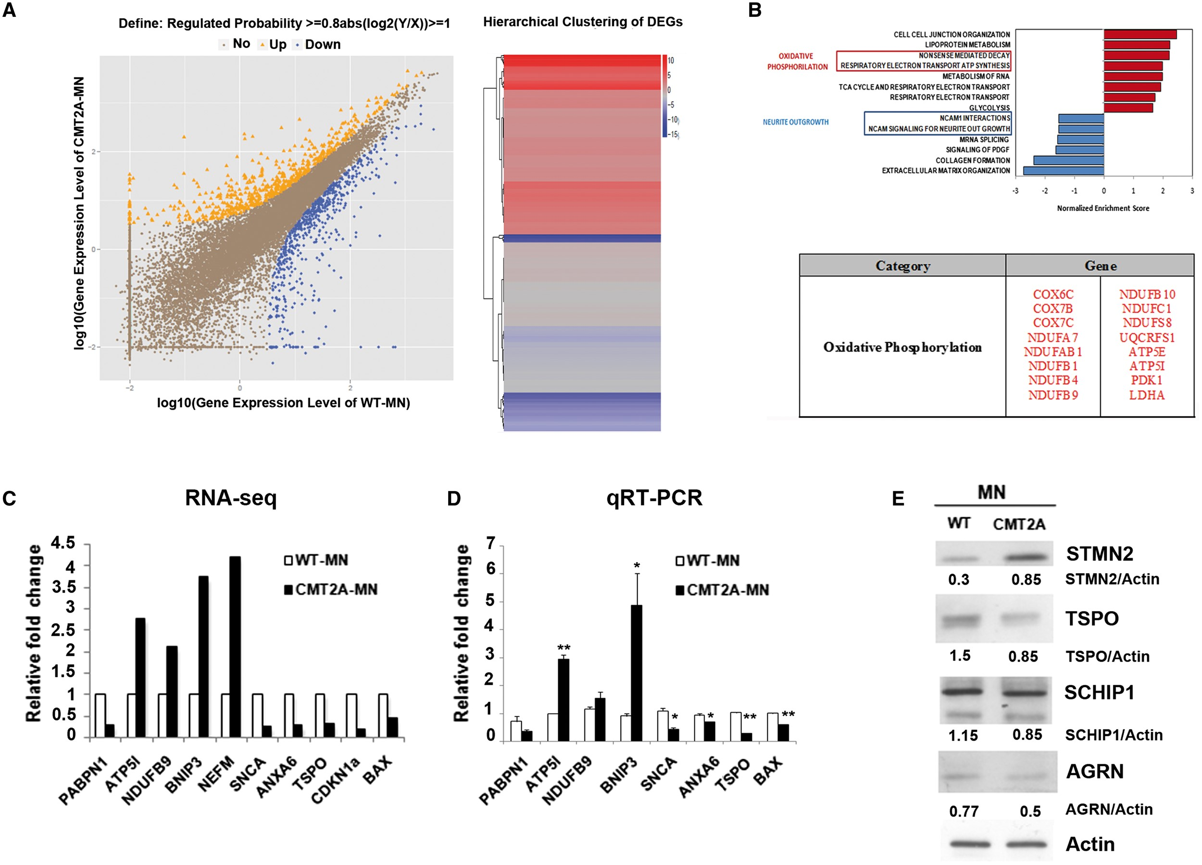
Figure 4. Gene expression profiling of CMT2A-MNs by RNA-Seq analysis. (A) Left: Graphical representation of the ...
Notes:
Figure 4. Gene expression profiling of CMT2A-MNs by RNA-Seq analysis. (A) Left: Graphical representation of the transcriptomic analysis of WT-MNs and CMT2A-MNs. A total of 1233 differentially expressed genes (fold change ≥2 and diverge probability ≥0.8) were observed in CMT2A-MNs compared to WT-MNs; 595 were up-regulated and 638 were down-regulated in CMT2A-MNs. Right: Image of hierarchical cluster analysis showing subdivided up-regulated and down-regulated genes in both groups. (B) Selected enriched gene sets obtained using the GSEA algorithm. Selected genes related to the Oxidative Phosphorylation pathway that were up-regulated in CMT2A-MNs are shown in red. (C,D) Comparison between RNA-Seq and quantitative RT-PCR findings for a select number of transcripts in MNs from control subjects (used as reference, set to 1) and the patients with CMT2A. Error bars represent SEM. **P<0.001, *P<0.05. (E) Western blot analysis of select proteins involved in neurite outgrowth and axon guidance in WT-MNs and CMT2A-MNs. Numbers indicate protein levels normalized to actin.
Unless provided in the caption above, the following copyright applies to the content of this slide: © The Author 2016. Published by Oxford University Press. All rights reserved. For Permissions, please email: journals.permissions@oup.com

Slide 5
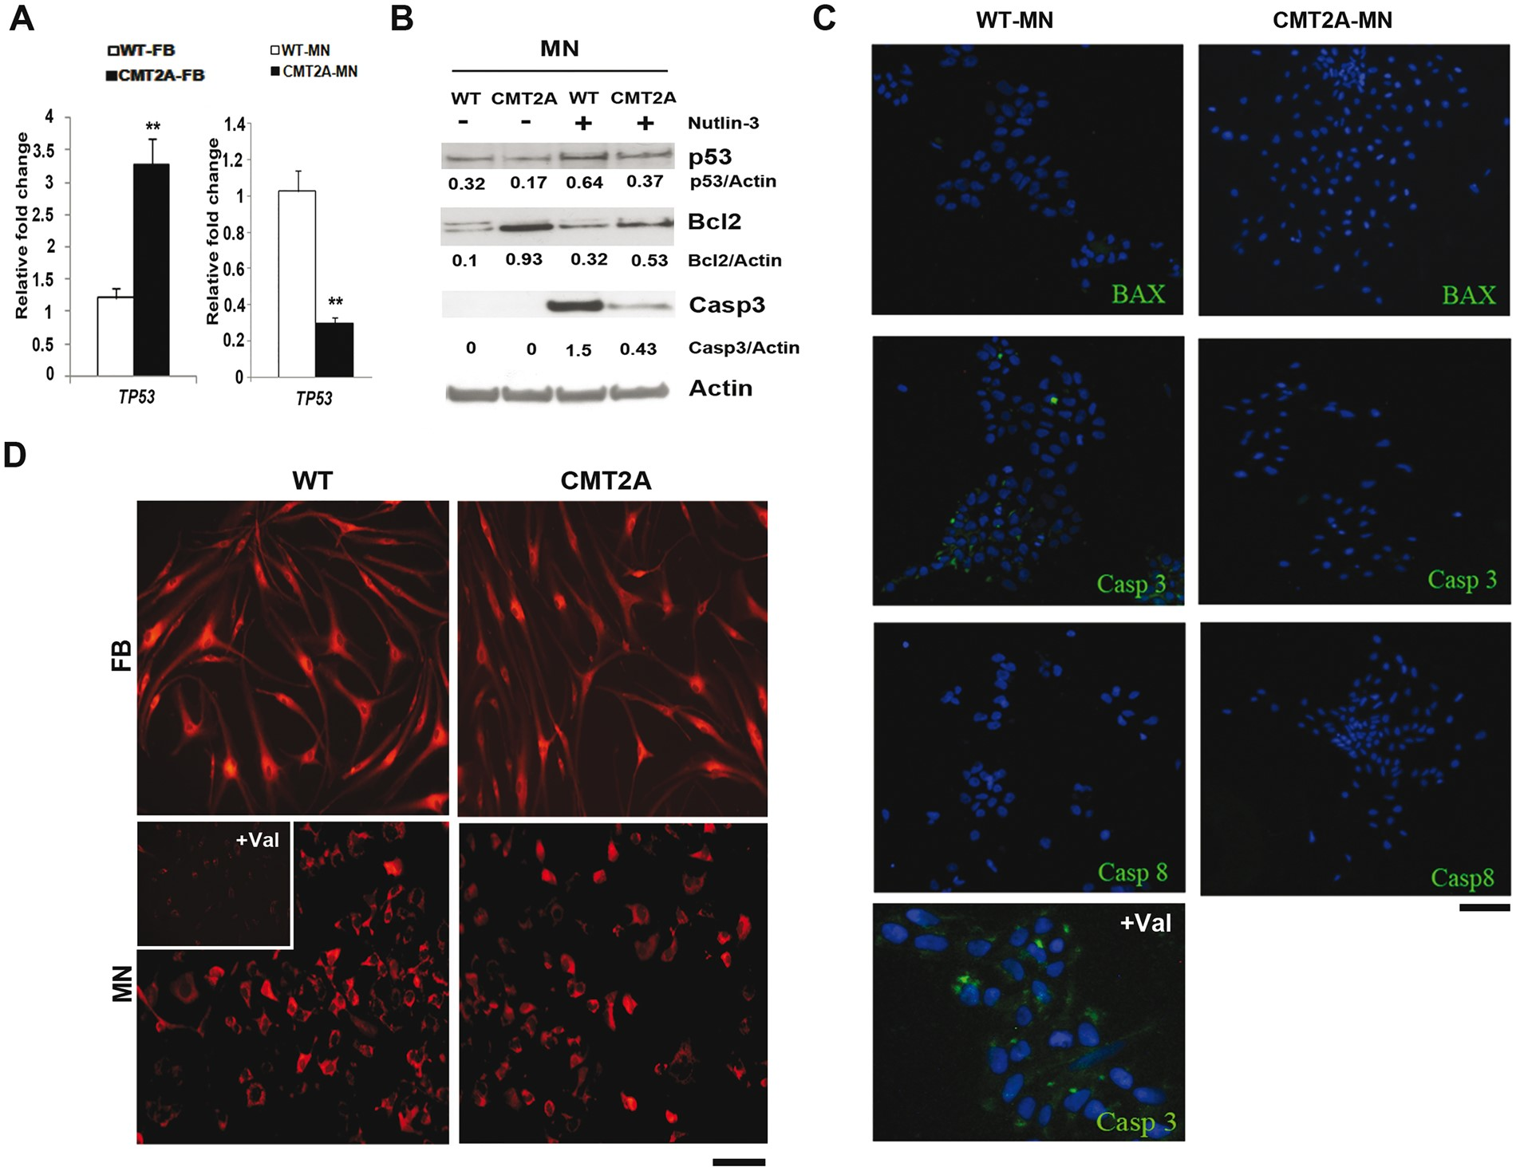
Figure 5. CMT2A-MNs express reduced apoptotic markers compared to controls. (A) Quantitative RT-PCR analysis of TP53 in ...
Notes:
Figure 5. CMT2A-MNs express reduced apoptotic markers compared to controls. (A) Quantitative RT-PCR analysis of TP53 in fibroblasts (FBs) and MNs. This analysis revealed a reduction in TP53 expression in CMT2A-MNs, whereas TP53 expression was increased in CMT2A FBs compared to WT cells. Error bars represent SEM. **P<0.001. (B) Western blot analysis of p53, Bcl2 and cleaved caspase 3 (Casp3) in WT- and CMT2A-MNs. The cells were analysed in basal condition and after treatment with Nutlin-3 (10 μM) to increase p53 levels. Numbers show protein levels normalized to actin. (C) Immunostaining for BAX, Casp3, and caspase 8 (Casp8) in WT-MNs and CMT2A-MNs. CMT2A-MNs expressed these pro-apoptotic markers (green). Nuclei were labelled with DAPI (blue). WT-MNs treated with apoptotic enhancer valinomycine (Val, 40 μM) were used as positive controls. Scale bar = 75 µm in bottom left, 150 µm for all others. (D) TMRE staining to assess the mitochondrial membrane potential in FBs and MNs. Representative images of FBs and MNs stained with TMRE (500 nM). Valinomycine (Val, 40 μM) was used as a positive control of mitochondrial membrane depolarization. No difference was observed in the mitochondrial membrane potential between CMT2A and WT cells. Scale bar = 100 µm, 120 µm for insert.
Unless provided in the caption above, the following copyright applies to the content of this slide: © The Author 2016. Published by Oxford University Press. All rights reserved. For Permissions, please email: journals.permissions@oup.com

Slide 6
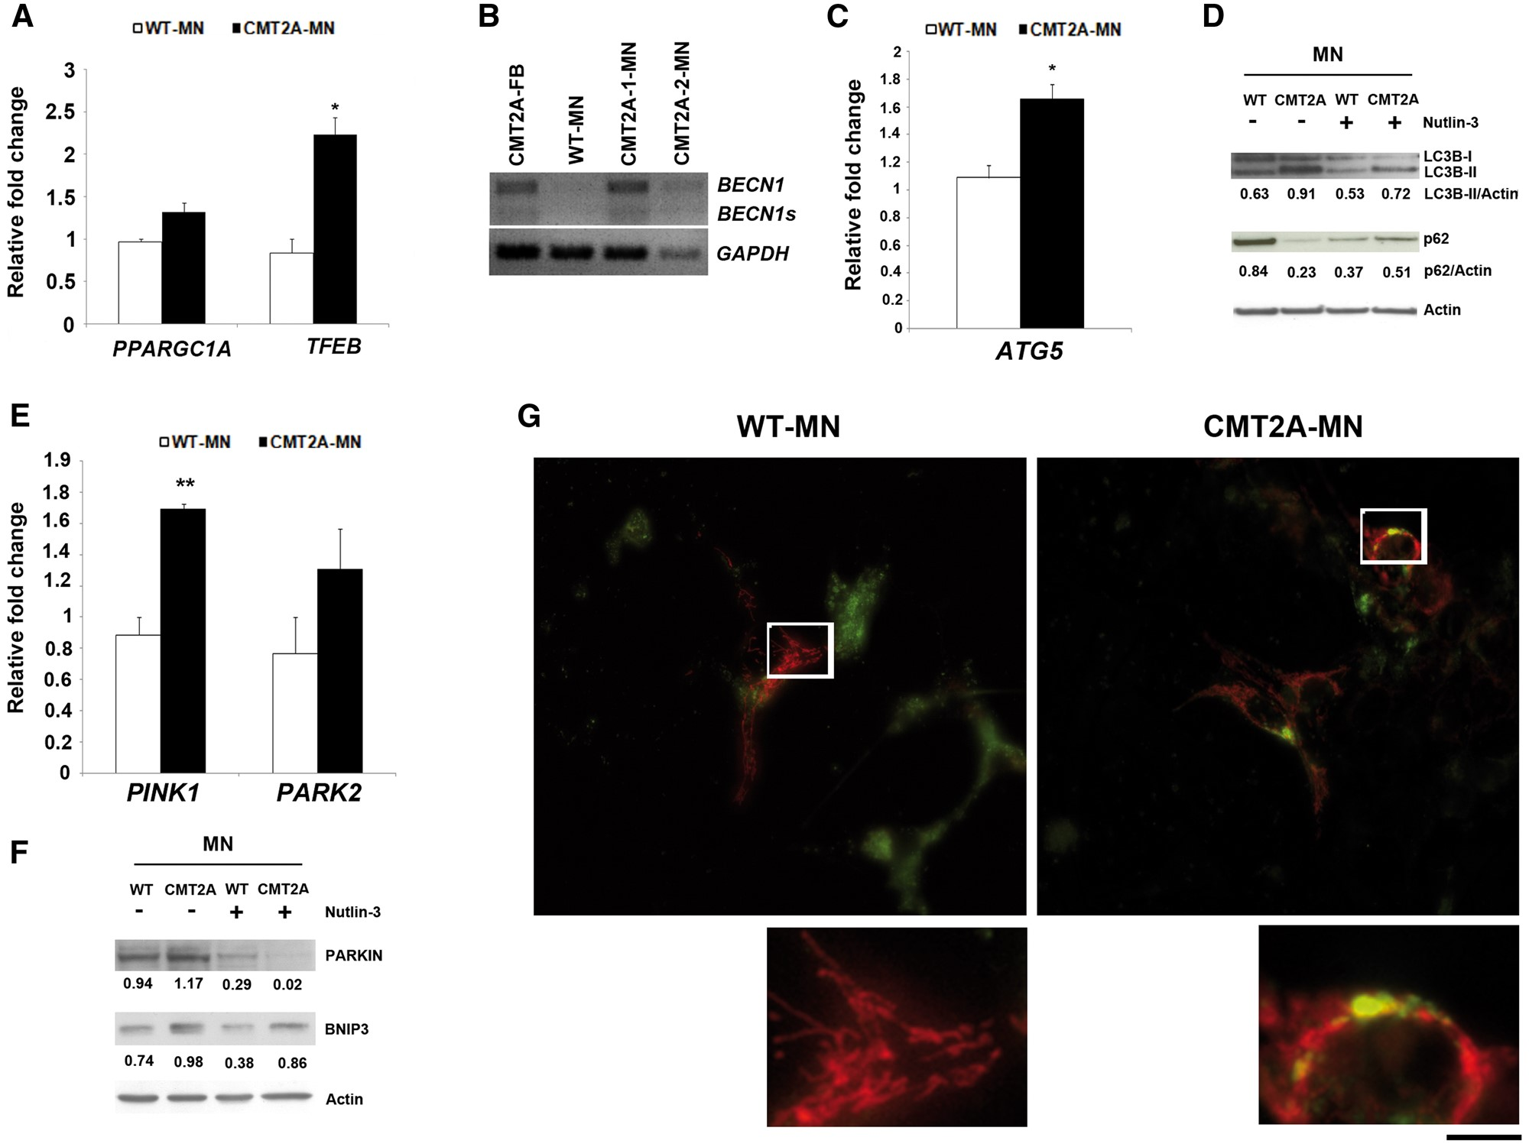
Figure 6. Increased autophagic clearance of mitochondria in CMT2A-MNs. (A) Quantitative RT-PCR analysis of PPARGC1A and ...
Notes:
Figure 6. Increased autophagic clearance of mitochondria in CMT2A-MNs. (A) Quantitative RT-PCR analysis of PPARGC1A and TFEB in WT-MNs and CMT2A-MNs. Error bars represent SEM. *P<0.05. (B) RT-PCR analysis of BECN1 transcript levels compared to GAPDH expression in CMT2A and WT cells. The upper band represents total BECN1 expression. The lower band shows the splice variants (BECN1s) selectively associated with mitophagy. Up-regulation of BECN1 was observed in CMT2A cells that also expressed splice variants, supporting the activation of autophagy in CMT2A-MNs. (C) Quantitative RT-PCR analysis of ATG5 transcript levels in WT-MNs and CMT2A-MNs. Increased expression was observed in CMT2A-MNs with respect to WT. Error bars represent SEM. *P<0.05. (D) Western blot analysis of p62 and LC3BII in WT- and CMT2A-MNs. The cells were analysed in basal condition and after treatment with Nutlin-3 (10 μM) to increase p53 levels. In untreated CMT2A cells, p62 expression was reduced, whereas LC3B-II expression was increased respect to WT-MNs. p62 and LC3BII expression were rescued by the increase of endogenous p53 levels. Numbers indicate protein levels normalized to actin level. (E) Quantitative RT-PCR analysis of PINK1, PARK2, and BNIP3 in WT-MNs and CMT2A-MNs. CMT2A-MNs expressed up-regulated levels of these transcripts compared to WT. Error bars represent SEM. **P<0.001. (F) Western blot analysis of PARKIN and BNIP3 in WT-MNs and CMT2A-MNs. The cells were analysed in basal condition and after treatment with Nutlin-3 (10 μM). Enhanced levels of both proteins were observed in untreated CMT2A-MNs. PARKIN and BNIP3 levels were reduced by the increase of endogenous p53 levels. Numbers indicate protein content normalized to the actin level. (G) Immunofluorescent images of WT-MNs and CMT2A-MNs showing the distribution of lysosomes (green) and mitochondria (red). The merged images are in yellow. CMT2A-MNs exhibited colocalization of the signals, supporting the autophagic removal of mitochondria. Boxed regions are enlarged. Scale bar = 40 µm in upper panels, 20 µm in the lower panels.
Unless provided in the caption above, the following copyright applies to the content of this slide: © The Author 2016. Published by Oxford University Press. All rights reserved. For Permissions, please email: journals.permissions@oup.com

