Slide 1
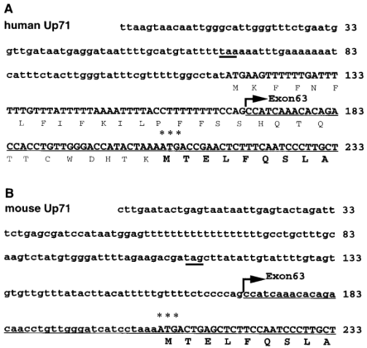
Figure 1 (A) The 5′ sequence of human Up71 cDNA. The arrow indicates the point at which Up71 differs from full-length ...
Notes:
Figure 1 (A) The 5′ sequence of human Up71 cDNA. The arrow indicates the point at which Up71 differs from full-length utrophin and the position of the boundary between intron 62 and exon 63 in the full-length transcript. The most likely translation initiation ATG codon is denoted by asterisks and the deduced amino acid sequence is shown in bold. Amino acid sequence from another more upstream ATG is also shown, as non-bold text; however, this is in a relatively unfavourable Kozak consensus sequence. The downstream ATG is conserved in the mouse Up71 sequence that is shown for comparison (B). The first stop codons in the 5′-UTR, upstream of the ATG codon, are underlined. Exon numbering as for dystrophin
Unless provided in the caption above, the following copyright applies to the content of this slide: © 1999 Oxford University Press

Slide 2
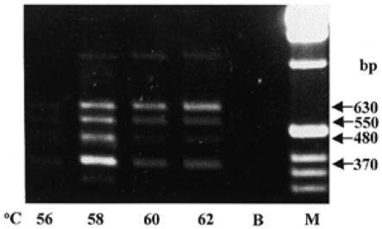
Figure 2 The 5′-RACE products amplified from human fetal brain mRNA using hGSP3-Up140 5′-TGCACAATCCCATCCCCAGTTCG and ...
Notes:
Figure 2 The 5′-RACE products amplified from human fetal brain mRNA using hGSP3-Up140 5′-TGCACAATCCCATCCCCAGTTCG and the anchor primer GGCCACGCGTCGACTAGTACGG18. Amplification was carried out at various annealing temperatures ranging from 56 to 62°C. B, amplification carried out in the absence of cDNA; M, DNA size marker track.
Unless provided in the caption above, the following copyright applies to the content of this slide: © 1999 Oxford University Press

Slide 3
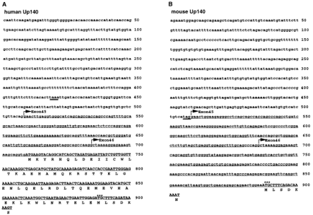
Figure 3 (A) The 5′ sequence of human Up140 cDNA. Arrows indicate the positions of the boundaries between intron 44 ...
Notes:
Figure 3 (A) The 5′ sequence of human Up140 cDNA. Arrows indicate the positions of the boundaries between intron 44 and exon 45, and intron 45 and exon 46. The arrow marking exon 45 indicates the point at which Up140 differs from full-length utrophin. The deduced amino acid sequence is shown in uppercase. The upstream ATG codon of the human sequence is not conserved in the mouse sequence (B) although the next ATG downstream (asterisks) is conserved. The first stop codons in the 5′-UTR, upstream of the ATG codon, are underlined.
Unless provided in the caption above, the following copyright applies to the content of this slide: © 1999 Oxford University Press

Slide 4
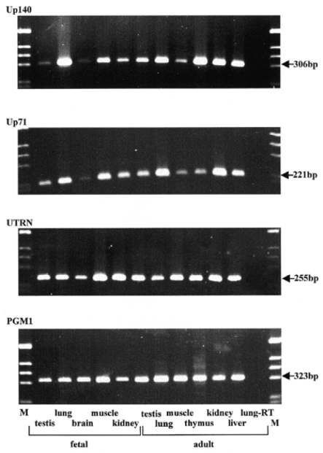
Figure 4 RT–PCR of mRNAs prepared from various human fetal and adult tissues. Forward primers specific for human Up71 ...
Notes:
Figure 4 RT–PCR of mRNAs prepared from various human fetal and adult tissues. Forward primers specific for human Up71 and Up140, hUp71-F4 and hUp140-F6, respectively, were used in combination with hGSP2-Up71 and hGSP3-Up140. The same set of cDNAs was also amplified with primers hUp-ex16/17-F and hUp-ex16/17-R, located in exons 16 and 17 (UTRN), and with primers that amplify the ubiquitously expressed PGM1. Amplifications were also performed in the absence of reverse transcriptase; one example is shown here, lung-RT.
Unless provided in the caption above, the following copyright applies to the content of this slide: © 1999 Oxford University Press

Slide 5
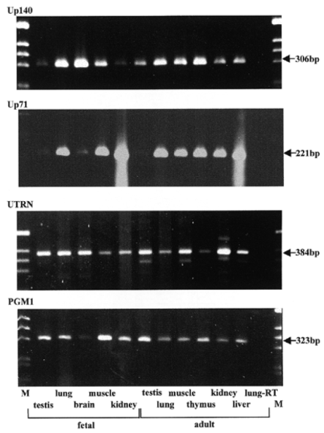
Figure 5 RT–PCR of mRNAs prepared from various mouse fetal and adult tissues. Forward primers specific for mouse Up71 ...
Notes:
Figure 5 RT–PCR of mRNAs prepared from various mouse fetal and adult tissues. Forward primers specific for mouse Up71 and Up140, mUp71-F8 and mUp140-F4, respectively, were used in combination with mGSP2-Up71 (5′-CGAATTTTGATTGCTGTGCGGTAGG) and mGSP2-Up140 (5′-TCCACCT-CAGCTACAAGAGTGC). The same set of cDNAs was also amplified with primers located in exons 17 and 20 (UTRN), mUp-ex17/20-F and mUp-ex17/20-R, and with primers that amplify the ubiquitously expressed PGM1. Amplifications were also performed in the absence of reverse transcriptase, e.g. lung-RT.
Unless provided in the caption above, the following copyright applies to the content of this slide: © 1999 Oxford University Press

Slide 6
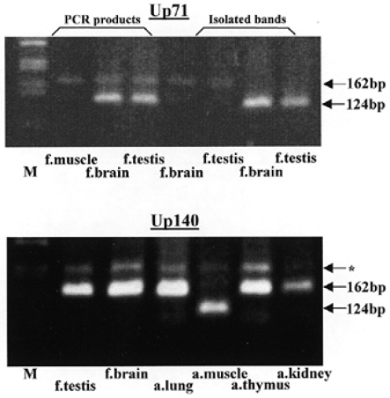
Figure 6 PCR to demonstrate the presence and absence of exon 71 in alternatively spliced forms of human Up71 and Up140 ...
Notes:
Figure 6 PCR to demonstrate the presence and absence of exon 71 in alternatively spliced forms of human Up71 and Up140 cDNA. Amplification of the transcript-specific cDNAs using the primers Ux70-F (5′-CAGGTCGAAGAA-GTACTTTGCC) and Ux72-R (5′-GGTGTCATCATGAAACAGTTGAGG) leads to a 162 bp product in the presence of exon 71, and a 124 bp product in the absence of exon 71. The nucleotide sequence of spliced forms was checked by direct analysis of DNA eluted from separated bands excised from agarose gels (‘isolated bands’). The band indicated by an asterisk was also isolated and sequenced and is a non-specific PCR product.
Unless provided in the caption above, the following copyright applies to the content of this slide: © 1999 Oxford University Press

