Slide 1
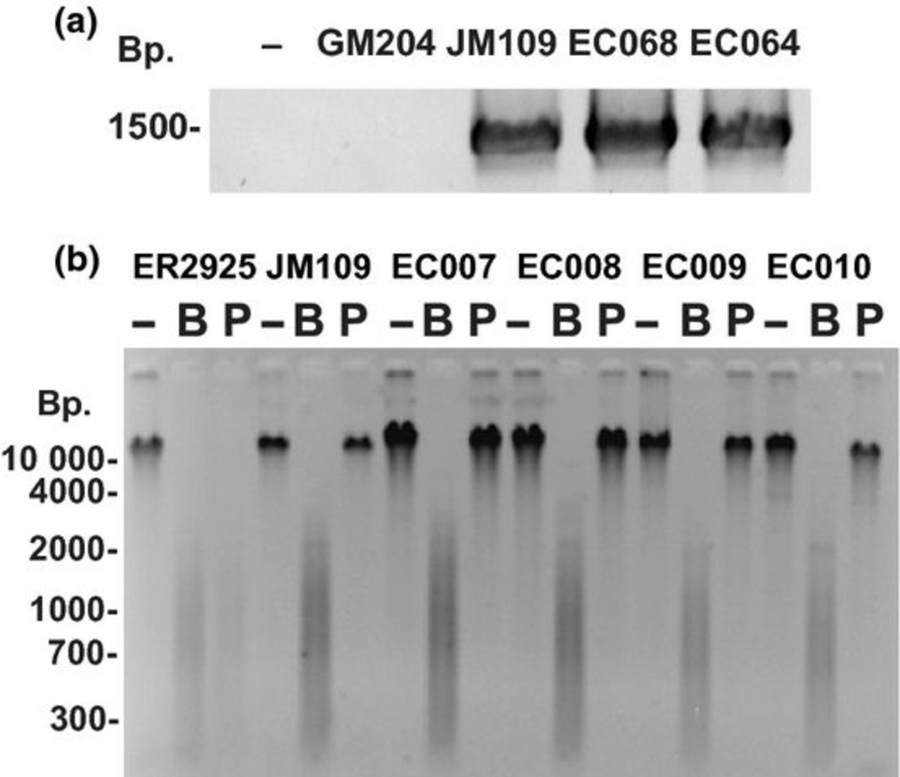
(a) Detection of the dcm gene via PCR. Escherichia coli genomic DNA from different strains was used as a ...
Notes:
(a) Detection of the dcm gene via PCR. Escherichia coli genomic DNA from different strains was used as a template for PCR using one forward dcm primer and two reverse dcm primers as described in the Materials and methods. PCR products were analyzed by agarose gel electrophoresis and ethidium bromide straining. The negative sign (−) represents a no DNA control. Escherichia coli GM204 DNA (GM204) contains a deletion of the dcm operon. Escherichia coli JM109 DNA (JM109) contains a wild-type dcm allele. EC068 and EC064 are DNAs from E. coli environmental isolates. (b) Detection of 5-methylcytosine in 5′CCWGG3′ sequences using restriction enzyme isoschizomer pairs. DNA from E. coli ER2925 (dcm-6), JM109 (dcm+), and four environmental strains (EC007-EC010) were left undigested (−), digested with BstNI (B), or digested with PspGI (P). Reactions were analyzed by agarose gel electrophoresis and ethidium bromide staining.
Unless provided in the caption above, the following copyright applies to the content of this slide: © 2012 Federation of European Microbiological Societies. Published by Blackwell Publishing Ltd. All rights reserved.

Slide 2
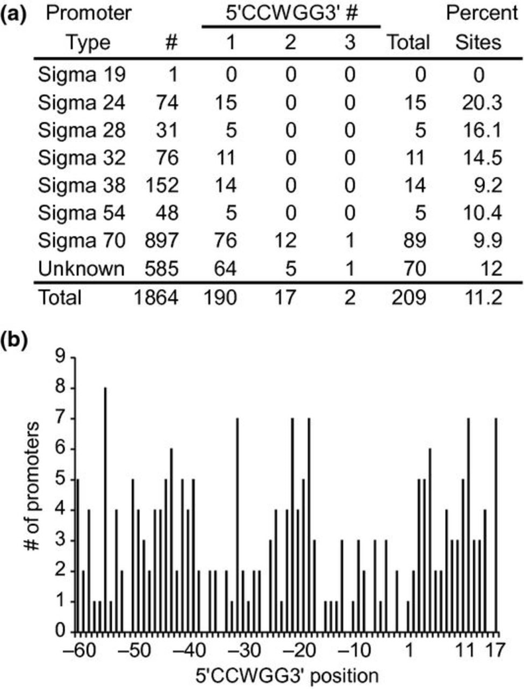
The number and location of 5′CCWGG3′ sites in Escherichia coli K-12 MG1655 promoters. (a) 5′CCWGG3′ abundance ...
Notes:
The number and location of 5′CCWGG3′ sites in Escherichia coli K-12 MG1655 promoters. (a) 5′CCWGG3′ abundance in E. coli promoters. Promoter sequences available in the Regulon database (http://regulondb.ccg.unam.mx/) were downloaded and queried for the number of 5′CCWGG3′ sites. # represents the number of promoters in each category and total is the total number of promoters with 5′CCWGG3′ sequences. (b) Histogram of the frequency of 5′CCWGG3′ sites with respect to the transcription start site. The numbers represent the distance to the transcription start site where the number 1 is the transcription start site. The position refers to the first C in the sequence 5′CCWGG3′.
Unless provided in the caption above, the following copyright applies to the content of this slide: © 2012 Federation of European Microbiological Societies. Published by Blackwell Publishing Ltd. All rights reserved.

Slide 3
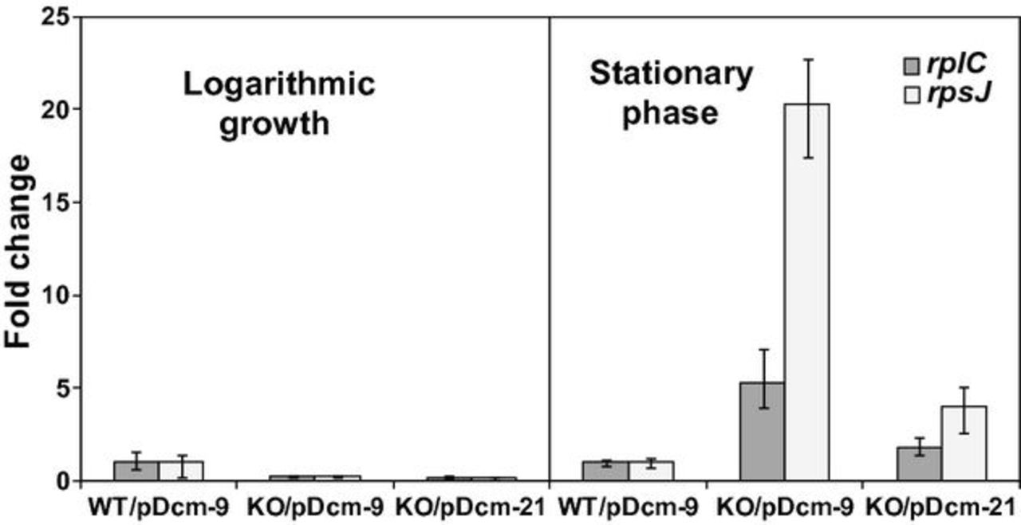
Expression of ribosomal protein genes in the absence and presence of dcm. Escherichia coli wild-type bacteria ...
Notes:
Expression of ribosomal protein genes in the absence and presence of dcm. Escherichia coli wild-type bacteria (BW25113) with a plasmid containing an inactive dcm truncation (WT/pDcm-9), dcm knockout bacteria (JW1944-2) containing an inactive dcm truncation (KO-2/pDcm-9), and dcm knockout bacteria (JW1944-2) containing a plasmid with a functional dcm gene (KO/pDcm-21) were grown to early logarithmic phase and early stationary phase. Total RNA was isolated and converted to cDNA. The levels of rplC and rpsJ were measured by qPCR and normalized to the levels of malate dehydrogenase (mdh) RNA. The WT/pDcm-9 samples were set to a value of one. Error bars represent one standard deviation.
Unless provided in the caption above, the following copyright applies to the content of this slide: © 2012 Federation of European Microbiological Societies. Published by Blackwell Publishing Ltd. All rights reserved.

